Slide 1
Building Enterprise Java Applications with Spring
Day 3
Magdalene Lim,
Desmond Lee,
Kavitha Muniraj
Republic Polytechnic

Slide 2
Welcome and admin matters
Please ensure that:
Attendance has been captured (via QR code scanning)
A learning laptop is with you
Good view on the display
Course materials are also available at: https://github.com/kavithamuniraj/CETSpringBootAY2022
Notes:
https://en.wikipedia.org/wiki/QR_code_payment

Slide 3
Admin matters
A tidy/clean laptop is a good laptop for learning
Files created on the laptop will linger on. To prevent this:
Create a folder in the "Documents" location for this workshop
E.g. “SpringBoot-Alan" or “SpringBoot-PeterPan“
All user created files to be placed in this folder
Delete that folder after the course
Notes:
https://en.wikipedia.org/wiki/QR_code_payment

Slide 4



Trainers
Magdalene Lim
Senior Lecturer
School of Infocomm
Magdalene_lim@rp.edu.sg
Desmond Lee
Associate Lecturer
School of Infocomm
DESMOND_LEE@myrp.edu.sg
Kavitha Muniraj
Lecturer
School of Infocomm
Kavitha_muniraj2@rp.edu.sg
Notes:
https://en.wikipedia.org/wiki/QR_code_payment

Slide 5
Schedule
Time | Agenda
9:00 am - 9:15 am | Welcome and admin matters
9:15 am – 10:30 am | Using Forms – Adding a new category using Forms
10:30 am – 10:45 am | Break
10:45 am – 12:30 pm | Adding Items using Forms
12:30 pm – 1:30 pm | Lunch
1:30 pm – 3:15 pm | Joining Tables (Item and Controller) Adding item using Forms with category
3:15 pm – 3:30 pm | Break
3:30 pm – 4:45 pm | Organizing Project Thymeleaf Fragments
4:45 pm – 5:00 pm | Wrap up, Q&A
Notes:
https://en.wikipedia.org/wiki/QR_code_payment

Slide 6
Topics Covered in this course
Using Bootstrap to style a webpage
Create Model and map to Database
CRUD using MYSQL
Notes:
https://en.wikipedia.org/wiki/QR_code_payment

Slide 7

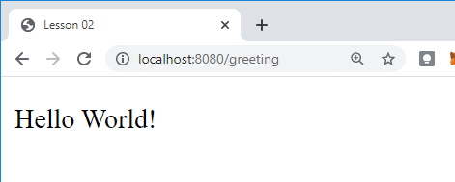
RECALL - REST API – Client Server Model
1. The client makes a request
http://localhost:8080/greeting
2. The web server receives the request and passes it to the controller.
3. GreetingController.java processes request and returns response (View)
greeting.html
(View)
4. The client displays the response received.
Notes:
What web server are we using?

Slide 8
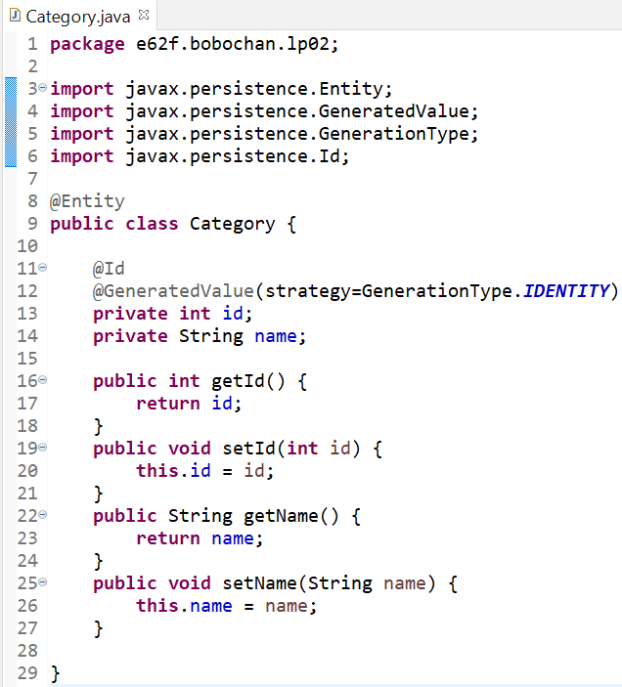
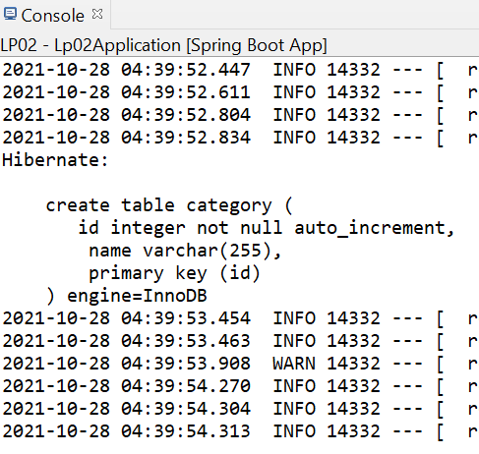
RECALL - JPA-Hibernate-MySQL
Springboot application
Spring Data JPA
Hibernate ORM Framework
MySQL DB

Slide 9

RECALL - Hibernate
Hibernate is an implementation of the Java Persistence API (JPA) specification.
It is an Object/Relational Mapping(ORM) framework which allows the mapping of Java classes to database tables.
This saves us time as we can perform CRUD operations without writing SQL code.
This is implemented through the use of Java annotations (e.g. @Entity)
Notes:
https://hibernate.org/orm/what-is-an-orm/

Slide 10
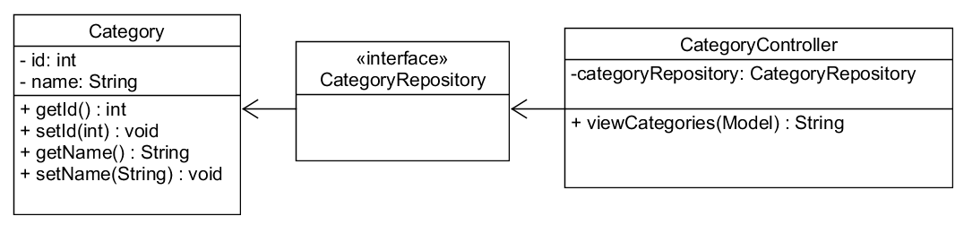
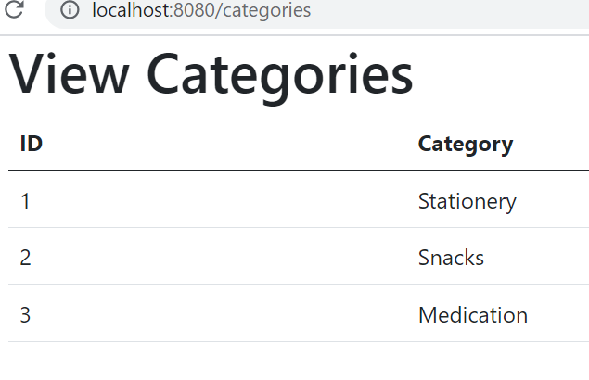
RECALL - Viewing a list of categories

Slide 11
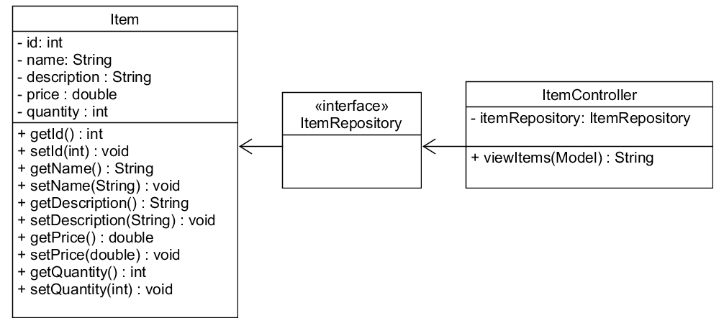
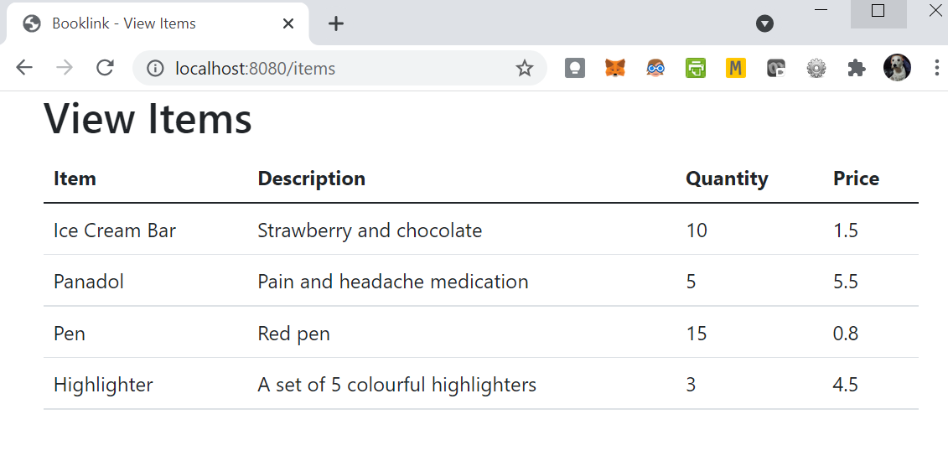
RECALL - Viewing a list of items

Slide 12
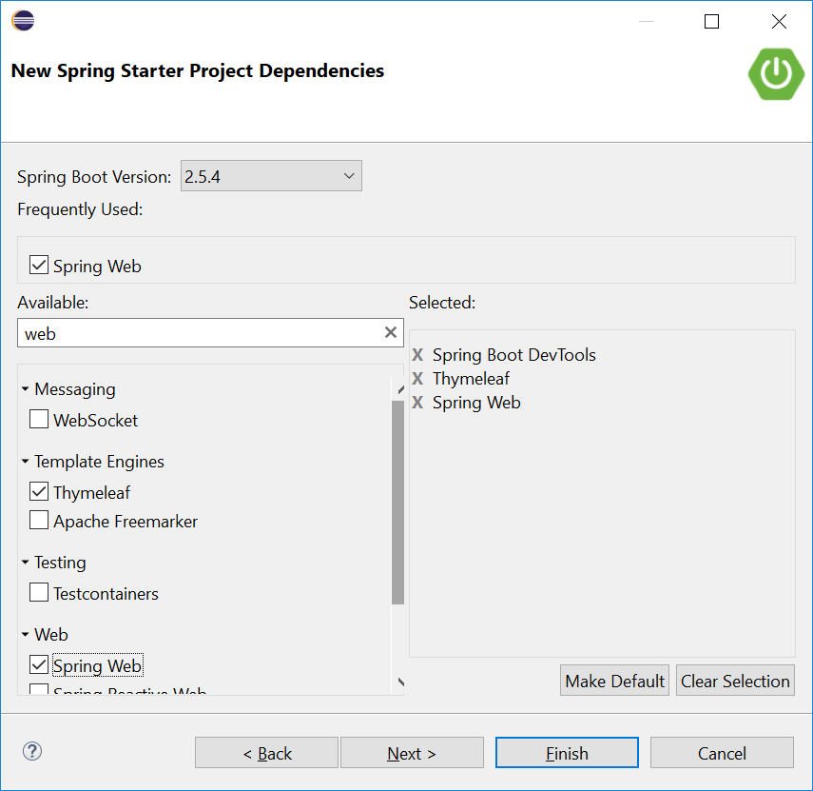
RECALL - Thymeleaf
Recall that in our Springboot projects, we included a dependency, Thymeleaf.
Thymeleaf is a server-side Java template engine for both web and standalone environments.
It is a view technology that performs server-side rendering of HTML.
We use variable expressions ${…} bind the data from the template context(model) into the resulting html(view).

Slide 13
RECALL: Thymeleaf attributes
th:each - used for iteration
th:text - evaluates its variable expression and sets the result of this as the body of the tag it is in
As we progress in the lessons, we will be using more types of attributes. You can find the full list here:
https://www.thymeleaf.org/doc/tutorials/3.0/usingthymeleaf.html#setting-attribute-values

Slide 14
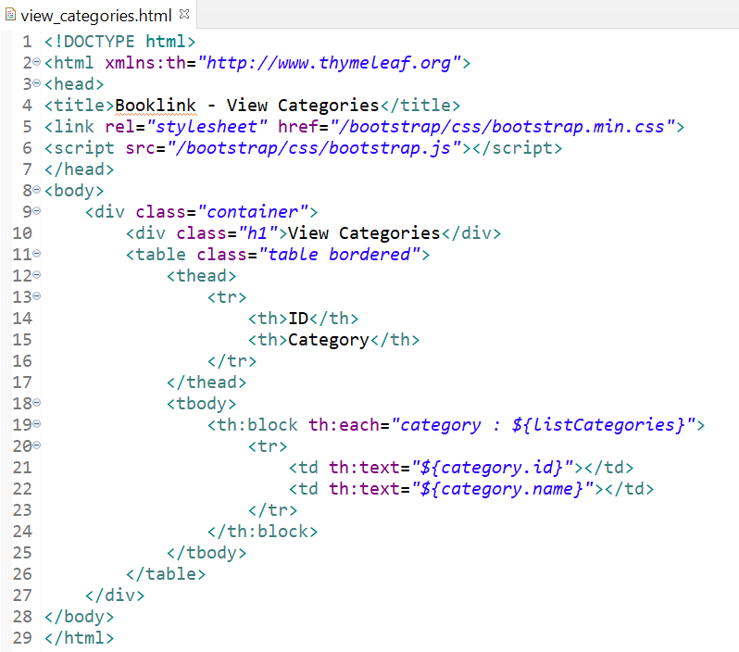
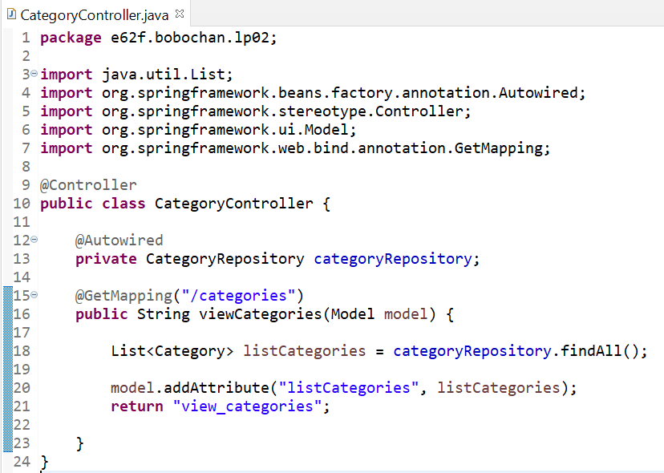
RECALL -How it works
We used the variable expression ${…} to retrieve the information stored in the model attributes.

Slide 15
Spring Boot Application Working with Forms Understanding Thymeleaf
Notes:
Similar to lesson 02 instructions

Slide 16
Web forms
Web forms are one of the main points of interaction between a user and a web site or application.
Forms allow users to enter data, which is generally sent to a web server for processing and storage, or used on the client-side to immediately update the interface in some way

Slide 17
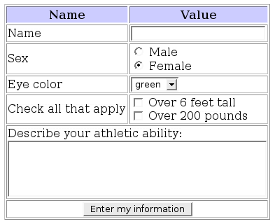
Web form controls
A web form is made up of one or more form controls.
Some examples of controls are: single or multi-line text fields, dropdown boxes, buttons, checkboxes, or radio buttons.

Slide 18
Web form controls
Text
Radio buttons
Dropdown
Checkboxes
Textarea
Button
Notes:
https://commons.wikimedia.org/wiki/File:Sample_web_form.png

Slide 19
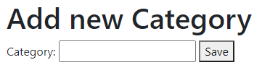
Web form attributes
A form will typically have the action and method attribute
<h1>Add new Category</h1>
<form action="/categories/save" method="post">
Category: <input type="text" />
<button type="submit">Save</button>
</form>

Slide 20
Web form attributes
The action attribute defines the location (URL) where the form's collected data should be sent when it is submitted.
The method attribute defines which HTTP* method to send the data with (usually get or post).
<h1>Add new Category</h1>
<form action="/categories/save" method="post">
Category: <input type="text" />
<button type="submit">Save</button>
</form>
*The Hypertext Transfer Protocol (HTTP) is designed to enable communications between clients and servers.

Slide 21
Web form methods
POST
Data submitted is not visible in URL
Has no size limitations
Usually used for form submissions
GET
Data is appended in the URL in name/value pairs
The length of a URL is limited
Data is visible in the URL

Slide 22
Springboot form methods
In Springboot, we have the corresponding annotations for the POST and GET methods.
GET - @GetMapping
POST - @PostMapping

Slide 23
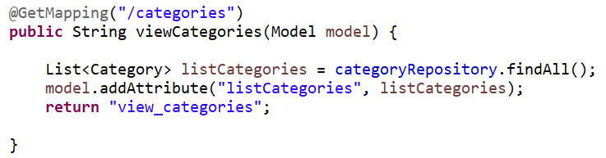
Springboot form methods
We have used @GetMapping previously.
Today, we will use @PostMapping as well when creating a form for add more categories.

Slide 24
Exercise 1 – Web forms
In the previous lesson, we were able to view a list of categories.

Slide 25
Exercise 1 – Web forms
To add more categories into the database, why is it better to have a form to allow adding of new categories, as compared to adding it directly in the database?

Slide 26
Exercise 1 – Web forms
To add more categories into the database, why is it better to have a form to allow adding of new categories, as compared to adding it directly in the database?
The database is not user friendly for people to use. Also, using forms help to prevent users from entering invalid data as we can implement validation on the input.

Slide 27
Adding new data

Slide 28
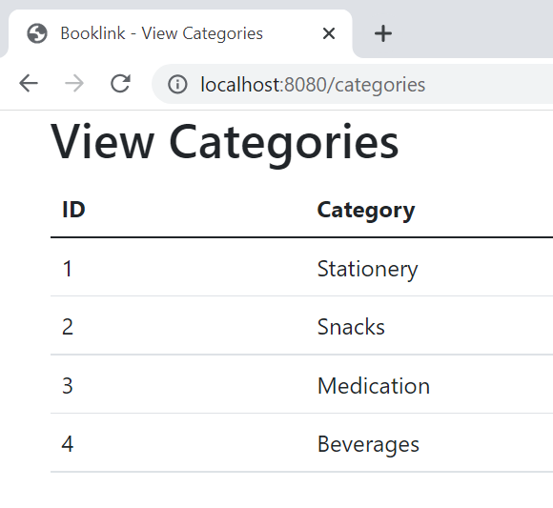
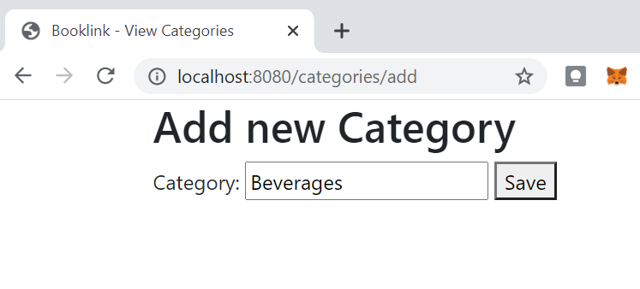
Exercise 2 – Add a new category
Below shows a sample of how the add form and result of adding a new category will look like.
Once saved, the new category is added to the list.

Slide 29
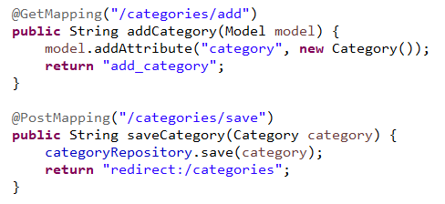
Exercise 2 – Add a new category
Updating the CategoryController.java with
@GetMapping
@PostMapping

Slide 30
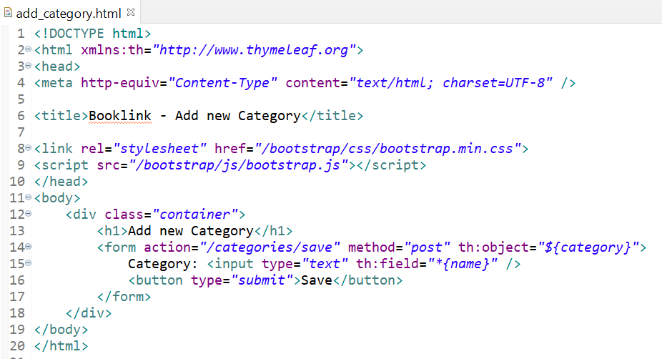
Exercise 2 – Add a new category
Create a new view named add_category.html.
Add the code shown below to add_category.html.

Slide 31
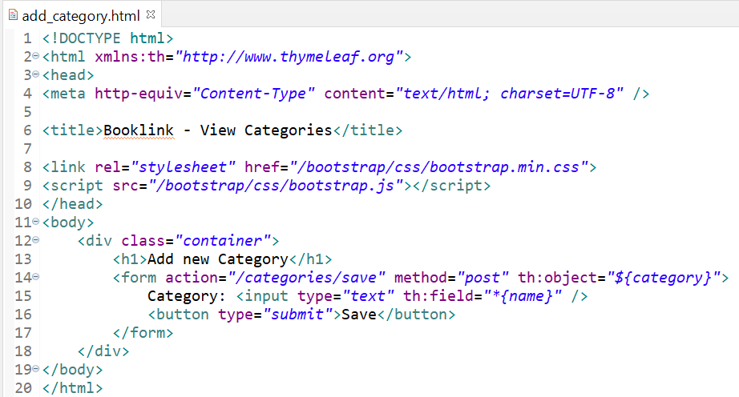
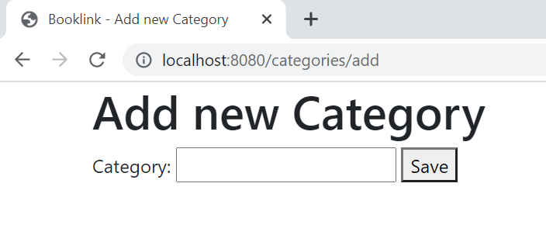
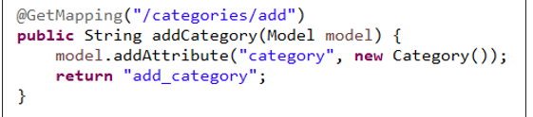
Exercise 2 – @GetMapping
GetMapping will get the form to be displayed with the category text box and object to store the data entered by the user.

Slide 32
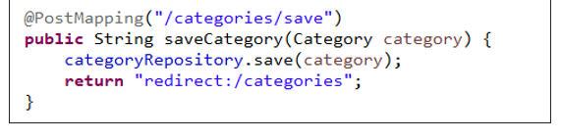
Exercise 2 – @PostMapping Insert Data into DB [save(*)]
PutMapping will save the category

Slide 33
Exercise 2 – Add a new category
Browse to http://localhost:8080/categories/add and try adding a new category.
What page is displayed after adding a new category?
http://localhost:8080/categories/ or the view_categories.html page is displayed.
Explain why the page in a) is displayed.
The page in a) is displayed because in the method saveCategory, the response returned is a redirect to /categories which will map to view_categories.html.

Slide 34
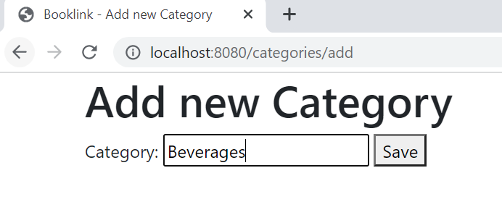
How it works
1. When the url http://localhost:8080/categories/add is requested, the CategoryController will map it to @GetMapping(“categories/add”)
2. As we are creating a new form to add a category, the form fields must be mapped to the category model.
*{name} or*{…} is a Thymeleaf selection expression. It is similar to variable expressions, but they are executed on an already selected object. E.g category in the add_category.html form.
Hence, a new Category object is created and added as an attribute to the model, which will then be passed to the view add_category.html.
In the view, id is omitted as it is auto_increment.

Slide 35
How it works
1. When the Save button is clicked, the data will be sent via the POST method to the location set in the action attribute of the form
2. The details will be passed as a category object to the method, saveCategory.
3. The category object containing the new information will be saved to the database using the save method from categoryRepository object.
Recall that the JpaRepository helps us with CRUD. No additional SQL is required to insert the data into the database.
4. After saving the new category, the page is then redirected to http://localhost:8080/categories/

Slide 36

BREAK

Slide 37
Thymeleaf attributes
th:action: Used to provide the form action URL
th:object: Used to specify an object to which the submitted form data will be bound.
th:field: Individual fields are mapped using the th:field=“*{property}” attribute, where the property is the matching property of the object.

Slide 38
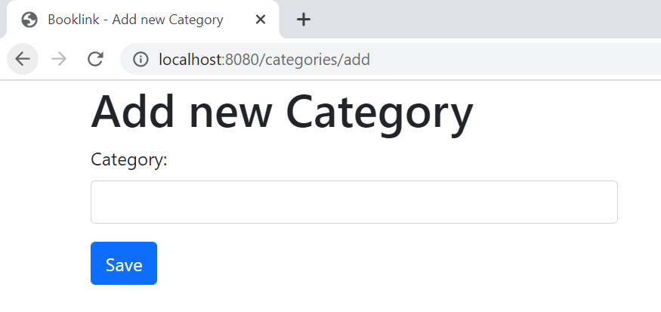
Styling a form
Bootstrap also provides classes to style forms.
We apply the classes to form elements similar to how we apply them previously in other HTML elements.
Bootstrap applied to the form elements
https://getbootstrap.com/docs/5.1/forms/overview/

Slide 39
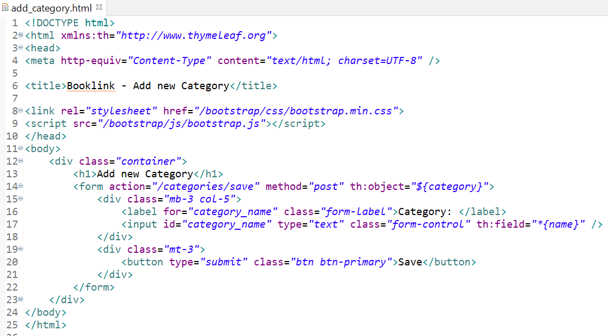
Exercise 3 - Styling a form
Modify add_category.html to include the code below

Slide 40
Exercise 3 - Styling a form
When you browse to http://localhost:8080/categories/add, what happens when you click on the text “Category”? Explain why.
In add_category.html, the classes mb-3, mt-3, col-5 is used. Fill in the table to describe what they do. The first one is done for you.
Bootstrap class | Description
mb-3 | Indicates to have Margin-bottom with size 3
mt-3
col-5
Notes:
Students may need to click away on white space first to see the effect of clicking on the label.

Slide 41
Exercise 3 - Styling a form
When you browse to http://localhost:8080/categories/add, what happens when you click on the smaller text “Category”? Explain why.
The textbox will be highlighted in light blue and the cursor will focus in the textbox to enter a new category. This happens because the label element was used. By setting the “for” attribute value as the id of the input element, when we click on the labeled text, the cursor will know where to focus.
In add_item.html, the classes mb-3, mt-3, col-5 is used. Fill in the table to describe what they do. The first one is done for you.
Bootstrap class | Description
mb-3 | Indicates to have Margin-bottom with size 3
mt-3 | Indicates to have Margin-top with size 3
col-5 | Indicates to span across 5 columns.

Slide 42
Exercise 4 – Add a new item
In LP02, include an add feature to add new items.
Modify ItemController to include the suitable mappings and methods to add a new item. @GetMapping /item/add and @PostMapping /item/save
Create a view named add_item.html to allow users to input details of a new item.
Upon clicking the Add Item button, the item details should be saved and view_items.html should be displayed.
See next slide for expected flow
Notes:
Give students time to work on this part on their own. Remind students that the layout for the form can be done later, they should make sure the add feature works first.

Slide 43
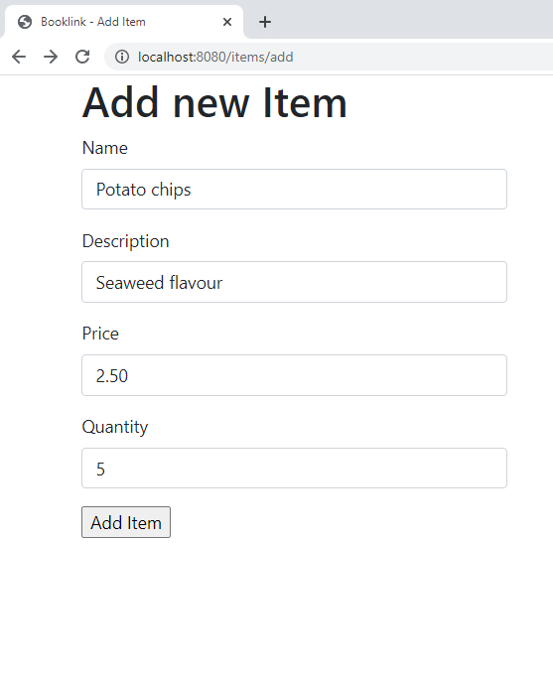
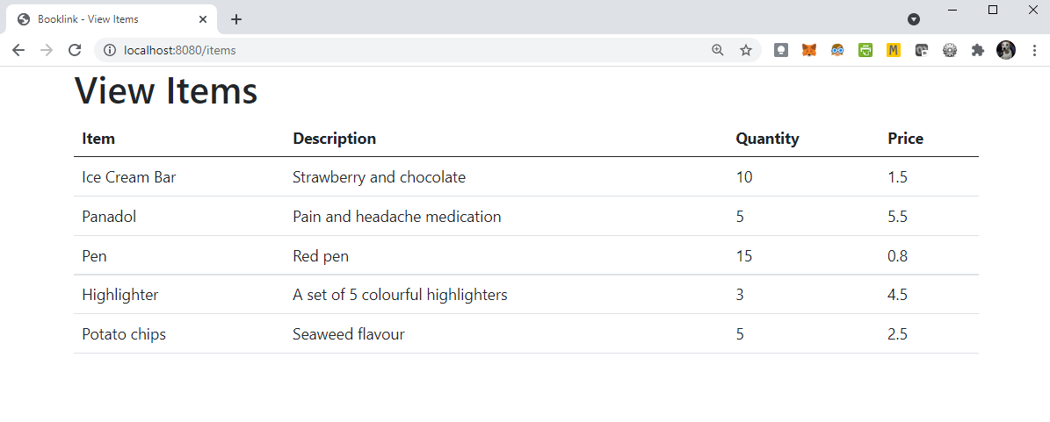
Exercise 4 – Add a new item
Add new item expected flow
Note: You should ensure that the add feature works first before using bootstrap to style the form to your preference.
Notes:
Give students time to work on this part on their own. Remind students that the layout for the form can be done later, they should make sure the add feature works first.

Slide 44
Exercise 4 – Add a new item
Browse to http://localhost:8080/items/add and try adding a new item to test that your item add feature works.
Paste the code for ItemController.java and add_item.html. here

Slide 45
Exercise 4 – Add a new item

Slide 46

LUNCH

Slide 47
Joining tables

Slide 48
Categories and Items
So far, we are able to view and add categories and items.
However, the items are not grouped under any categories, so there is no relationship between items and categories at the moment.
We will now modify our class and code so that an item will belong to a category.

Slide 49
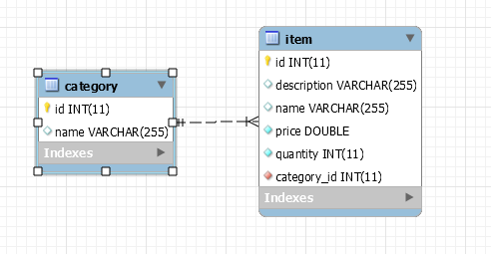
Categories and Items
One category could have many items belonging to it.
Many items could belong to one category.
Notes:
Some students may notice the empty diamonds, they can ignore that for now, in future we will discuss how to improve on this.

Slide 50
Categories and Items
Using Spring Data JPA, we can express these relationships with annotations
Category: @OneToMany
One category could have many items belonging to it.
Item: @ManyToOne
Many items could belong to one category.
https://javaee.github.io/javaee-spec/javadocs/javax/persistence/package-summary.html

Slide 51
Exercise 5 – Joining Category and Item
Stop LP02 Springboot application.
In MySql workbench, drop the category and item tables.
Note: Dropping the tables are not necessary but will avoid possible errors when we build the project.

Slide 52
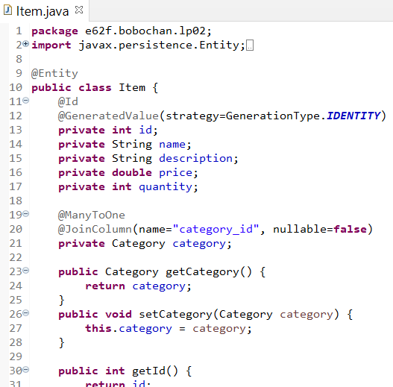
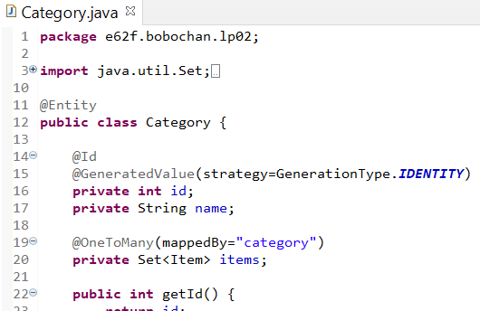
Exercise 5 – Joining Category and Item
Modify the Item and Category class as shown below.

Slide 53
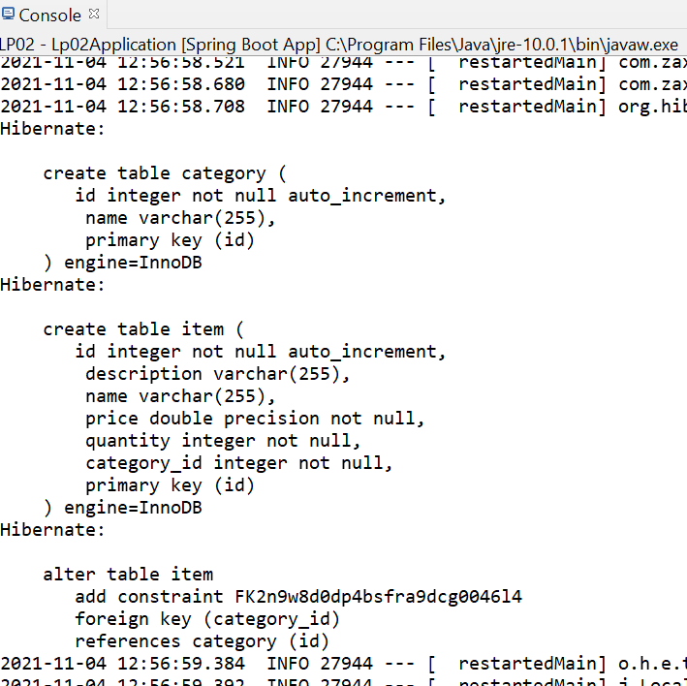
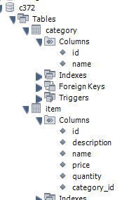
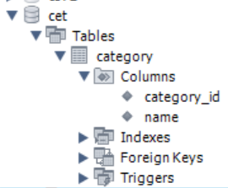
Exercise 5 – Joining Category and Item
Run LP02 Springboot application and observe the output in the console
Refresh cet schema in MySQL Workbench.

Slide 54
How it works
@JoinColumn defines the column to join the category and item tables.
The @OneToMany and @ManyToOne describes the relationship between the 2 entities.
A Set is a collection that does not contain any duplicate objects. In this case, items will not contain any duplicate Item objects. The @OneToMany annotation will be applied to items.
Category object added as a field here. The annotations @ManyToOne and @JoinColumn above will be applied to category.
mappedBy indicates link to category object in the Item class.

Slide 55
Adding new items with categories

Slide 56
Exercise 6 - Adding new items with categories
The original form for adding new items did not include categories.

Slide 57
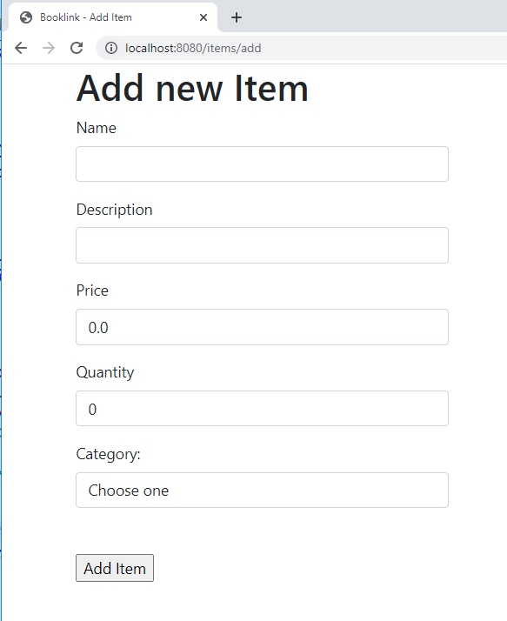
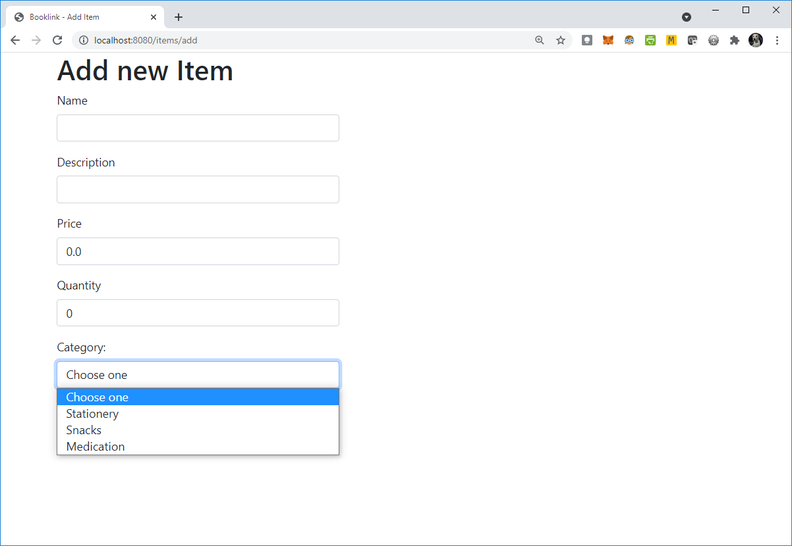
Exercise 6 - Adding new items with categories
We need to update add_item.html to include the category as shown.

Slide 58
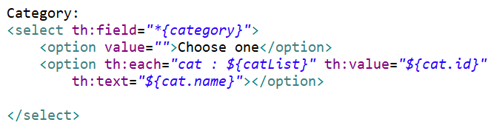
Exercise 6 - Adding new items with categories
Modify add_item.html to include the following code:

Slide 59
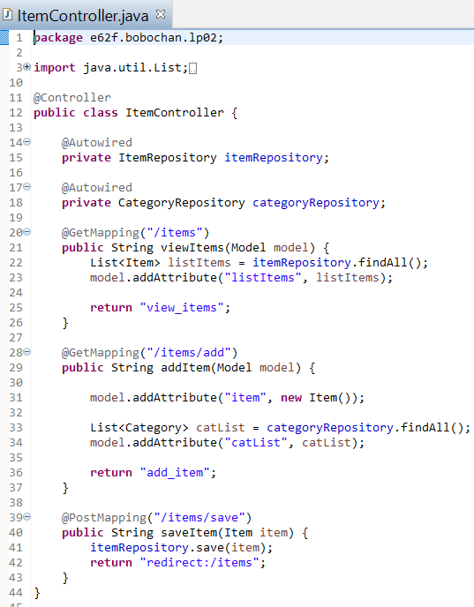
Exercise 6 - Adding new items with categories
In the ItemController, modify the addItem* method to include the code as shown:
*Note:
Depending on what you named the method to add an item earlier and the mappings you used, they could be different from the code shown here.

Slide 60
Exercise 6 - Adding new items with categories
Browse to http://localhost:8080/items/add to check that the categories appear in the add form.
Check that your add form works by adding a new item.
Paste the code for ItemController.java and add_item.html into your worksheet.

Slide 61
How it works
1. The category field here is from the item object in the add form. Recall that category was added as one of the fields in the Item class
2. A list of category objects was retrieved using the findAll method from the categoryRepository.
3. catList was added as an attribute to the model.

Slide 62
How it works
The option element will be iterated through as many times as there are category objects inside catList.

Slide 63
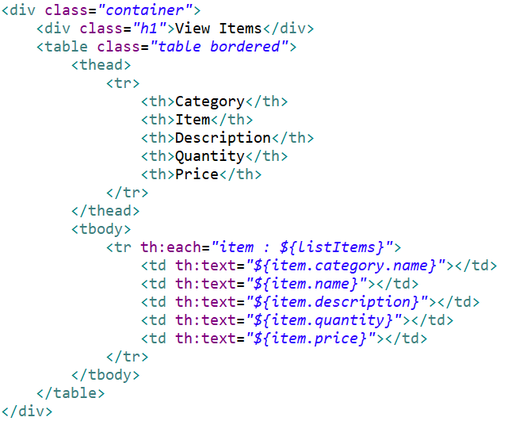
Exercise 7 – Viewing items with categories
Modify the code in view_items.html to include the category of the item

Slide 64
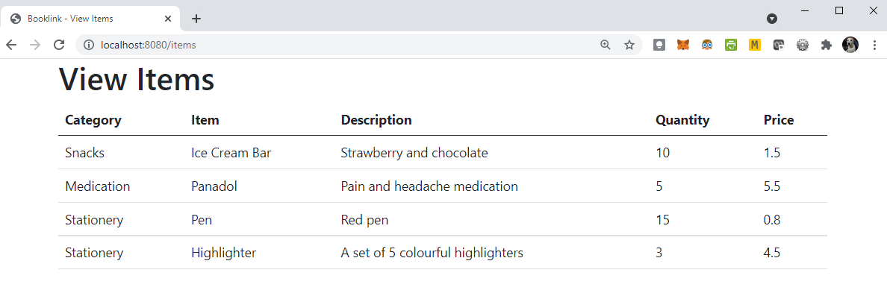
Exercise 7 – Viewing items with Categories
Add a new category Snacks using the form
Add a new item Ice Cream Bar and with the category snacks and display the view_items as shown below:

Slide 65
BREAK

Slide 66
Organizing the project

Slide 67
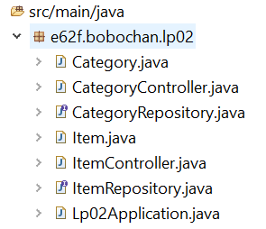
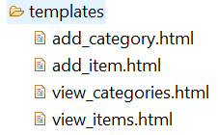
Organizing the project
At this stage you would have created the following features:
Viewing of all categories and items
Adding new categories and items
You would have the following files in the respective folders.

Slide 68
Organizing the project
The starting point of a website is typically the index page.
Earlier we create the ItemController and CategoryController classes that specifically handle mappings and routings for their respective types

Slide 69
Organizing the project
We will now create a controller and view to handle the generic routings and our home page.
Controller: HomeController
View: index.html

Slide 70
Exercise 8 - Organizing the project
Create a controller class named HomeController.
In HomeController, create a public method named home that returns a String “index”
Map the method such that when we browse to http://localhost:8080/ , index.html will be displayed.
Remember to use the @Controller and @GetMapping annotations

Slide 71
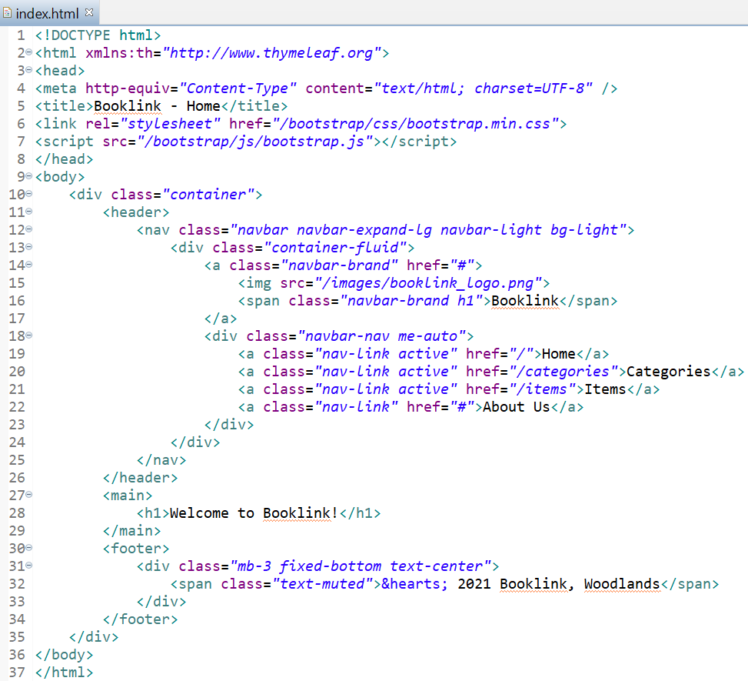
Exercise 8 - Organizing the project
Create a view named index.html and include a header, main and footer as shown
Observe that the href values are the same as the mappings in the controllers.
You should not link directly to the HTML files.
The main element represents the main content section of the body of a document
Notes:
Students may reuse their header/footer design from LP01 if they wish to.

Slide 72
Exercise 8 - Organizing the project
Include the header and footer into view_categories.html and view_items.html.
Browse to http://localhost:8080/ and check that you can click on the links and view the list of items and categories with the header and footer.
Paste the screenshot of the index page into your worksheet.

Slide 73
Thymeleaf Fragments

Slide 74
Thymeleaf Fragments
Previously, we organized our web pages and included the header and footer. However, it can be tedious to maintain.
Thymeleaf can help with easy maintenance of page layouts
In the index page we created last lesson, we included the header and footer details.
These details should be common and consistent across the website.
E.g. viewing list of categories, items, etc

Slide 75
Thymeleaf Fragments
Rather than copying and pasting the code several times in the various documents, we can use Thymeleaf fragments to help us reuse code.
To use Thymeleaf fragments, we simply extract the section of code we will be reusing, and create a separate file for it.

Slide 76
Exercise 9 – Website consistency
When trying to maintain a consistent page layout in the website that has 10 web pages, what is wrong with copying and pasting common components such as header and footer across the web pages?

Slide 77
Exercise 9 – Website consistency
When trying to maintain a consistent page layout in the website that has 10 web pages, what is wrong with copying and pasting common components such as header and footer across the web pages?
Firstly, it is tedious to copy and paste the header or footer components multiple times.
Secondly, if there was an update to the hyperlinks or one of the attributes such as adding a class to the header or footer, the update would have to be applied to as many web pages that we have.

Slide 78
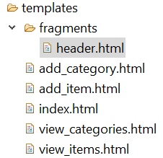
Exercise 10 – Creating header fragment
In the templates folder, create a folder named fragments.
In the fragments folder, create a new file named header.html

Slide 79
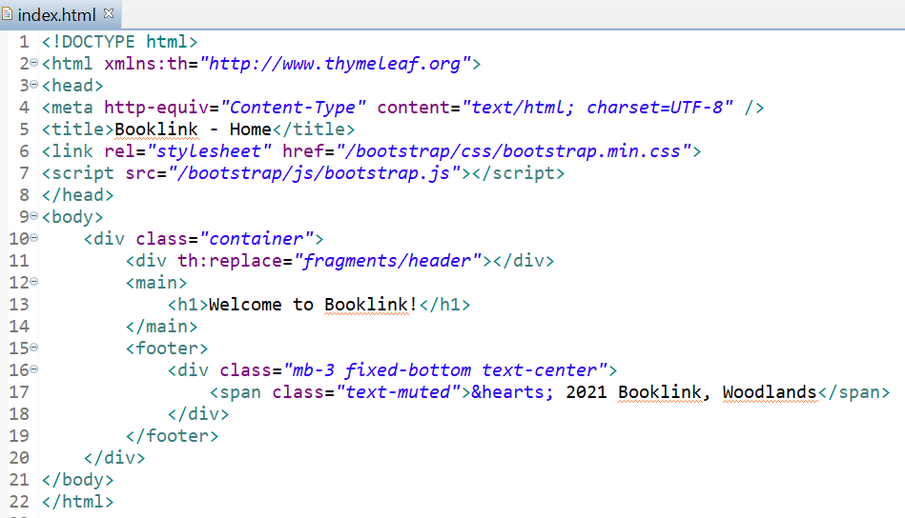
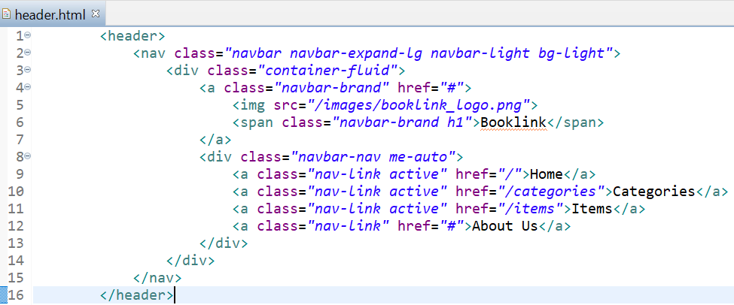
Exercise 10 – Creating header fragment
From index.html, copy the header HTML code and paste it inside header.html.
In index.html, replace the header code with the reference to the fragment as shown.
Note that the mappings here are handled automatically by Thymeleaf.
We do not need to create the mappings ourselves in the controllers.

Slide 80
Exercise 11 – Creating footer fragment
Repeat the steps for the footer element.
Paste the code here

Slide 81
Exercise 11 – Applying fragments to all webpages
To ensure consistency among the webpages, apply the use of the header and footer fragments to the rest of the web pages.
Test that the fragments are working correctly by browsing first to http://localhost:8080/
From there, you should be able to click on the Categories and Items links and view the results.

Slide 82
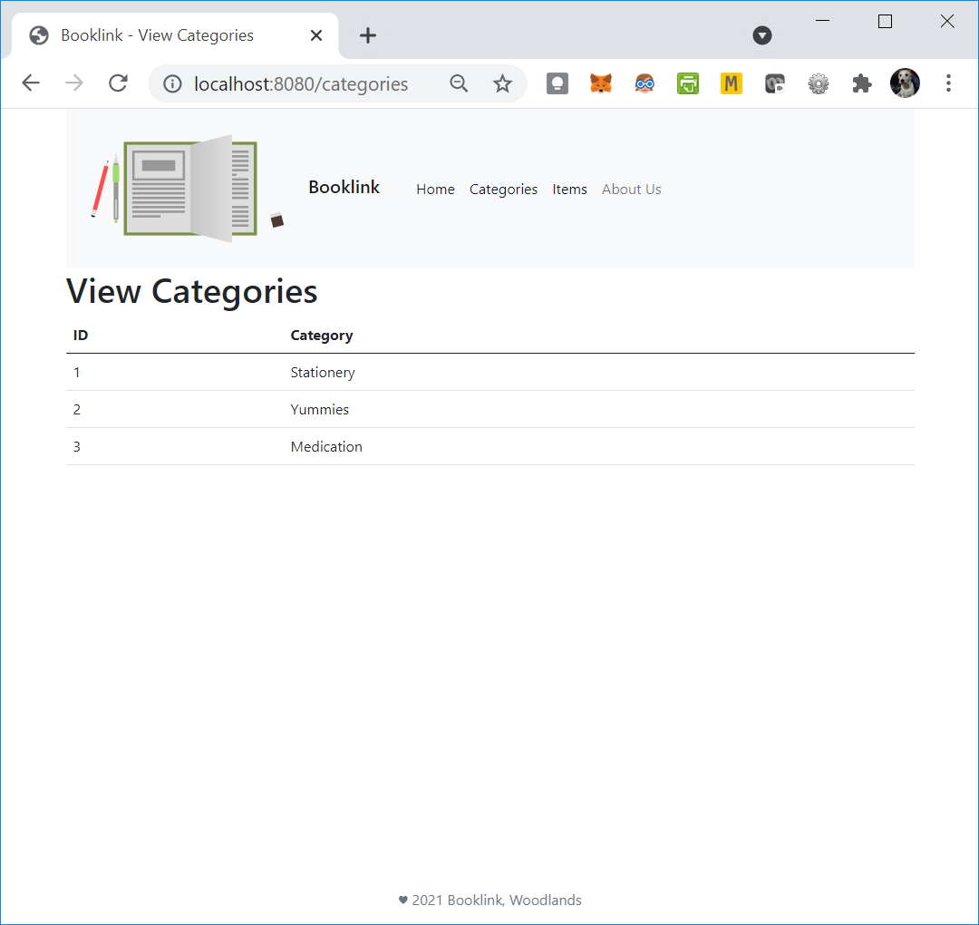
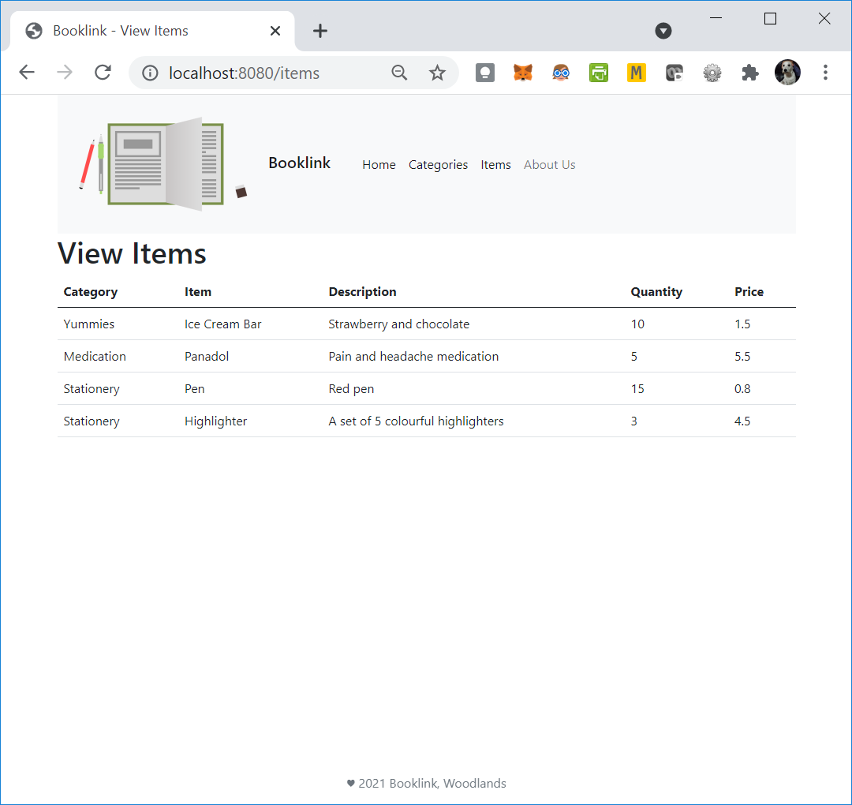
Exercise 11 – Applying fragments to all webpages
From there, you should be able to click on the Categories and Items links without having to enter the url or use the back button on the web browser.

Slide 83
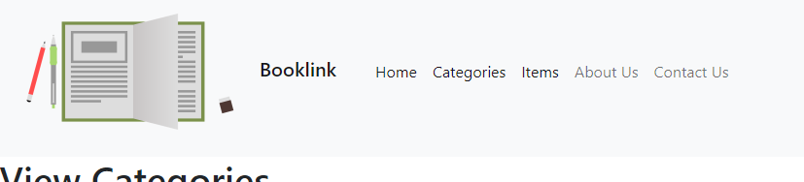
Exercise 12 – Adding a new hyperlink
To include a new link as shown in the image below, where should we put the link?
<a class="nav-link" href="#">Contact Us</a>

Slide 84
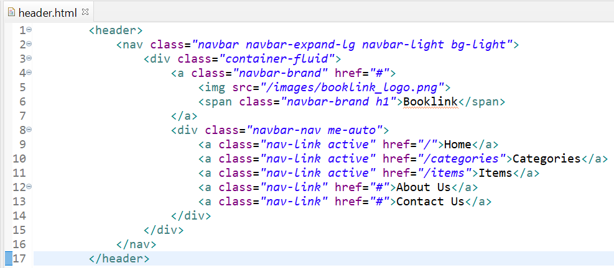
Exercise 12 – Adding a new hyperlink
To include a new link as shown in the image below, where should we put the link?
The link should be added once only to the header fragment. This will be reflected in the pages that contain the header fragment

Slide 85
Summary
In this lesson, you learnt about:
Understanding Forms
Save Data from Forms to Database
Joining Tables and their relationship (Category and Item)
Organizing the project using Header and Footer
Reuse HTML code using Thymeleaf Fragments

Slide 86
Thank you Q&A

