Slide 1

Project Title :Chat Bot for Java/Python Language Query Group Name: Group 07

Slide 2
Team Leader:
Dr K Senathipathi
Team Members
Dr. K.Senathipathi
Mr. Kumara Raja
Ms.M.Kavitha
Mrs. G.Bhavani

Slide 3
Introduction
Nowadays almost 30 percent of the tasks are fulfilled by chatbots.
Lot of organization use the chatbots to provide services like customer support, generating information, etc.
With examples like Siri, Alexa it becomes clear how a chatbot can make a difference in our daily lives.
The chatbot assist programmers with structures with which they can build a new applications.
However, this tool apply to a fixed set of use cases and can be used to assemble and deploy a single-task bot which, at the end of the day, and ongoing management capabilities.
The proposed chatbot will be developed by considering all the requirements of how a chatbot should response for the query

Slide 4
Proposed Chatbot-Java
Python chatbot AI tools that helps in creating a python based chatbot with minimal coding.
This provides both bots AI and chat handler and also allows easy integration of python function calls which makes it unique and more powerful in functionality.
This chatbot provides numerous features like learn or training the model, topic-based conversation handling, etc.

Slide 5
Benefits of Chatbot
Quick answers to simple questions
Getting 24-hour service
Quick answers to complex questions
Getting detailed / expert answers

Slide 6
Implementation Details
Software Used
Python Packages: Tensor Flow, Scikit-learn, Pandas, spaCy ,NLTK.

Slide 7
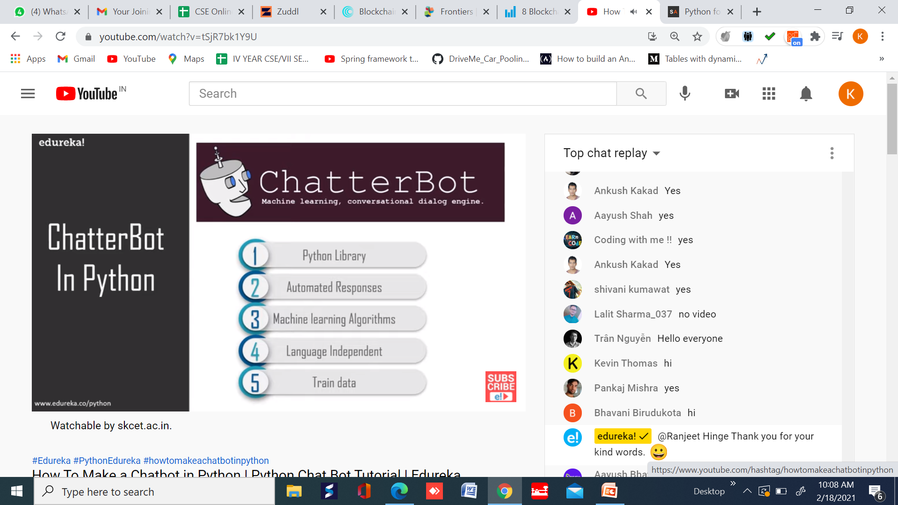

Slide 8


Slide 9
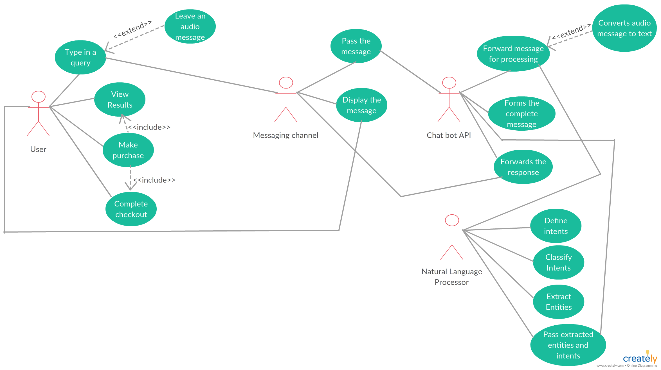
Use Case Diagram

Slide 10
The evaluation plan
Set up | Five randomly picked evaluators, the only criteria is that they have to be beginners .
Control questions | Did you feel like the chatbot gave you a good answer? Do you think that the answer from the chatbot was trustworthy? Do you feel a need to ‘double check’ the answers you got from the chatbot? If you were to rate this chatbot from 1-6 where six is the best, what would you rate it? If low: What improvements does it need to get a six?

