Slide 1
Automated Snyk Vulnerability Remediation
Kavitha A

Slide 2
AS IS
Run Snyk Scan
Use the Snyk CLI or Snyk Portal or IDE Snyk plugin to scan the codebase. This identifies the snyk vulnerabilities.
Review the Report
Developers manually review the output: Severity (low, medium, high), Affected packages, Suggested fixes
Apply Fixes
Dependency upgrades and Code-level fixes
Re-test
Validate the fixed vulnerability (In Maven Java Project – Do a maven build and Start the application).Run snyk test again to ensure vulnerabilities are resolved.
Commit and Push
Changes are committed and pushed to version control.
Optionally, a pull request is created for review.
.

Slide 3
Problem Statement
🚨 Current Challenges
- Manual Process: Security teams manually review each vulnerability
- Time Consuming: Hours spent on research and testing fixes
- Error Prone: Human mistakes in dependency updates
- Inconsistent: Different approaches to similar vulnerabilities
- Delayed Fixes: Security patches take weeks to implement

Slide 4
Solution Overview
🚀 Our Solution
- Automated Scanning: Snyk CLI integration
- AI-Powered Fixes: Mistral AI generates pom.xml updates
- Automated Validation: Maven build + Spring Boot testing
- Smart Organization: Success/failure tracking
- GitHub Integration: Automated PR creation

Slide 5

The script is an end-to-end automation tool that scans for vulnerabilities, uses an AI to fix them, verifies the fixes, and then creates a pull request for human review.

Slide 6
2. Vulnerability Processing: The script reads and parses the snyk-results.json file to get a list of all the vulnerabilities. It then processes these vulnerabilities one at a time in a loop.
3. AI-Powered Fix Generation: For each vulnerability, the script sends the vulnerability data and the current pom.xml content to the Mistral AI API. It prompts the AI to act as a Java and Maven expert and provide a corrected pom.xml with the vulnerability fixed by updating the dependency to a newer version. It also requests a summary of the fix.
4. Applying and Verifying the Fix: The script takes the updated pom.xml from the AI and saves it. It then runs a Maven build (mvn clean install) to compile the project and run tests. If the build is successful, it starts the Spring Boot application. Once the application has started, the script stops it.
5. Retry on Failure: If the Maven build or the application startup fails, the script will retry the fix process up to three times. It informs the AI about the previous failure to get an alternative solution.
6. GitHub Integration: After a vulnerability is successfully fixed and verified, It creates a new branch. It commits the modified pom.xml file to this new branch. Finally, it creates a pull request to merge the changes from the new branch into the main branch.
1. Snyk Scan: It begins by executing a Snyk scan on the pom.. The results of this scan, which detail any found vulnerabilities, are saved as a JSON file.
BREAKDOWN OF HOW IT WORKS:
This Python script automates the process of finding and fixing vulnerabilities in a Java Maven project and then creating a pull request with the fixes. Here's a breakdown of how it works:

Slide 7
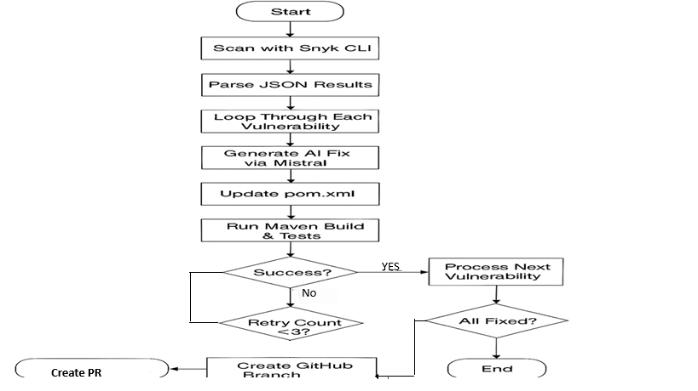
How does it work?

Slide 8
BENEFITS & ROI
💰 Business Benefits
- Time Savings: 90%+
- Cost Reduction: 80% less security work
- Quality: Standardized approach
- Risk Mitigation: Faster patching

Slide 9
Agentic Automation benefits
Feature | Traditional Fixing | Agentic Development
Manual effort | High | Low
Speed | Slower | Faster
Coverage | Partial | Comprehensive
Adaptability | None | High
Learning | No | Yes (via feedback)

Slide 10
System Prompts
prompt = f"""You are an expert in Java and Maven. You are given a Snyk vulnerability result (as JSON) and the contents of a pom.xml file. Only update the pom.xml file to fix the vulnerability by updating to the latest version. DO NOT remove, modify, or reorder any other dependencies or sections in the pom.xml. DO NOT add any comments, explanations, or markdown code blocks inside the pom.xml. Return ONLY the full, valid pom.xml content. If no changes are needed, return the pom.xml content exactly as is. Provide a summary report separately, not inside the pom.xml. ### Vulnerability provided: {vuln_json} ### pom.xml: {pom_content} ### Fixed pom.xml (ONLY THE UPDATED CONTENT, NO COMMENTS OR EXPLANATION) and summary report:"""

Slide 11
THANK YOU!

