Slide 2
Introduction
The objective of this project is to monitor and improve the quality of care of people in remote location and to provide continuous information about the patient for making better healthcare decisions in critical situation and to reduce the regular checkup of the aged patients.
It helps the doctor to monitor their patients at any time apart from their consulting hours. Improved home care facilities and regular health updates to clinicians reduce the chances of redundant or inappropriate care. It improves patient care and safety by reduction in overall costs for care.

Slide 3
Internet of Things (IoT), gather and share information directly from patients and it also make possible to collect, record and analyze new Data Stream faster and more accurately.
As the technology for collecting, analyzing and transmitting data in the IoT continues to mature, with the help of sensors, actuators, and computing devices. This provides data communication capabilities.

Slide 4
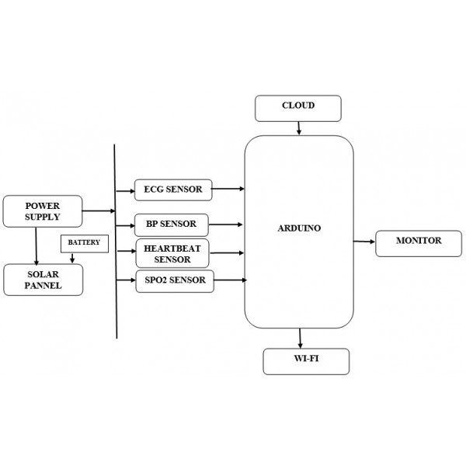
Methodology
The sensing devices from the patient are connected to the aurdino and programmed to convert the sensed data from the patient to readable signals and then transfer the signal wirelessly to IoT or the doctor’s checking.

Slide 5
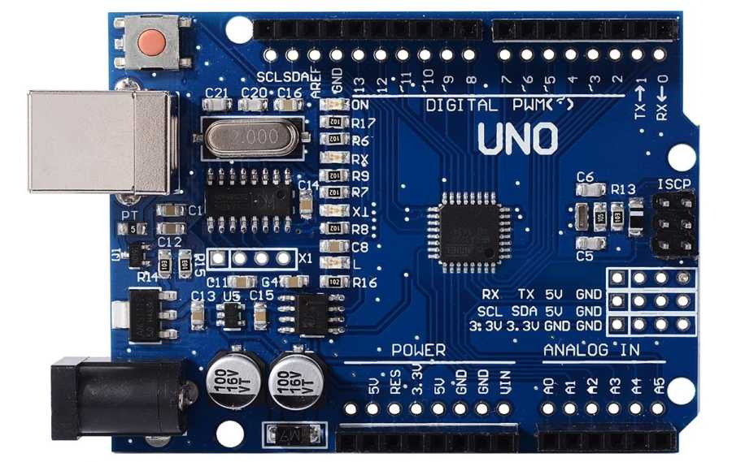
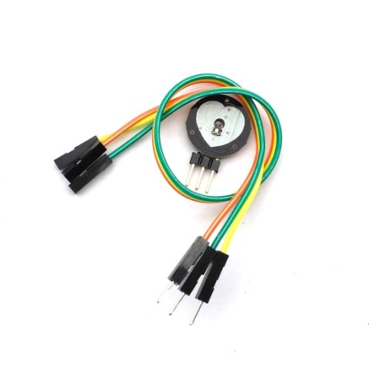
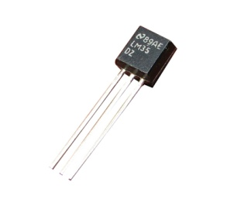
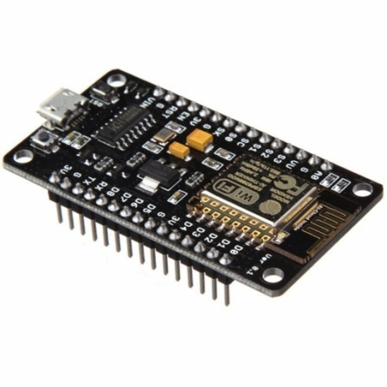
Components that are used
Aurdino uno
Heart rate sensor
Temperature sensor LM35
Aurdino uno board
Node mcu
Heart rate sensor
LM35
Node mcu

Slide 6
Working of the smart health monitoring system
The heart or pulse rate sensor is a very vital health parameter that is directly related to the soundness of the human cardiovascular system. This project describes a technique o measuring the heart rate through a fingertip Using a aurdino Board. While the heart is beating, it is actually pumping blood throughout the body, and that makes the blood volume inside the finger artery to change too. This fluctuation of blood can be detected through an optical sensing mechanism placed around the fingertip. The signal can be amplified further for the aurdino Board to count the rate of fluctuation, which is actually the heart rate.
The TEMPERATURE SENSOR (LM35) is an integrated circuit sensor that can be used to measure temperature with an electrical output proportional to the temperature (in Celsius). It can measure temperature more accurately than using thermistor. The sensor circuitry is sealed not subject to oxidation. The LM35 generates a higher output voltage than thermocouples and may not require that the output voltage be amplified. The LM35 has an output voltage that is proportional to the Celsius temperature.

Slide 7

A. HEART RATE SENSOR Heart rate is a very vital health parameter that us directly related to the soundness o the human cardiovascular system. This project describes a technique o measuring the heart rate through a fingertip Using a Aurdino Board. While the heart is beating, it is actually pumping blood throughout the body, and that makes the blood volume inside the finger artery to change too. This fluctuation of blood can be detected through an optical sensing mechanism placed around the fingertip. The signal can be amplified further for the aurdino Board to count the rate of fluctuation, which is actually the heart rate.

Slide 8
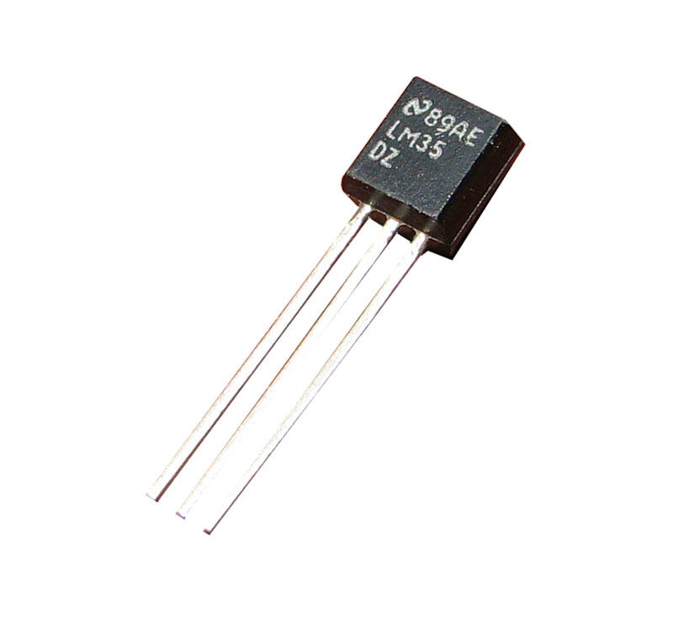
B. TEMPERATURE SENSOR (LM35)
The LM35 is an integrated circuit sensor that can be used to measure temperature with an electrical output proportional to the temperature (in Celsius). It can measure temperature more accurately than using thermistor. The sensor circuitry is sealed not subject to oxidation. The LM35 generates a higher output voltage than thermocouples and may not require that the output voltage be amplified. The LM35 has an output voltage that is proportional to the Celsius

Slide 9
Conclusion
Health of the patients are monitored using internet of things (IoT) and enables the doctor to monitor their patients outside the clinic and also apart their consulting hours. Connected health care devices utilize resources to provide an improved quality of care, leading to better clinical outcomes. Measureable benefits of connected medical devices include reduces clinic visits, including reduction in bed days of care and length of stays in hospitals. Using Internet of Things (IoT), patient conditions are obtained and stored for further analysis. In this project the heart rate and blood pressure of patient are recorded. From this work it is expected to monitor the whole body of the patient from remote location and improve the technology to world widely for patient monitoring by providing personalized and optimized services, it will promote a better standard of living. Nations across the world to improve patient care and IoT provides a timely and cost-effective response to those critical situations. Healthy and active people can also benefit from IoT-driven monitoring of their well-being, It also enables features for the aged persons who want only a monitoring device that can detect a fall or other interruption in every day activity and report it to emergency responders or family members.

