Slide 1

SOA in Internet of Things
BY KAVITHA R S

Slide 2
Agenda
1.IoT Introduction
2.IoT Architecture
3.SOA Introduction
4.Issues and Challenges
5.SOA in IoT case study

Slide 3
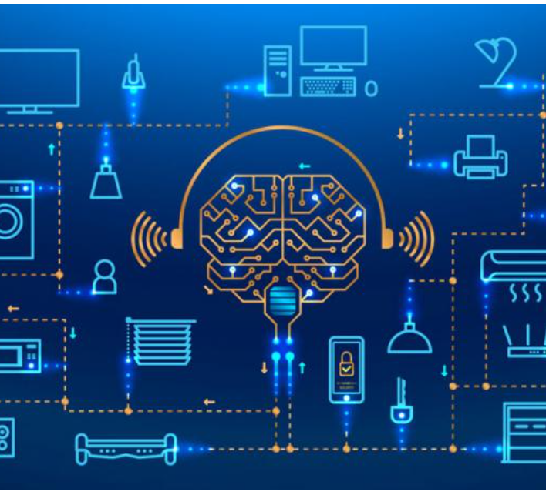
Introduction
What is IoT?
It is when physical devices connect and share data with one other things and people.
IoT is rapidly making the world smarter by connecting the physical and the digital.

Slide 4
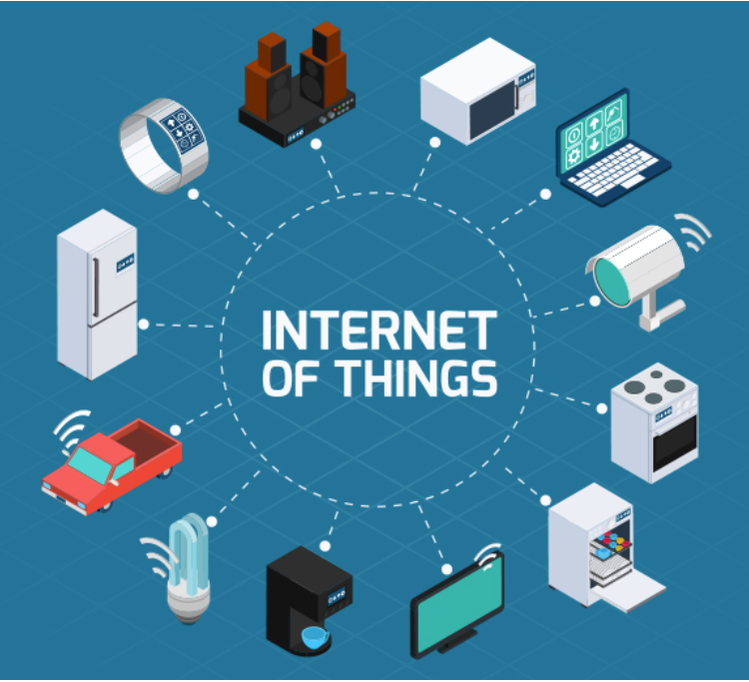
The Internet of Things is made up of devices – from simple sensors to smartphones and wearables – connected together.
By combining these connected devices with automated systems, it is possible to "gather information, analyze it and create an action" to help someone with a particular task , or learn from a process.
IoT allows devices on closed private internet connections to communicate with others and "the Internet of Things brings those networks together. It gives the opportunity for devices to communicate not only within close silos but across different networking types and creates a much more connected world."

Slide 5
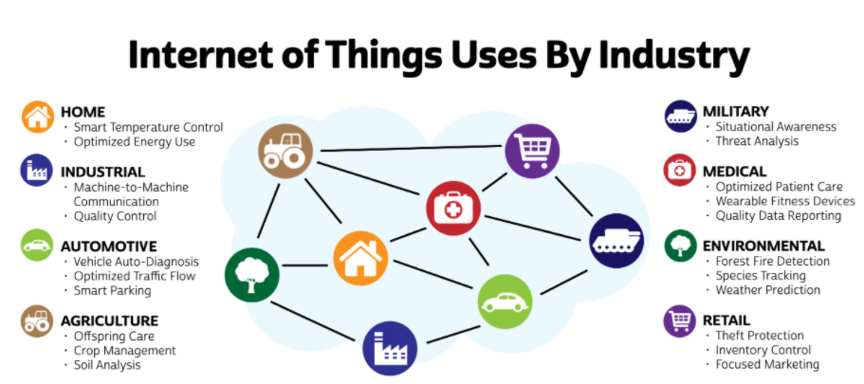
IoT Applications

Slide 6

How IoT works
Just like Internet has changed the way we work & communicate with each other, by connecting us through the World Wide Web (internet), IoT also aims to take this connectivity to another level by connecting multiple devices at a time to the internet thereby facilitating man to machine and machine to machine interactions.
The fundamental components of IoT system tells how IoT works.

Slide 7
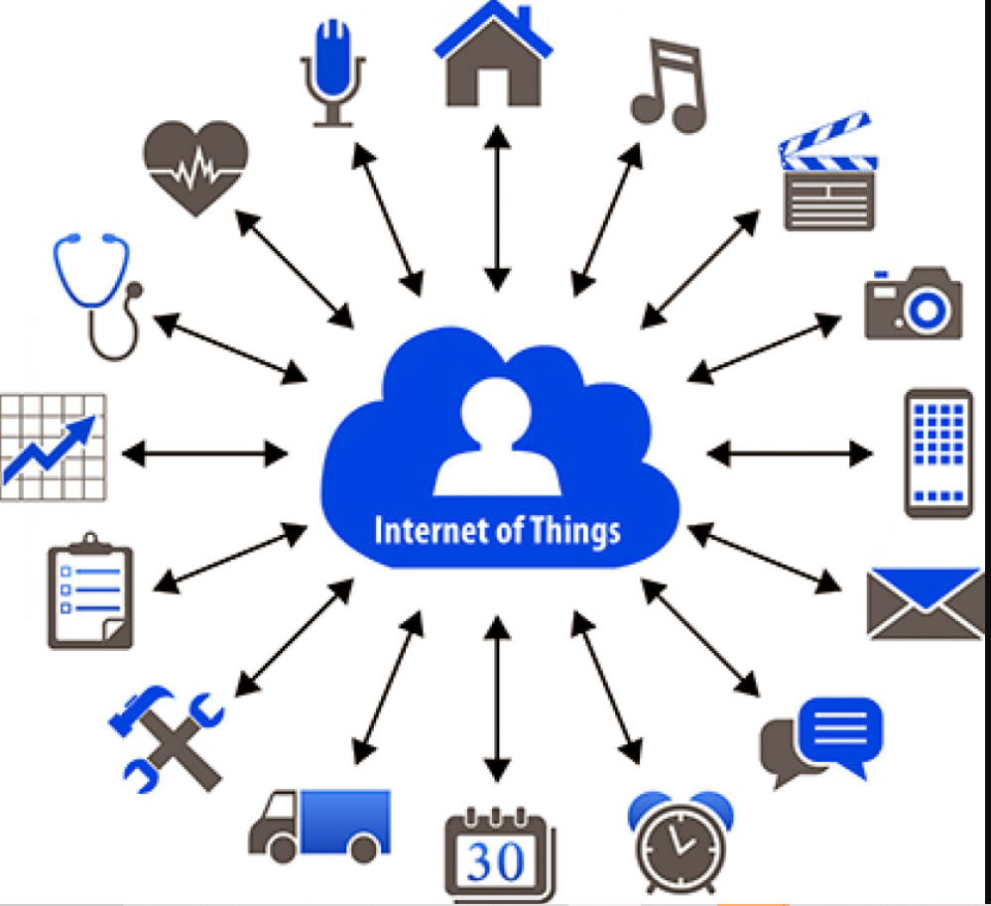
Sensors/Devices
Sensors or devices help in collecting very minute data from the surrounding environment. All of this collected data can have various degrees of complexities ranging from a simple temperature monitoring sensor or a complex full video feed.
A device can have multiple sensors that can bundle together to do more than just sense things. For example, our phone is a device that has multiple sensors such as GPS, accelerometer, camera but our phone does not simply sense things.

Slide 8

Connectivity
The collected data is sent to a cloud infrastructure which needs a medium for transport.
The sensors can be connected to the cloud through various mediums of communication and transports such as cellular networks, satellite networks, Wi-Fi, Bluetooth, wide-area networks (WAN), low power wide area network and many more.
Choosing the best connectivity option in the IoT system is important.

Slide 9
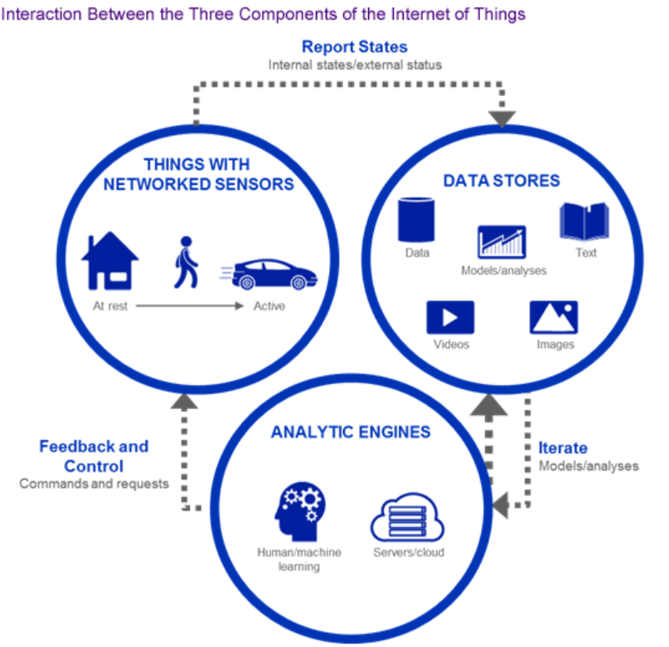
Data Processing
Once the data is collected and it gets to the cloud, the software performs processing on the acquired data.
This can range from something very simple, such as checking that the temperature reading on devices such as AC or heaters is within an acceptable range. It can sometimes also be very complex, such as identifying objects (such as intruders in your house) using computer vision on video

Slide 10
User Interface
The information is provided to end-user.
Allows the user to proactively check on the system.
Some actions are performed automatically.

Slide 11
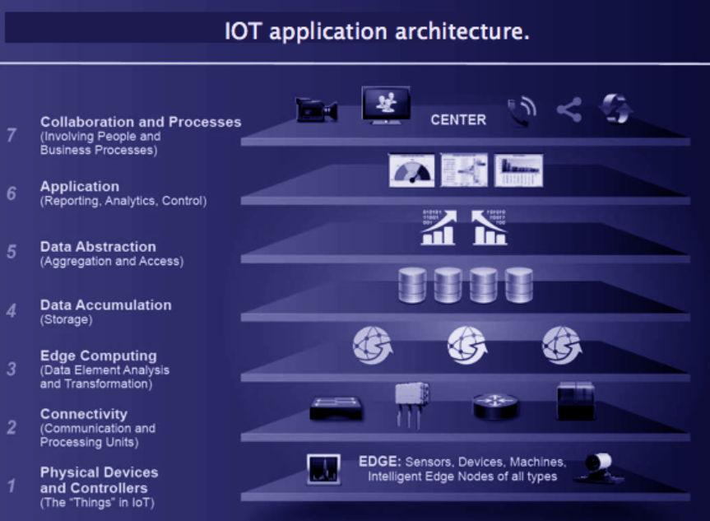
IoT Architecture
1.Sensors and electronic gadgets
2.Convert the data into understandable format
3.Join the tool with wi-fi or net stressed connection.
4.Store the data and apply security
5.Access the information
6.Use the information for reporting purpose.
7.Use the information for effective decision –making in business.

Slide 12

Designing of IoT service architecture must consider the sensor physical characteristics, the ability to move geographically, communication techniques and standards.
By designing so, these architectures support the integration of third party services which enables the operation focus on business process instead of underlying technology.
This leads to low cost system maintenance and extension of the system when required is facilitated.
The technical advancement of the SOA paradigm will help the IoT services to enable sustainability, reliability and heterogeneous service management

Slide 13
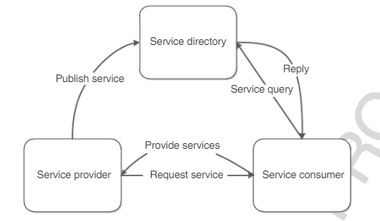
SOA
Service-oriented architecture is a distributed software architecture that consists of multiple autonomous services. Services are distributed such that they can execute on different nodes with different service providers.
A service is comprised of a set of functions and each function deﬁnes the operation that can be executed by the service.

Slide 14
SOA elements
Service-oriented architecture is divided into three elements: service provider , service directory, and service consumer.
The service provider is responsible to design and develop the service.
The developed service information will be published into the service directory.
The services inside the service directory will publish the service information into the network.
When the service consumer requires the service, service consumer requests the service information from the service directory and binds with the service provider to invoke the services.

Slide 15
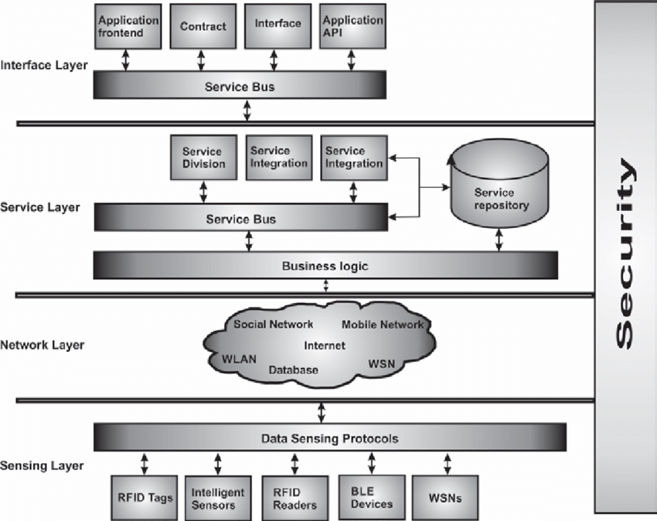
SOA in IOT

Slide 16

Case study : SOA for home networks

Slide 17
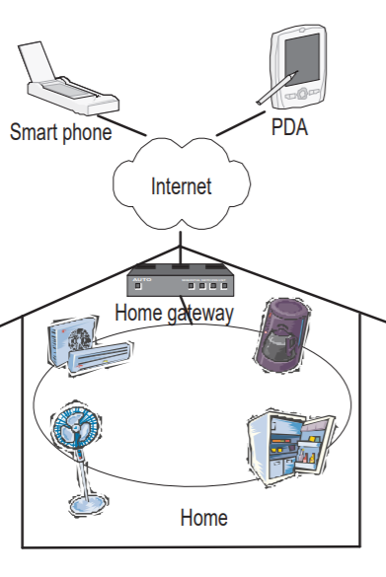
Traditional Architecture
All components in a homenetwork are controlled by a home gateway, which acts as service provider for users.
Users control all other appliances through this server. Users must define scenarios about how home equipments work together from this server. From the defined scenarios, the server knows to it will control other equipments. And to be able to control and interconnect all other devices, the server must be able to work with appliances that have different technologies and protocols.
In some cases, appliances can work in a peer-to-peer network, but this feature is applicable to appliances that use the same protocol. The reason is they can not understand the others that use different protocols. That is why the home gateway is needed to act as a service gateway, translating between different protocols for appliances

Slide 18
Issues
Appliances are restricted to a specific kind of services or technologies which leads to interoperability problem.
Using a service gateway, we can control and interconnect different appliance systems but it brings difficulty of usage and maintenance.
Another problem is scalability. Because we use a service gateway to interconnect different systems from different technologies, there might be a problem with a new device whose communication technologies are unknown for the gateway. In this situation, users have to update their server, that is always complicated, or they can not use the new device.

Slide 19
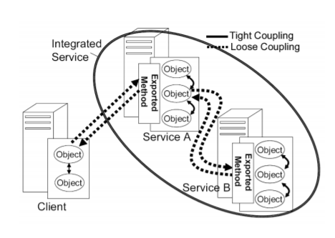
Home appliance networks in SOA
How appliances communicate:
SOA can be applied in networks of home appliance to link different appliance types, making them able to communicate with each other in a standardized manner.

Slide 20
The way appliances work together must meet the following requirements:
• Standard communication and loose coupling: It guarantees that any appliance can interoperate with others and changes inside each appliance do not affect the network.
• Autonomous interoperation: This requirement allows appliances to function without any centralized component or foreknowledge about others

Slide 21
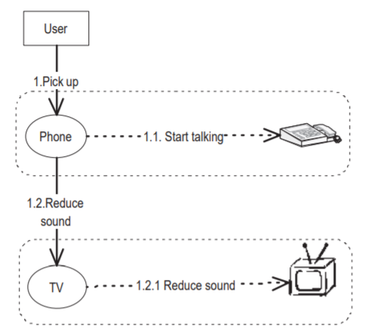
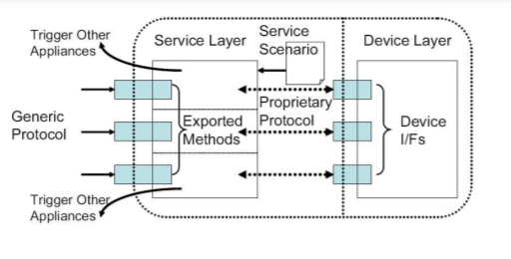
Appliance architecture and service scenario

Slide 22
Why SOA?
In SOA, appliances advertise their services with the description in a standardized format. As a result, if two different devices use different technologies, they can still understand how to call each other’s services. And because the architecture produces loose coupling, no appliance depends on others’ work, so it provides extendability and scalability. In addition, each appliance can discover what services others offer and also advertise its services, they can work autonomously with minimum user’s control.

Slide 23
Security in IOT
Security is critical for almost every IoT system, and in the last few years we have witnessed many stark examples of security breaches in smart devices.
Policy based security model ensures that an application is only able to access device features and services for which it has permission and thus cannot interfere with other applications.

Slide 24
References
[1] P. Bergstrom, K. Driscoll, and J. Kimball. Making home automation communications secure. Computer, 34(10):50–56
[2]R. Hall and H. Cervantes. Challenges in building service-oriented applications for OSGi. Communications Magazine, IEEE, 42(5):144–149
[3]D. O’Sullivan. An Advanced Appliance Interaction Architecture. Master thesis, University of Dublin, Trinity College

