Slide 1
IOT BASED MONITORING SYSTEM FOR COAL MINING ENVIRONMENT USING LI-FI
BATCH NO-A 16
MEMBERS OF THE PROJECT
V.KAVITHA-211417104115
V.KUSHMASRI-211417104126
V.LAVANYA-211417104132
UNDER THE GUIDANCE OF
Mrs.M.S.Vinmathi,M.E
Professor,
Department of Computer Science and Engineering,
Panimalar Engineering College, Chennai.

Slide 2
ABSTRACT
Now a days due to global warming and climate changes there are challenging situations in field of coal mine. To reduce the cost and improve the productivity in the field of coal mines,our project proposes a design of a wireless sensor network (WSN) with the help of microcontroller which is able to monitor the temperature, humidity,gas and status of brightness in an underground mine. This system utilizes low power, cost effective arduino uno, temperature sensor, humidity sensor, LDR and gas sensor for sensing the mine climate parameters and Li-Fi for remote logging of data transmission from coal mine to the monitoring unit.Traditional coal mine monitoring systems tend to be wired network systems but with continuous enlarging of exploiting areas and extension of depth in coal mine, many lane ways become blind areas, where in there are lots of hidden dangers. Moreover, it is inconvenient to lay cables which are expensive and consume time. In order to solve the problems, we will design a coal mine safety monitoring system using Li-Fi.

Slide 3
INTRODUCTION
At present, coal mining workers are affected by accidents which is due to the complexity of my environment. So it is indispensable to monitor mine working environment condition.An overview of Li-Fi communication system for underground mines for passing emergency information to the worker under risk conditions is described in our project. The system includes light signal which can be used for data transmission. The recent tragic coal mine accidents have highlighted the need for reliable communications between inside and outside mines. Nowadays, most of the mines are using radio wave communication for their information exchange. While doing that, the proper data communication through radio wave is not possible at the bottom of underground mines because of irregular data propagation and limited frequency range 3 kHz-300 GHz. So, Wi-Fi technology is replaced by Light Fidelity technology, the basic idea behind this technology is visible light communication. According to this technology, it has covered wide range of frequency (430-790) THZ and fast data transmission when compared to Wi-Fi. Real-time data of underground gas, carbon monoxide, temperature, humidity and other field data are collected and transmitted to the upper computer using a high speed wireless communication technology Li-Fi.

Slide 4
PROBLEM STATEMENT
The major problem identified is that there are numerous accidents occurring in the coal mines due to improper maintenance and inadequate monitoring of the mining activities. These led to numerous loss of lives and immeasurable resources loss. There is no proper early detection of the uncertainty in the coal mines. Many miners continue to die annually, either through direct accidents in coal mines or through adverse health consequences from working under poor conditions. The safety issues of coal mines have gradually turned into a major concern for the society and nation.. Miners health and life is vulnerable to several critical issues, which includes not only the working environment, but also the after effect of it. Underground coal miners are exposed to a wide range of hazards including gas explosions, gas poisoning, shifting rock, falls, and machinery and mobile equipment accidents.

Slide 5
LITERATURE SURVEY

Slide 6
S.NO | TITLE | YEAR | JOURNAL NAME | AUTHOR | METHODOLOGY | INFERENCE
1 | An Efficient Implementation of Wireless Sensor Network for Performing Rescue & Safety Operation in Underground Coal Mines | 2020 | IEEE | Shilpa Lande; Punam Chabukswar; Vishal Bhope | The structuring of the underground coal mine monitoring system based on the ZigBee wireless sensor network evacuates the traditional underground coal mine monitoring system. In this monitoring system for wireless communication, ZigBee is utilized. | Zigbee disadvantages mainly include short range.
2 | Monitoring System for Coal Mine Safety Based on Wireless Sensor Network | 2019 | IEEE | Yingli Zhu ,Guoping You | This paper designed a environment monitoring system based on sensor network. The system consists of ZigBee wireless sensor network, router, coordinator, mine network switch and monitoring computer. ZigBee wireless sensor nodes form a tree-like network topology. Real-time data of underground gas, temperature, humidity. | Low complexity, and low data speed. Here also zigbee is used.

Slide 7
SNO | TITLE | YEAR | JOURNAL NAME | AUTHOR | METHODOLOGY | INFERENCE
3 | IoT based Safety System for Coal Mines | 2018 | IEEE | Yingli Zhu ,Guoping You | The system consists of ZigBee wireless sensor network, router, coordinator, mine network switch and monitoring computer. ZigBee wireless sensor nodes form a tree-like network topology. Underground gas, carbon monoxide, temperature, humidity and other field data are collected and transmitted to the upper computer. The system can also extend video data acquisition function to realize real-time monitoring of mine site operation. | This uses a serial monitoring system and Zigbee System
4 | LabVIEW based coal mine monitoring and alert system with data acquisition | 2018 | IEEE | Ashwini J. Pudke; Sanket N. Bhagat; S. L. Nalbalwar | The signal are fed to LabVIEW which works as a signal processor and monitoring system. Being a signal processor LabVIEW continuously compares the sensed and Working as a monitoring and data acquisition system it acquires the data. | The system can be monitored is Labview and in a portable mini monitor panel. Lab-view monitoring is accurate but it is expensive due to the expense of the software.

Slide 8
SNO | TITLE | YEAR | JOURNAL NAME | AUTHOR | METHODOLOGY | INFERENCE
5 | Coal Mine Safety Monitoring and Alerting System | 2017 | IJRET | S. R. Deokar, J. S. Wakode | . This system also provides an early warning, which will be helpful to all miners present inside the mine to save their life before any casualty occurs. The system uses Zigbee technology and GSM for transmission of data. There is alert switch at receiver and transmitter side for emergency purpose. | Some workers are not aware for safety and they would not wear helmet.

Slide 9
SNO | TITLE | YEAR | JOURNAL NAME | AUTHOR | METHODOLOGY | INFERENCE
6 | Mine safety system using wireless sensor networks | 2016 | IEEE | Valdo Henriques; Reza Malekian; Dijana Capeska Bogatinoska | The input from the sensor is sampled by the micro controller, which forms the central processing Unit (CPU) of the measurement module. The microcontroller also has a timer which determines the delay between two sensor sample readings. A wireless communication module is also integrated into the microcontroller for transmitting data to the data collection station. | Wi FI based communication is used.
7 | Automatic monitoring system for coal mine safety based on wireless sensor network. | 2016 | IEEE | Jingjiang Song, Yingli Zhu | This system design monitoring for coal mine safety constructed by MSP430F and nRF2401. The sensor groups of the system intensively monitor temperature, humidity and other parameters in the underground mine, parameters measured are sent to wireless communication module by the micro-controller. The collected information is sent to longdistance monitoring center by cable | The problem of this implementation is that hardware is placed inside the coal mines, when a natural calamity or a roof fall occurred, the system is damage. So the reliability and long life of conventional communication system is poor.

Slide 10
SNO | TITLE | YEAR | JOURNAL NAME | AUTHOR | METHODOLOGY | INFERENCE
8 | Design of Coal Mine Intelligent Monitoring System based on ZigBee Wireless Sensor Network | 2016 | IEEE | Dan Gao, Weiwei Li, Kun Dai | This paper presents implementation of safety helmet for coal mine workers. This helmet is equipped with methane and carbon monoxide gas sensor. It is on the safety helmet of the coal mine workers This sensor sense the gas and the data is transmitted to the control room wirelessly, through a wireless module called X-Bee connected with the helmet. | X bee wireless sensor network is used which is not efficient.
9 | The study on coal mine using the Bluetooth wireless transmission | 2015 | IEEE | Yongping Wu; Guo Feng; Zhang Meng | Bluetooth technology is to establish a common low-power, low-cost wireless air interface and controlling software opening system. This paper describes the development background, technical features and the structure of the protocol stack of Bluetooth. | At the same time, the system uses CAN bus technology maturely, has realized the combination of wired and wireless data transmission system. The main difficulty of this system is that the Bluetooth is short distance wireless technology

Slide 11
SNO | TITLE | YEAR | JOURNAL NAME | AUTHOR | METHODOLOGY | INFERENCE
10 | Intelligent coal mine monitoring system based on the Internet of Things | 2015 | IEEE | Shushan Hu; Cunchen Tang; Riji Yu; Feng Liu; Xiaojun Wang | The proposed sense network architecture is completed based on Controller Area Network (CAN) bus and ZigBee technology. The sense nodes work cycle, powered by batteries, is extended by specific work model. Position of miners can be obtained through inquiry routing tables of network nodes. Manage system is designed to provide services for mine managers. The proposed system can monitor the process of mining intelligently and warn miners and managers immediately when dangerous issues emerge, such as gas leaking and water leaking. | This method is scalable Only for short distance.

Slide 12
EXISTING SYSTEM
Traditional coal mine safety monitoring system adopts wired network to transmit. In the mining process, the wired communication system is not so efficient. The most famous system for underground mines communication is Radio Frequency Identification Device (RFID) system. It is comprised of radio frequency identifier tags, RFID readers, routers and a host station. RFID tags are very small chips capable of storing a specified amount of data in its circuitry. RFID tags area unit of 2 sorts, active and passive. In underground mine application, active tags should be used having the signal range of 100 meters, whereas for passive tags the allowed range is 6-8 meters . In addition to above, there are many wireless systems such as; Wi-Fi (IEEE 802.11), Bluetooth (IEEE 802.15) and Wi-Max used in underground mines application. Zigebee based wireless data transmission is used widely in coal mine monitoring system. In this system,the data of the concentration level of harmful gases and hazardous event of coal mines are transmitted to the base station using Zigbee.Ultra Wide Band system is another radio system for short-range communication with very low power and very high data rate.
TECHNOLOGY USED:
Wired system,Wi-fi,Zigbee,Bluetooth

Slide 13
DRAWBACKS OF EXISTING SYSTEM
The wired connections will fail in natural calamities such as landslides, earthquake etc.,
Re-installation cost of the wired networks is also a disadvantage for these connections.
The wired connection requires a lot of maintenance cost also.
Zigbee ,Wi-Fi based data transmission can be used only for short range communication.

Slide 14
PROPOSED SYSTEM
The main objective of the proposed method is to improve the effective data transmission from the base station to receiving station in the underground mines. At present, the Wi-Fi technology has been used for information exchange along with large delay which affects the data transmitting speed and loss of the data. This problem can be overcome by proposed method and give effective communication between sender and receiver. Here, working procedure is same as that of Wi-Fi but instead of radio wave the light wave is used from the lighting arrangement in the underground mine and power consumption of these light also very low. The lightning system consists of the Li-Fi circuit driver to sense the signal from the base station through the light the photo detector in the device capture the signal and passes the data to the monitoring section of the underground mines.

Slide 15
In this proposed system the coal mine safety systems are fixed with gas sensor modules, the light dependent resistor(LDR sensor), temperature sensor ,humidity sensor, fire sensor, buzzer and led. We integrate all the sensors to the Arduino uno. In this system we mainly have monitoring and controlling systems monitoring system where monitor all the data from different sensors. Gas sensor detects the gas in the coal mine environment. The temperature and humidity values are also he monitored inside the coalmine. LDR sensor is used to measure the intensity of the light by varying its resistance value. TECHNOLOGY USED: Light Fidelity Technology ,IOT Cloud platform

Slide 16
ADVANTAGES 1.The transmission separation of Li-Fi is faster than other wireless data transmission systems. 2. Driven devours less power and gives more effectiveness. It gives more channels to Transmit and thus there will be more data transfer capacity. 3.These waves are innocuous since it is light. 4.It tends to be utilized anyplace with no issues. 5.The light waves are quick and can’t be seen by the human eyes. It is hard to hack the data or information in the Li-Fi innovation. The information is particularly verified.

Slide 17
DEVELOPMENT ENVIRONMENT HARDWARE REQUIREMENTS PROCESSOR : PENTIUM IV 2.6 GHz, Intel Core 2 Duo. RAM : 4GB DD RAM MONITOR : 15” COLOR HARD DISK : 40 GB
SOFTWARE REQUIREMENTS Operating System : Windows 07 Coding Language : C/C++ Coding Platform : Arduino IDE Cloud platform : Thinkspeak

Slide 18
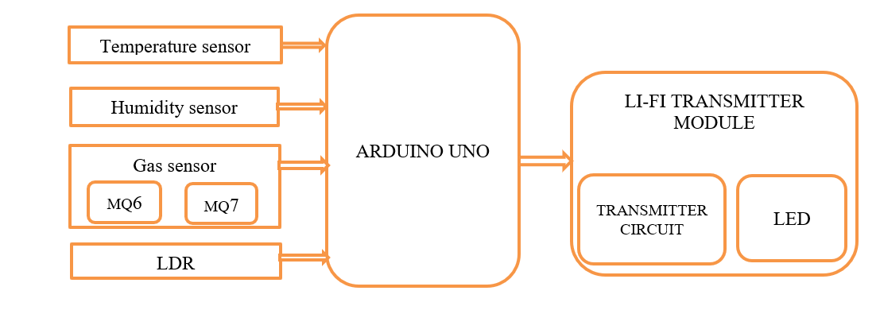
SYSTEM ARCHITECTURE
Transmitter side

Slide 19
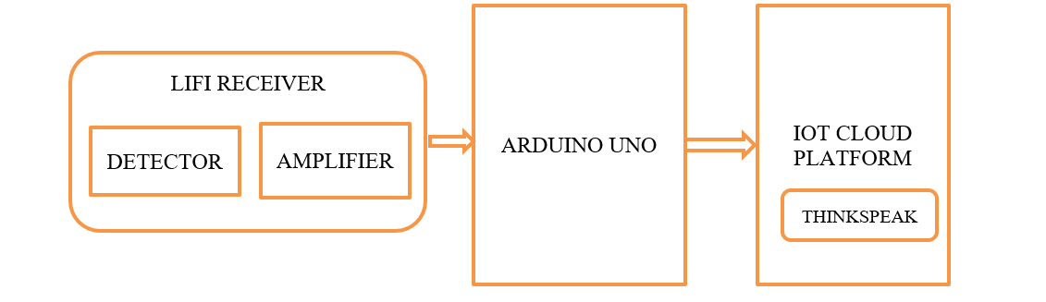
Receiver side

Slide 20
Components required
Arduino Uno
Li-Fi Transmitter/Receiver
MQ6 Sensor
MQ7 Sensor
LDR Sensor
DHT11 Sensor

Slide 21
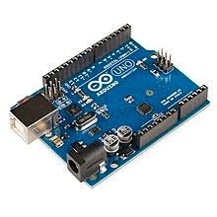
ARDUINO
Arduino is a single board microcontroller intended to make the application of interactive objects or environments more accessible
It receives input from variety of sensors.
It is the Arduino Microcontroller, which controls the whole system.
All the sensors are interfaced using this controller

Slide 22
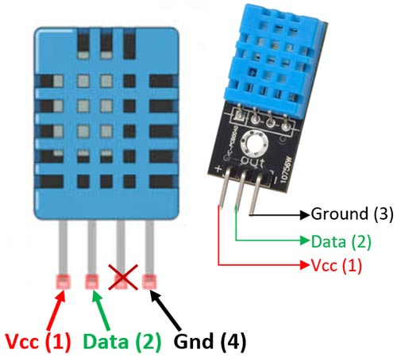
DHT11
DHT11 is a low-cost digital sensor for sensing temperature and humidity.
This sensor can be easily interfaced with any micro-controller.
To measure the surrounding air this sensor uses a thermistor and a capacitive humidity sensor.
DHT11 sensor consists of a capacitive humidity sensing element and a thermistor for sensing temperature.

Slide 23
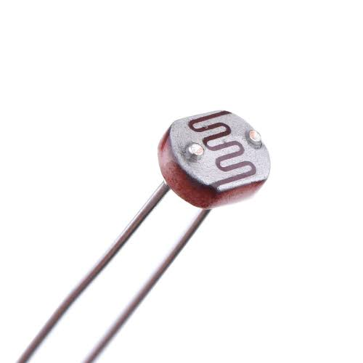
LDR
Light dependent resistors (LDR) or photo diode resistor or photocell is a light controlled variable resistor. Its resistance changes with light intensity that falls on it.
The resistance of a photo resistor decrease with increasing incident light intensity. In other words, it exhibits photoconductivity.
The resistance range and sensitivity of a photoresist or can substantially differ among dissimilar devices.
It values get through to the lifi

Slide 24
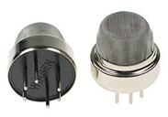
MQ6 sensor
In deep cave mining, some poisonous gases like methane, carbon monoxide, sulphur dioxide etc emit from the cave walls. In order to, detect these poisonous gas, gas sensors are used.
MQ6 gas sensor is used.
It can be used in gas leakage detecting equipment in consumer and industry applications,this sensor is suitable for detecting LPG, iso-butane, propane and natural gases like methane.

Slide 25
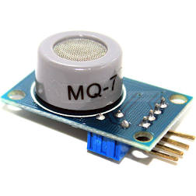
MQ7 Sensor
The MQ7 is a simple-to-use Carbon Monoxide (CO) sensor suitable for sensing CO concentrations in the air.
It can detect CO-gas concentrations anywhere from 20 to 2000ppm.

Slide 26
Li-Fi
Light fidelity technology is known for the high data speed and the data are transmitted electromagnetically and runs on visible light.
It uses the common light emitting diodes which is at the sender side and photo detector is placed at the receiver end, the The analog signals which are detected by the various sensors are given to the LI-FI transmitter, here the analog signals are converted into the digital signals and the these digital data are received by the the LIFI receiver .
The received data can be converted into any forms such as video and audio application or the web enabled services and the main advantages of LI-FI are high speed, data density, security, device to device connectivity.

Slide 27
MODULES DESCRIPTION
Temperature,Humidity and gas detection
LDR Based Light System and Control
Li-Fi Transmitter side
Li-Fi Receiver Side
Monitoring using IOT cloud platform

Slide 28
1. Temperature,Humidity and gas detection
TEMPERATURE SENSOR
ARDUINO UNO
HUMIDITY SENSOR
GAS SENSOR
We integrate all the sensors to the Arduino uno. In this system we mainly have monitoring and controlling systems monitoring system where monitor all the data from different sensors. Gas sensor detects the gas in the coal mine environment. The temperature and humidity values are also he monitored inside the coalmine

Slide 29
2. LDR Based Light System and Control
In this module, LDR sensor used to detect the light intensity in the working environment based upon that ,the brightness of the light is monitored using the IOT cloud platform Thinger.io.
ARDUINO UNO
LDR SENSOR
IOT CLOUD

Slide 30
3.Li-Fi Transmitter side
Light fidelity technology is known for the high data speed and the data are transmitted electromagnetically and runs on visible light.
It uses the common light emitting diodes which is at the sender side and photo detector is placed at the receiver end, the The analog signals which are detected by the various sensors are given to the LI-FI transmitter.
SENSORS
ARDUINO
LI FI TRANSMITTER

Slide 31
.
.
4. Li-Fi Receiver side
In this module , the analog signals are converted into the digital signals and the these digital data are received by the the LIFI receiver .
The received data can be converted into any forms such as video and audio application or the web enabled services and the main advantages of LI-FI are high speed, data density, security, device to device connectivity.
LIFI RECEIVER
IOT CLOUD

Slide 32
5.Monitoring using IOT cloud platform
THINKSPEAK Platform: It is an open source cloud platform for IoT.
It provides scalable cloud infrastructure for connecting things, devices. With this we can monitor the mine parameters like temperature,humidity and gas.

Slide 33
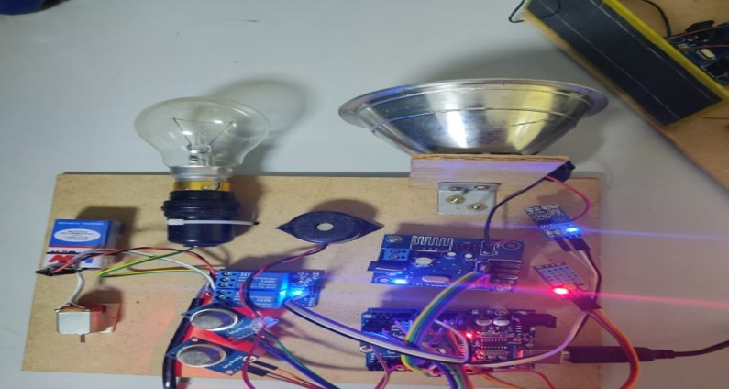
SCREENSHOTS Transmitter side

Slide 34
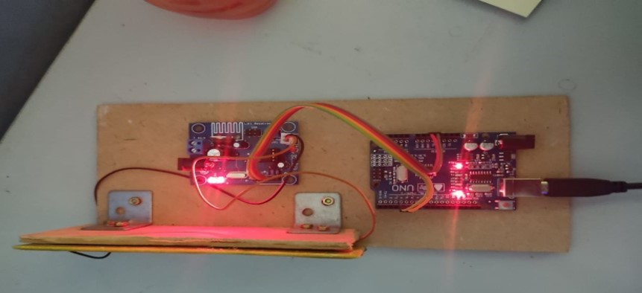
Receiver side

Slide 35
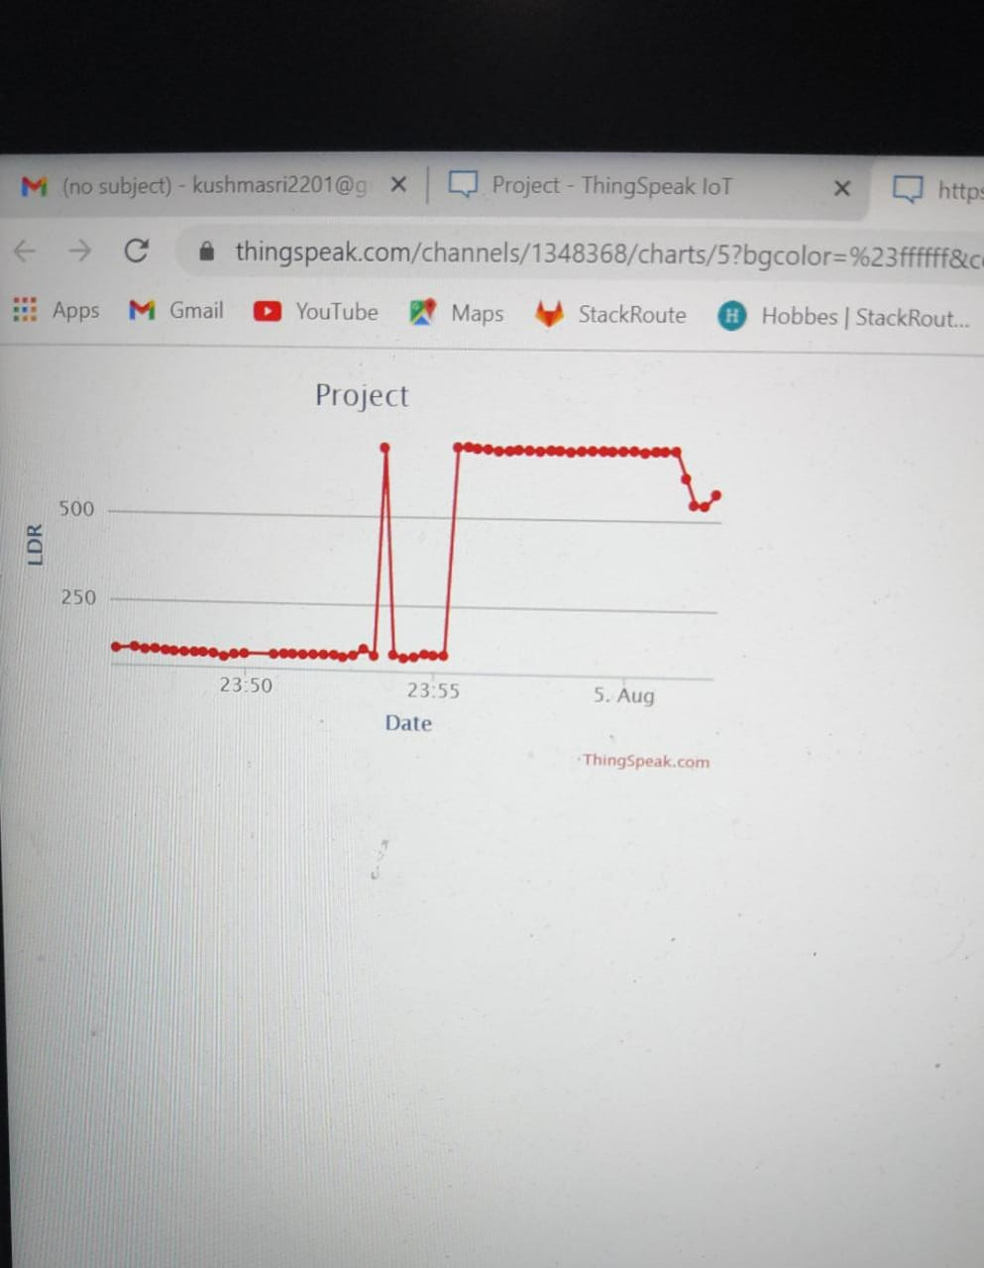
Results
LDR SENSOR

Slide 36
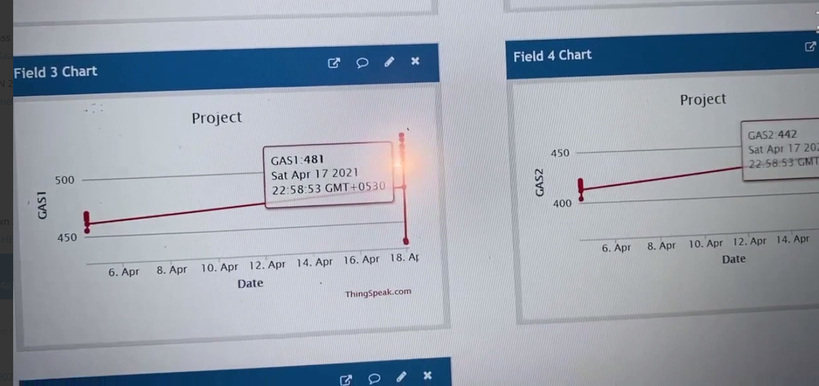
GAS SENSOR
X axis- Date, Y axis- Gas sensor value in ppm

Slide 37
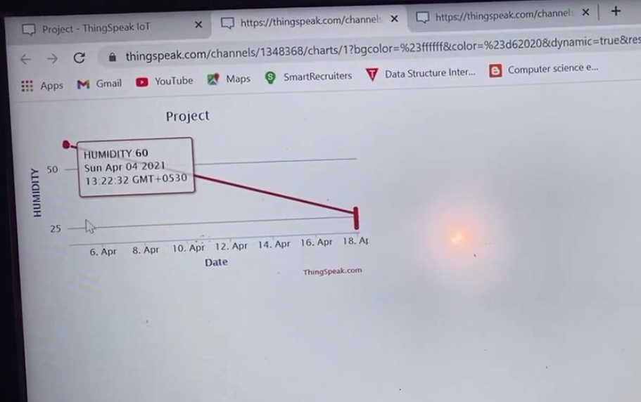
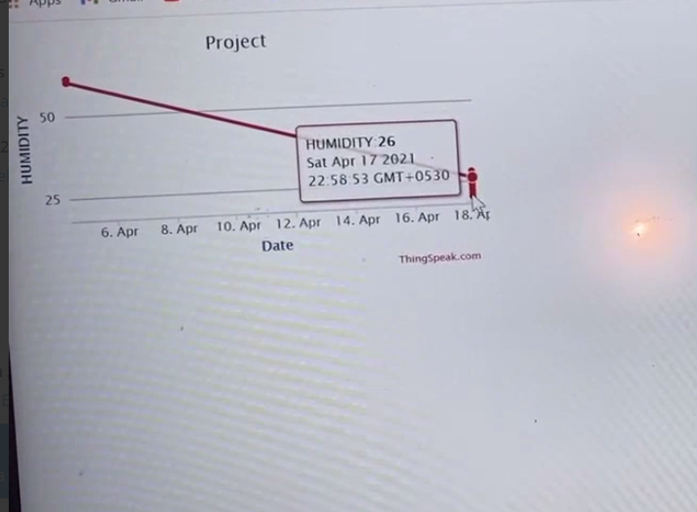
HUMIDITY SENSOR
X axis – Date, Y axis- Humidity in g/kg(grams of water vapor per kilogram of air g.kg⁻¹ )

Slide 38
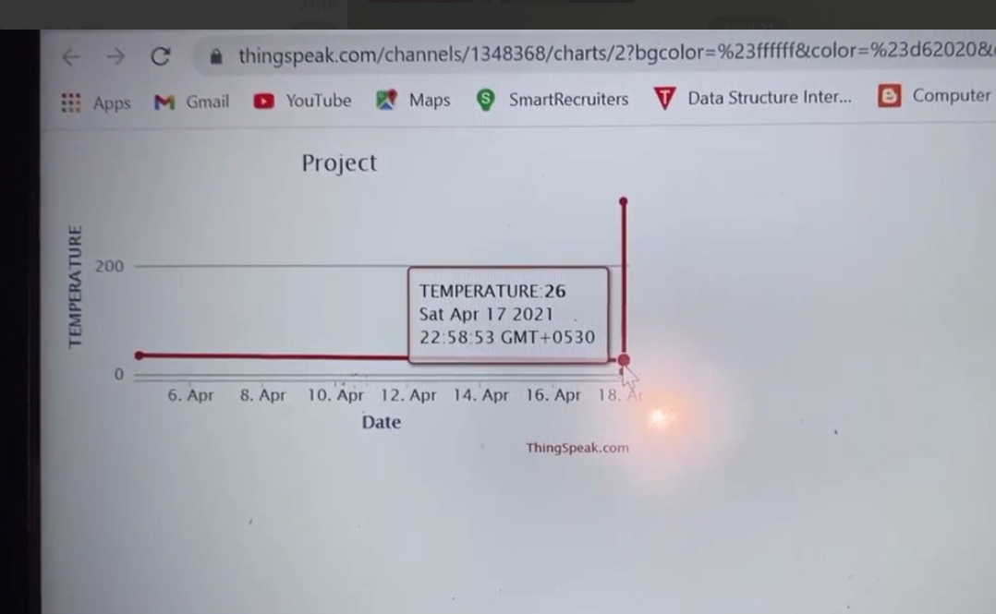
TEMPERATURE SENSOR
X axis- Date, Y axis- Temperature in Celsius

Slide 39
TEST CASE | TEST CASE DESCRIPTION | Expected output | ACTUAL OUTPUT | RESULT PASS/FAIL
Test Case#1 | When gas sensor detects no harmful gas | 200-400ppm | 370ppm | PASS
Test Case#2 | When gas sensor detects harmful gas | 400-600ppm | 481ppm | PASS
Test Case#3 | LDR sensor in the presence of light | 300-500ohms | 371ohms | PASS
Test Case#4 | LDR sensor in the absence of light | 200-300ohms | 300ohms | PASS
Test Case#5 | Humidity sensor in the open surface | 60-65 g.kg⁻¹ | 60 g.kg⁻¹ | PASS
Test Case#6 | Humidity sensor in an air conditioned surface | 23-27 g.kg⁻¹ | 26 g.kg⁻¹ | PASS
Test Case#7 | Temperature sensor in an open surface | 32-39ºC | 36ºC | PASS
Test Case#8 | Temperature sensor in an air conditioned surface | 23-27ºC | 26ºC | PASS

Slide 40
CONCLUSION
In any Mine, there are many risk factors. In order to safe guard the people working inside the mine its environmental parameters are monitored. In earlier days if any harmful effects are occurred send a person and get report back. In our project we can avoid this risk by monitoring environment parameters. We can see the result at anywhere through IOT that what is happening in the mining. Li-Fi technology is wireless communication and eco friendly to nature. We can get the information with the help of Li-Fi. Then send information to them to come out from there. In our project we monitor the mine parameters using IOT cloud platform Thinkspeak.

Slide 41
FUTURE ENHANCEMENT
Decision making methods like artificial neural network can be used.This helps to forecast the methane hazards and the purpose is to avoid methane gas explosions or ignition in the underground coal mines. Basically artificial neural networks consist on set of brain-inspired algorithms. This technique is depends upon learning as kids brain learn the about things similarly ANN learn but human brain is consist of thousands of connected neurons which learn and identifies things for decision making and human brain process them efficiently and other side ANN works on limit connected neurons due to low processing power and low parallel computing. ANN famous technique just because of learning as human brain learn and decision making as human brain make decision. Nature of the problem is related to the disasters during natural resource management and that is the one reason to recommend using artificial neural networks technique for decision making for the prediction of the underground coal mine explosion .

Slide 42
REFERENCES
[1].VALDO HENRIQUES AND REZA ALEKIAN,”Mine safety date system using wireless sensor network”, IEEE Trans. Ind. Appl., of publication June 16, 2016
[2] Muzaffer Kanaan and Eda Simsek,”On the use of zigbee technology for coal mine safety”,IEEE Trans Ind.,published in 2016 24th signal processing and communication application conference.
[3] Gang sun; Zhongxin Wang; Jia Zhao; Hao Wang; Huaping Zhou; Kelei sun,”A coal mine safety evaluation method based on concept drifting data stream classification”,2016 12th International conference on National Computation,Fuzzy Systems and Knowledge Discovery.
[4] Miguel Angel Reyes; Thomas Novak,”Injuries surveillance and safety considerations for large-format leadacid batteries used in mining applications”,2014 IEEE Ind. Appl.,date of conference 27 October,20
[5] P. Deshpande and M. S. Madankar, „„Techniques improving throughput of wireless sensor network: A survey,‟‟ in Proc. Int. Conf. Circuit, Power Comput. Technol., Mar. 2015, pp. 1–5

Slide 43
6. Ashish “Coalmine safety monitoring using Wireless sensor Networks”, International Journal of Scientific Engineering and Technology (IJSET) Volume 2, Issue 10, October 2013
7. Wakode “Coalmine safety monitoring and alerting system”, International research journal on Engineering and Technology (IRJET) Volume 4, Issue 3, March 2017
8. Aarthi “Coal Mine safety Monitoring system using ARM 9”, International Journal of Science and Research (IJSR),Volume3,Issue-11,November 2014
9. Dheeraj “IoT in mining for sensing, Monitoring and prediction of underground mines Roof support”, conference on recent information and advancement technology 2018.
10. Cheng “Coal Mine safety Monitoring system based on Zigbee and GPRS”, Applied Mechanics and Material Volume 422, 2013

Slide 44
11. D. Iturralde, C. Azurdia-Meza, N. Krommenacker, I. Soto, Z. Ghas-semlooy, and N. Becerra, “A new location system for an underground mining environment using visible light communications,” in 2014 9th International Symposium on Communication Systems, Networks Digital Sign (CSNDSP), pp. 1165–1169, July 2014.
12 . Abdul: "Wi-Fi-based Mine Safety Application” of International Journal of Scientific and Research Publications. 4, issue 1, Jan 2014.
13. Ghassemlooy, S. Rajbhandari, and I. Papakonstantinou, “Visible lightweight communications Naidu Kolli et al.; International Journal of Advance Research, Ideas and Innovations in Technology
14. http://en.wikipedia.org/wiki/Li-Fi]
15. www.lificonsortium.org

Slide 45


