Slide 1
MAPPA
The first map after the landslide
Consumer-drone photos in. Georeferenced map, change report and blocked roads out.
Offline. On a laptop. No ground control points.
github.com/kavixsri/MAPPA
Notes:
MAPPA answers the problem statement 'The First Map After The Landslide'. Responders need a current map in three hours; the satellite pass is Thursday. MAPPA turns drone photos into a georeferenced map, a change report and a blocked-road list, offline on a laptop.

Slide 2
Responders need a map in 3 hours, not Thursday
×
×
×
×
Cloud photogrammetry
Ground control points
Satellite tasking
Raw video
Needs bandwidth the field does not have.
Nobody is placing GCPs during a disaster.
Too slow on day one, and cloud cover can remove it.
Footage is not a map. Nobody plans from it.
MAPPA closes the gap: fast, low, offline, and honest about its error.
Notes:
The four reasons the usual answers fail, straight from the problem statement. Our design target: stitched, georeferenced, compared with the last known state and exported in standard formats, all without internet.

Slide 3
One offline pipeline, six open-source steps
1
2
3
4
5
6
Photos
Stitch
Register
Change
Roads
Export
Interval JPEGs with GPS EXIF
OpenDroneMap
orthophoto + DSM
OpenCV SIFT + RANSAC
to base imagery
Colour diff + DSM−DEM height
GeoPandas / Shapely
OSM segments
GDAL formats
+ PDF brief
Online once, before any disaster
Offline in the field
Sentinel-2 or OpenAerialMap base imagery, OpenStreetMap roads, Copernicus DEM. Stored on the laptop.
Steps 2 to 6 need no network. The mappa package contains no network imports (grep-verified).
Notes:
Photos go into OpenDroneMap for the orthophoto and DSM. MAPPA then registers the orthophoto to pre-cached base imagery to fix the GPS-only georeference, detects change, scores OSM road segments, and exports. Base data is cached once while online.

Slide 4
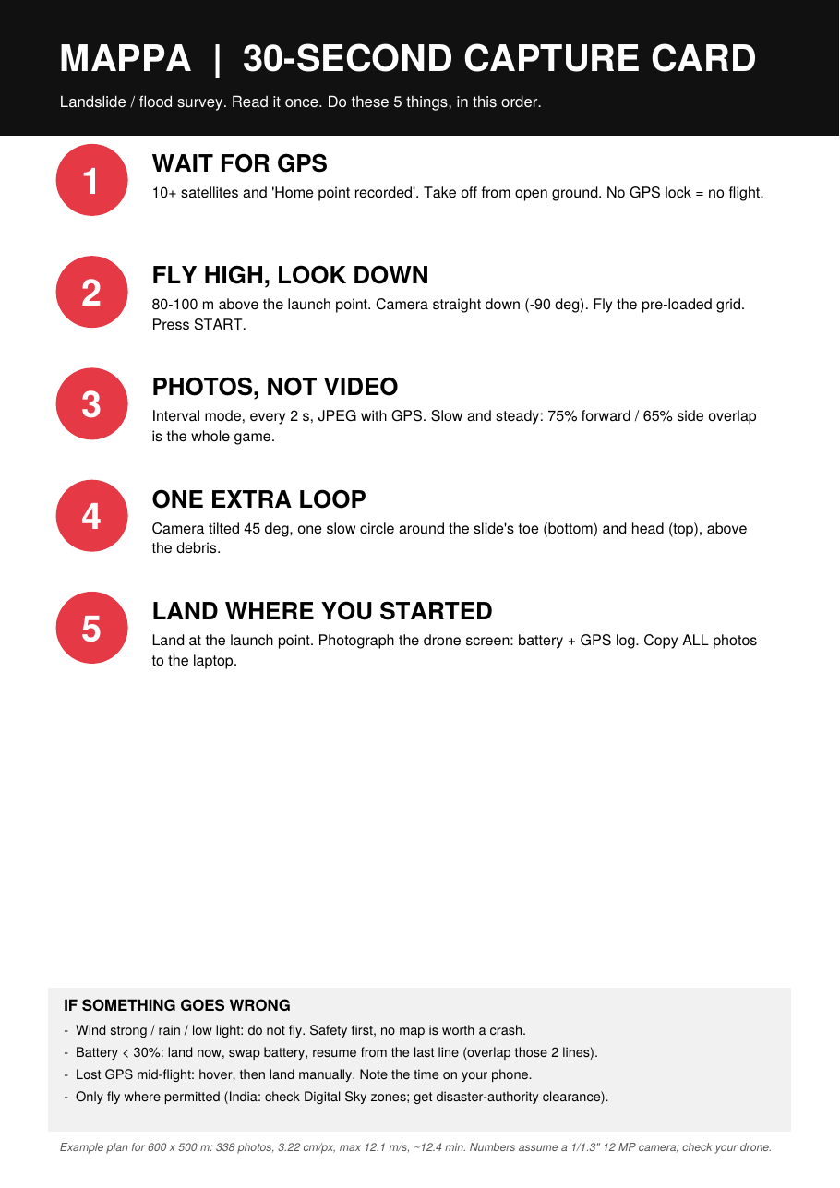
A capture card a stressed pilot can follow
1
Wait for GPS lock
10+ satellites, home point recorded.
2
80–100 m, camera down
Fly the pre-loaded KML grid.
3
Photos, not video
Every 2 s, 75% forward / 65% side overlap.
4
One oblique loop
45° around the slide toe and head.
5
Land at launch point
Photograph the screen. Copy every photo.
Planner: mappa plan gives GSD, speed and image count, and writes the lawnmower KML. Example 600 × 500 m at 90 m: 338 photos, 3.2 cm/px (assumed 1/1.3" 12 MP camera).
Notes:
The card has five rules. GPS lock, high and straight down, interval photos with high overlap, one oblique loop, land at launch. A KML survey grid can be pre-loaded so the pilot only presses start. Flying only where permitted.

Slide 5
Georeferencing without GCPs, with the error stated
1
Start from camera GPS
±10 m
Stated absolute accuracy, 95%. Limited by the 10 m base layer. Unverified against ground truth.
ODM places the ortho using EXIF only. Typically metres off.
2
Register to base imagery
5.7 → 0.14 m
Mean error before → after, on a synthetic scene with a known injected GPS error (25 check points).
SIFT features, RANSAC similarity, applied to the geotransform. Pixels are not resampled.
3
State the bound
acc95 = √(base² + (2·RMS)²), printed on every output.
0.3–2.7 m
Error after correction across 12 synthetic runs (10 m and 20 m base layers).
Synthetic results show the method works. They are not a field accuracy claim.
Notes:
Absolute accuracy ends up bounded by the base layer, not by our matching. For Sentinel-2 that is of the order of ten metres, so we state plus or minus ten metres at 95 percent, unverified. The synthetic test injects a known 5.7 metre error and recovers it to 0.14 metres on average. We label this clearly as synthetic.

Slide 6
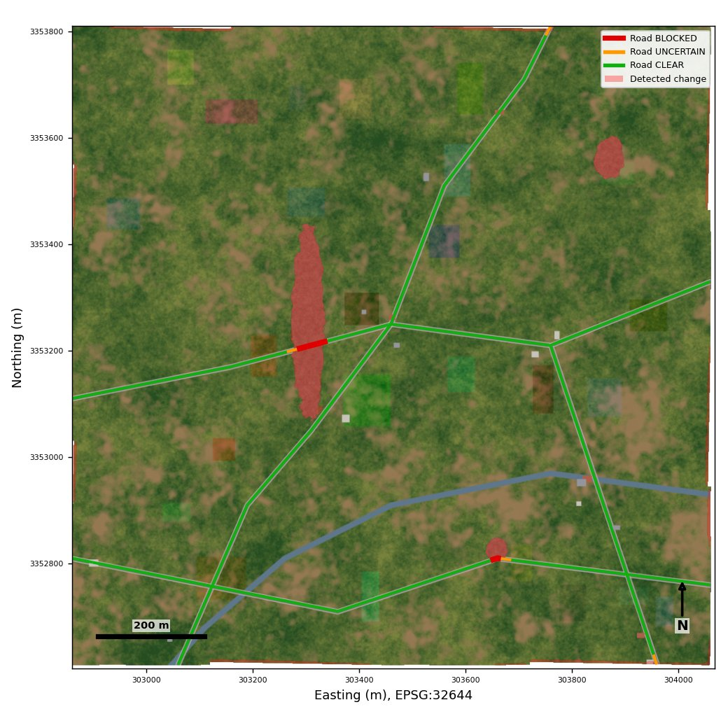
What changed, and which roads are blocked
BLOCKED
≥ 40% of the road buffer changed AND height anomaly ≥ 0.5 m
UNCERTAIN
≥ 15% changed, no height confirmation
CLEAR
Little or no change
Change = colour difference after radiometric normalisation, plus DSM−DEM height with the vertical bias removed. Roads: 20 m segments, 5 m buffer. Thresholds are tunable and not field-calibrated.
SIMULATED DEMO SCENE
Notes:
Change detection compares the aligned orthophoto with the base image after radiometric normalisation, and uses a height anomaly from DSM minus DEM. Each road is split into twenty metre segments and buffered five metres. Red needs both a large changed share and a height anomaly.

Slide 7
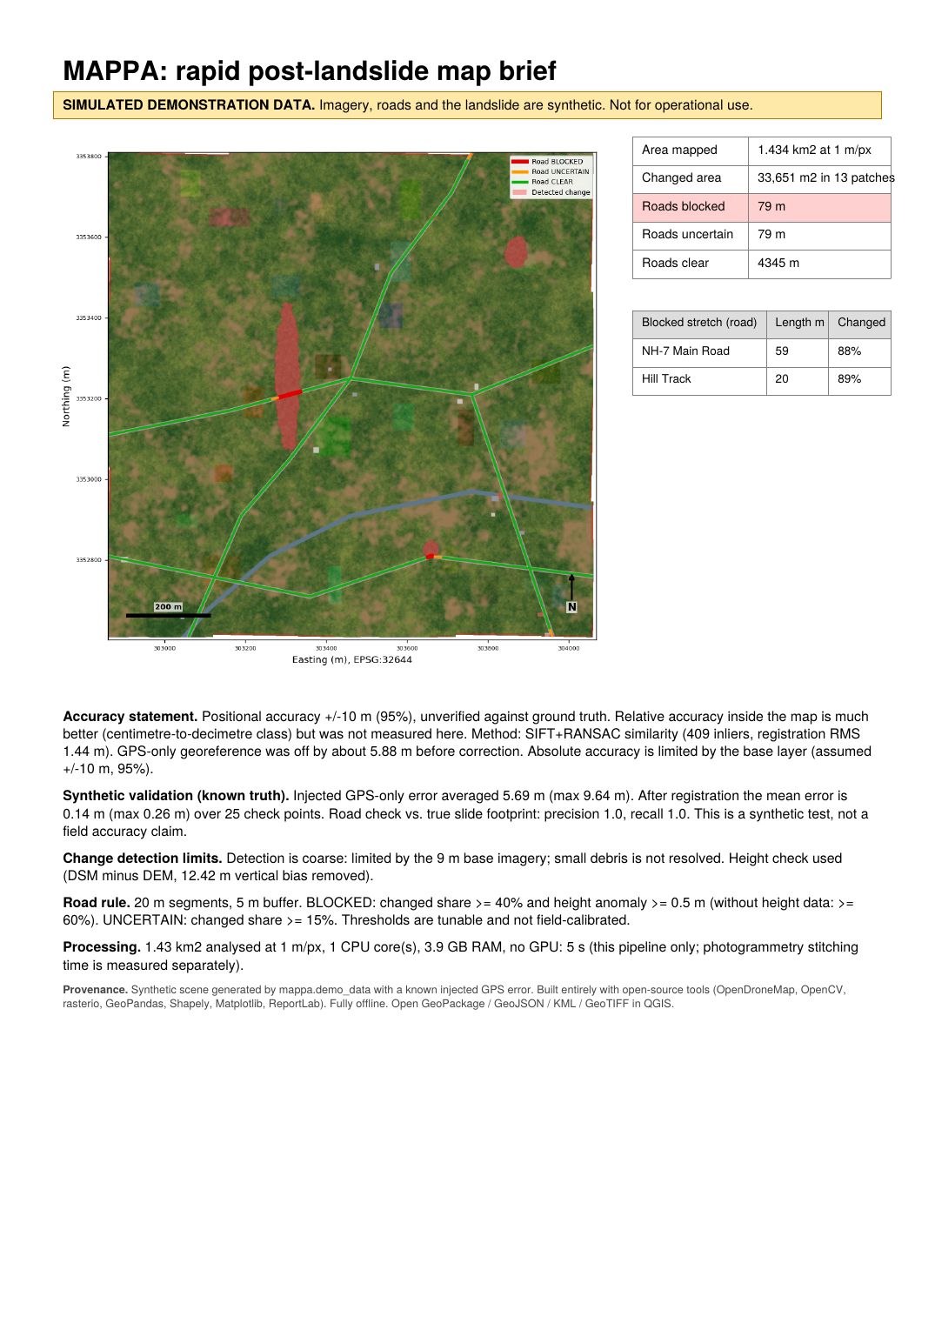
Result: a one-page brief responders can act on
79 m
Blocked road found: NH-7 Main Road 59 m, Hill Track 20 m
13
Change patches, 33,651 m², on a 1.43 km² scene
1.0 / 1.0
Road precision / recall vs known truth. Synthetic scene only.
Formats responders already open
GeoTIFF · GeoPackage · GeoJSON · KML · CSV · PDF. All 10 outputs re-opened by independent readers and verified.
Notes:
This is the PDF brief the pipeline writes. It carries a simulated-data banner, the accuracy statement and processing time. The perfect precision and recall are on a synthetic scene where we know the truth; they are not a field result.

Slide 8
Colour alone missed every blocked road
Why
Debris on a dirt road looks like the road. Height is the signal.
Impact
Precision stayed 1.0 with the cue. Colour-only gave false BLOCKED calls at a 20 m base.
Action
Always pre-cache a DEM and run ODM with --dsm.
Notes:
We ran 3 seeds at 10 and 20 metre base resolution, with and without the height cue. Colour alone found none of the debris-covered road. This is an honest finding that shaped the design: a DSM and DEM are required for a BLOCKED call. All synthetic.

Slide 9
Measured time, offline by design, all open source
5 s
Open-source stack
OpenDroneMap
stitching, orthophoto, DSM
1.43 km² at 1 m/px: register, change, roads, export, PDF. 1 CPU core, 3.9 GB RAM, no GPU.
OpenCV
SIFT, RANSAC registration
rasterio / GDAL
raster IO, reprojection
GeoPandas, Shapely
Stitching time: to be measured on the target laptop
road segments, vectors
OpenStreetMap, Sentinel-2, OAM, Copernicus DEM
The 5 s excludes OpenDroneMap. scripts/run_odm.sh prints images, seconds and cores to quote. ODM was not run in the build environment (no Docker).
base data
Matplotlib, ReportLab, QGIS
brief, map, viewing
Notes:
The five second figure is the MAPPA pipeline only, on one core with no GPU. OpenDroneMap stitching time is separate and must be measured on the target laptop with the provided script. The package has no network imports; internet is only used for pre-caching base data.

Slide 10
Honest limits, and what we do next
Limits
Next steps
Validated on a simulated scene only, not yet on a real landslide
Absolute accuracy is bounded by the base layer (about 10 m)
Change detection is coarse at 10 m base resolution
Thresholds are not field-calibrated; DSM−DEM also sees trees and buildings
Run ODM on OpenDroneMap sample sets and our own flight, and publish the measured time
Test on real OpenAerialMap post-disaster imagery
Calibrate thresholds against surveyed ground truth
Add MBTiles and a QGIS project
github.com/kavixsri/MAPPA · MIT licensed · runs offline
Notes:
We would rather be honest than impressive: the method works on controlled synthetic data, and the next step is real data and a measured ODM time. Everything is open source and the code is on GitHub.

