Slide 1
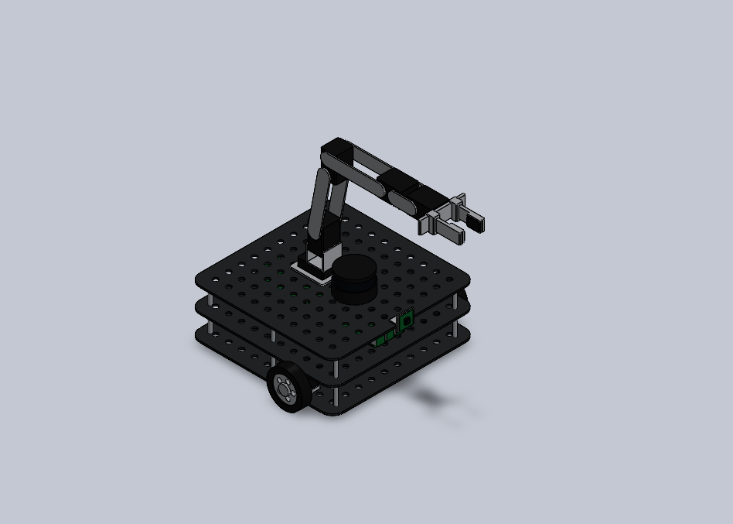
Motion Planning for a TurtleBot3 + OpenMANIPULATOR-X Mobile Manipulator
Comparison of RRT, RRT* and PRM
Subject: Robot Dynamic Control
Team: Kaviyashree T S, Barath K M, Jyothish S, Nabeeha Naaz H
Project review | 14 October 2026

Slide 2
Outline
• 1 Abstract
• 2 Background and objectives
• 3 Literature review, research gap and novelty
• 4 Methodology: architecture, equations, algorithms
• 5 Results: simulation of each algorithm and justification
• 6 Conclusion and future work
• 7 References
Motion Planning for a Mobile Manipulator | Project review, 14.10.2026
2

Slide 3
1. Abstract
• Goal: study three motion-planning algorithms (RRT, RRT*, PRM) on a mobile manipulator
• Built a parametric SolidWorks 2025 model (19 parts, 2 assemblies, gripper) and a ROS 2 Humble package from one spec file
• Wrote and simulated each algorithm on the arm; scene where the straight path is blocked; 10 runs each; all succeeded
• RRT: fastest (43 ms) but longest paths (4.32 rad)
• RRT*: best paths (2.83 rad, 18 % above the 2.40 rad lower bound) with a 10 s budget
• PRM: 10.7 s to build the roadmap, 3.64 rad paths, reusable
• Next: full MoveIt 2 + OMPL + Gazebo study
Motion Planning for a Mobile Manipulator | Project review, 14.10.2026
3

Slide 4
2. Background
• Mobile manipulation: drive to a place, then work on objects there
• TurtleBot3 Waffle Pi: differential drive, LDS-01 LiDAR, Raspberry Pi 4, OpenCR, camera
• OpenMANIPULATOR-X: 4-DOF arm + gripper, DYNAMIXEL XM430-W210 servos
• The arm needs collision-free paths in joint space, and the search space grows with every joint
• Sampling-based planners in OMPL / MoveIt 2 are the usual answer
Motion Planning for a Mobile Manipulator | Project review, 14.10.2026
4

Slide 5
2. Problem statement and objectives
• Build a parametric SolidWorks 2025 model of the TurtleBot3 Waffle Pi with the OpenMANIPULATOR-X, including working revolute joints and a two-finger gripper.
• Export it as a STEP file and as a ROS 2 Humble description package (URDF, xacro, STL meshes, RViz launch).
• Check that the kinematics, joint limits and inertial values match the official ROBOTIS model.
• Explain RRT, RRT* and PRM mathematically, simulate each one on the robot and justify its behaviour.
• Compare the three on planning time, path length, success rate and node count.
• Get the package ready for the MoveIt 2 + OMPL + Gazebo comparison.
Motion Planning for a Mobile Manipulator | Project review, 14.10.2026
5

Slide 6
3. Literature review (1/3)
Title | Key findings | Limitations / Research gap
LaValle (1998) Rapidly-exploring random trees: a new tool for path planning [1] | Introduced RRT: a tree grown by sampling random states and extending the nearest node. Probabilistically complete, works in high-dimensional spaces, very quick to a first path. | Paths are jagged and not optimal; behaviour depends on step size and distance metric.
Kavraki et al. (1996) Probabilistic roadmaps for path planning in high-dimensional configuration spaces [2] | Introduced PRM: build a roadmap of free configurations once, then answer many queries by graph search. Good for static scenes and many goals. | Roadmap construction is costly; narrow passages are hard; roadmap must be rebuilt if obstacles move.
Kuffner & LaValle (2000) RRT-Connect: an efficient approach to single-query path planning [4] | Grows two trees (from start and goal) that try to connect greedily; much faster than basic RRT on manipulator-type problems. | Still not optimal, so paths need post-smoothing; only for problems where two states can be connected directly.
Karaman & Frazzoli (2011) Sampling-based algorithms for optimal motion planning [3] | Showed that RRT and PRM are not asymptotically optimal; proposed RRT* and PRM*, which converge to the optimal path with the same asymptotic complexity. | Convergence can be slow in higher dimensions; extra cost per sample from neighbour search and rewiring; radius needs tuning.
Motion Planning for a Mobile Manipulator | Project review, 14.10.2026
6

Slide 7
3. Literature review (2/3)
Title | Key findings | Limitations / Research gap
Gammell et al. (2014) Informed RRT* [13] | After the first solution, samples only inside an ellipsoid that can still improve it, so the path converges faster than RRT*. | Needs a first solution; advantage shrinks as dimension grows; assumes a simple distance-based cost.
Sucan et al. (2012) The Open Motion Planning Library [5] | Common C++ interface to many planners (RRT, RRT*, PRM and more) with benchmarking tools; it is the planning back-end of MoveIt. | Generic library: results depend on the robot model, collision checker and parameters chosen by the user.
Chitta et al. (2012) MoveIt! [6] | Brings kinematics, collision checking, planning and execution together for manipulators in ROS. | Needs per-robot configuration; arm-centred, so planning base and arm together takes extra set-up.
Motion Planning for a Mobile Manipulator | Project review, 14.10.2026
7

Slide 8
3. Literature review (3/3)
Title | Key findings | Limitations / Research gap
Macenski et al. (2022) Robot Operating System 2 [7] | Describes ROS 2 design: DDS communication, real-time support, multi-robot use and security. | General framework with no manipulation-specific planning comparison.
Koenig & Howard (2004) Design and use paradigms for Gazebo [8] | Open-source simulator with physics and sensor models, widely used to test robots before hardware. | Simulation-to-real gap; results are only as good as the URDF, inertia and friction values supplied.
ROBOTIS (e-Manual, GitHub) [11], [12] turtlebot3_manipulation | Official URDF, MoveIt configuration and Gazebo files for the TurtleBot3 + OpenMANIPULATOR-X. | No editable parametric CAD source and no planner comparison; meshes are fixed.
Motion Planning for a Mobile Manipulator | Project review, 14.10.2026
8

Slide 9
3. Research gap
• Many planner studies use fixed-base industrial arms rather than a small ROS 2 mobile manipulator.
• Papers compare algorithms in general, but give no editable CAD-to-URDF model of the TurtleBot3 + OpenMANIPULATOR-X to repeat the study on.
• The official ROBOTIS package gives the model and a working MoveIt setup, but no side-by-side RRT / RRT* / PRM comparison and no parametric CAD.
• RRT, RRT* and PRM are often explained through theory and generic benchmarks; we also show each one running on the same robot with the same metrics.
Motion Planning for a Mobile Manipulator | Project review, 14.10.2026
9

Slide 10
3. Novelty of this work
• One specification file (robot_spec.py) generates both the SolidWorks model and the URDF, so geometry and kinematics cannot drift apart. Changing one parameter, e.g. forearm length, updates the CAD and the simulation model together.
• A fully parametric SolidWorks 2025 model of the TurtleBot3 Waffle Pi + OpenMANIPULATOR-X (19 parts, working joint mates, two-finger gripper) with a drop-in ROS 2 package for MoveIt 2 and Gazebo.
• A like-for-like comparison of RRT, RRT* and PRM on this robot: same kinematics, same collision model, same start/goal and same metrics, with a simulation and a written justification for each algorithm.
• A reproducible benchmark script that the team can re-run, and a clear path to repeat the same study in MoveIt 2 / OMPL / Gazebo.
To the best of our knowledge, based on the sources reviewed.
Motion Planning for a Mobile Manipulator | Project review, 14.10.2026
10

Slide 11
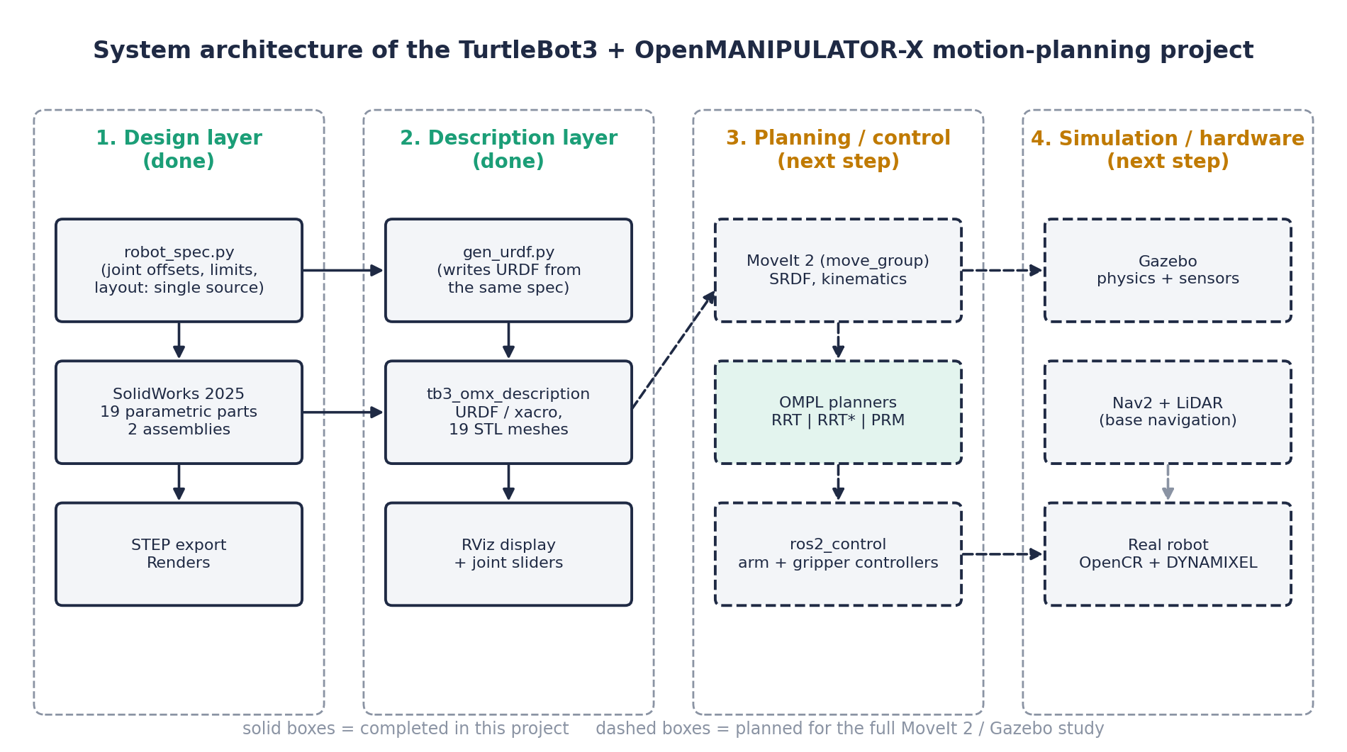
4. System architecture
Motion Planning for a Mobile Manipulator | Project review, 14.10.2026
11

Slide 12
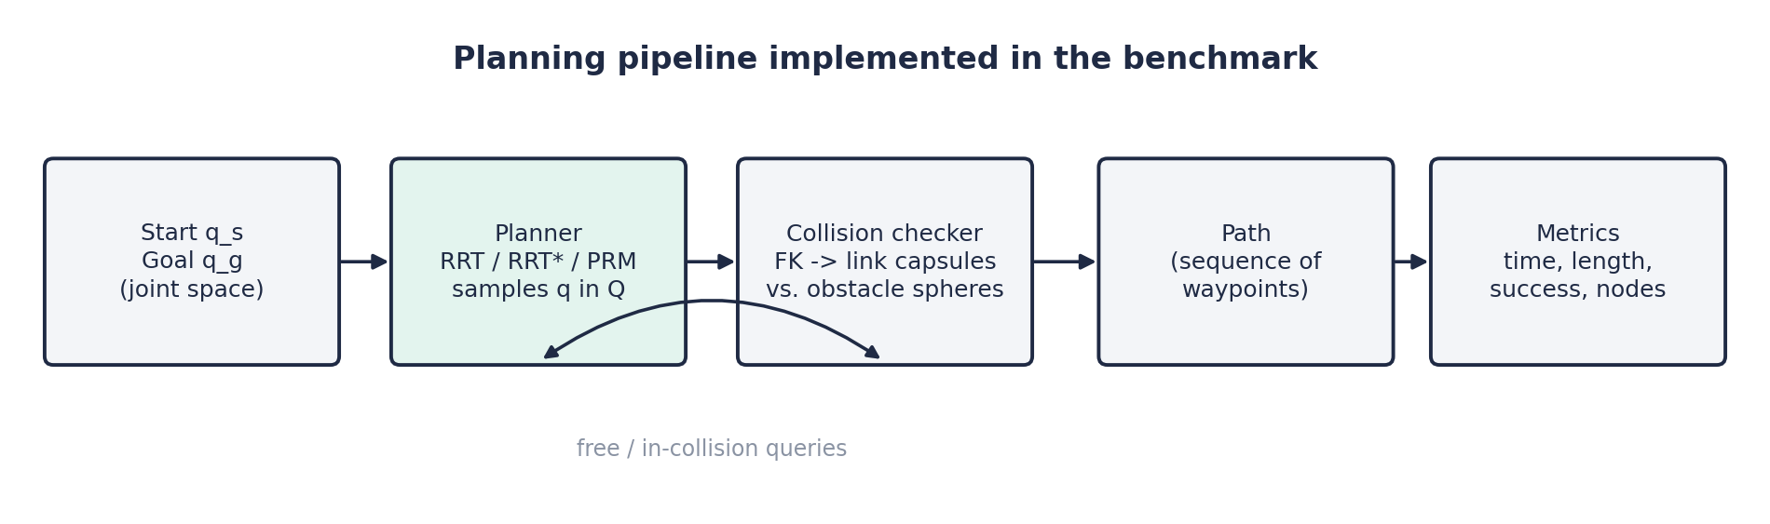
4. Planning pipeline used in the benchmark
• Collision checker: forward kinematics -> link capsules (r = 25 mm) vs obstacle spheres
• Metrics: success, time to first solution, joint-space path length, node count
Motion Planning for a Mobile Manipulator | Project review, 14.10.2026
12

Slide 13
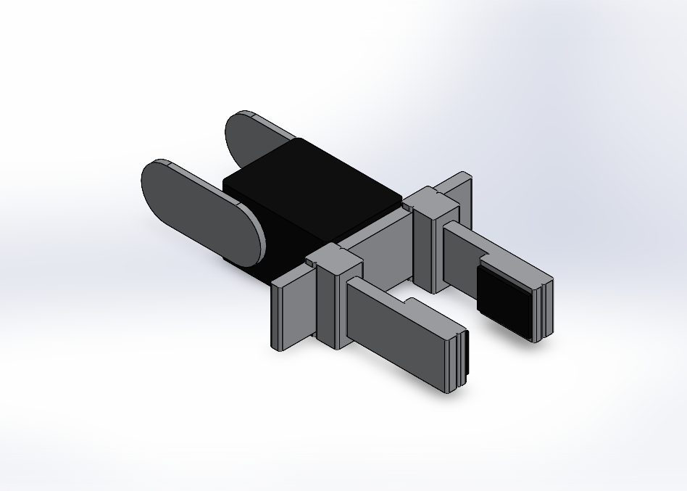
4. Methodology: CAD and ROS 2 model
• 19 parametric parts: TB01-TB13 (TurtleBot3), OM01-OM06 (arm)
• Dimensions tied to Global Variables, e.g. J3_Z, J4_X, Hole_P, Tire_D
• Joints 1-4: real revolute mates; fingers: slider mates (6-64 mm opening)
• URDF generated from the same spec file, so CAD and URDF stay in step
• Same link / joint names as the official package
Motion Planning for a Mobile Manipulator | Project review, 14.10.2026
13

Slide 14
4. Kinematic chain
Joint | Parent -> child | Origin (m) | Axis | Limits
base_fixed | base_link -> link1 | (-0.092, 0, 0.091) | - | fixed
joint1 | link1 -> link2 | (0.012, 0, 0.017) | z | +/-0.9 pi
joint2 | link2 -> link3 | (0, 0, 0.0595) | y | -0.57 pi ... 0.5 pi
joint3 | link3 -> link4 | (0.024, 0, 0.128) | y | -0.3 pi ... 0.44 pi
joint4 | link4 -> link5 | (0.124, 0, 0) | y | -0.57 pi ... 0.65 pi
gripper_left/right | link5 -> finger | (0.0817, +/-0.021, 0) | +/-y | -0.010 ... 0.019 m
end_effector_joint | link5 -> tool | (0.126, 0, 0) | - | fixed
wheel_left/right | base_link -> wheel | (0, +/-0.144, 0.023) | z | continuous
Same as turtlebot3_manipulation_description (ROS 2 Humble); checked automatically.
Motion Planning for a Mobile Manipulator | Project review, 14.10.2026
14

Slide 15
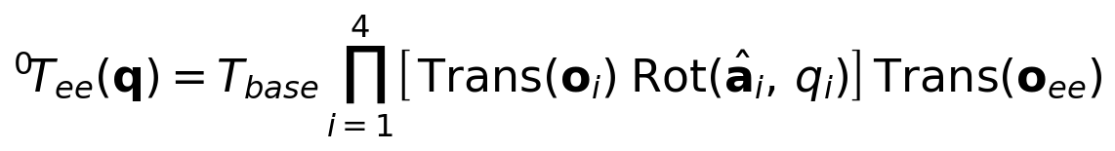
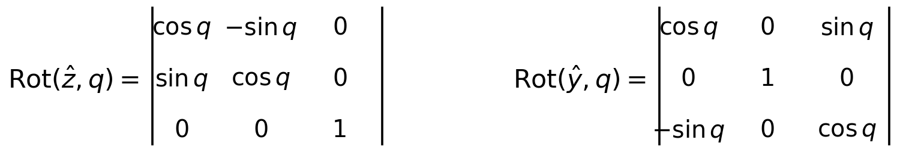
4. Equations (1/4): kinematics and free space
Forward kinematics
Joint rotations
Free configuration space
Motion Planning for a Mobile Manipulator | Project review, 14.10.2026
15

Slide 16
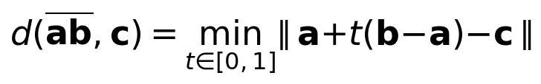
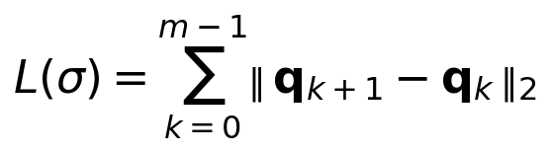
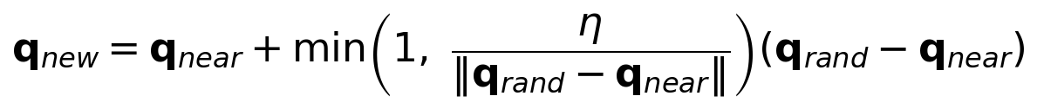
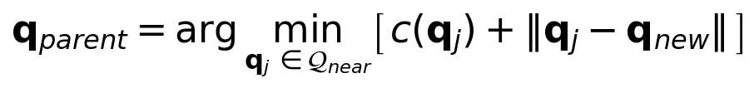
4. Equations (2/4): collision, cost and RRT
Point-to-segment distance (collision test)
Path length (cost)
RRT: extend towards a random sample
RRT*: choose the cheapest parent
Motion Planning for a Mobile Manipulator | Project review, 14.10.2026
16

Slide 17
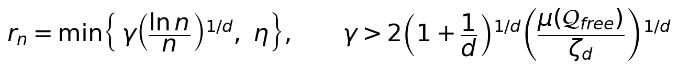

4. Equations (3/4): RRT* and PRM
RRT*: rewire neighbours
RRT*: neighbour radius
RRT*: asymptotic optimality
PRM: roadmap edges
Motion Planning for a Mobile Manipulator | Project review, 14.10.2026
17

Slide 18
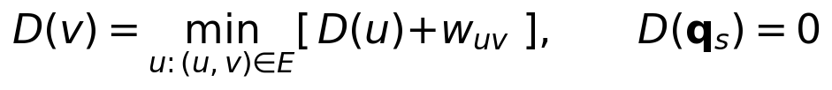

4. Equations (4/4): PRM query and dynamics
PRM: Dijkstra query
Manipulator dynamics (tracking the planned path)
Computed-torque control
Dynamics are shown for context; they are not simulated in this review.
Motion Planning for a Mobile Manipulator | Project review, 14.10.2026
18

Slide 19
4. The three algorithms
RRT
RRT*
PRM
• 1. Start the tree T with q_s.
• 2. Sample q_rand in the joint limits (with probability 0.1 take q_g instead).
• 3. Find the nearest node q_near in T and step towards q_rand to get q_new (Eq. 6).
• 4. If the segment q_near -> q_new is collision-free, add q_new to T.
• 5. If q_new can reach q_g, stop and read the path back through the parents.
• 1. Steps 1-3 as in RRT.
• 2. Collect the neighbours Q_near within radius r_n (Eq. 9).
• 3. Choose the parent that gives the lowest cost-to-come (Eq. 7).
• 4. Rewire: for each neighbour, if going through q_new is cheaper, make q_new its parent (Eq. 8).
• 5. Do not stop at the first solution; keep sampling until the time budget ends and keep the cheapest path.
• 1. Learning phase: sample N collision-free configurations (plus q_s and q_g).
• 2. Connect each node to its k nearest neighbours if the straight segment is free (Eq. 11).
• 3. Query phase: run Dijkstra from q_s to q_g over the roadmap (Eq. 12).
• 4. If no path exists, add more nodes and repeat.
Motion Planning for a Mobile Manipulator | Project review, 14.10.2026
19

Slide 20
4. Benchmark setup
• Python implementation of FK, capsule collision check and the three planners
• 3 spherical obstacles; straight line start-to-goal is blocked (checked), so a detour is required
• Start (-1.2, -0.2, 0.6, 0.3) to goal (1.2, -0.2, 0.6, 0.3) rad; lower bound 2.40 rad
• RRT: step 0.4 rad, 10 % goal bias, stop at first solution
• RRT*: same step, rewiring, 10 s budget
• PRM: 1500 nodes, k = 10, Dijkstra query
• 10 runs per planner; metrics: success, time, path length, nodes
Motion Planning for a Mobile Manipulator | Project review, 14.10.2026
20

Slide 21
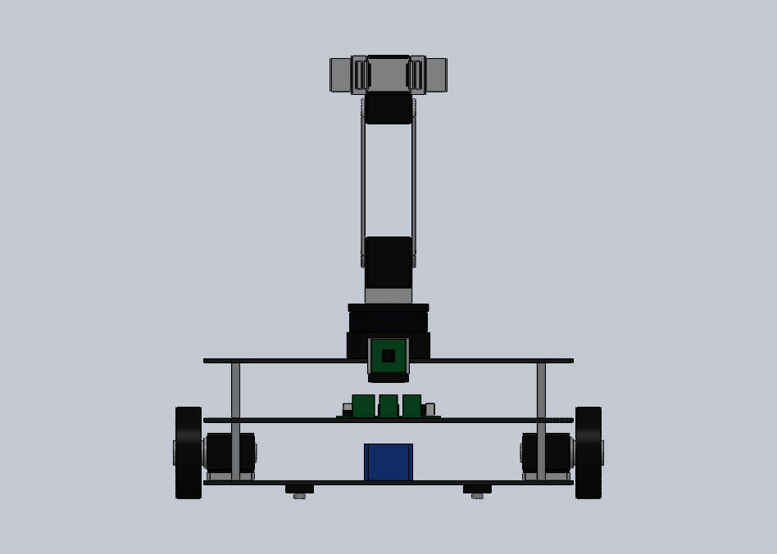
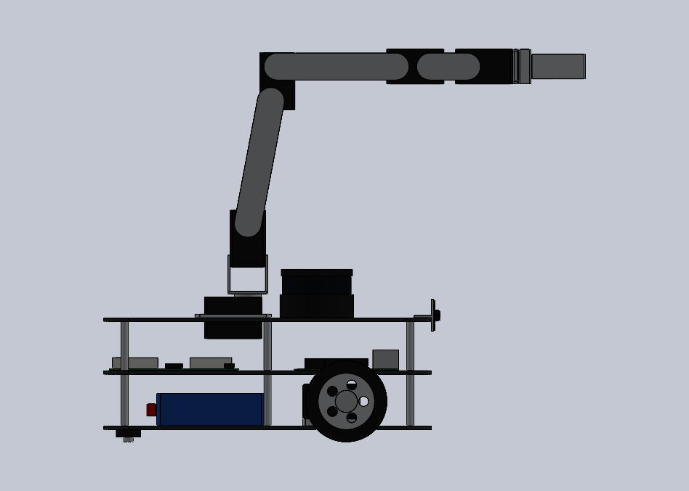
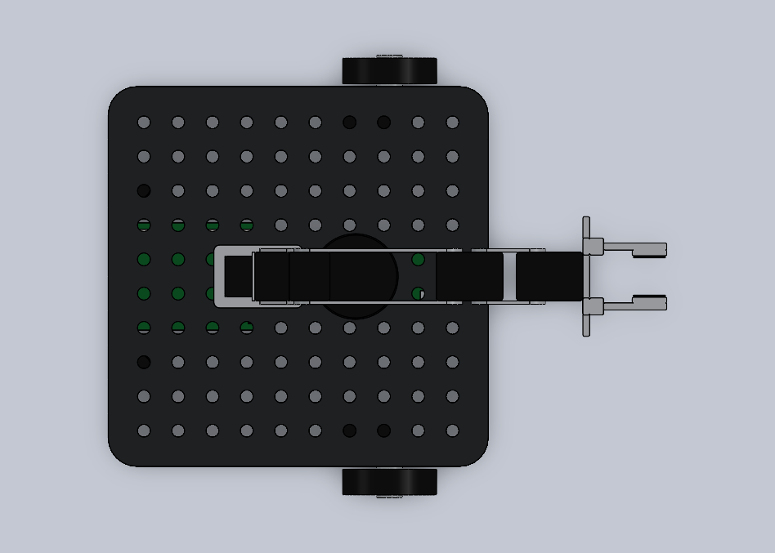
5. Results: CAD and ROS 2 package
• 19 parts, 2 assemblies, 1 STEP file, 19 STL meshes
• Standalone URDF (20 links, 19 joints) and a drop-in xacro for Gazebo / ros2_control
• RViz launch with joint sliders; MoveIt 2 and Nav2 configs work unchanged
Motion Planning for a Mobile Manipulator | Project review, 14.10.2026
21

Slide 22
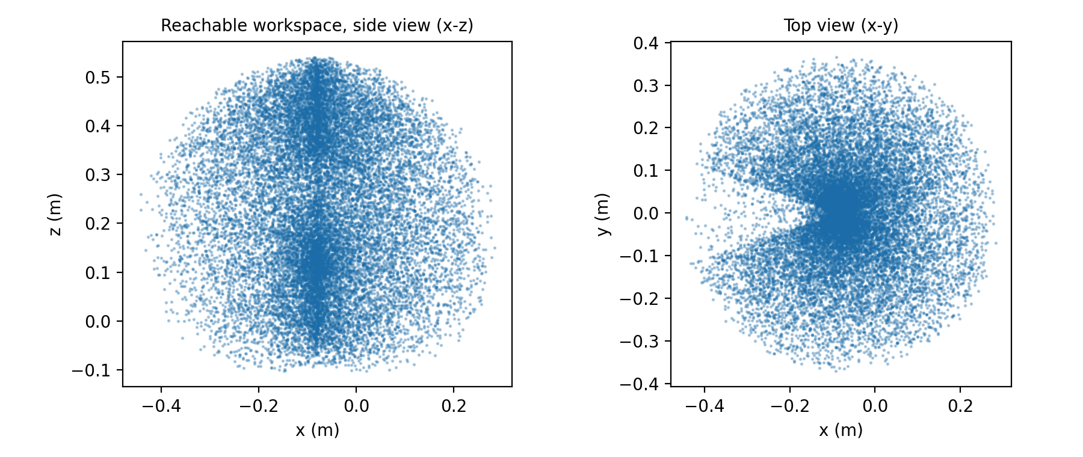
5. Results: arm workspace
• Max reach from arm base (link1): 45.0 cm
• Max height above floor: 55.1 cm
• Max forward reach: 28.3 cm from base_link
• 20 000 sampled configurations
Motion Planning for a Mobile Manipulator | Project review, 14.10.2026
22

Slide 23
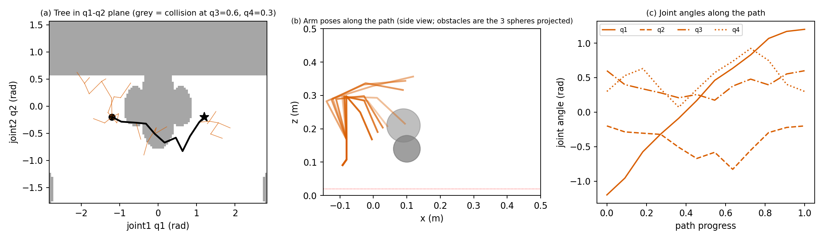
5. Simulation: RRT
• Tree of only 39 nodes in this run (43 ms on average over 10 runs)
• Path 4.32 +/- 0.54 rad: 80 % above the lower bound, jagged
• Why: it extends towards the nearest node and stops at the first connection, so it is fast but never improves the path
Motion Planning for a Mobile Manipulator | Project review, 14.10.2026
23

Slide 24
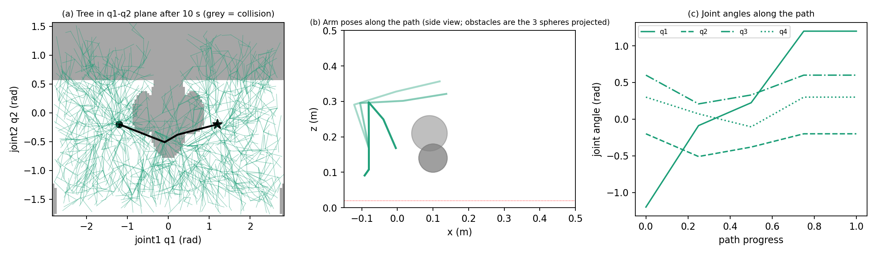
5. Simulation: RRT*
• About 1661 nodes after 10 s; first path after 87 ms
• Path 2.83 +/- 0.28 rad: only 18 % above the lower bound, smooth
• Why: best-parent choice and rewiring remove detours; cost is paid in computation (tree about 46x larger than RRT)
Motion Planning for a Mobile Manipulator | Project review, 14.10.2026
24

Slide 25
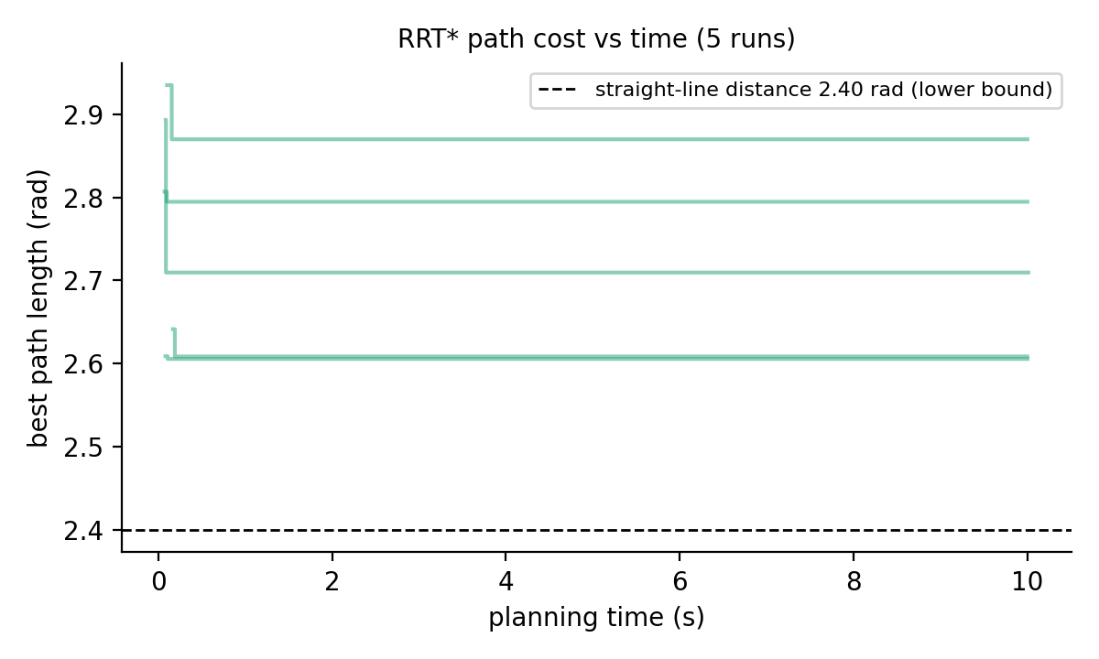
5. RRT* improves with time
• Each curve starts at the first path and steps down as rewiring finds shorter routes
• The straight line (2.40 rad) is blocked, so the true optimum is above it
• Can be stopped at any time and still returns a valid path
Motion Planning for a Mobile Manipulator | Project review, 14.10.2026
25

Slide 26
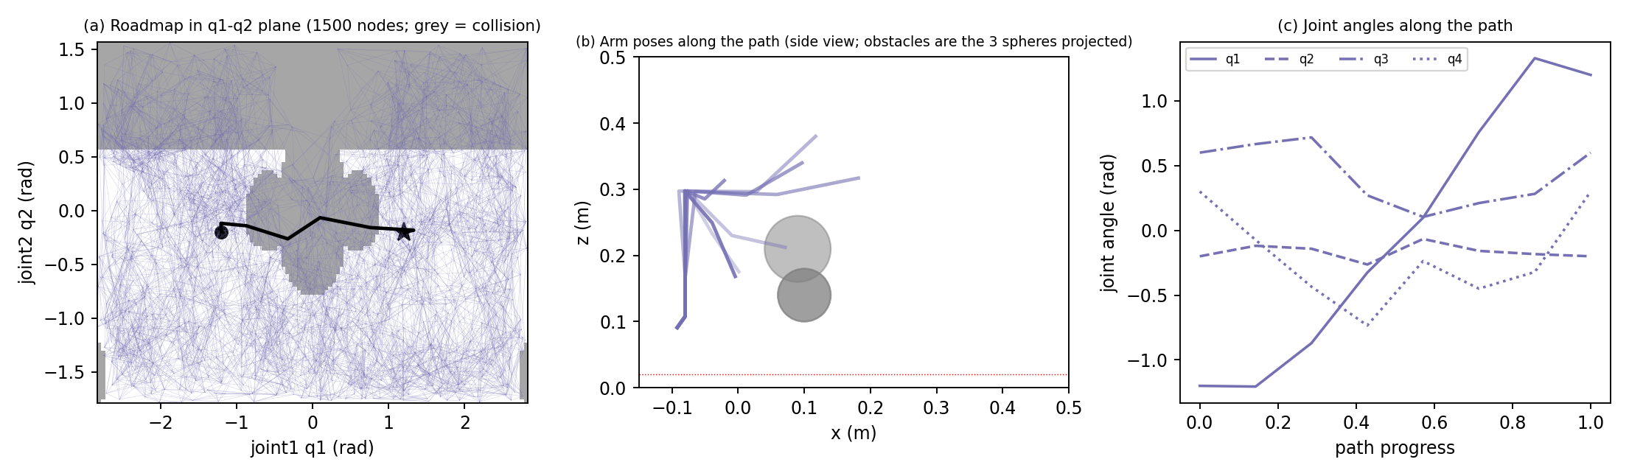
5. Simulation: PRM
• 1500 nodes, 7417 edges in this run; 10.7 s to build, then a graph search
• Path 3.64 +/- 0.27 rad: limited to roadmap edges
• Why: effort is spent up front; later queries in the same static scene are almost free
Motion Planning for a Mobile Manipulator | Project review, 14.10.2026
26

Slide 27
5. PRM: effect of roadmap size
Nodes N | Success | Build + query (s) | Mean path length (rad)
100 | 10/10 | 1.4 | 4.13
250 | 10/10 | 2.7 | 4.22
500 | 10/10 | 4.5 | 3.81
1000 | 10/10 | 7.5 | 3.50
1500 | 10/10 | 10.7 | 3.64
• Build time rises steadily with N
• Path length tends to fall as N grows, but neighbouring sizes differ by less than the run-to-run spread (about 0.27 rad)
• All sizes solved the problem 10/10
Motion Planning for a Mobile Manipulator | Project review, 14.10.2026
27

Slide 28
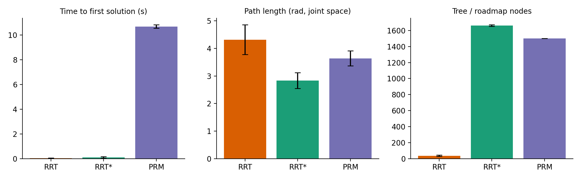
5. Results: comparison
Algorithm | Success | First solution (ms) | Path length (rad) | Above lower bound | Nodes
RRT | 10/10 | 43 | 4.32 | 80 % | 36
RRT* | 10/10 | 87 | 2.83 | 18 % | 1661
PRM | 10/10 | 10694 | 3.64 | 52 % | 1500
• RRT: fastest
• RRT*: shortest, most repeatable
• PRM: slow build, reusable
Our own Python implementation (not OMPL); mean of 10 runs. PRM time = roadmap build + query.
Motion Planning for a Mobile Manipulator | Project review, 14.10.2026
28

Slide 29
5. Justification: which algorithm when?
Algorithm | Best used when | Trade-off
RRT | One-off motion, need an answer fast | Paths long and jagged; no improvement
RRT* | One-off motion, path quality matters; default for this robot | Uses full time budget; larger tree
PRM | Repeated moves in a fixed scene (workstation) | Slow first query; rebuild if obstacles move
• Mobile manipulator arrives at new places, so the scene changes: RRT / RRT* fit best
• The MoveIt 2 study will test whether RRT* stays the best default
Motion Planning for a Mobile Manipulator | Project review, 14.10.2026
29

Slide 30
5. Limitations
• Simple scene (3 spheres); fixed base; no self-collision, gripper fingers or mesh collision
• Our own Python planners, not OMPL: times not comparable with MoveIt
• 10 runs per planner: rough picture of the spread
• Dynamics shown as equations only, not simulated
• So: repeat in MoveIt 2 + OMPL + Gazebo
Motion Planning for a Mobile Manipulator | Project review, 14.10.2026
30

Slide 31
6. Conclusion and future work
• Delivered: parametric CAD + ROS 2 model whose kinematics match the official robot
• Simulated and justified RRT, RRT* and PRM on it: RRT quickest, RRT* best paths, PRM reusable
• Next: MoveIt 2 + OMPL + Gazebo (RRTkConfigDefault, RRTstarkConfigDefault, PRMkConfigDefault)
• Next: RRT-Connect, Informed RRT*, arm dynamics with computed-torque control, base + arm planning, real-robot pick-and-place
Motion Planning for a Mobile Manipulator | Project review, 14.10.2026
31

Slide 32
7. References
[1] S. M. LaValle, "Rapidly-exploring random trees: A new tool for path planning," Tech. Rep. TR 98-11, Computer Science Dept., Iowa State University, 1998.
[2] L. E. Kavraki, P. Svestka, J.-C. Latombe and M. H. Overmars, "Probabilistic roadmaps for path planning in high-dimensional configuration spaces," IEEE Trans. Robotics and Automation, vol. 12, no. 4, pp. 566-580, 1996.
[3] S. Karaman and E. Frazzoli, "Sampling-based algorithms for optimal motion planning," Int. J. Robotics Research, vol. 30, no. 7, pp. 846-894, 2011.
[4] J. J. Kuffner and S. M. LaValle, "RRT-Connect: An efficient approach to single-query path planning," Proc. IEEE ICRA, pp. 995-1001, 2000.
[5] I. A. Sucan, M. Moll and L. E. Kavraki, "The Open Motion Planning Library," IEEE Robotics & Automation Magazine, vol. 19, no. 4, pp. 72-82, 2012.
[6] S. Chitta, I. Sucan and S. Cousins, "MoveIt!," IEEE Robotics & Automation Magazine, vol. 19, no. 1, pp. 18-19, 2012.
[7] S. Macenski, T. Foote, B. Gerkey, C. Lalancette and W. Woodall, "Robot Operating System 2: Design, architecture, and uses in the wild," Science Robotics, vol. 7, no. 66, 2022.
[8] N. Koenig and A. Howard, "Design and use paradigms for Gazebo, an open-source multi-robot simulator," Proc. IEEE/RSJ IROS, pp. 2149-2154, 2004.
[9] S. Macenski, F. Martin, R. White and J. G. Clavero, "The Marathon 2: A Navigation System," Proc. IEEE/RSJ IROS, 2020.
[10] B. Siciliano, L. Sciavicco, L. Villani and G. Oriolo, Robotics: Modelling, Planning and Control. Springer, 2009.
[11] ROBOTIS Co., Ltd., "TurtleBot3 and OpenMANIPULATOR-X e-Manual," https://emanual.robotis.com (accessed 2026).
[12] ROBOTIS-GIT, "turtlebot3_manipulation" (ROS 2 Humble branch), https://github.com/ROBOTIS-GIT/turtlebot3_manipulation.
[13] J. D. Gammell, S. S. Srinivasa and T. D. Barfoot, "Informed RRT*: Optimal sampling-based path planning focused via direct sampling of an admissible ellipsoidal heuristic," Proc. IEEE/RSJ IROS, pp. 2997-3004, 2014.
Motion Planning for a Mobile Manipulator | Project review, 14.10.2026
32

Slide 33
Thank you
Thank you | Questions?
Motion Planning for a Mobile Manipulator | Project review, 14.10.2026
33

