Slide 1
Digital Portfolio
STUDENT NAME: G.KAVIYA
REGISTER NO AND NMID: 24132011802522042
asanm201224132011802522042
DEPARTMENT: BSC COMPUTER SCIENCE
COLLEGE: ARIGNAR ANNA GOVERNMENT ARTS COLLEGE VILLUPURAM , ANNAMALAI UNIVERSITY.

Slide 2
PROJECT TITLE
DIGITAL PORTFOLIO

Slide 3


AGENDA
Problem Statement
Project Overview
End Users
Tools and Technologies
Portfolio design and Layout
Features and Functionality
Results and Screenshots
Conclusion
Github Link
3/21/2024 Annual Review

Slide 4

PROBLEM STATEMENT
A digital portfolio provides a central, easy-to-access platform to showcase skills,
achievements, and projects. It replaces traditional resumes, making profiles interactive,
updatable, and shareable to support education, career growth, and personal branding.

Slide 5

PROJECT OVERVIEW
A digital portfolio is an online platform to display a person’s skills, achievements, and work in an organized and visually appealing way. It helps create a strong personal brand and makes sharing credentials easy for career or academic opportunities.

Slide 6

WHO ARE THE END USERS?
Students, job seekers, freelancers, professionals, and educators who want to showcase skills and achievements online.

Slide 7
TOOLS AND TECHNIQUES
HTML, CSS, JavaScript, frameworks (React/Angular), graphic design tools (Canva/Figma), hosting platforms, and responsive design techniques.

Slide 8
POTFOLIO DESIGN AND LAYOUT
Clean, responsive design with sections for profile, skills, projects, achievements, and contact details.
8

Slide 9
FEATURES AND FUNCTIONALITY
Interactive UI, easy navigation, responsive design, media integration,
contact forms, and downloadable resume.

Slide 10
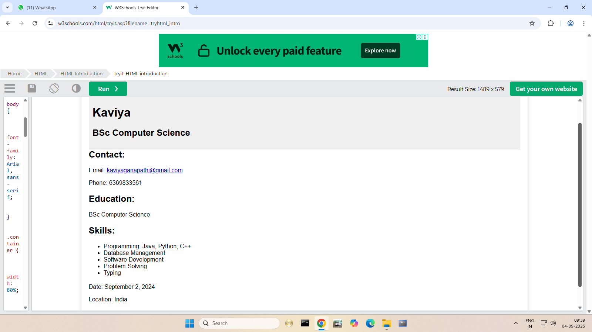
RESULTS AND SCREENSHOTS
A professional, easy-to-share online
portfolio showcasing skills, projects, and
achievements effectively.
3/21/2024 Annual Review
10

Slide 11
CONCLUSION
A digital portfolio is an effective way to present skills and achievements, enhancing career and academic opportunities.
11

