Slide 1

School of Computer Science and Engineering
Internship Review - Presentation
BCSE399J (Summer Industrial Internship)/
CBS1902/CSE1902/ CSI3903 (Industrial Internship)
FALL SEMESTER 2026-27
Type of Intern: Industry offline
Title of Intern: Data & AI Intern
Internship completed at : BPO Integra India Private Limited, Chennai
Registered office: 428/3, 1st Floor, Kanapathy Towers, Sathy Road, Ganapathy, Coimbatore 641006,
Tamil Nadu, India · Phone +91 422 4328555
Duration : 47 days : 15 May 2026 to 30 June 2026
Date of Presentation: 16-10-2026
by
SHARAN K
23BDS1153
Notes:
Good morning. I'm Sharan K. I did my industry internship as a Data and AI intern at BPO Integra India in Chennai, from 15 May to 30 June 2026: 47 days, on two assignments.

Slide 2
Contents (Industry)
Outline slide
Introduction
Aim, objectives and motivation
About the industry: BPO Integra India Private Limited
Certificate (period of study: 15 May to 30 June 2026)
Skills acquired during the industrial internship
New technologies, frameworks, real-time problems and analysis: Project I (floor-plan input processing) and Project II (Operations Intelligence Platform)
Conclusion (brief summary)
Notes:
The talk follows the department's outline: introduction, aims, the company, the certificate, skills, then the two projects, and a short conclusion.

Slide 3
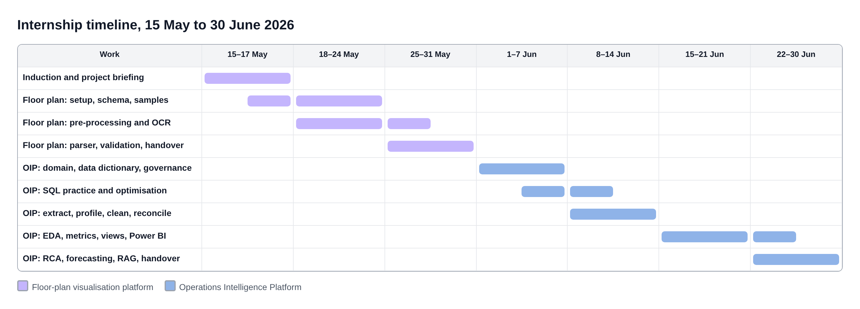
Introduction
ROLE
ORGANISATION
PERIOD
SUPERVISION
Data & AI Intern
Intern ID IGS1022
BPO Integra India
Private Limited, Chennai
15 May to 30 June 2026
47 days
Project guide (Project I)
Mentor (Project II)
Two assignments
Project I, 15 to 30 May: the input stage of a 2D floor plan to 3D interior platform.
Project II, 1 to 30 June: the Operations Intelligence Platform, the analytics system for the delivery operations.
Every date on this timeline comes from my daily activity log.
Notes:
I was a Data and AI intern for 47 days. For the first two weeks I worked on the input stage of a floor-plan-to-3D interior platform under a project guide. From 1 June I moved to the Operations Intelligence Platform under a mentor. The timeline is taken straight from my daily log.

Slide 4
Aim, Objectives and Motivation
Aim
Objectives
Motivation
Apply data engineering, analytics and AI to real operational problems inside a production team, and hand over reviewed, working components.
Understand how a production data and AI system is organised
Learn the contact-centre domain well enough to define metrics correctly
Build skill in SQL, Python, Power BI, machine learning and RAG
Follow professional practice: approvals, reviews, handovers
Deliver scripts, queries, a cleaning pipeline and a dashboard page
A dimension misread at the input becomes a wrong 3D home: the geometry is locked after it is read
Contact-centre data comes from six systems and rarely agrees
Daily averages hide half-hour failures that clients still penalise
Notes:
The aim was to apply data and AI to real operational problems and hand over working components. The objectives were understanding the system, learning the domain, building skills, following professional practice and delivering. The motivation: in the floor-plan work an input error cannot be fixed later; in operations, data from six systems rarely agrees and daily averages hide the half-hour failures that clients penalise.

Slide 5
About the Industry
BPO Integra India Private Limited
A business process outsourcing company and NASSCOM member, with its registered office in Coimbatore and a delivery centre in Chennai, Tamil Nadu.
It runs customer service for clients in industries such as telecom, insurance, retail and banking.
The Data & AI team builds internal analytics and AI tools for delivery operations and prototypes for clients. I worked in this team.
Every intern signs a confidentiality undertaking and works on approved, masked data with read-only access.
Voice
Chat
Inbound and outbound calls through the dialler; judged on service level, e.g. 80% answered in 20 s
Concurrent chat sessions; service level in seconds, CSAT after each session
Email
Back office
Ticket queues answered within hours, e.g. 90% within 4 h
Case processing such as KYC checks, judged on turnaround time
Service lines covered in the induction (15 May) and the domain session (2 June)
Notes:
BPO Integra is a business process outsourcing company and a NASSCOM member, registered in Coimbatore with a delivery centre in Chennai. It runs voice, chat, email and back-office services for clients in telecom, insurance, retail and banking. I was in the Data and AI team, which builds analytics and AI tools for these operations.

Slide 6
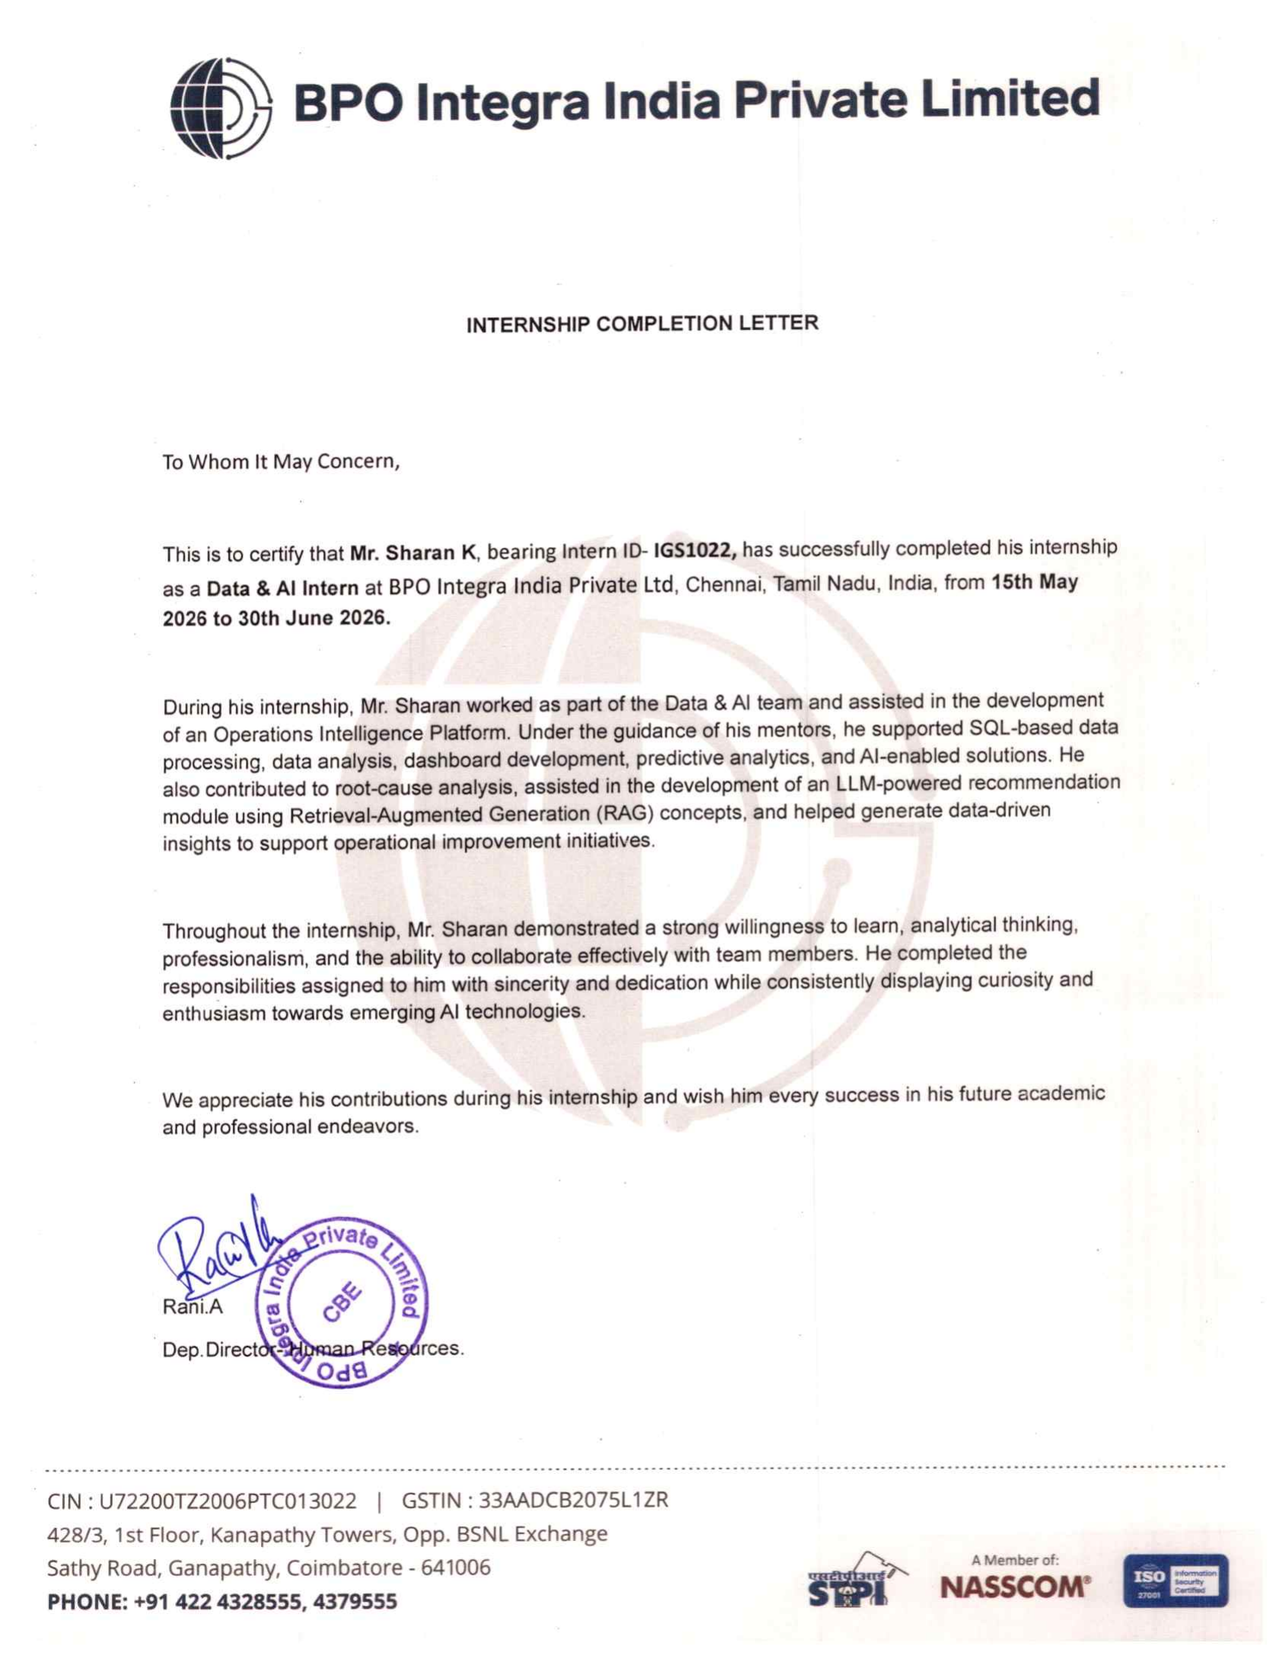
Certificate (Period of Study)
Item | Detail
Name | Sharan K
Intern ID | IGS1022
Role | Data & AI Intern
Organisation | BPO Integra India Private Limited, Chennai
Period of study | 15 May 2026 to 30 June 2026 (47 days)
Recognised work | Operations Intelligence Platform: SQL data processing, data analysis, dashboards, predictive analytics, root-cause analysis, LLM recommendation module (RAG)
Original internship completion letter and daily activity log available for verification.
Notes:
This is my internship completion letter. It confirms the period, 15 May to 30 June 2026, my intern ID, and the work: SQL processing, analysis, dashboards, predictive analytics, root-cause analysis and the RAG recommendation module. I have the original with me.

Slide 7
Skills Acquired During the Internship
SQL and data modelling
Python data processing
Power BI
Statistics and RCA
Joins and cardinality, CTEs, ROW_NUMBER, RANK, AVG OVER, execution plans, indexes, star schema
pandas and SQLAlchemy: profiling, imputation, mapping dictionaries, IQR outliers, reconciliation
Star-schema model, date table, Power Query, DAX with CALCULATE and time intelligence, slicers, RLS
Pareto analysis, hypothesis tests, change points, Erlang C queueing
Machine learning
Vision and OCR
LLMs and RAG
Engineering practice
Lag and calendar features, chronological split, baselines, random forest, MAE, RMSE, MAPE
OpenCV thresholding, deskew, morphology, Hough lines; Tesseract; regex parsing
Chunking, embeddings, vector store, BM25, retrieval evaluation, grounded prompts
Git branches, README handovers, FastAPI, automated tests
Professional skills Confidentiality and data approvals · reviews before changes · reporting observations to component owners · documentation and handover · requirements from team leaders
Notes:
Technically I learnt SQL to the level of window functions and execution plans, data processing in pandas, Power BI modelling and DAX, statistics for root-cause analysis, forecasting with proper validation, computer vision and OCR, and retrieval-augmented generation. Professionally I learnt to work under approvals, get reviews before changes and hand work over properly.

Slide 8
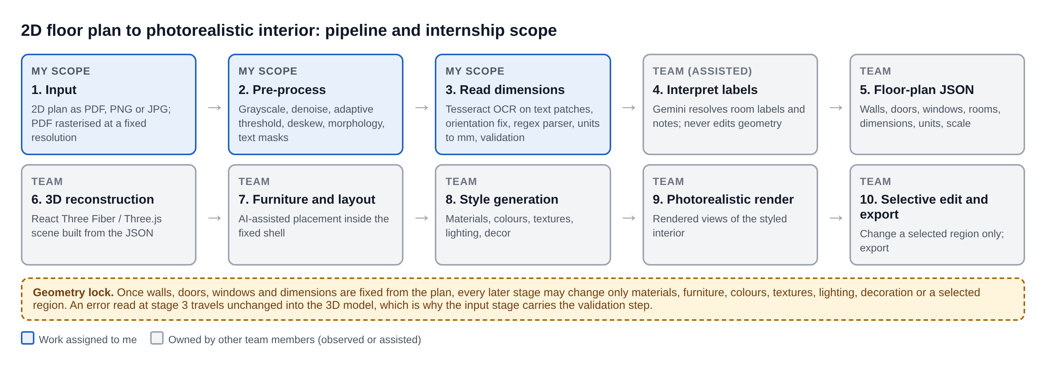
Project I: Floor Plan to 3D Interior
Notes:
The team's platform turns a 2D plan into an editable 3D interior. The central rule is geometry preservation: once walls, doors, windows and dimensions are read, later stages may only change materials, furniture, colours, lighting or a selected region. My scope was the first three stages, shown in blue.

Slide 9
Project I: Reading Dimensions Reliably
1 Pre-process
2 OCR
3 Parse
4 Validate
Grayscale, denoise, adaptive threshold
Deskew scanned plans
Morphology splits walls from text
Settings tuned per quality group
Baseline on 10 plans first
Failures grouped: rotated, small, touching
Crop, upscale, sharpen text patches
Rotate vertical text before OCR
Regex for mm, cm, m, ft-in
Everything normalised to mm
Fractions supported
Ambiguous readings flagged
Units present, plausible ranges
Agreement with drawing scale
Report: plan, region, raw text
Two false alarms fixed after review
Notation on plan | Normalised (mm) | Note
360 cm / 3.6 m | 3600 | Metric units
11'-10" | 3607 | 142 in x 25.4
11' 10 1/2" | 3620 | Fraction
3,600 / 3.600 | flagged | Separator is ambiguous
Handed over (30 May)
Pre-processing utilities, dimension parser, validation script and accuracy sheet, committed with a README
Ground-truth annotation and error sheet for the team
Gemini used only to read room labels, never geometry
Notes:
I catalogued the samples into clean, moderate and poor quality, built the OpenCV pre-processing, then measured an OCR baseline before changing anything. The failures fell into rotated text, small fonts and text touching lines, so I cropped text patches, upscaled them and rotated vertical text. A regex parser normalises every notation to millimetres and flags ambiguous ones, and a validation script checks units, ranges and scale before values enter the JSON.

Slide 10
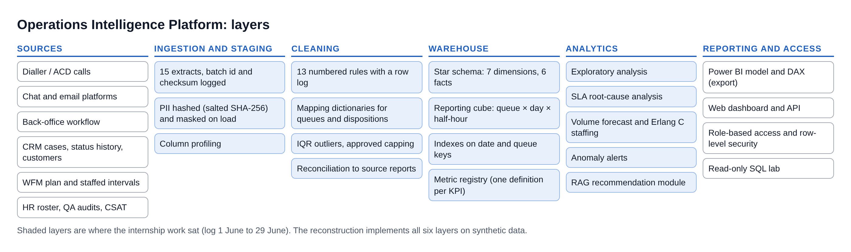
Project II: Operations Intelligence Platform
Data from six systems
One metric, many numbers
Daily averages hide failures
Dialler, chat, email, back office, CRM and WFM extracts with duplicates, label drift, gaps and personal data
Service level computed differently in different reports, so meetings argue about the figure
A queue can meet its daily target and still fail every weekday morning
Company data is confidential. Every screen and number from here on comes from my reconstruction of the platform on synthetic data.
Notes:
The platform exists because operations data comes from six systems, the same metric is calculated differently, and daily averages hide interval failures. The architecture runs from sources through staging, cleaning, the warehouse and analytics to reporting. The company's data is confidential, so everything I show from here is my reconstruction on synthetic data, using the methods I worked on.

Slide 11
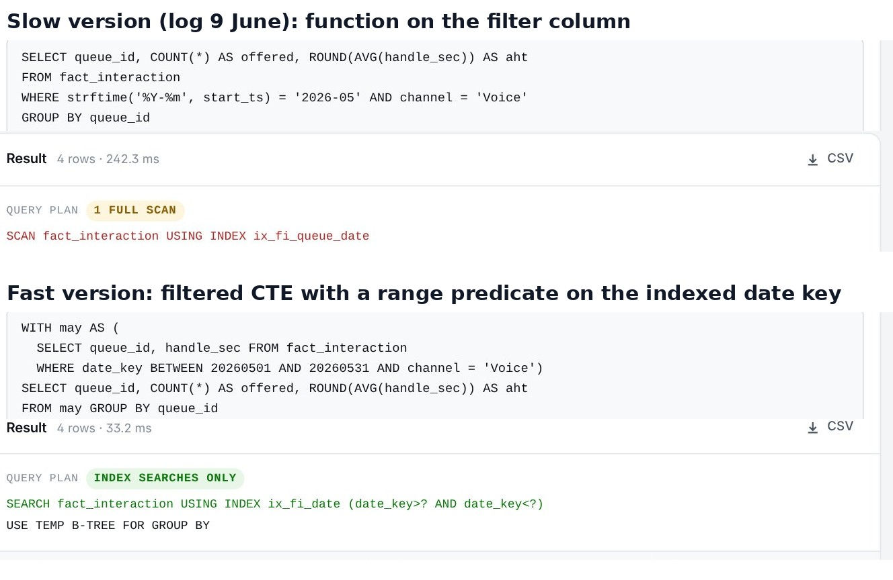
SQL Development and Optimisation
Aggregation (5 Jun). Volume, AHT and talk time by queue; WHERE filters rows, HAVING filters groups; checked against an operational report.
Join trap (6 Jun). A four-table join duplicated rows: one interaction has many status rows. Row counts are now checked before and after every join.
Window functions (8 Jun). ROW_NUMBER keeps the latest status, RANK orders agents in each queue, AVG OVER gives a 7-day moving average.
Optimisation (9 Jun). A function on the date column forced a full scan. A range on the indexed date key turned it into an index search.
Notes:
I moved from aggregation to joins, window functions and optimisation. The lesson I keep is the join trap: joining to a one-to-many table silently multiplies rows. On the right is the optimisation: the same query, but the filter no longer wraps the column in a function, so the plan changes from SCAN to SEARCH, 242 ms to 33 ms on the reconstruction.

Slide 12
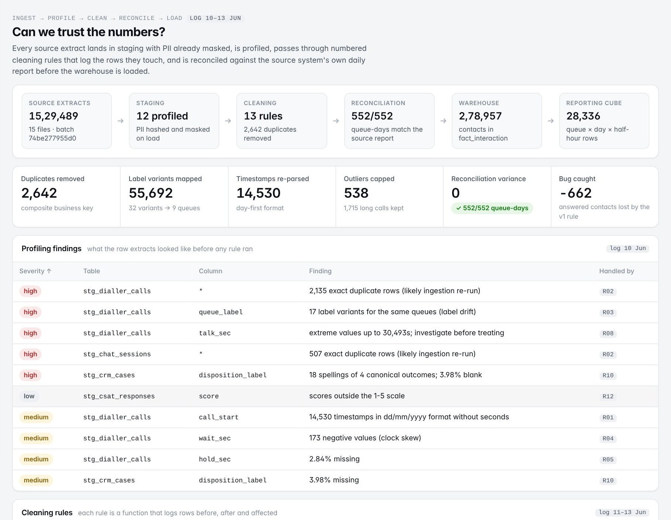
Data Cleaning and Reconciliation
2,642
duplicate rows removed on a composite business key
32 → 9
queue-label spellings mapped to canonical queues
538
unclosed agent sessions capped; 1,715 genuine long calls kept
552 / 552
queue-days reconcile exactly with the source report
662
answered calls the first version silently dropped
Notes:
I profiled the masked extract, then built reusable cleaning steps: de-duplication on a business key, mapping dictionaries for queue names, median imputation for skewed hold times. Extreme handle times were mostly unclosed sessions, so only those were capped, after approval. Reconciling against the source report exposed a rule that dropped answered calls without an agent ID; after the fix every queue-day matches.

Slide 13
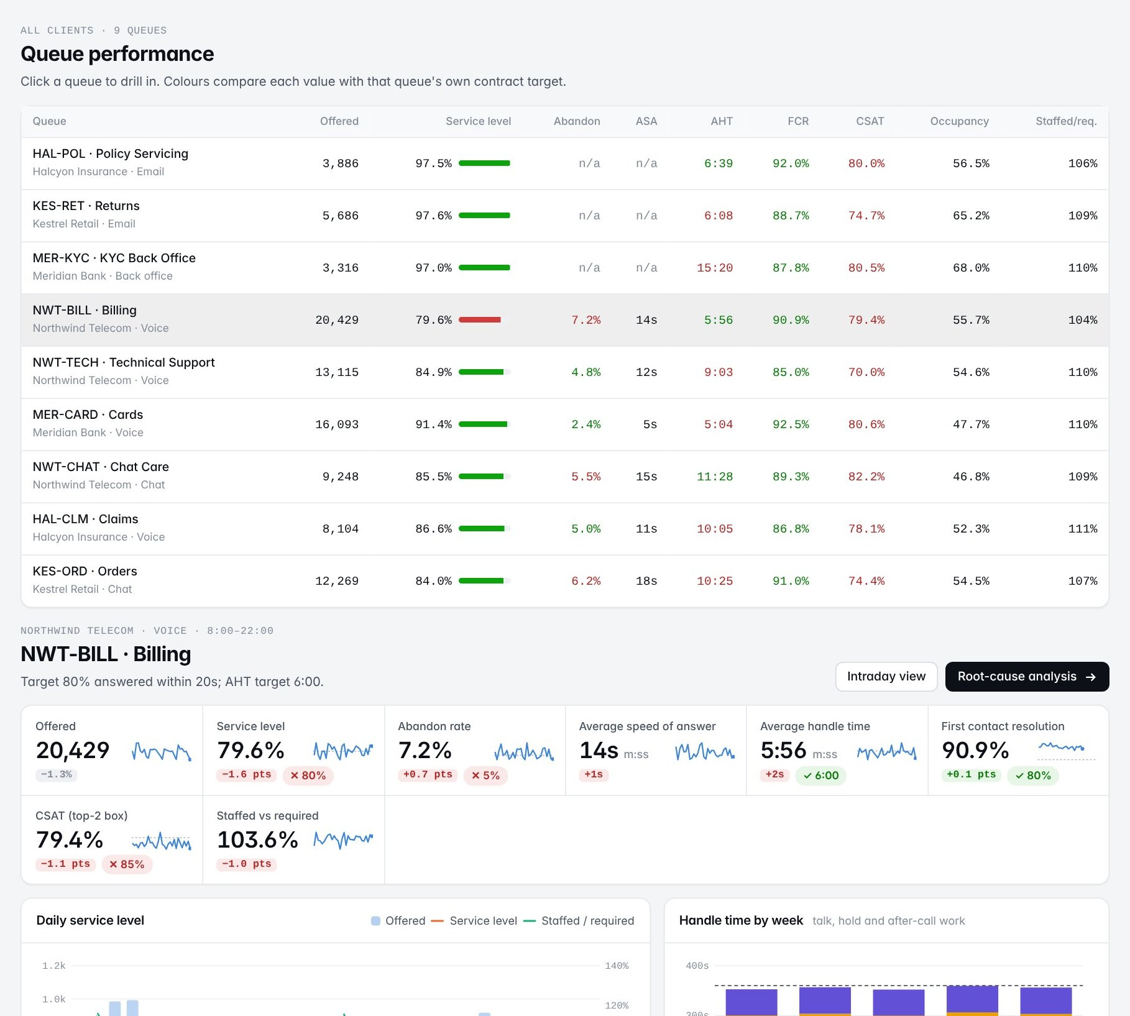
Metric Definitions and Power BI
Metric | Numerator | Denominator
Service level | Answered within threshold | Offered - short abandons (<= 5 s)
Abandon rate | Abandoned - short abandons | Offered - short abandons
Average handle time | Talk + hold + after-call work | Handled contacts
First contact resolution | No repeat within 7 days | Handled contacts
Mismatch found (16 Jun): service level differed from the month-end figure until short abandons were excluded from the denominator, as operations does.
Power BI (18 to 22 Jun): star schema, marked date table, DAX with CALCULATE for month-to-date and previous month, and my queue performance page.
A measure broken by a slicer's filter context was found and fixed; every measure was validated against SQL.
Notes:
With the reporting team I wrote each metric with its numerator, denominator and exclusions. Service level did not match the month-end figure until short abandons were excluded. In Power BI I helped build the star schema and date table, wrote DAX measures and built the queue performance page; one measure was wrong under a slicer, and I fixed it. Every measure was checked against SQL.

Slide 14
Root-Cause Analysis of SLA Breaches
39%
of all breaches sit in four morning half-hours
9% → 55%
hotspot breach rate after the roster change on 6 April
75%
of hotspot breaches are staffing-driven (Shapley, Erlang C)
Blue: recurring hotspots (breach rate significantly above the queue). Breach = SL below target by more than random variation.
82.4% → 85.0%
My part (23 to 24 Jun): breach extract, Pareto, candidate-cause tests and the staffing-gap figures for the senior analyst. The statistics on the right are from the reconstruction.
queue SL with about four more heads in the hotspots
Notes:
One queue kept missing its SLA. I segmented breaches by half-hour and built the Pareto: four morning half-hours stand out. We tested staffing, volume and handle time; breaches concentrated where scheduled staff lagged forecast volume. In my reconstruction the breach rule is statistical, Mann-Whitney tests the causes and Shapley values over Erlang C attribute them: staffing explains 75% of hotspot breaches, and about four more heads take the queue from 82.4 to 85 percent.

Slide 15
Volume Forecasting
What I did (25 to 26 Jun)
Features: lags 1, 7 and 14 days, rolling means, day of week, month, holidays, prior-day staffing ratio and AHT
Chronological split: a random split leaks the future through the lag features
Moving-average baseline, linear regression and random forest; MAE, RMSE and MAPE; residual plots
Reconstruction adds
A recursive 14-day forecast turned into heads per half-hour with Erlang C and 30% shrinkage, compared with the current roster
Every model must beat a simple baseline on days it has never seen. Random forest is best on 8 of 9 queues; every model misses the sale week because promotions are not yet a feature.
Notes:
I built the feature set and used a chronological split, because a random split lets lag features see the future. Every model had to beat a seven-day moving average. On the reconstruction random forest cuts mean error from 19.5 to 9.3 percent and wins on eight of nine queues. The sale week is missed by every model, which is the next improvement: a promotions calendar.

Slide 16
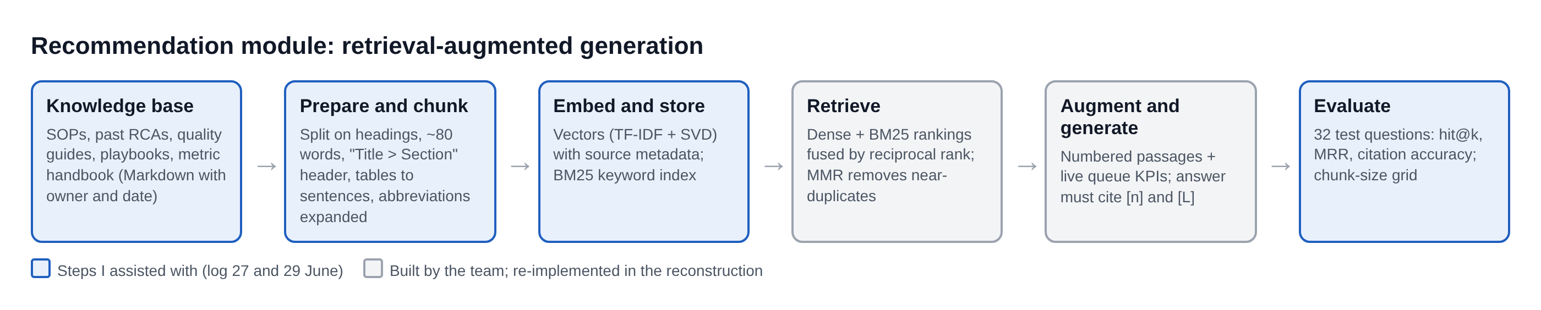
LLM Recommendation Module (RAG)
Retrieval (80-word chunks) | Hit@1 | Hit@3 | MRR | Citation
Keyword (BM25) | 0.91 | 0.97 | 0.93 | 1.00
Semantic (dense) | 0.81 | 0.94 | 0.88 | 0.94
Hybrid (fused) | 0.88 | 1.00 | 0.93 | 1.00
My part (27 and 29 Jun)
Cleaned the SOP, RCA and quality documents; generated embeddings into the vector store with source metadata
Compared chunk sizes; ran citation test queries and logged weak cases for the module owner
32 test questions with expected sources. Larger chunks (160 and 320 words) scored lower: they mix procedures in one passage.
Notes:
The recommendation module answers operational questions from the company's own SOPs and past RCAs. I prepared the documents, generated embeddings into the vector store, compared chunk sizes and ran citation tests. In my reconstruction, keyword and semantic retrieval are fused and the model may answer only from cited passages: on 32 test questions the right document is always in the top three.

Slide 17
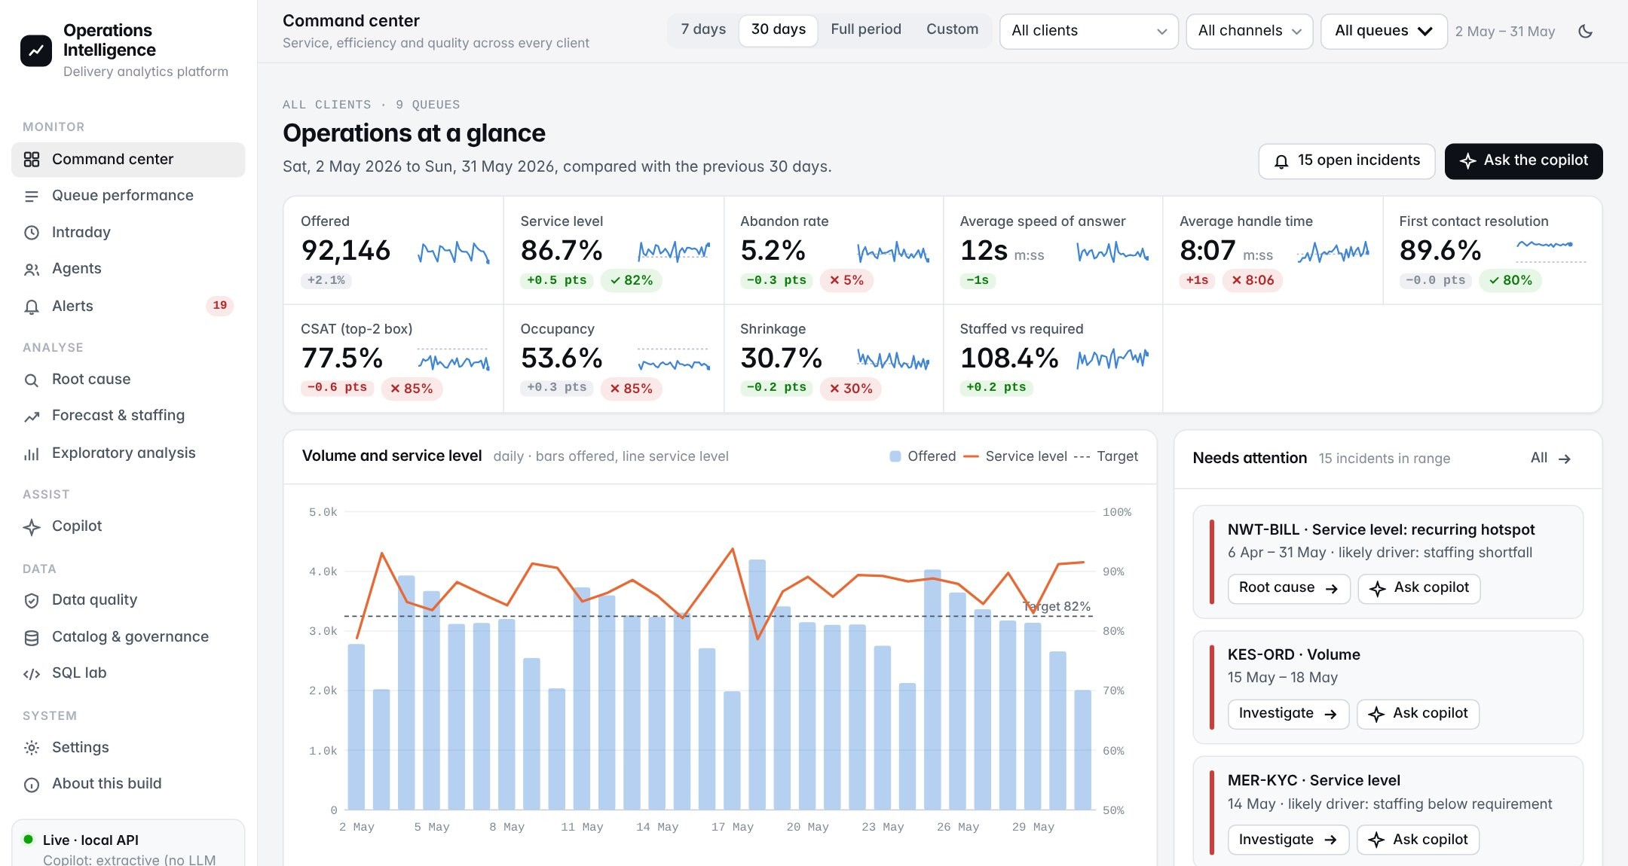
The Platform, Rebuilt End to End
Built after the internship on synthetic data for four fictional clients, with defects and four business events planted so every finding can be checked.
13 pages: command center, queues, intraday, agents, alerts, root cause, forecast, EDA, copilot, data quality, catalog, SQL lab, about
Roles and row-level security; client viewers see masked agent names
Power BI export with generated DAX
40 automated tests: metric parity, cleaning, reconciliation, Erlang C, access, retrieval
Contains no company code and no client data.
Notes:
To show the work without company data, I rebuilt the platform end to end on synthetic data. It has 13 pages, role-based access with row-level security, a SQL lab, the copilot, a Power BI export and 40 automated tests. If time allows I'll demo the command center, root cause, the copilot and the client view.

Slide 18
Challenges and Learnings
Challenge | How it was resolved
Rotated and small dimension text | Measured a baseline, grouped failures, fixed the largest group first
Duplicated rows after a join | Traced the one-to-many table; ROW_NUMBER; row counts on every join
Totals did not reconcile | Found a rule dropping valid calls; keep and flag; re-ran to zero variance
SLA did not match month-end | Aligned the short-abandon exclusion with operations
DAX wrong under a slicer | Fixed the filter context; validated against SQL
Data work is mostly verification
Row counts, reconciliation and SQL checks catch what code review misses
Definitions are business decisions
A metric is right once its exclusions are agreed
Grain matters
Half-hour data found what daily averages hid
Notes:
Each challenge was solved the same way: measure first, find the biggest cause, fix it, measure again. The three learnings I'll keep: data work is mostly verification, metric definitions are business decisions, and the grain of the data decides what you can see.

Slide 19
Conclusion
Project I
Project II
Reconstruction
Input stage for the floor-plan platform: pre-processing, OCR with orientation handling, a millimetre parser and validation that protects the geometry lock. Handed over with README and accuracy sheet.
SQL, cleaning and reconciliation, agreed metric definitions, reporting views and a Power BI page, plus data and analysis for the RCA, forecast and RAG module.
The platform rebuilt end to end on synthetic data: reconciles exactly, finds the planted roster gap, halves forecast error and cites its sources.
Next: promotions as a forecast feature, interval-level forecasting, a server warehouse with scheduled orchestration and SSO, and a larger human-rated test set for the copilot.
Thank you. Questions?
Notes:
To conclude: I delivered the floor-plan input stage, supported the platform's data, reporting and analytics work, and rebuilt the platform end to end to show the methods. Next steps would be promotions in the forecast, interval-level forecasting and a production deployment. Thank you, I'm happy to take questions.

