Slide 1
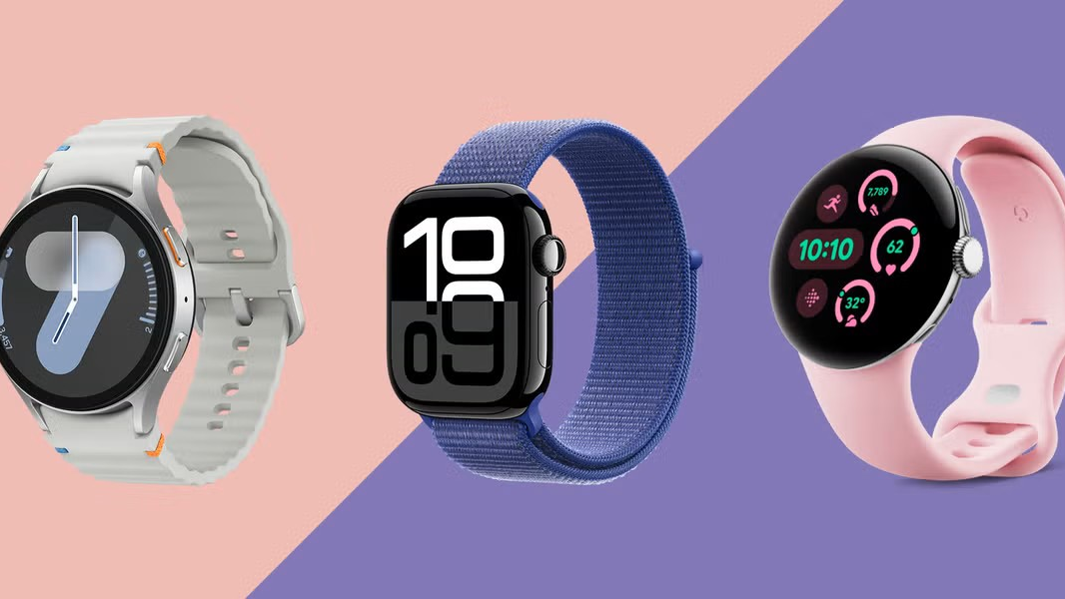
NanoGluco

Slide 2

Digital screen with analog aesthetics for classic look and smart functionality
Nano-sensor embedded needle beneath watch for periodic glucose testing
Auto-trigger mechanism based on diabetic level thresholds
Liquid glucose-filled bands for emergency sugar level correction
Modular medical disposal unit for hygienic and easy replacement

Slide 3
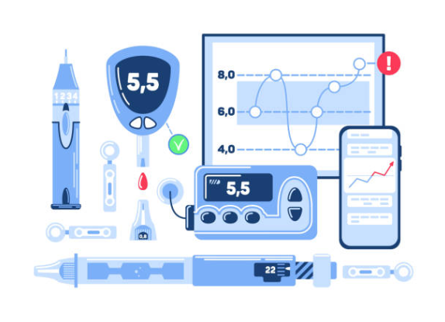
Concept Overview – Smart Diabetic Detection Watch
Hybrid gadget combining analog-style watch with digital health tech
Uses nano-technology for non-intrusive blood sugar monitoring
Designed for diabetic patients with real-time detection and emergency support
Seamless integration of healthcare and wearable tech

