Slide 1
TRAFFIC MANAGEMENT
GANESH COLLEGE OF ENGINEERING
M.EVANGELIN ( TEAM LEADER )
R.KAVIYA
B.SNEHA
G.SUBALAKSHMI

Slide 2
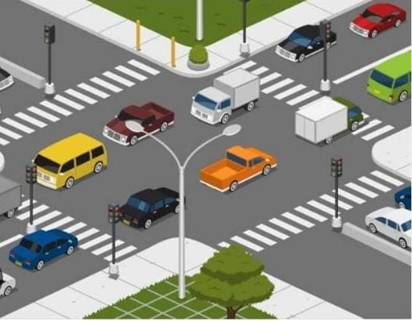
TRAFFIC MANAGEMENT

Slide 3
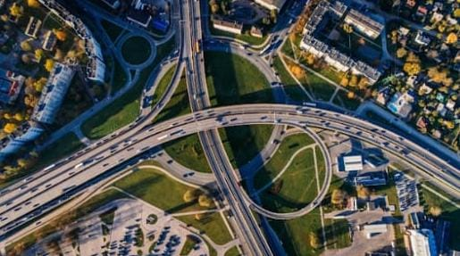
Road network and functional hierarchy
Traffic management is a process of adjusting or adapting the existing road network to improve traffic operations without major constructions .
Traffic management objectives may include
Traffic efficiency
Improved environment amenity

Slide 4
Traffic management objectives
Enhanced access
Better access for particular group of road users
Pedestrians
Bicyclists
Freight vehicles
Road safety
These objectives may potentially be in conflict of each other, so priorities be in conflict to be determined

Slide 5

Traffic management or traffic calming
There have been many different interpretation has been proposed by brindle
Traffic calming is used encompasses two axes
The scope of the measure
Local, intermediate or citywide

Slide 6
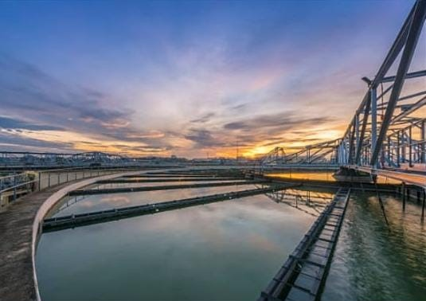
Area treatments
Area treatments divided into two distinct types
Applicable to low density residential development
Aim to control speeds which are in excess of a statutory speed limit of around 30-35 mph
Used in higher density cities
Aim is to reduce speed to around 20 mph

Slide 7
Poblems and difficulties
They cause unnecessary wear and tear on motor vehicles
They disadvantage some local businesses
Their lighting is a source of annoyance to some residents
They hinder emergency vehicles
They waste taxpayer’s money
They make some motorists more aggrssive and impatient
They detract from the environment
Lights, signs, noise

Slide 8
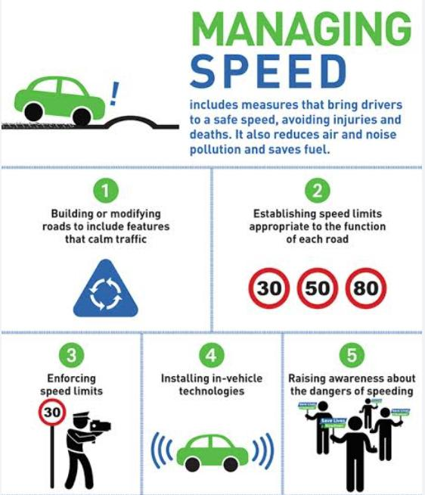
Speed management
Speed may be managed in two ways
traffic calming
using physical devices aimed to restrict the speed of vehicles
Speeds and safety
There is clear evidence of the effect of speed on accident rates
As trvel speeds drop, the impact speeds drop, and collision may be avoided

Slide 9
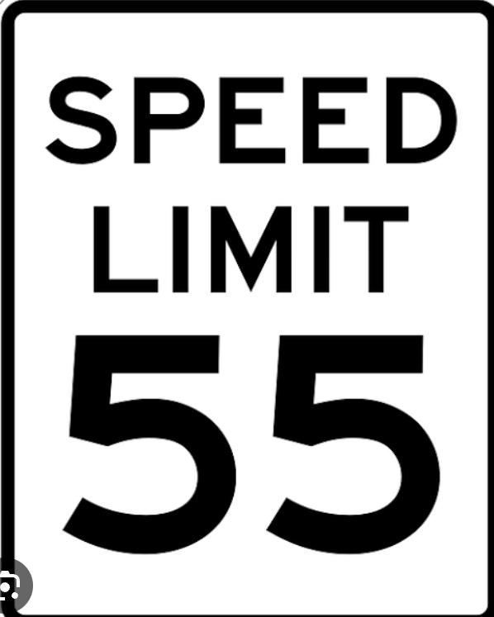
Speed limits and travel speeds
Speed limits affect safety only if they affect actual travel speed
The influence of speed limit relies
Reasonableness of speed limit as perceived by driver
On enforcement

Slide 10
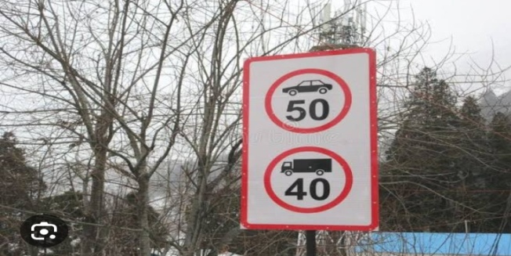
Differential speed limits for heavy vehicles
There is evidence that accident rates are related to the dispersion or variance of speed of vehicles in the traffic stream.
Many different studies reported the chance of being involved in an accident follows shaped distribution .
The minimum occurring when the vehicle is travelling at about the average speed of traffic , or slightly above.

Slide 11
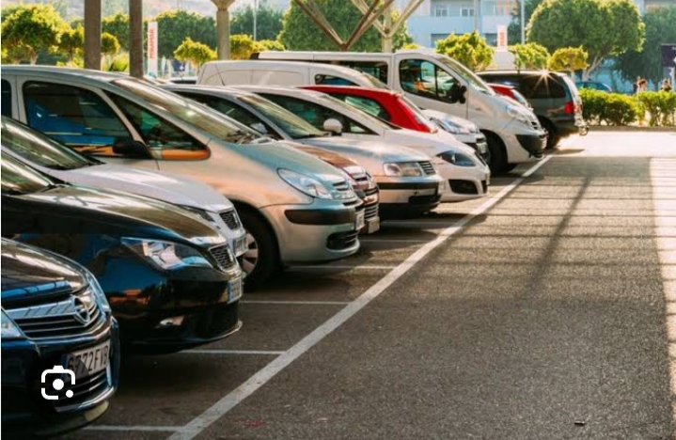
Parking
An important task for traffic management is how and where to store the vehicle.

Slide 12

Enforcement
Enforcement would results in a reduction in mean speed and in the spread of speed
This will lead to reduction in crash number and severity
Automated speed enforcement have been effective in reducing speed
Not only on the site where they have been set up
But also in leading to a change in attitudes towards speeding

Slide 13
One way streets
One way streets tend to be inherently safer than two streets
Function from an opposing traffic stream has been removed

Slide 14
Truck routes
Control of trucks through truck routing is a means of implementing an urban traffic management scheme
Its application is to pursue amenity objectives, not safety objectives.

Slide 15
Traffic demand management
The capacity accommodate the demands is hardly fulfilled only with phyical development of infrastructures, because of serious constraints against funds.

Slide 16
Traffic management policy and measures
To achieve smooth traffic flow
To reduce traffic accidents
To create pedestrain – friendly facilities

Slide 17
THANK YOU.....

