Slide 1
TRAFFIC MANAGEMENT
GANESH COLLEGE OF ENGINEERING
M. EVANGELIN TEAM LEADER
R. KAVIYA
B. SNEHA
G. SUBALAKSHMI

Slide 2
INDEX
MEANING OF TRAFFUC MANAGEMENT
TRAFFIC MANAGEMENT OBJECTIVE
TRAFFIC MANAGEMENT FUNCTION
TRUCK Routes
ONE WAY STREETS
PARKING
SETTING SPEED LIMITS
SPEED MANAGEMENT
AREA TREATMENTS
IMPLEMENTATION OF DEVICES

Slide 3
TRAFFIC MANAGEMENT OBJECTIVE
Enhanced access better access for particular group of road users Pedestrians,Bicyclists,Freight,Vehicles, Road safety . There objectives may potentially be in conflict of each other so priorities may have to be determined

Slide 4
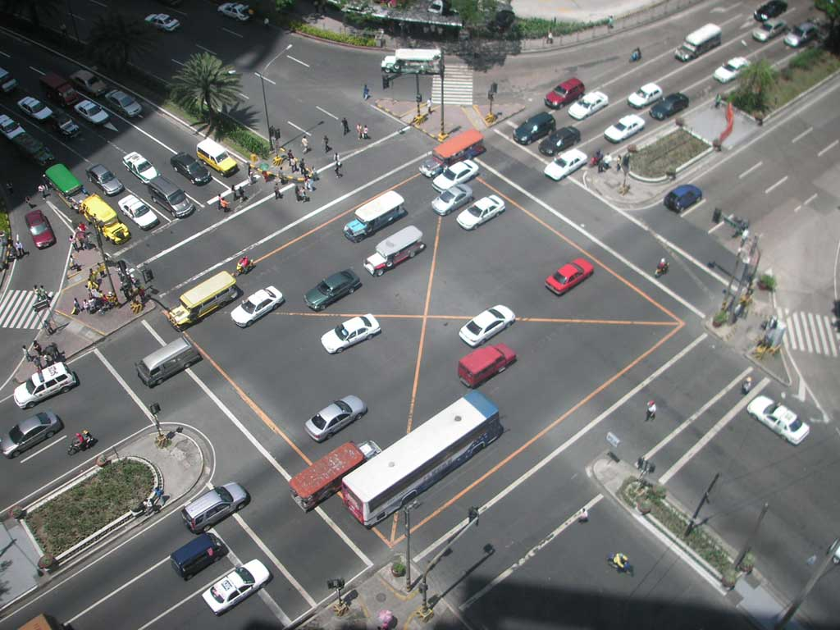
TRAFFIC MANAGEMENT FUNCTION
The use of traffic management to pursue safety objective must take place I the context of a clear view of the function of a road network which is referred to as function hierarchy Roads function is the prime determinant of the management of any given road within the overall network

Slide 5

TRUCK ROUTES
Control of truck through truck routing is a means of implementing an urban traffic management scheme its application is to pursue amenity objectives not safety objective . The only reference form the safety stand point is to trucks routing of hazardous materials

Slide 6
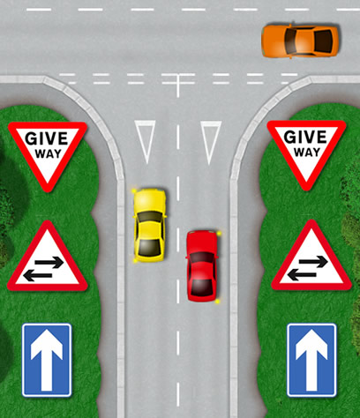
ONE WAY STREETS
One way streets tend to be inherently safe than two way streets Friction from an opposing traffic stream has been removed Generally one way operation leads to higher speeds and longer trips to Higher speeds and longer trips fewer stops traffic flow tends to be more orderly

Slide 7
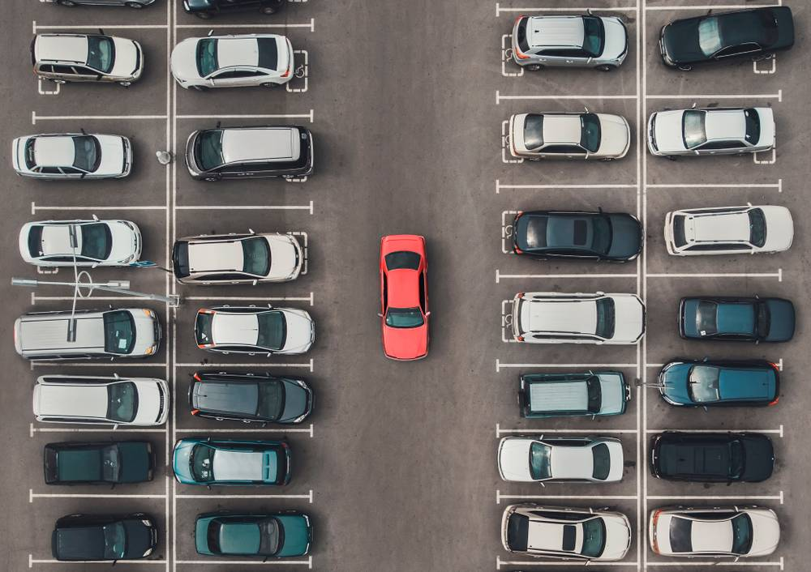
PARKING
An important task for traffic management is how and where to store the vehicles since they are spending the majority of their time at rest Parked or parking vehicles are particularly associated with pedestrian fatalities Ross silcock partnership suggest that planning for parking involves

Slide 8
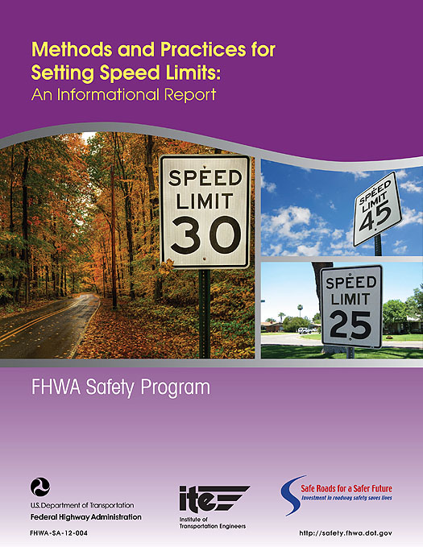
SETTING SPEED LIMITS
VEHICAL LIMITS APPLY TO SPECIFIC CLASSES OF
VEHICAL TRUCKS AND BUSES DRIVER LIMITS APPLY TO SPECIFIC CLASSES OF THE DRIVER LEARNERS FORMAL MANEGEMENT OF VEHICLE SPEEDS USING ANY OF THESES LEGALLY ENFORCEABLE SPEED LIMITS INVOLES ESTABLISHING A BETWEEN SAFETY , MOBILITY , AND AMENITY FOR USERS.

Slide 9
SPEED LIMIT AND TRAVEL SPEEDS
SPEED LIMITS AFFECT SAFETY ONLY IF THEY AFFECT ACTUAL SPEED THE INFLUENCE OF SPEED TRAVEL LIMIT RELIES REASONABLENESS OF SPEED LIMITS.’IN ORDER TO BRING ABOUT A REDUCTION IN MEAN SPEED AND SPEED DISPERSION,A SPEED LIMIT SHOULD BE SET AT 85 PERCENTILE OF EXITING SPEEDS, OR AT A LOWER LEVEL

Slide 10
SPEED MANEGEMENT
INJURY TO VULNERABLE ROAD USERS PEDESTRIANS AND BICYCLISTS . IN MANY CASES THE DRIVER IS WITHIN THE SPEED LIMIT, 1994 BASED ON A DETAILED STUDY OF 146 FATAL PEDESTRIAN CRASHES FOUND THAT 45 PERCENT OF THESE WOULD PROBABLY SURVIVED IF VEHICLE STRUCK THEM WITH 10KM/H SLOWER SPEED LIMITS.

Slide 11
SPEED LIMITS AFFECT TRAVEL SPEED AND THERFORE SHOULD AFFECT ACCIDENTS SPECIALLY IN URBAN AREAS AND ROADS WITH LIMITS DESIGN STANDARDS .THERE IS LESS CLEAR EVIDENCE OF AFFECT OF SPEED LIMITS ON CRASHES IN RURAL AREAS . DIFFERENT STUDIES FOUND DIFFERET RESULTS ON AFFECT OF INCRESING SPEED LIMIT IN RURAL AREAS.

Slide 12
AREA TREATMENT
THE DOMAINT TYPES OF ACCIDENT WERE CROSS TRAFFIC RIGHT- THROUGH RARE END HIT PARKED VEHICAL LOCAL AREA TRAFFIC MAGAGEMENT SCHEMES MAY NOT BE AS EFFICTIVE IN REDUCING ACCIDENTS AS MANY PRACTITIONERS BELIEVERS HOWEVER , THERE WERE SEVERALL STUDIES WHICHH HAVE REVEALED THE POSITIVE EFFECT OF TRAFIC MANAGEMENT SCHEMES.

Slide 13

IMPLEMENTATION OF DEVICES
USEFUL GUIDELINES IN IMPLEMENTING DEVIES INTRODUCED BASED ON WORLDWIDE RESEARCHES NETWORK CONFIGURATION SHOULD BE SUCH THAT THE AMOUNT OF TRAFFIC VOLUMES IN RESIDENTIAL STREETS ARE IN THE RANGE OF 2000-3000vpd.WIDE, LONG STREETS WITH HOUSE FROUNTAGES HAVE A POOR SAFTEY RECORD AND SHOULD BE AVOIDED.

Slide 14
NETWORK DISCONTINUITIES CAN BE MADE TO DISCOURAGE THE ENTRY OF NON- LOCAL TRAFFIC INTERSECTIONS ALONG STREET WITHIN THE RESIDENTIAL NETWORK SHOULD BE SEPARATED BY AT LEAST 70 FT

Slide 15
THANK YOU

