Slide 1
Digital Portfolio
STUDENT NAME: K.KAVIYA
REGISTER NO AND NMID: astvu36336324u18020
DEPARTMENT: B.Sc.Computer Science
COLLEGE:Sree Abiraami arts and science college for women
UNIVERSITY:Thiruvalluvar university

Slide 2
PROJECT TITLE
DIGITAL PORTFOLIO

Slide 3


AGENDA
Problem Statement
Project overview
End users
Tools and technics
Portfolio design and Layout
Features and Functionality
Results and Screenshots
Conclusion
Github Link
3/21/2024 Annual Review

Slide 4

PROBLEM STATEMENT
People cannot show their work and talent clearly in paper resumes.
Paper portfolios are not creative and less attractive.
It is difficult to update and share achievements quickly.

Slide 5

PROJECT OVERVIEW
A digital portfolio is an online collection of a person’s skills, projects, and achievements.
It helps to show work in a creative and attractive way.
It can be updated easily and shared with anyone, anywhere.

Slide 6

WHO ARE THE END USERS?
Students – to show their studies and projects.
Job seekers – to share skills with companies.
Professionals/Creators – to display work and achievements.

Slide 7

TOOLS AND TECHNIQUES
Website builders – to create online portfolios (Wix, WordPress, Google Sites).
Design tools – to make it attractive (Canva, Figma).
Coding (HTML, CSS, JS) – for custom and creative portfolios.

Slide 8
PORTFOLIO DESIGN AND LAYOUT
Home page – brief intro about yourself.
About page – personal details, background, and skills.
Projects/Work page – showcase of your work, projects, or creations.
Gallery/Media – images, videos, or samples of work.
Contact page – ways to reach you (email, phone, social links).
8

Slide 9
FEATURES AND FUNCTIONALITY
Showcase Skills – display your talents and expertise.
Project Display – present your work, projects, or achievements.
Easy Updates – add new work or information anytime.
Share Online – share portfolio link with anyone, anywhere.
Multimedia Support – include images, videos, and documents

Slide 10
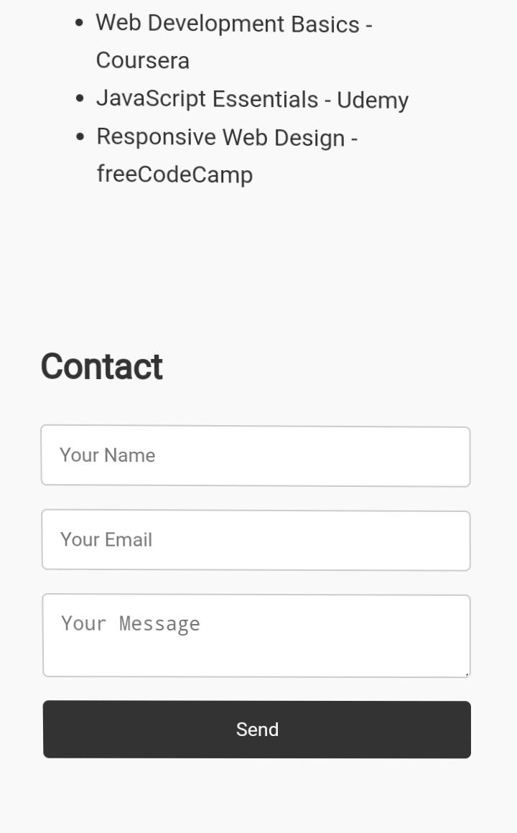
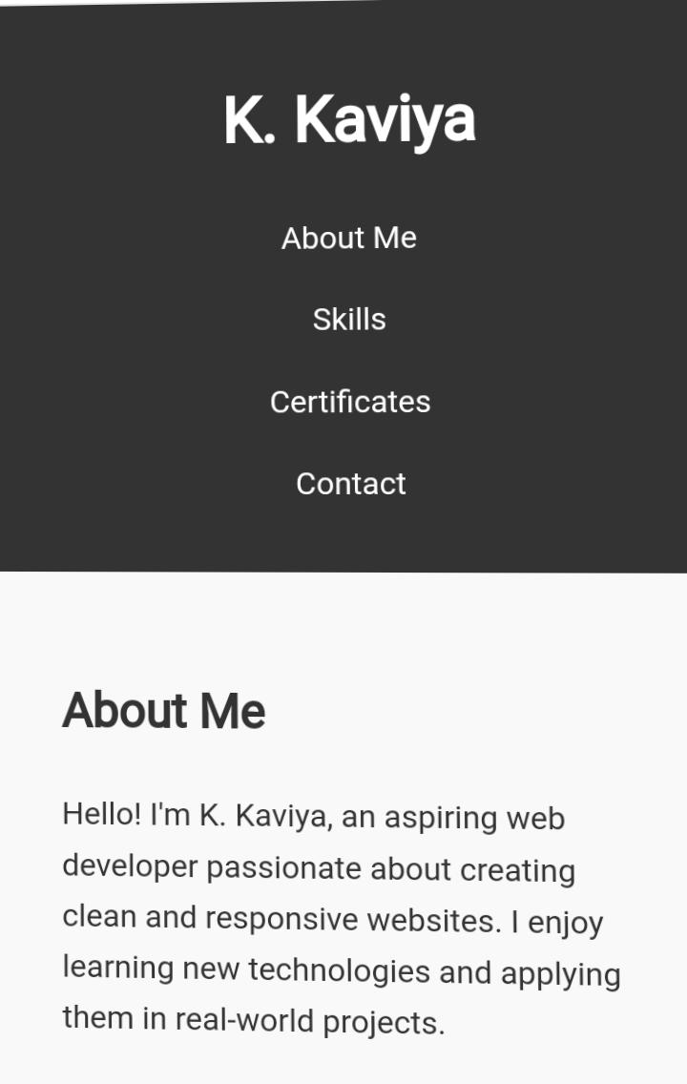
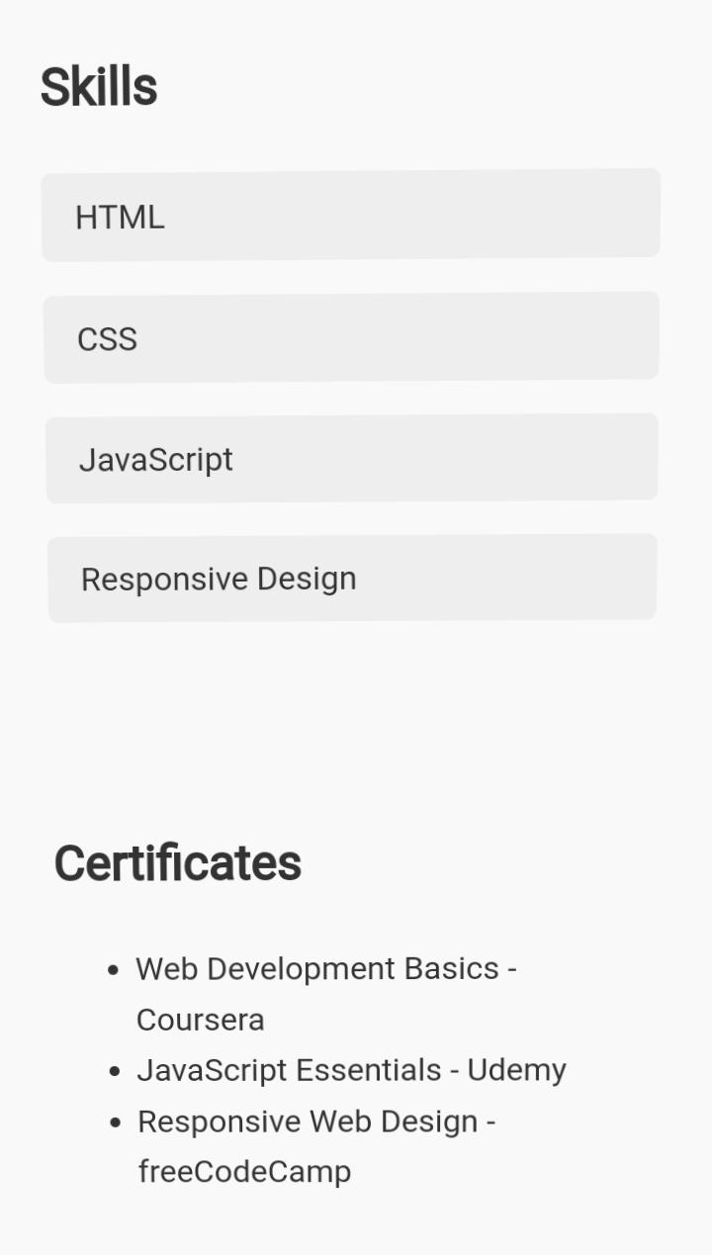

RESULTS AND SCREENSHOTS
3/21/2024 Annual Review
10

Slide 11
CONCLUSION
The digital portfolio is an online way to show skills and work.It helps students, job seekers, and professionals present their achievements.Projects and work are displayed in a creative way.It is easy to update anytime.The portfolio can be shared quickly with others.It makes presenting work simple, organized, and professional.
11

Slide 12
GITHUB LINK:https://kaviyakamaraj4539.github.io/kkaviportfolio/

