Slide 1
Online real estate
Register
Login
  Sale land
  Buy land
    Search land
      Based on price
      Based on BHK
      Based on transaction type

Slide 2
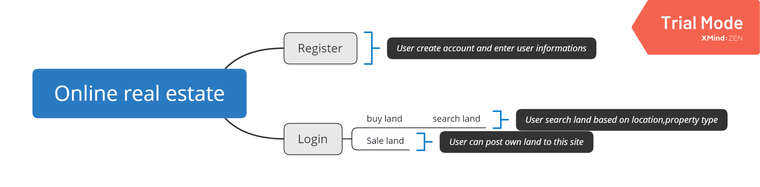
Project Over view

Slide 3
Register
Sale land
Login
Name
Mail
Phone number
Password
Property name
price
BHK
City
Locality
Building name
Land size
Transaction type
Purchase type
Discount
Status
Description
Mail
Phone number

Slide 4
Register - create account
Login - To search land or Sale land
Search land – Searching land details based on user requirement
Sale land - Post land information for sale
Buy land – User select land from the searching results and contact land owner

