Slide 1
Online real estate
Karthikeyan
Mahendran
kaviyarasan

Slide 2
Register
Login
  Profile
  Sale land
  Own land
  Buy land
    Search land
      Based on price
      Based on BHK
      Based on transaction type
Forgot password

Slide 3
Model classes
User
Land
City
Name
Mail
Phone number
Password
Property name
price
BHK
City
Locality
Building name
Land size
Transaction type
Purchase type
Discount
Status
Description
Name
Location
  Location name

Slide 4
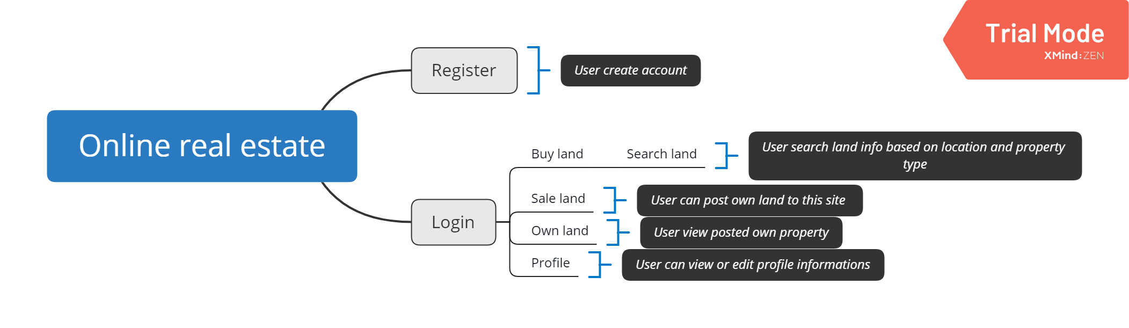
Project Over view

Slide 5
Register - create account
Login - To search land or Sale land
Search land – Searching land details based on user requirement
Sale land - Post land information for sale
Buy land – User select land from the searching results and contact land owner
Own land – User can view posted land details

Slide 6
THANK YOU

