Slide 1

Sales Dashboard-Report

Slide 2
Exploratory Data Analysis-EDA
i) Cleaning
1. Check the percentage of NULL Values
i) if NULL values > 80% => drop the column
ii) If NULL values <10% => drop the rows
2. Null Value imputation :
i) Categorical : mode
ii) Continuous : median, mean
iii) Time Series Data : Forward fill, Backward fill
3. Outliers :
i) Here we have found outliers in every report
ii) but we are not treating the outliers hence the given input data’s are metrics kind of data

Slide 3

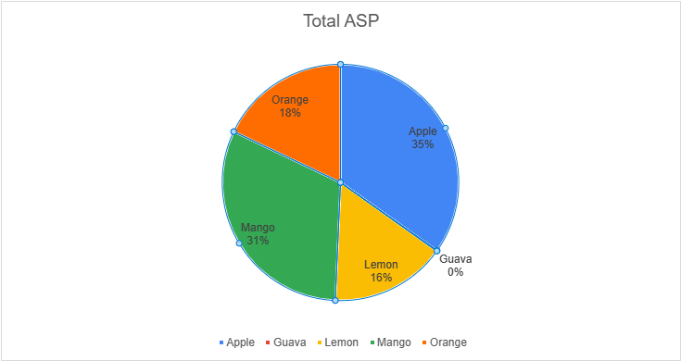
Category vs SUM of ASP-December month
Interpretation :
with respect to Category column, most no of sales happened in “Apple” and ”Mango” Category and very less no of sales happened in “Guava” Category.

Slide 4
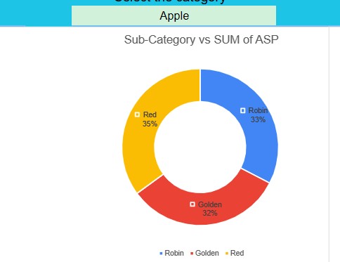
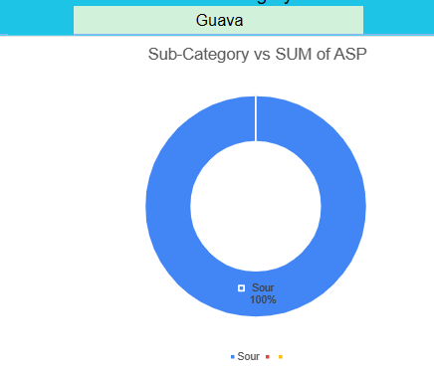
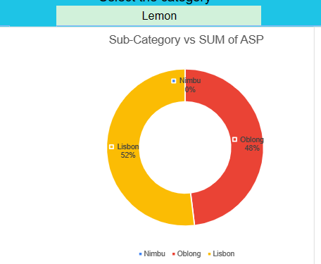
Sub-Category Dec-Month Report
Interpretation :
i) apple :
In apple category, all apples are have more or less equal sales.
ii) lemon :
majority of the sales happened in only “Lisbon” and “Obiong” and there is no sales in “Nimbu” sub-category.
iii) Guava:
within guava we have only “Sour”.

Slide 5
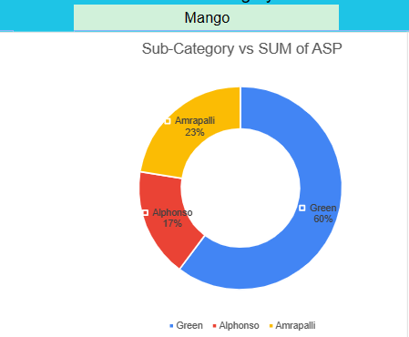
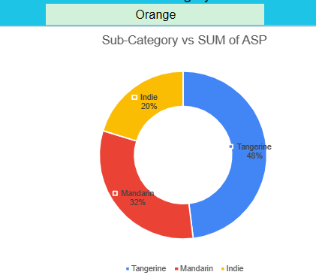
Sub-Category Dec-Month Report
Interpretation :
i) Mango :
In mango category, most no of sales happened in “green”.
ii) Orange :
majority of the sales happened in only “Tangerine” and less no sales in “Indie” sub-category.

Slide 6
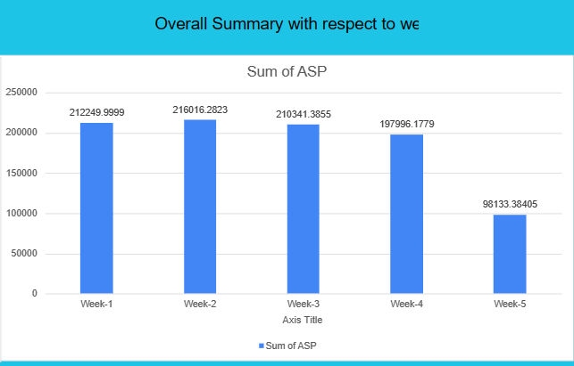
Overall Summary with respect to weekly Report
Interpretation :
more or less all weeks haves equal amount sales except week-5

Slide 7
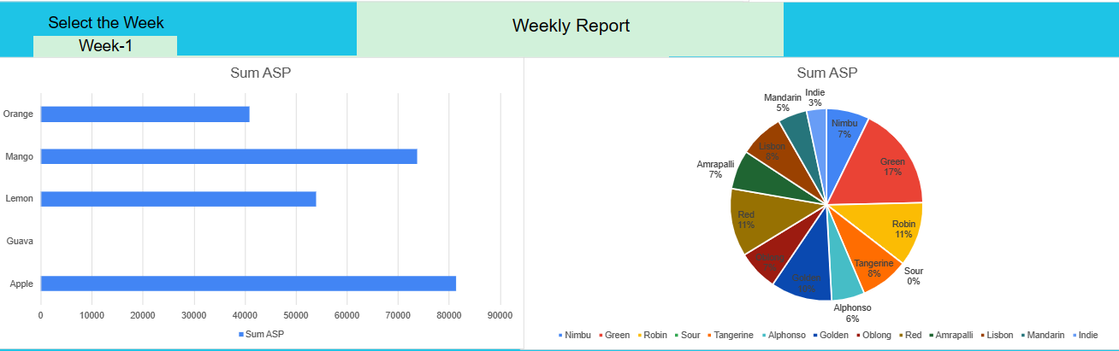
Pages & Screens Report
Interpretation :
while comparing every week apple have highest sales and followed by mango.
Guava have almost zero percent contribution in sales.

Slide 8
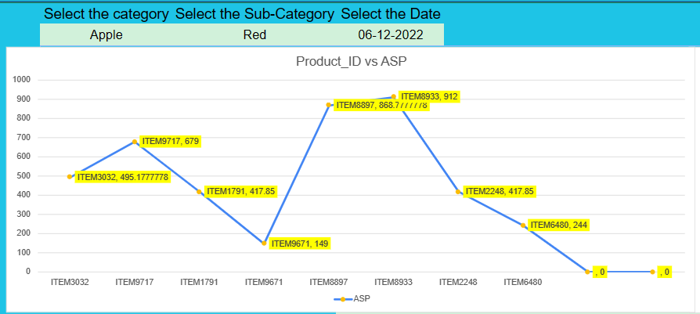
Product_ID Report
Interpretation :
when we will know the category and sub category ,With the help of above report we can able to find out the particular product_id, which have more no sales.

Slide 9

Conclusion & Recommendation:
In December month more no of apple and mango fruits are sold. So we can increase the apple and mango fruits.
Very less no of guava fruits are sold in December month.
So we ignore the guava fruit in December month sales.

