Slide 1
My application
Presented By
A.Sharmila
S.Udita
B.Pavithra
s.kaviya
thiruvezhil

Slide 2
introduction
A project well structured for beginners with deep knowledge on Spring boot, Java, HTML and CSS. we will build a Login and registration page with Backend as Java code and front end using JSP. It is recommended to follow the video tutorial on YouTube and follow step by step development. Project is better viewed on desktop.
Assuming that you have already installed STS and basic development environment setup for a spring project, lets start with creating the project. In STS, Click on Spring started project, Give the project a name and and group ids and include the dependencies “spring-boot-starter-web”, devtools, jpa, “tomcat-embed-jasper”, you can get the dependencies from the pom.xml file below. Ignore the below image for now, it is just to let you know the structure of the files and folders, we will create these files one by one.

Slide 3
Technologies
Spring boot
Html
Jsp
css

Slide 4
Spring boot
Spring Boot is a project that is built on the top of the Spring Framework. It provides an easier and faster way to set up, configure, and run both simple and web-based applications.
It is a Spring module that provides the RAD (Rapid Application Development) feature to the Spring Framework.
Spring Boot helps developers create applications that just run. Specifically, it lets you create standalone applications that run on their own.
Syntax
@SpringBootApplication annotation.

Slide 5
advantages
Spring Boot works well with several servlet containers
Bootstrapping saves memory space.
Decreased boilerplate code.
No XML configuration required.
WAR files are not required.
POM dependency management.
A large community of helpful users.

Slide 6
html
HTML (HyperText Markup Language) is the code that is used to structure a web page and its content..
HTML describes the structure of a Web page. HTML consists of a series of elements. HTML elements tell the browser how to display the content.
For example, content could be structured within a set of paragraphs, a list of bulleted points, or using images and data tables

Slide 7
advantages
HTML is Browser friendly
Allowed to utilize
Simple to learn
Basic design
Lightweight and quick
Utilization of formats
Information stockpiling

Slide 8
css
CSS is the language for describing the presentation of Web pages, including colors, layout, and fonts.
It allows one to adapt the presentation to different types of devices, such as large screens, small screens, or printers.
CSS is independent of HTML and can be used with any XML-based markup language

Slide 9
advantages
Faster Page Speed. More code means slower page speed.
Better User Experience. CSS not only makes web pages easy on the eye, it also allows for user-friendly formatting.
Quicker Development Time.
Easy Formatting Changes.
Compatibility Across Devices.

Slide 10
jsp
It stands for Java Server Pages. It is a server side technology. It is used for creating web application. It is used to create dynamic web content.
In this JSP tags are used to insert JAVA code into HTML pages.
syntax
jsp:include action tag

Slide 11
advantage
Easy to learn and easy to apply.
Increases readability of code because of tags.
Takes care of exception handling.
Suitable for both java and non java programmer.

Slide 12
controller
Responsible for processing incoming REST API requests, preparing a
model, and returning the view to be rendered as a response.
SYNTAX
@Controllerpublic class UserController {@RequestMapping("/user")public StringgetUser() {
}}

Slide 13
uses
Indicates that a particular class serves the role of a controller.
Controls the flow of the data.

Slide 14
respository
Mechanism for encapsulating storage, retrieval, and search behavior which emulates a collection of objects.
SYNTAX
public interface PagingAndSortingRepository<T, ID extends Serializable> extends CrudRepository<T, ID> {}
uses
Allows you to populate data in memory that comes from the database in the form of the domain entities.

Slide 15
Crud respository
CrudRepository is a Spring Data interface for generic CRUD operations on a repository of a specific type.
It provides several methods out of the box for interacting with a database.
SYNTAX
public interface DepartmentRepository extends CrudRepository<Department,
Long> {}

Slide 16
ENTITY
An entity is a lightweight persistence domain object
Typically, an entity represents a table in a relational database, and each entity instance corresponds to a row in that table.
TABLE
A table is an arrangement of information or data, typically in rows and columns, or possibly in a more complex structure.
Tables are widely used in communication, research, and data analysis.
ID
id attribute specifies a unique id for an HTML element.
The value of the id attribute must be unique within the HTML document.

Slide 17
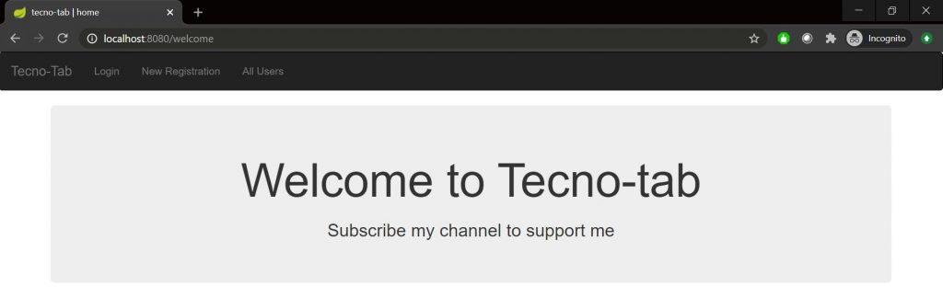
Snap shot

Slide 18
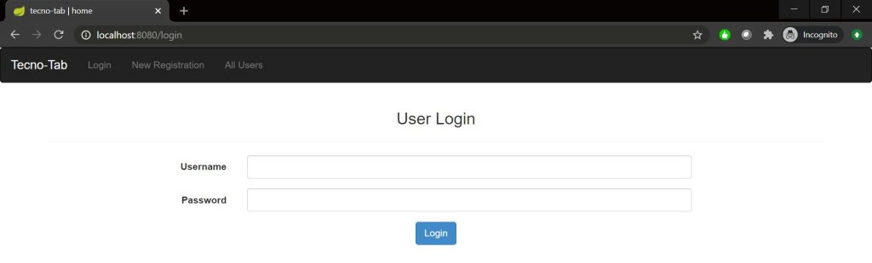

Slide 19
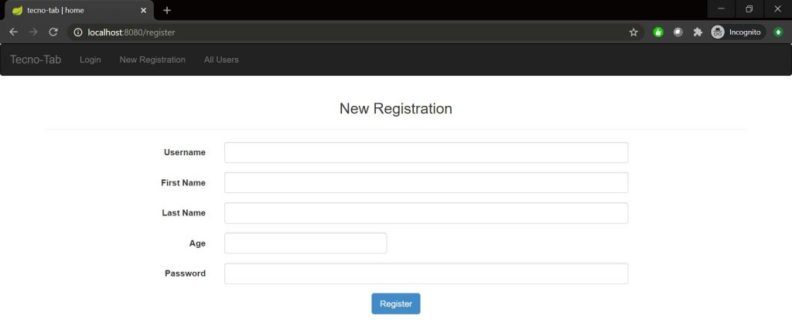

Slide 20
Thank you

