Slide 1

ZEPTO ANALYSIS
Welcome to our presentation on applying strategic frameworks to analyze the leading e-commerce company, Zepto. Over the next 10 slides, we will dive deep into various analyses to gain a comprehensive understanding of Zepto's business landscape and competitive positioning.
by Kavin Sathya

Slide 2
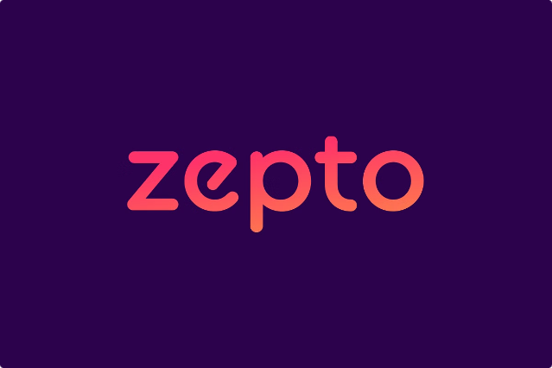
Introduction to Company Zepto
Zepto is a rapidly growing e-commerce platform that specializes in delivering a wide range of products to customers' doorsteps within 10 minutes. Established in 2021, Zepto has quickly become a disruptive force in the online retail industry, challenging traditional delivery methods and redefining customer expectations.

Slide 3
Porter's Five Forces Analysis of Zepto
Bargaining Power of Suppliers
Bargaining Power of Buyers
Threat of New Entrants
Zepto's suppliers have moderate bargaining power due to the company's scale and strategic partnerships.
Customers have high bargaining power as they can easily switch between e-commerce platforms.
The e-commerce industry has high barriers to entry, including significant capital requirements and logistics infrastructure.

Slide 4

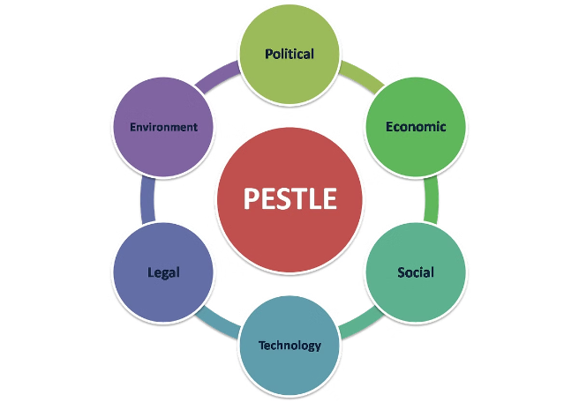
PESTLE Analysis for Zepto
Political
Favorable government policies towards e-commerce and technology startups.
Economic
Rising consumer disposable income and shift towards online shopping.
Social
Increasing demand for convenience and fast delivery in urban areas.
Technological
Advancements in logistics and delivery technologies enabling rapid fulfillment.
Legal
Compliance with industry-specific regulations and standards
Environmental
Sustainability practices in Zepto's operations and supply chain

Slide 5

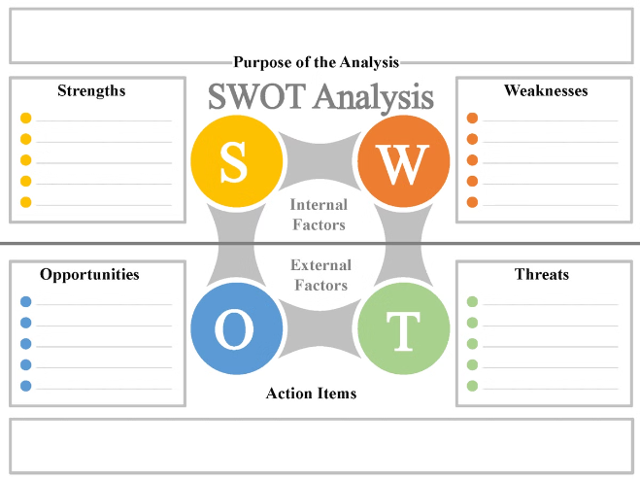
SWOT Analysis of Zepto
Strengths
Innovative delivery model, strong brand recognition, and efficient logistics network.
Weaknesses
Reliance on third-party vendors, high cash burn, and limited product range.
Opportunities
Expansion into new geographical markets and product categories, and potential partnerships with traditional retailers.
Threats
Intense competition from established e-commerce players, regulatory changes, and shifting consumer preferences.

Slide 6
Marketing Mix Model Application for Zepto
Product
Price
Promotion
Zepto offers a wide range of everyday essentials, with a focus on convenience and fast delivery.
Zepto's pricing strategy aims to be competitive and accessible to a broad range of consumers.
Zepto emphasizes digital marketing channels, including social media and targeted advertising, to reach and engage customers.

Slide 7

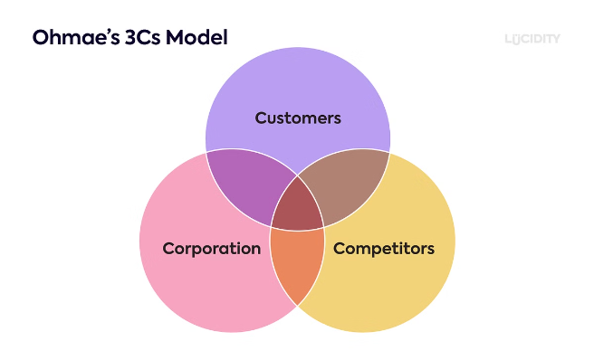
The 3 C's Framework for Zepto
1
Company
Zepto's core competencies, resources, and capabilities enable it to deliver a superior customer experience.
2
Customers
Zepto deeply understands its target audience, their needs, and preferences to create tailored offerings.
3
Competition
Zepto closely monitors the competitive landscape and differentiates itself through innovative solutions.

Slide 8


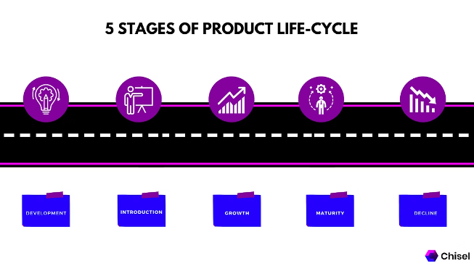
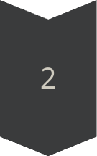
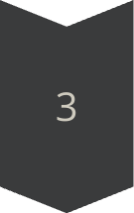
Product Life Cycle Analysis for Zepto
Introduction
Zepto launched its innovative 10-minute delivery service, driving rapid market awareness and adoption.
Growth
Zepto's customer base and market share have been expanding, as it attracts more consumers with its unique value proposition.
Maturity
As the e-commerce industry matures, Zepto must continuously innovate and diversify to maintain its competitive edge.

Slide 9


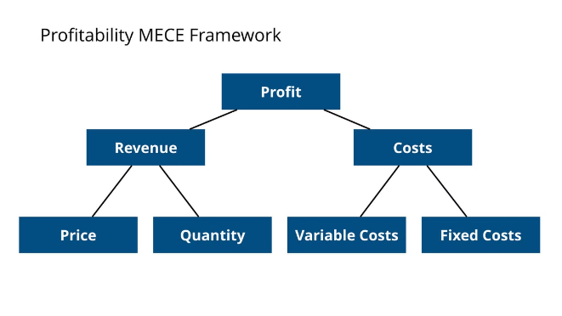


MECE Framework for Zepto
Strategy
Zepto's strategic focus on fast delivery and convenience sets it apart from competitors.
Execution
Zepto's operational excellence and logistics network enable it to deliver on its promise.
Innovation
Zepto continuously explores new technologies and business models to drive growth.

Slide 10

Thank you for your time and attention. We hope this presentation has provided you with a comprehensive understanding of Zepto's strategic positioning and the various frameworks used to analyze its business.

