Slide 1
Data science Capstone Project Finding better Neighborhood in Toronto

Slide 2
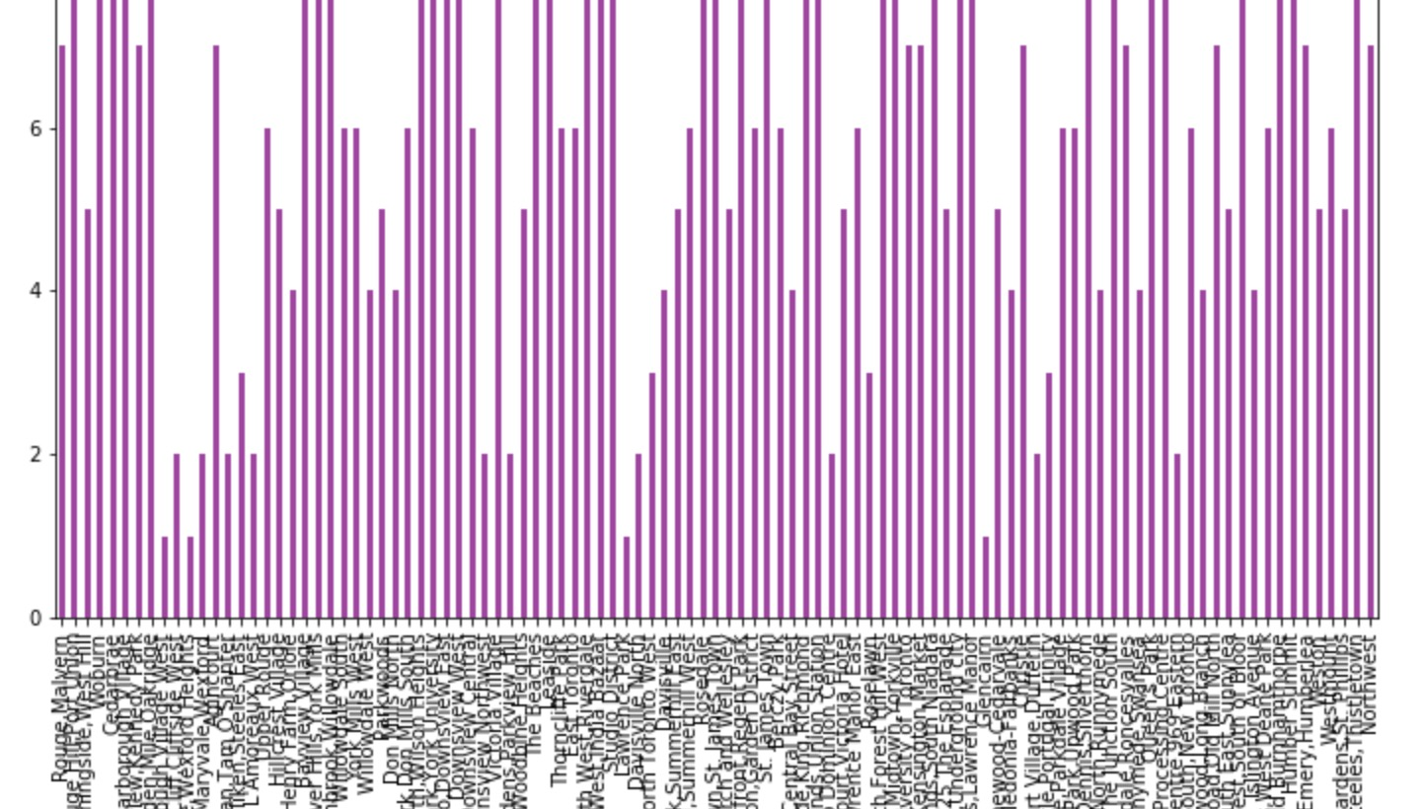
School ratings in Scarborough

Slide 3
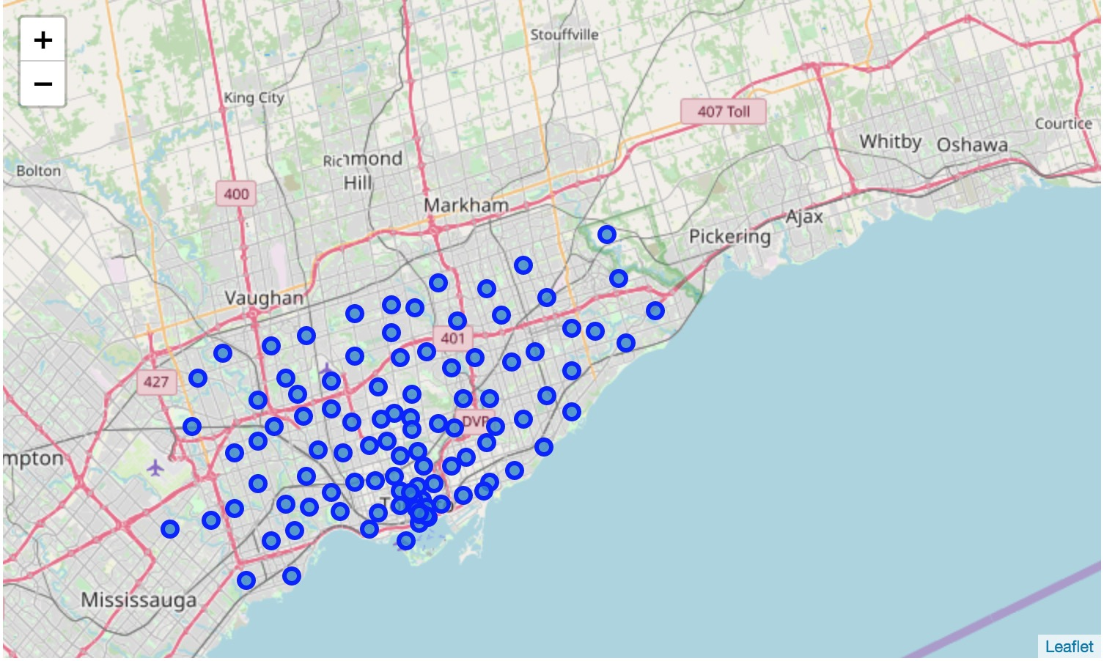
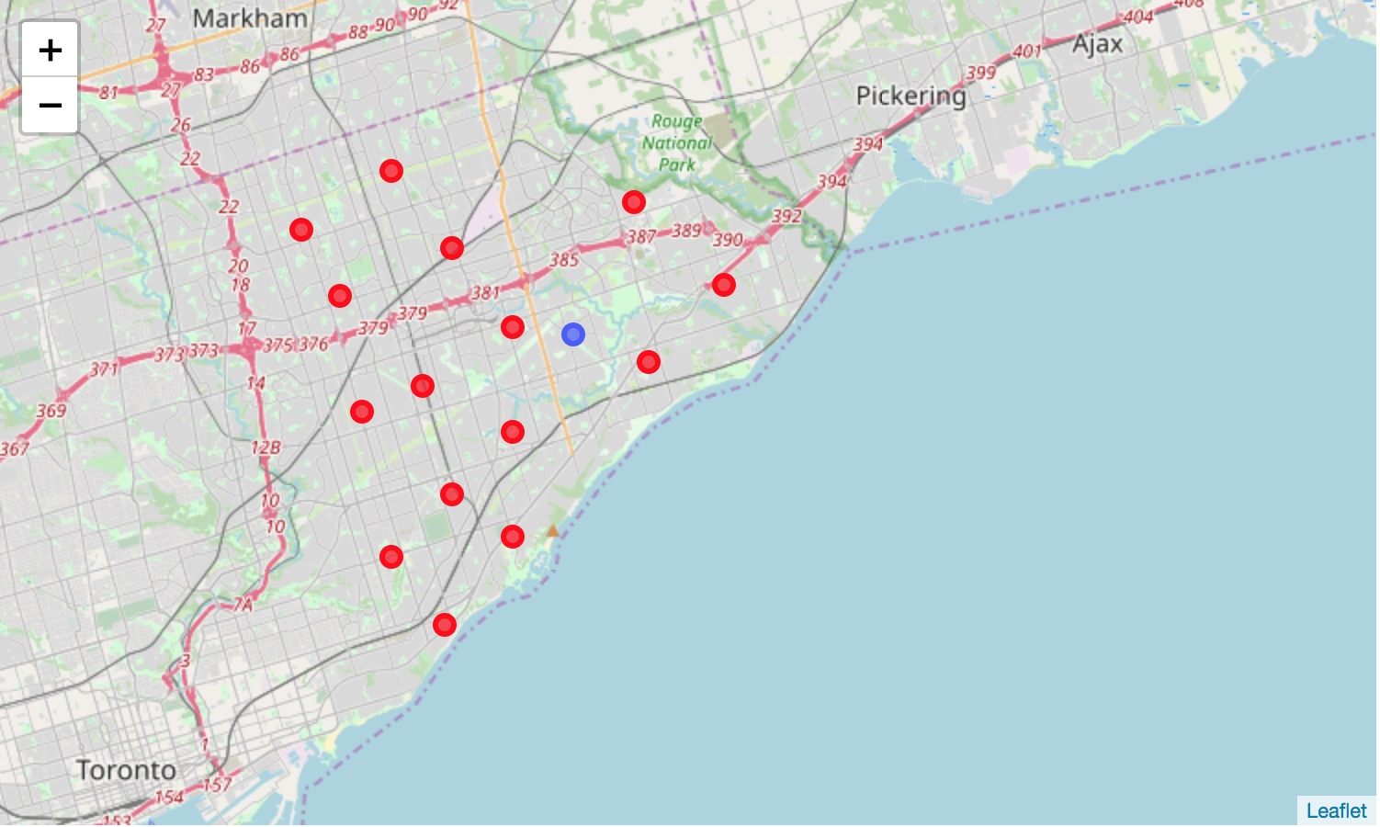
Map & cluster Map

Slide 4
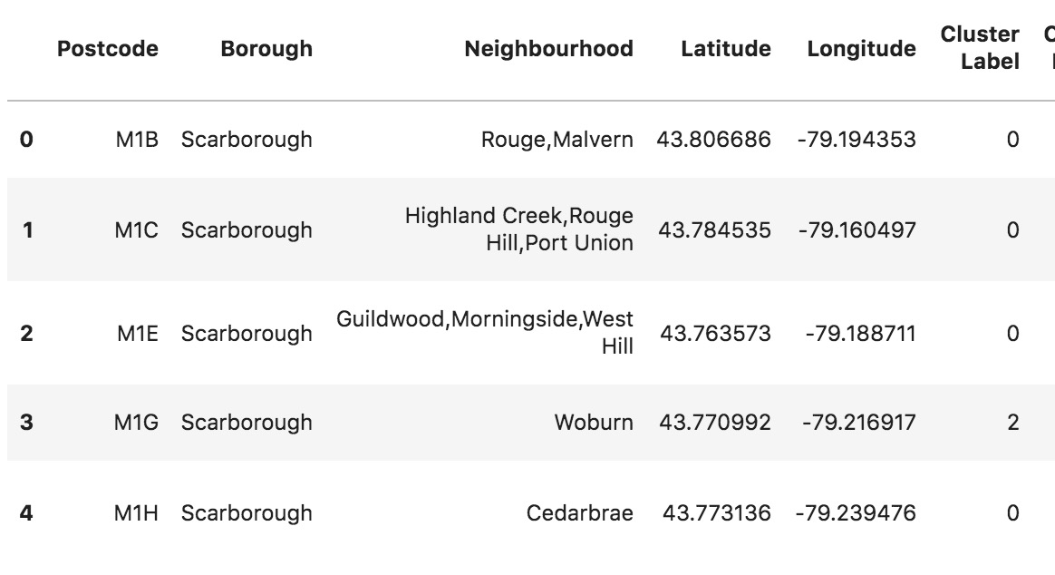
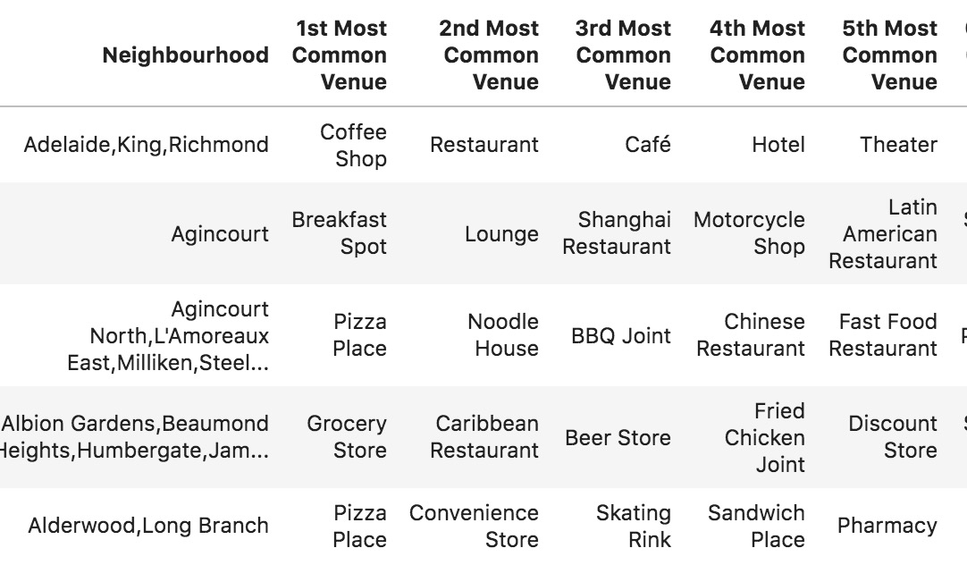
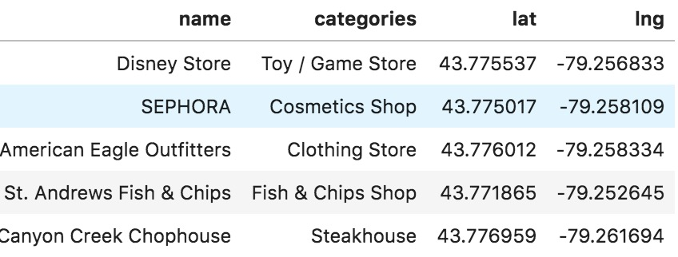
DataSets

Slide 5
Conclusion
In this Capstone project, using k-means cluster algorithm I separated the neighborhood into 10 different clusters and for different latitude and longitude from dataset, which have very-similar neighborhoods around them. Using the charts above results presented to a particular neighborhood based on average house prices and school rating have been made.

