Slide 1
Foundations of NLP and Transformers

Slide 2
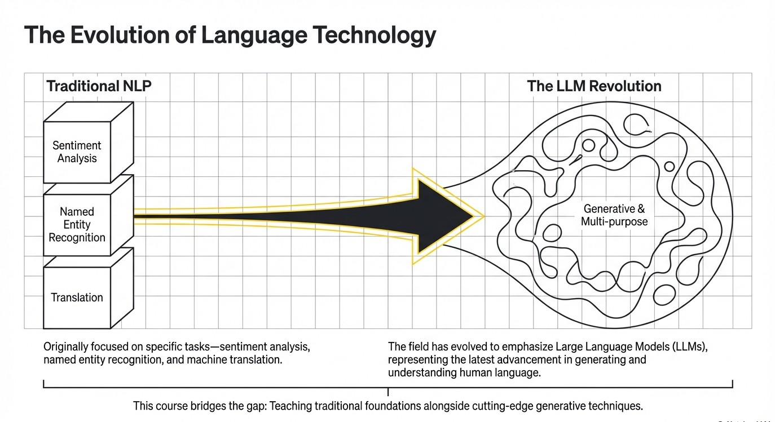

Slide 3
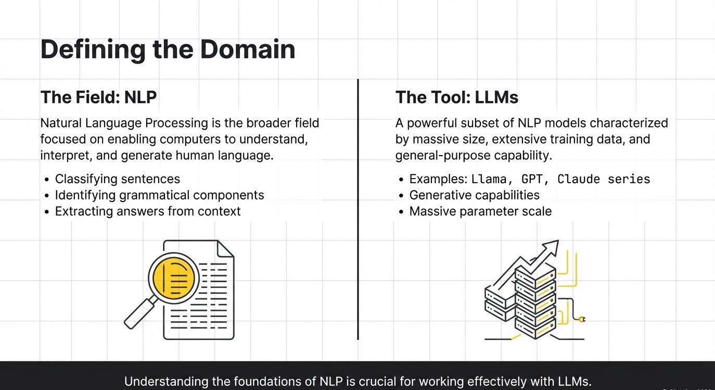

Slide 4
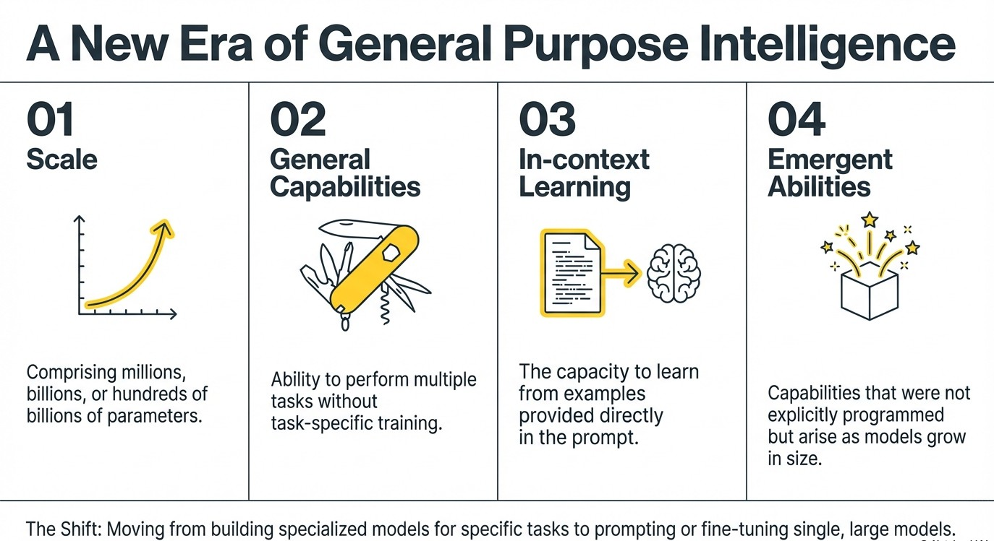

Slide 5
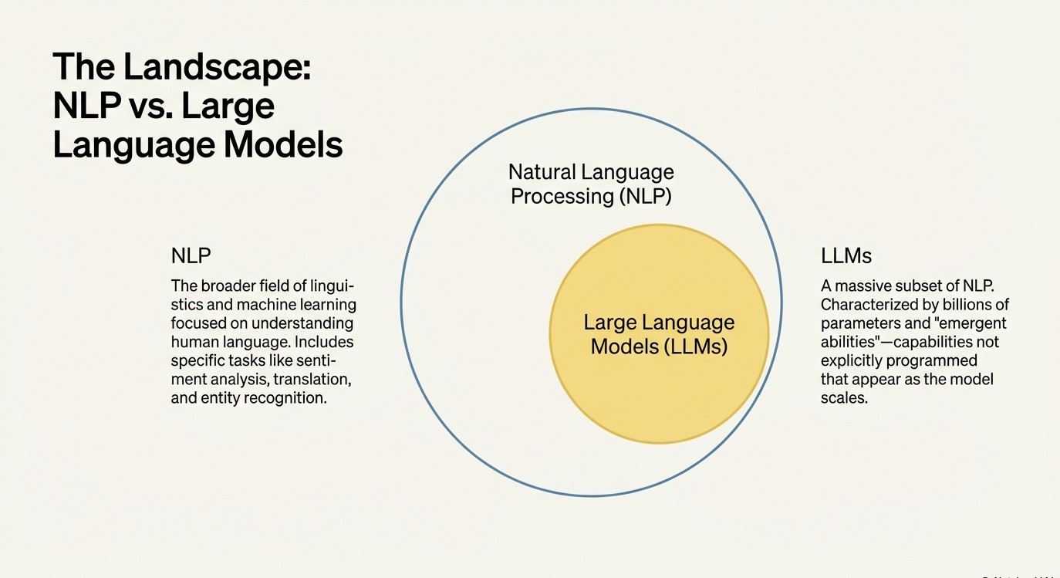

Slide 6
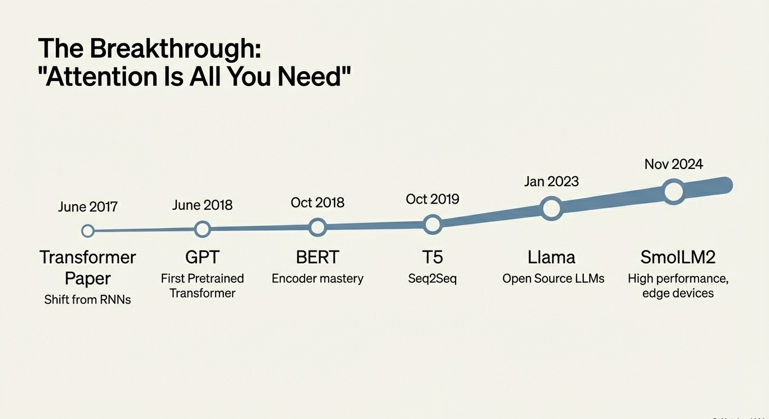

Slide 7
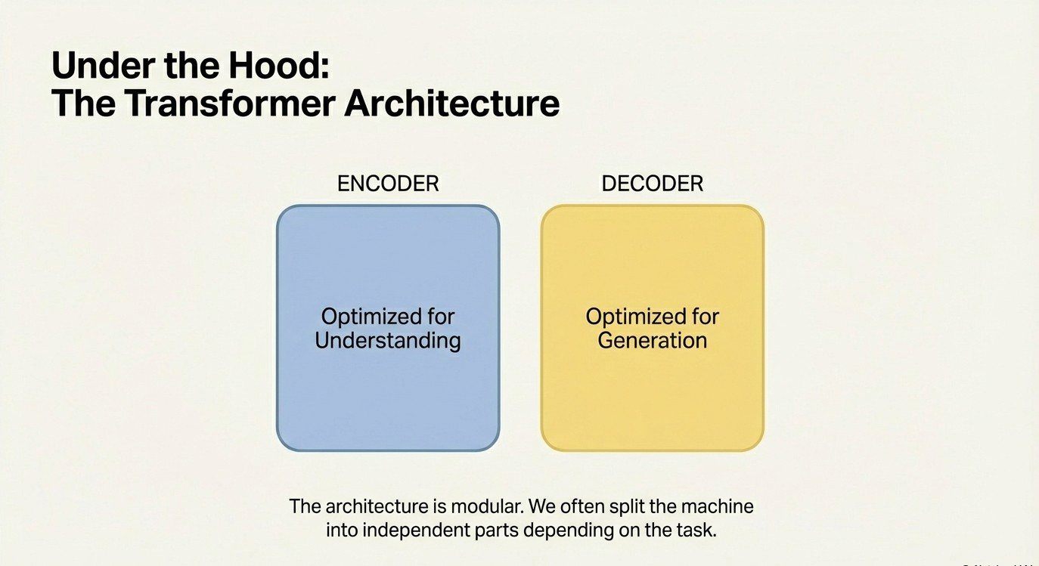

Slide 8
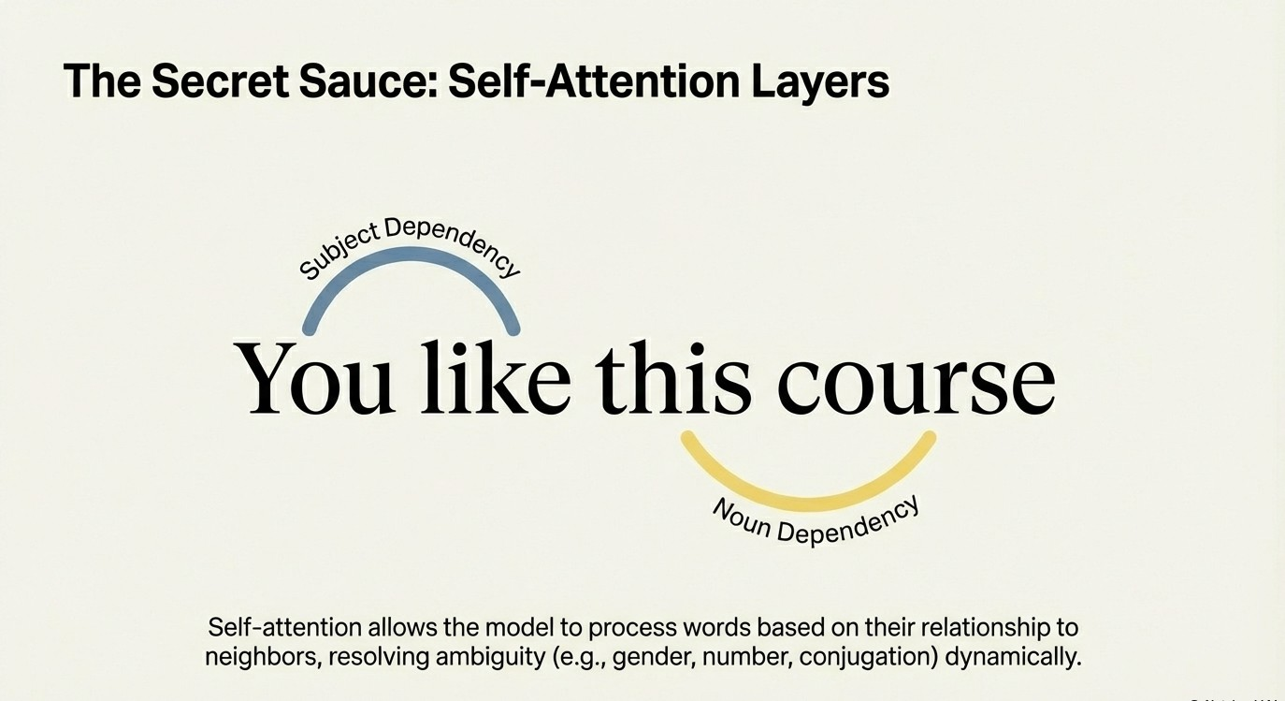

Slide 9
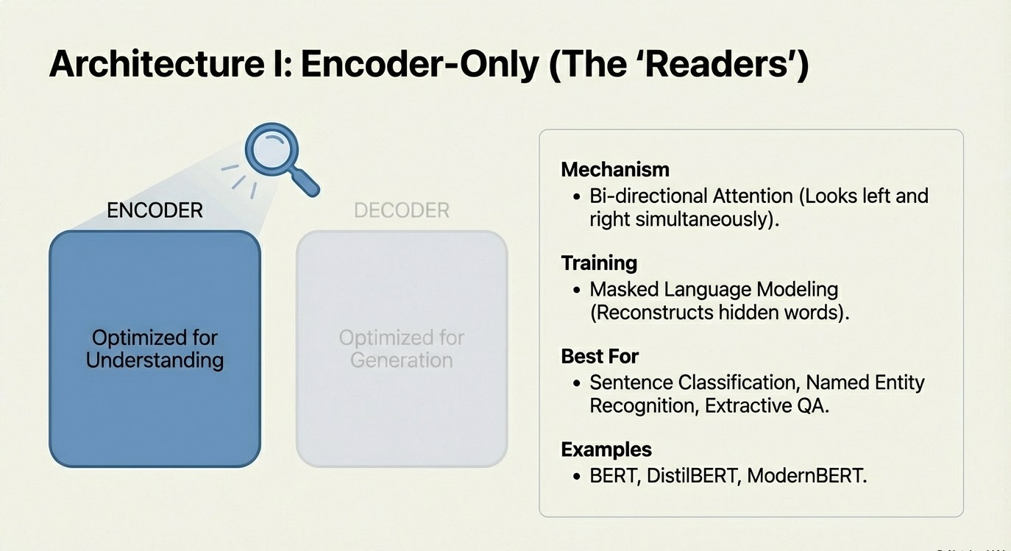

Slide 10
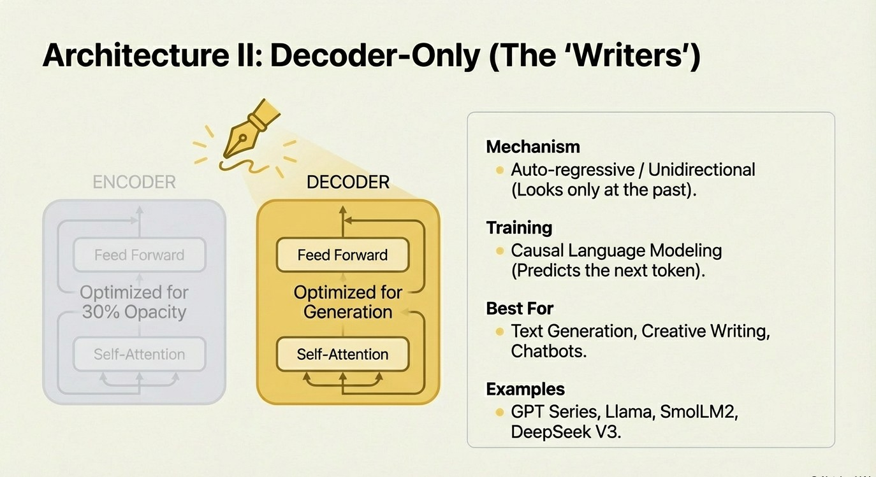

Slide 11
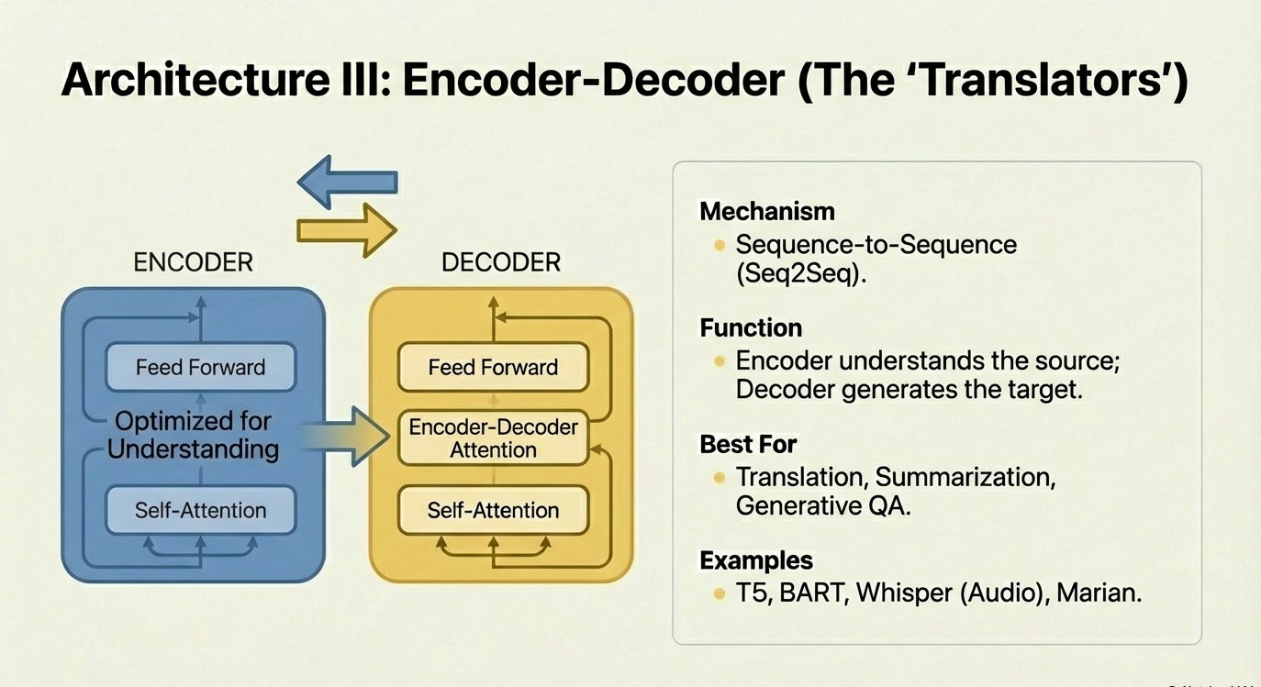

Slide 12
Task Simulation: https://poloclub.github.io/transformer-explainer/

Slide 13
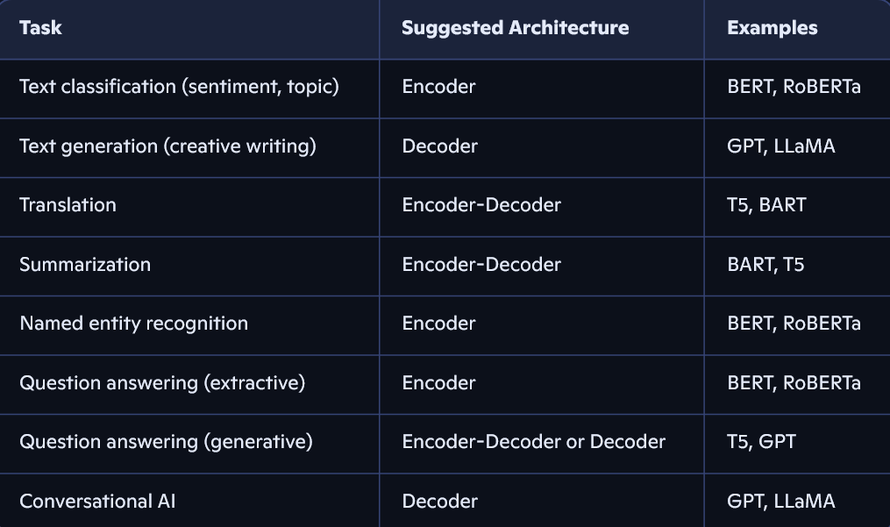

Slide 14
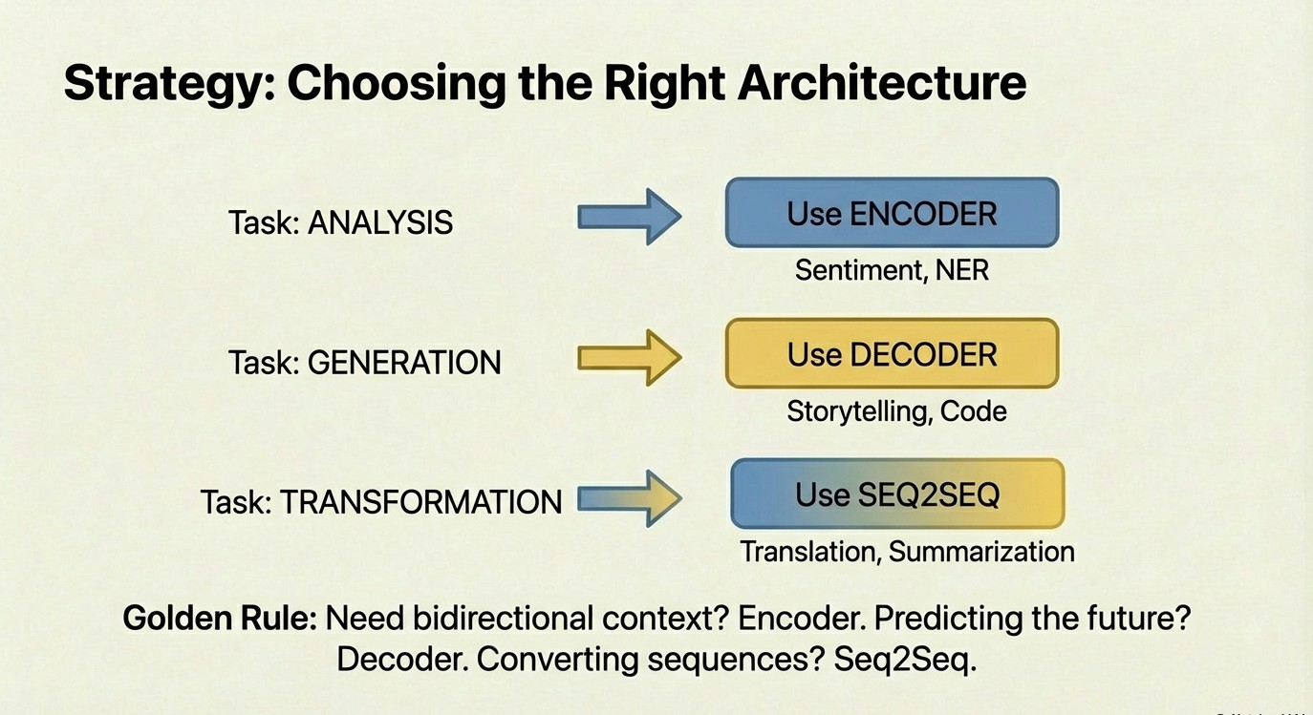

Slide 15
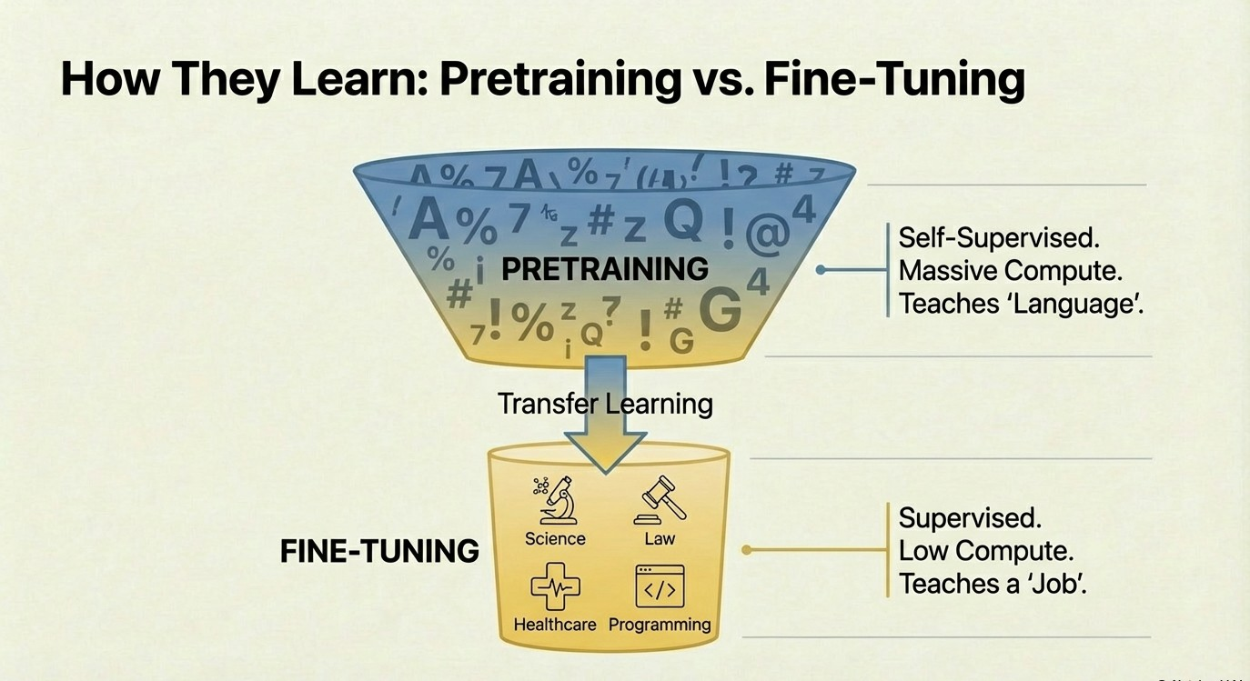

Slide 16
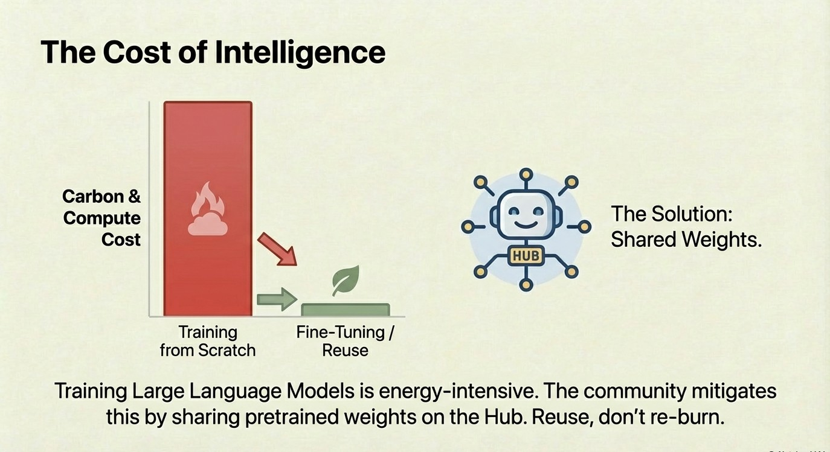

Slide 17
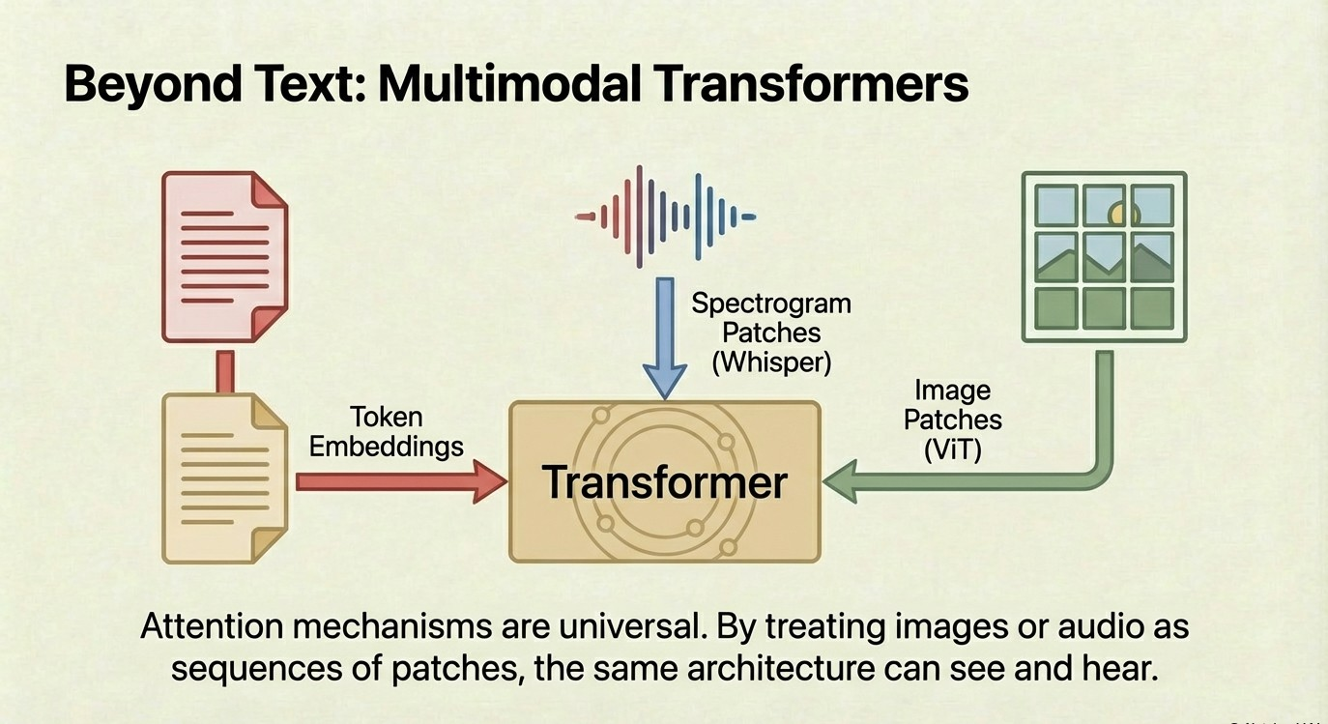

Slide 18
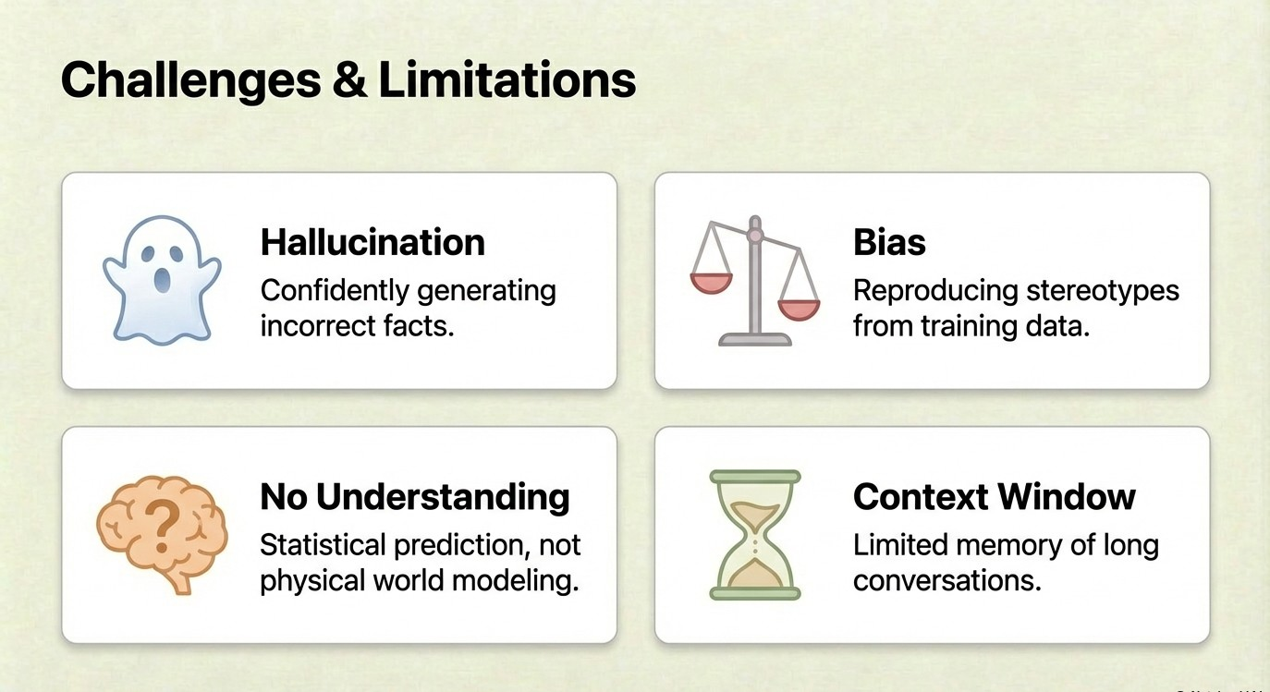

Slide 19
Hugging Face Introduction

Slide 20
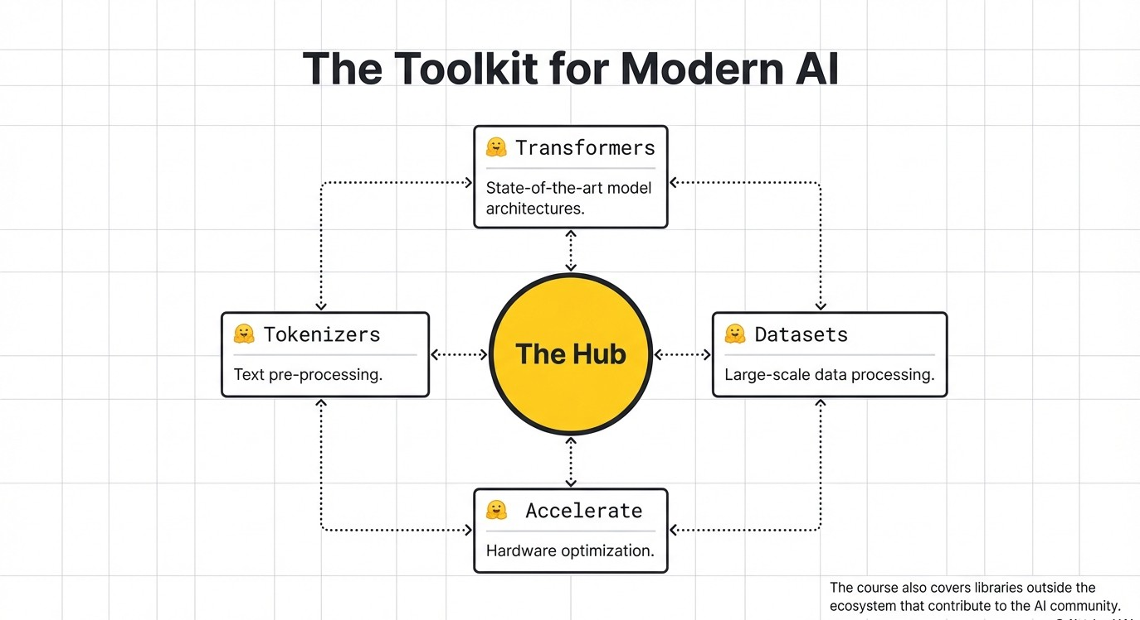

Slide 21
Pipelines
pipelines are a great and easy way to download and use models for inference. These pipelines are objects that abstract most of the complex code from the library, offering a simple API dedicated to several tasks, including Named Entity Recognition, Masked Language Modeling, Sentiment Analysis, Feature Extraction and Question Answering
There are two categories of pipeline abstractions to be aware about:
The pipeline() which is the most powerful object encapsulating all other pipelines.
Task-specific pipelines are available for audio, computer vision, natural language processing, and multimodal tasks.

Slide 22
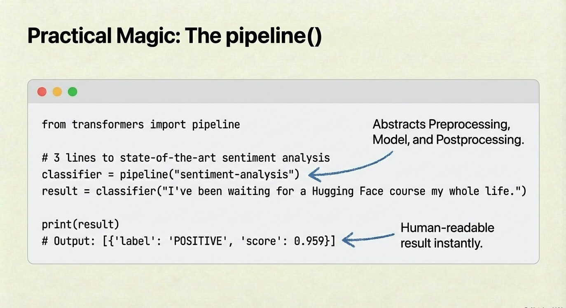
Note: in recent versions of the Hugging Face transformers library (v5+), the dedicated "question-answering" pipeline (along with "summarization" and "translation") was officially deprecated and removed.
the modern standard is to use general-purpose Large Language Models (LLMs).

Slide 23
Demonstration: Hugging Face and Inferencing LLM
https://colab.research.google.com/drive/1ivQtFPUm44BSarMzLmOou62gLlZfv87w

Slide 24
Exercise: Hugging Face and Inferencing LLM

Slide 25
Knowledge Check
1. What was the primary task the original Transformer architecture was designed for?
A. Image Classification
B. Speech Recognition
C. Machine Translation
D. Sentiment Analysis
2. Which of the following is an example of a Decoder-only Transformer model family?
A. BERT
B. T5
C. GPT
D. RoBERTa
3. What does self-supervised learning mean in the context of Transformer training?
A. Humans manually label all data
B. The training objective is automatically derived from the data itself
C. The model trains without any data
D. The model supervises other models

Slide 26
Knowledge Check
4. What is the primary role of the Encoder in a Transformer?
A. Generate output sequences
B. Store model checkpoints
C. Build contextual representations of the input
D. Compress the model size
5. Which Transformer architecture is most suitable for text classification tasks?
A. Decoder-only
B. Encoder-only
C. Encoder-Decoder
D. None of the above
6. Why are attention layers important in Transformers?
A. They reduce model size
B. They help the model focus on relevant words and context
C. They eliminate the need for training data
D. They replace tokenization

Slide 27
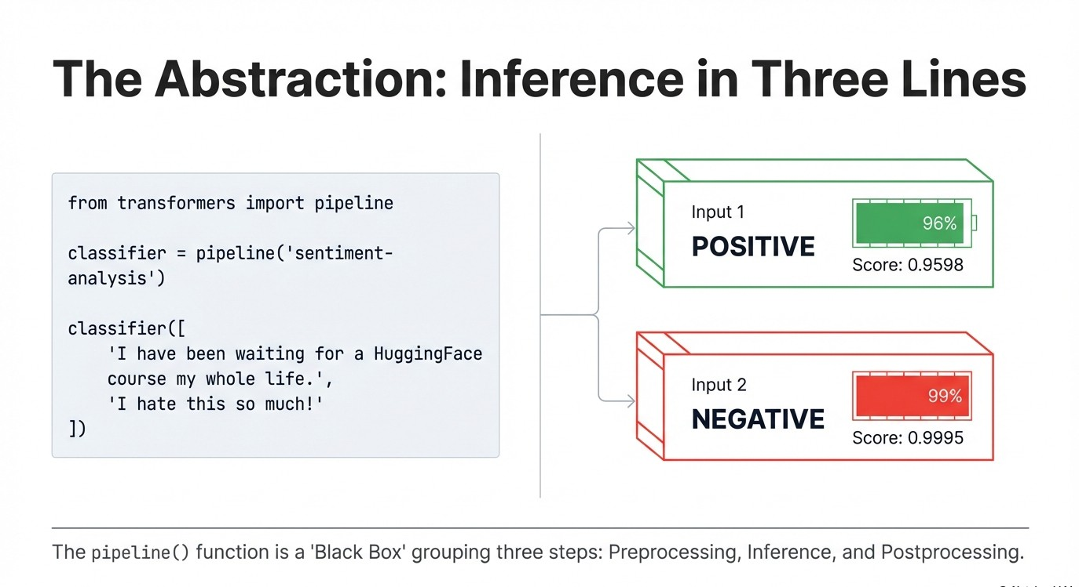

Slide 28
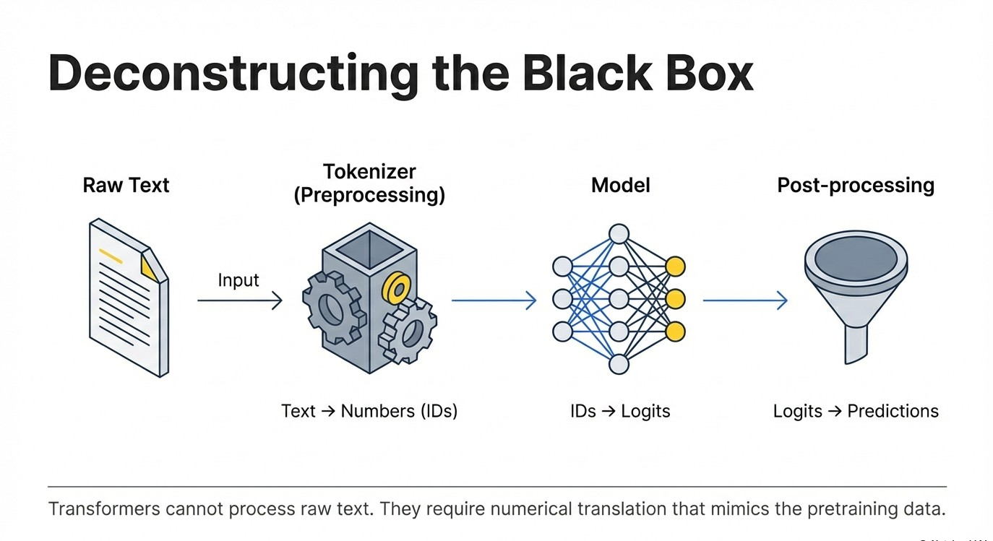

Slide 29
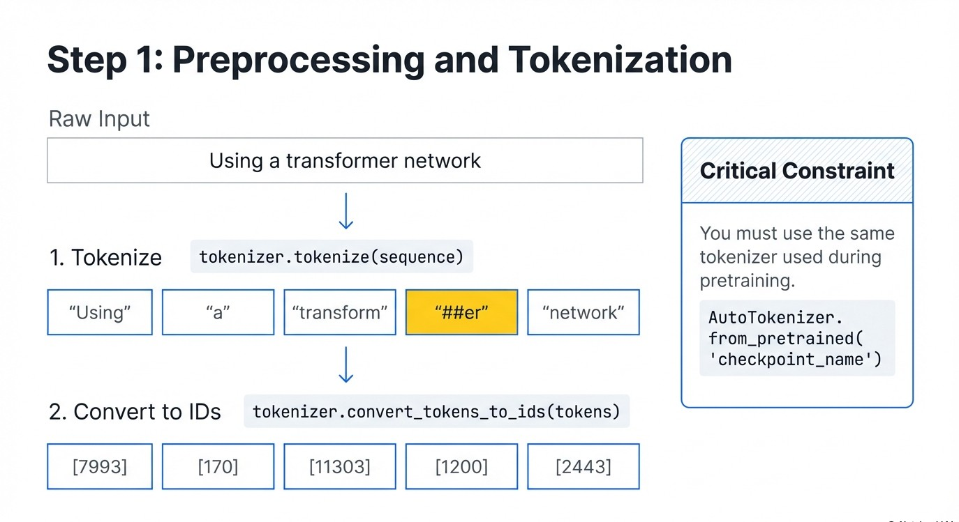

Slide 30
Understanding Tokenizers
What is a Tokenizer?
• Converts raw text into tokens (subwords or words)
• Maps tokens into numerical IDs
• Adds special tokens like [CLS], [SEP]
• Handles padding and truncation
Why do we need it?
Neural networks cannot understand text. They only understand numbers.
Tokenizers convert text → tokens → input IDs → tensors.
from transformers import AutoModel
model = AutoModel.from_pretrained(checkpoint)
outputs = model(**inputs)

Slide 31
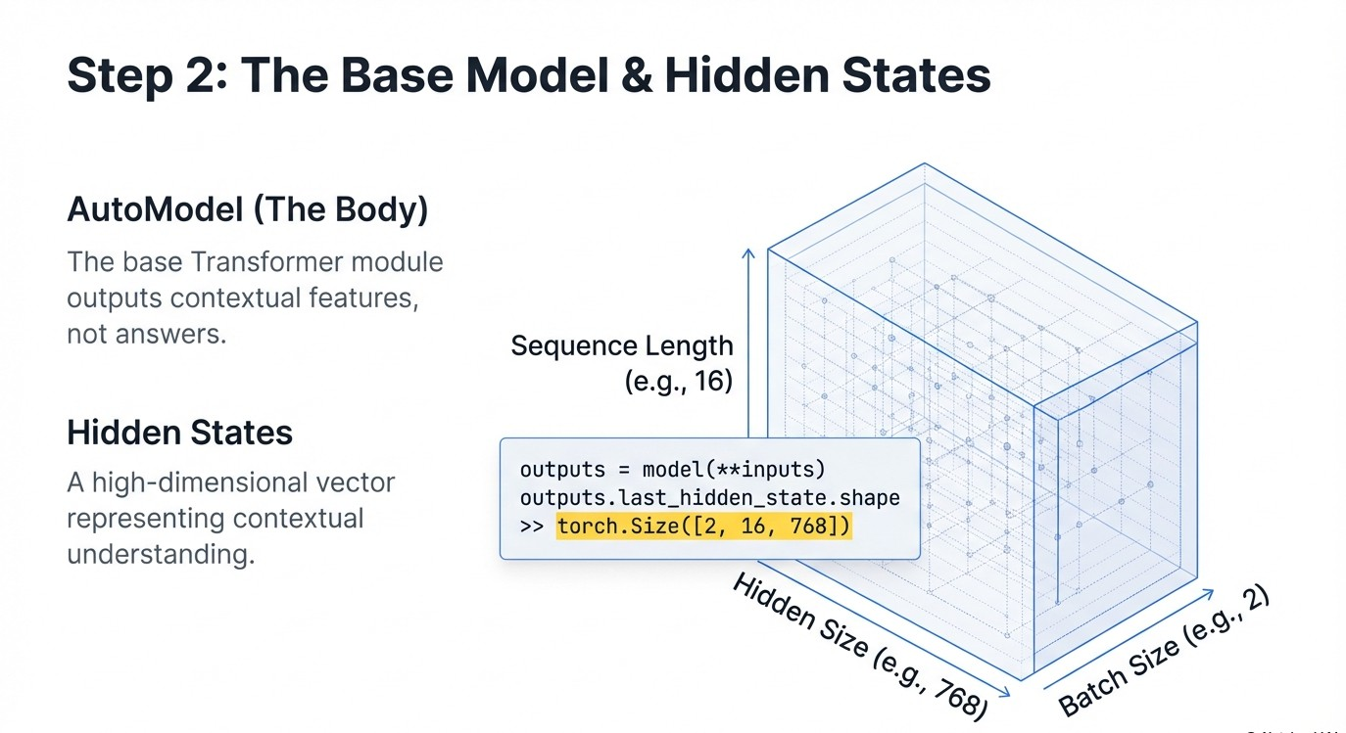

Slide 32
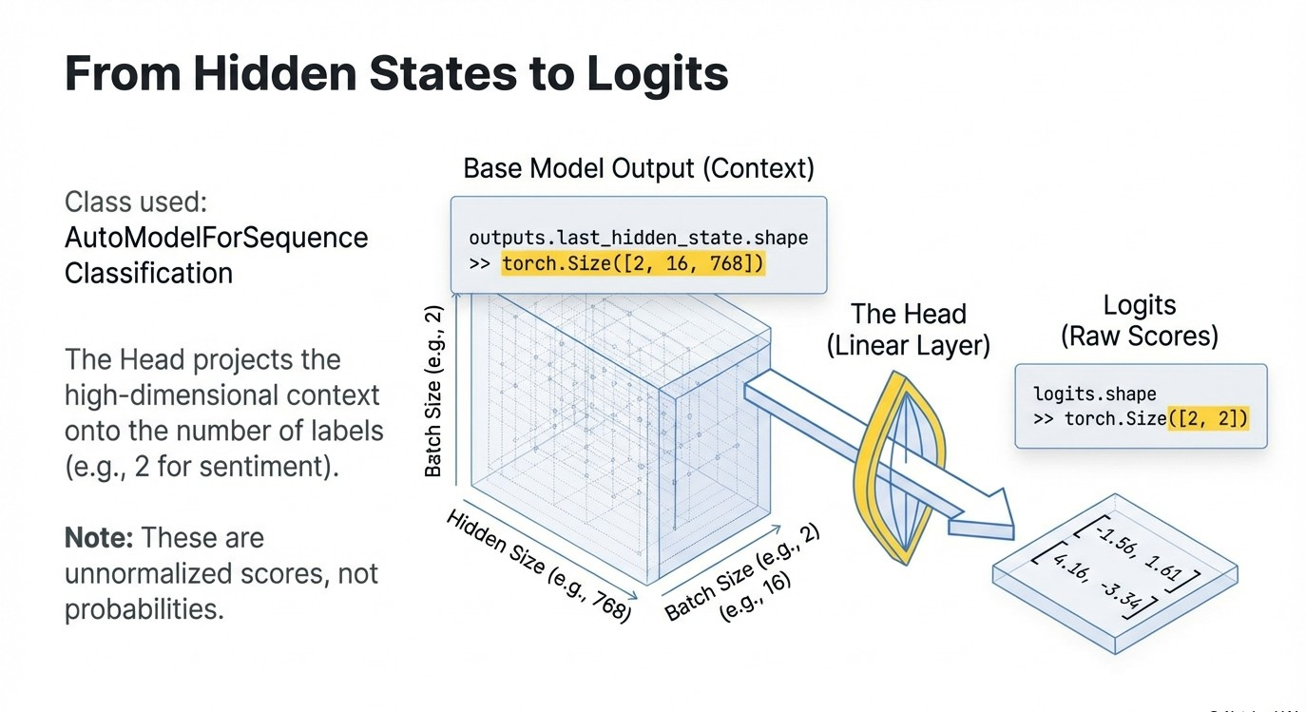

Slide 33
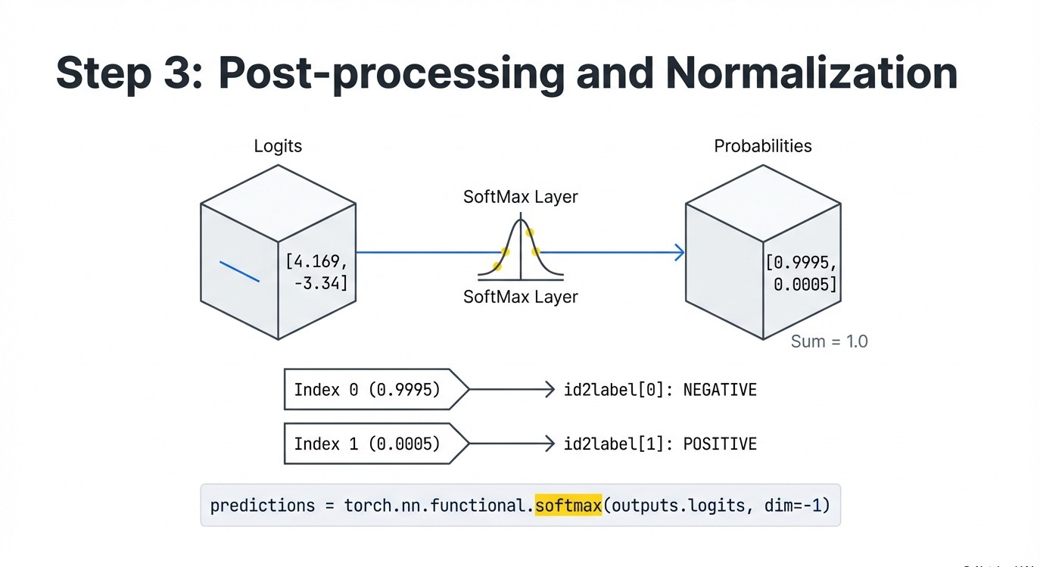

Slide 34
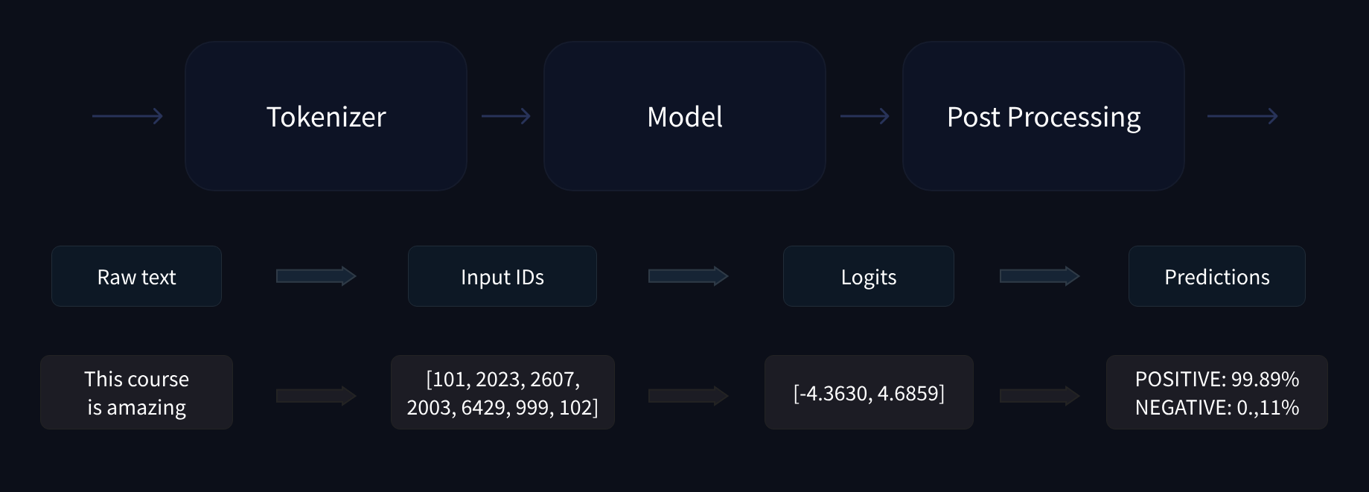

Slide 35
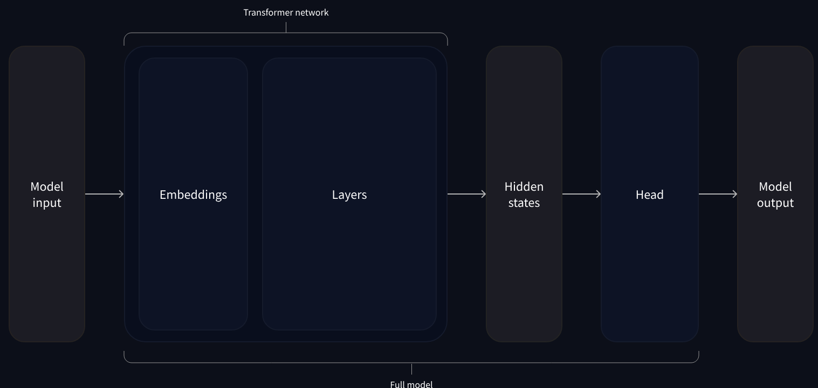

Slide 36
Demo + Exercise : Behind the Pipeline
https://colab.research.google.com/drive/1Z3QpeGzFdH4qNc2YxlJFEiMONAp4kbf2

