Slide 1
MCP
Model Context Protocol

Slide 2
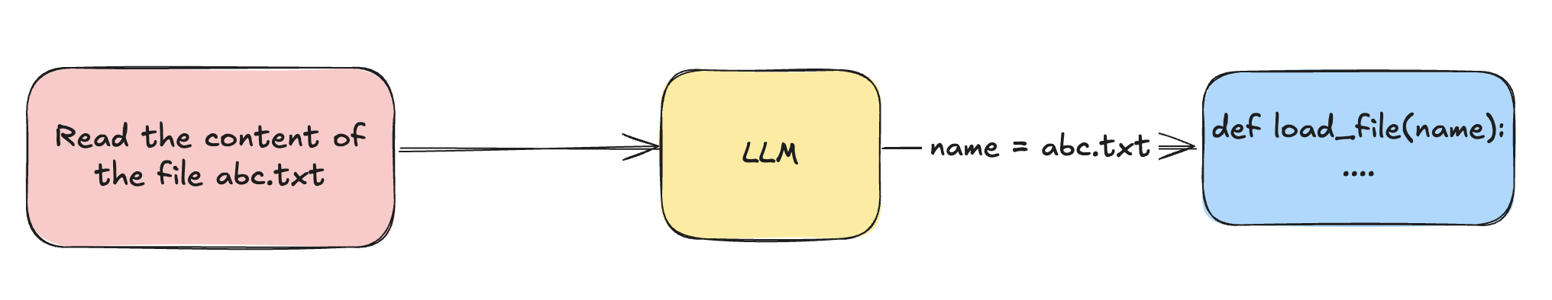
Function Calling
OpenAI introduced function calling in mid 2023
Function Calling is a way using which LLMs can call ext functions

Slide 3
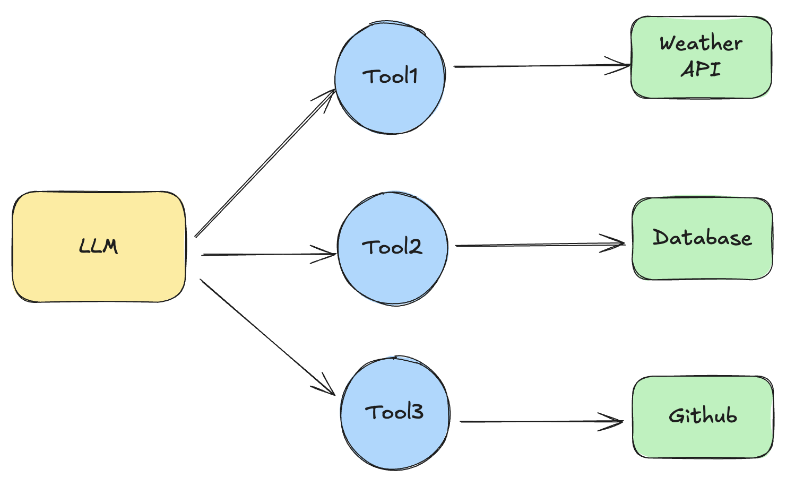
Abundance of Tools

Slide 4
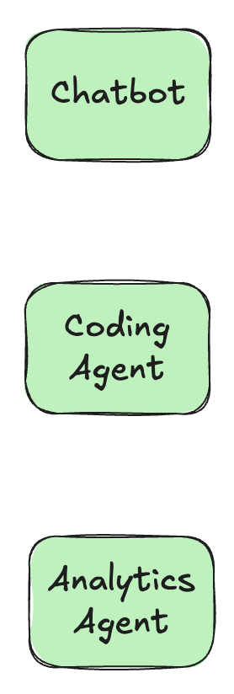
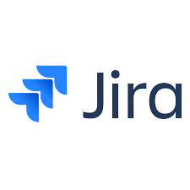


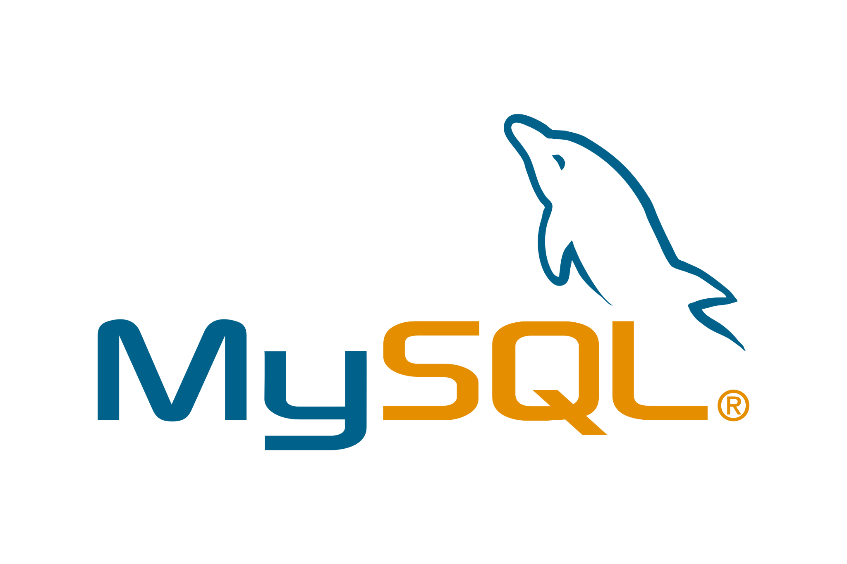

Problem with Tools
Integration Problem
N * M
Development Nightmare
Diff authentication methods
Diff data formats and API patterns
Diff error handling

Slide 5



Overview of the Problem
Every AI tool was building its own way to call every API.

Slide 6
The Solution
Github builds an integration that can be used by any AI Tool

Slide 7
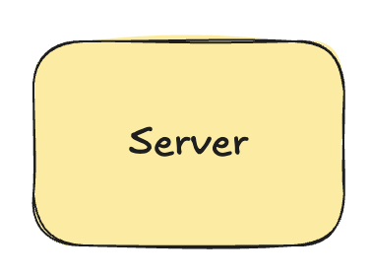
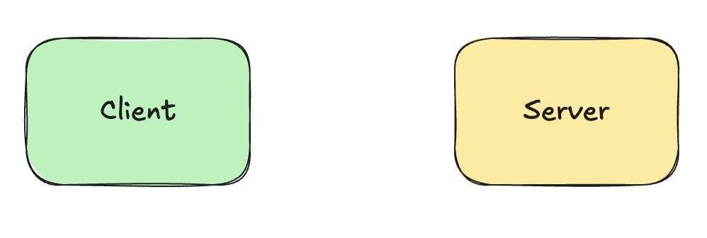
Enter MCP
MCP Server SDK
MCP Client SDK

Slide 8
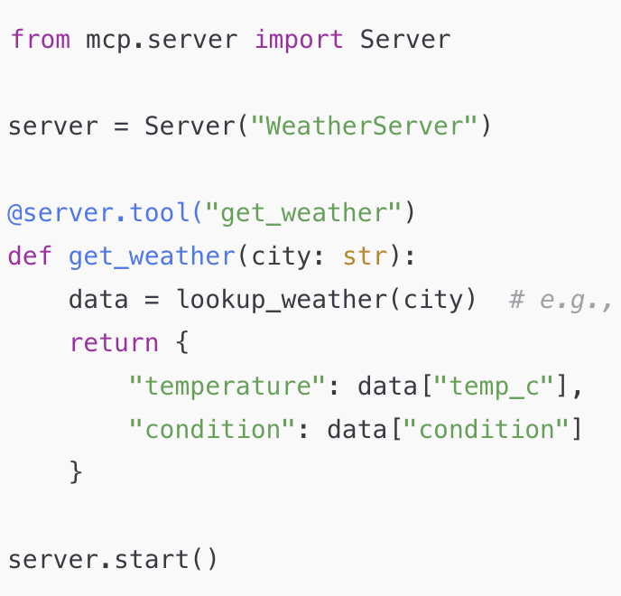
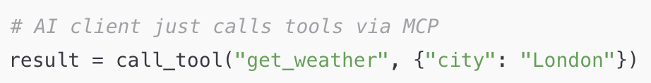
MCP vs API
Server
Client

Slide 9
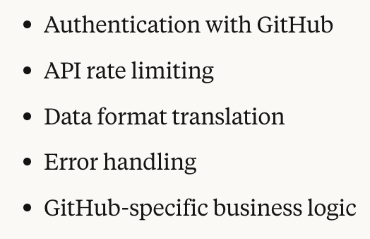
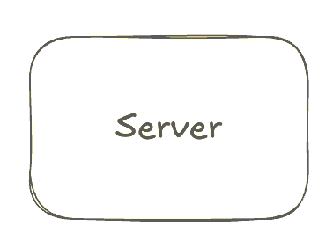
Server does the Heavy Lifting
The Client has to just connect to the server using the same language

Slide 10
Knowledge Check
Q1. What is the main purpose of the Model Context Protocol (MCP)?
To restrict the training data used by AI models
To enable AI models to interact with external tools, data sources, and environments
To eliminate the need for prompting in LLMs
To introduce a new programming language for AI
Q2. Which core problem is MCP designed to address?
The shortage of AI models
The high cost of training large language models
The M×N integration problem between applications and tools
The complexity of designing new AI algorithms
Q3. What is a key advantage of using MCP?
Reduced accuracy of AI models
Increased development complexity
Standardization and interoperability across AI systems
Isolation of AI systems from external services

Slide 11
Knowledge Check
Q1. What is the main purpose of the Model Context Protocol (MCP)?
To restrict the training data used by AI models
To enable AI models to interact with external tools, data sources, and environments ✅
To eliminate the need for prompting in LLMs
To introduce a new programming language for AI
Q2. Which core problem is MCP designed to address?
The shortage of AI models
The high cost of training large language models
The M×N integration problem between applications and tools ✅
The complexity of designing new AI algorithms
Q3. What is a key advantage of using MCP?
Reduced accuracy of AI models
Increased development complexity
Standardization and interoperability across AI systems ✅
Isolation of AI systems from external services

Slide 12
MCP Primitives
Tools - Actions the AI ask the server to perform.
Resources - Structured data sources that the AI can read
Prompts - Predefined prompt templates or instructions that the server offers to help shape the AI's behavior

Slide 13
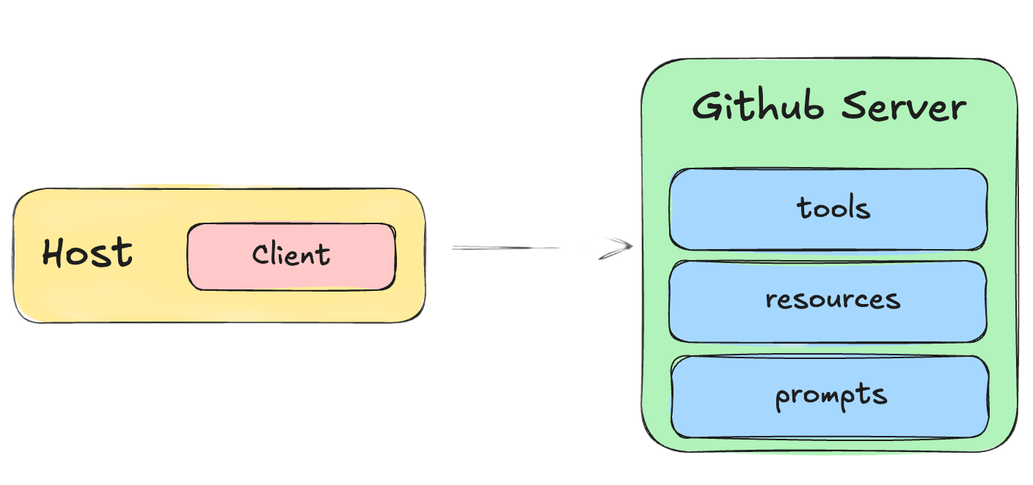
The Prompts Primitives
Create an issue for a bug:
the login button doesn’t work.
/create-issue

Slide 14
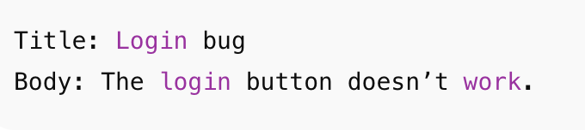
The Prompts Primitives
Too vague!

Slide 15
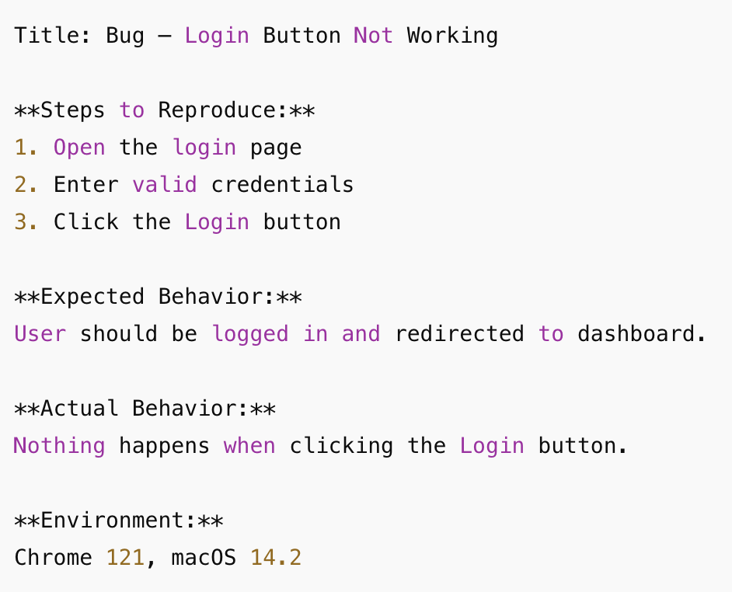
The Prompts Primitives
{
"name": "issue_report_prompt",
"description": "Write clear, detailed GitHub issues",
"messages": [{
"role": "system",
"content": "Always include: Title, Steps to Reproduce, Expected, Actual, Environment"}
}]
}

Slide 16
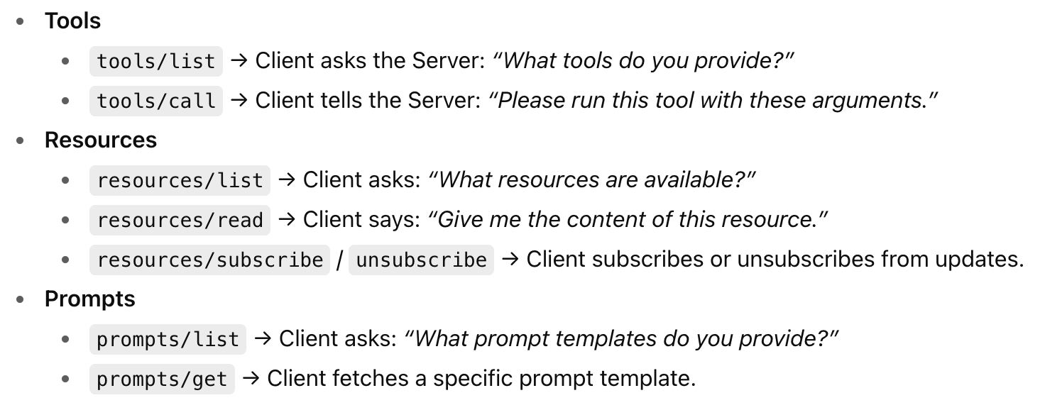
Primitives - Standard Operations

Slide 17
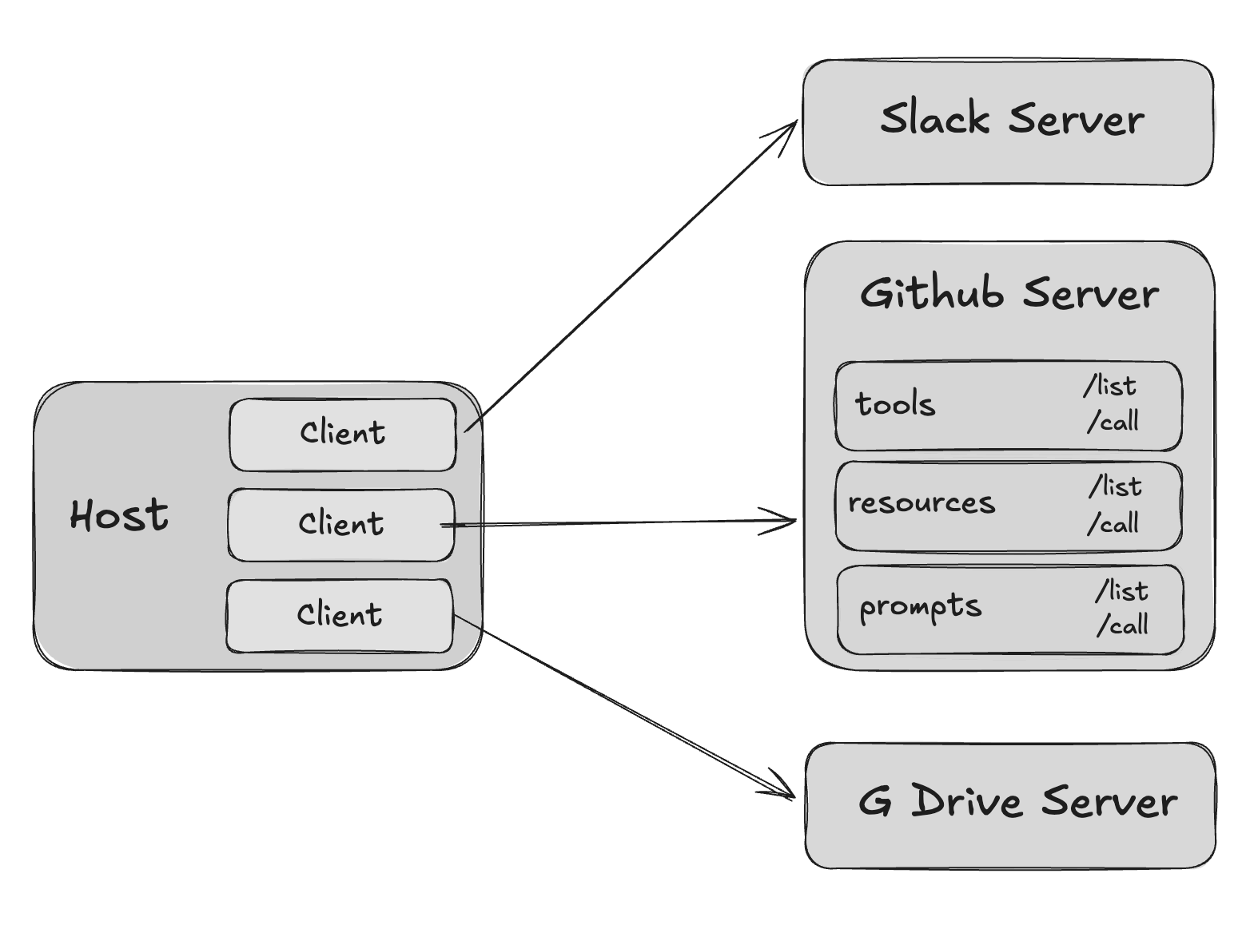
Summary till now!

Slide 18
MCP Data Layer
Data Layer - The data layer is the language of the MCP ecosystem that everyone agrees upon to communicate.
In MCP, JSON RPC 2.0 serves as the foundation of the data layer

Slide 19
JSON RPC 2.0
JSON-RPC stands for JavaScript Object Notation – Remote Procedure Call.
A Remote Procedure Call (RPC) allows a program to execute a function on another computer as if it were local, hiding the details of network communication and data transfer. This abstraction makes it easier to build distributed applications.
Instead of writing add(2, 3) locally, you send a request to the server saying “please run add with parameters 2 and 3.”

Slide 20
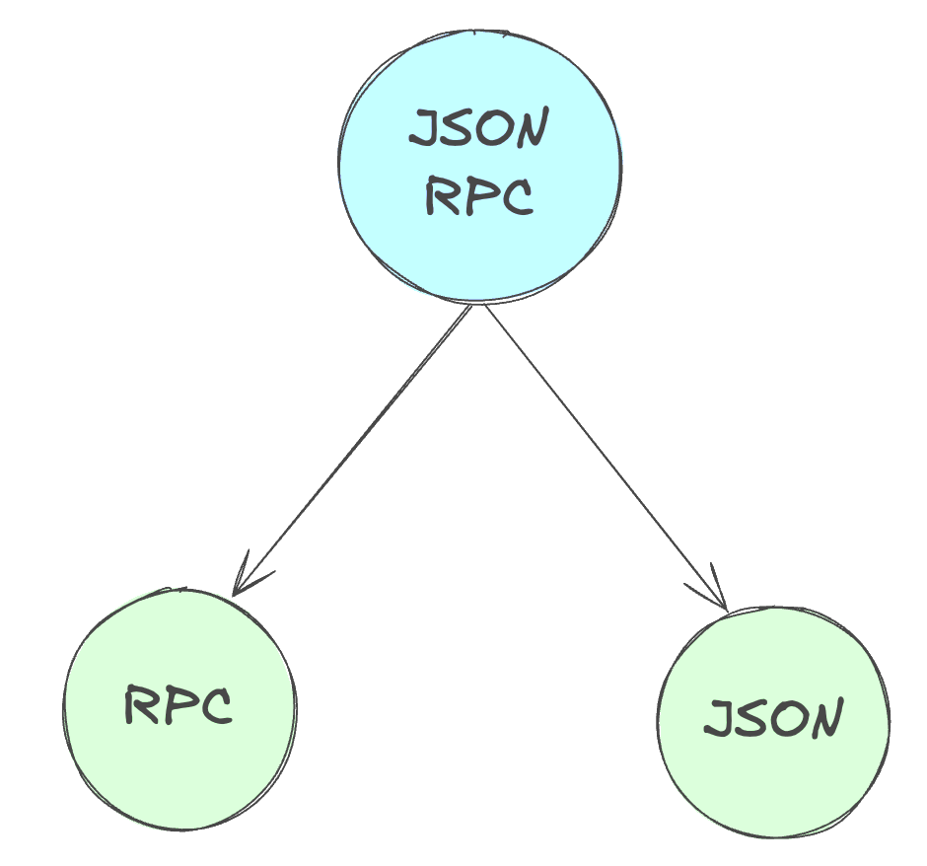
JSON RPC 2.0
JSON-RPC combines the concept of Remote Procedure Calls with the simplicity of JSON, allowing developers to structure RPC requests and responses in a standardized JSON format.

Slide 21
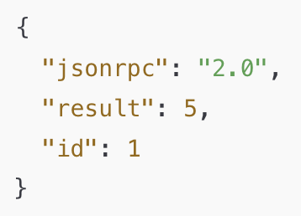
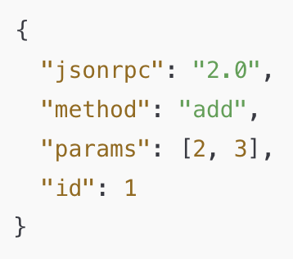
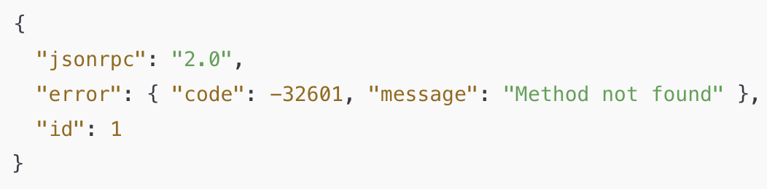
JSON RPC 2.0
Response Structure
Request Structure

Slide 22
Why JSON RPC for Data Layer?
It’s lightweight
Supports bi-directional communication
It is transport-agnostic
Supports batching
Supports notification

Slide 23
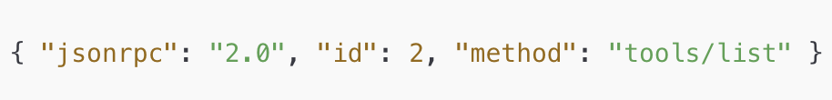
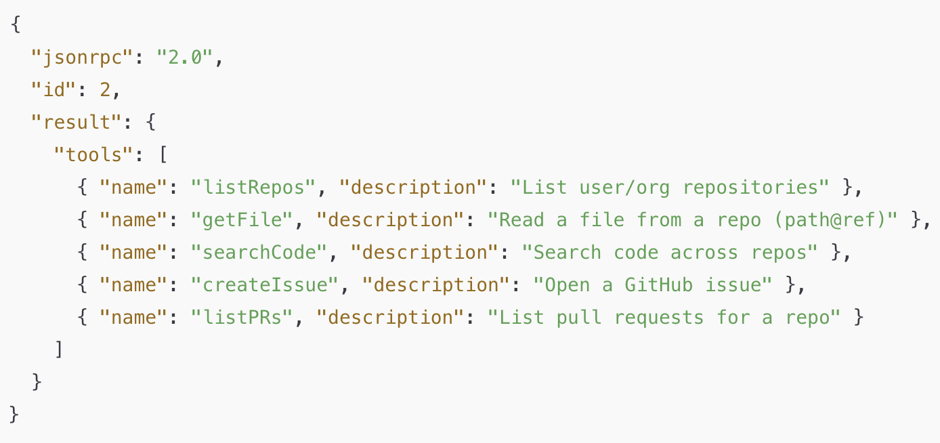
Dynamic Capability Discovery

Slide 24
Demo: Building our own MCP Server
+
Exercise: Creating own MCP server and adding it as tool

Slide 25
Knowledge Check
Q1: What is the main purpose of the MCP SDKs?
To define the MCP protocol specification
To make it easier to implement MCP clients and servers
To provide a visual interface for MCP interactions
To replace the need for programming languages
Q2: According to the provided text, which company maintains the official Python SDK for MCP?
Google
JetBrains
Microsoft
Anthropic
Q3: What is the role of JSON-RPC 2.0 in MCP?
As a primary transport mechanism for remote communication
As a tool for debugging AI models
As the message format for all communication between Clients and Servers
As a method for defining AI capabilities like Tools and Resources

Slide 26
Knowledge Check
Q1: What is the main purpose of the MCP SDKs?
To define the MCP protocol specification
To make it easier to implement MCP clients and servers
To provide a visual interface for MCP interactions
To replace the need for programming languages
Q2: According to the provided text, which company maintains the official Python SDK for MCP?
Google
JetBrains
Microsoft
Anthropic
Q3: What is the role of JSON-RPC 2.0 in MCP?
As a primary transport mechanism for remote communication
As a tool for debugging AI models
As the message format for all communication between Clients and Servers
As a method for defining AI capabilities like Tools and Resources

