Slide 1
Advanced RAG and AI Agents with Hugging Face, Microsoft Foundry, MCP and Agent Framework
4 Days | 32 Hours | Instructor-led | Hands-on
From transformer foundations to adaptive RAG, orchestrated agents and production observability

Slide 2
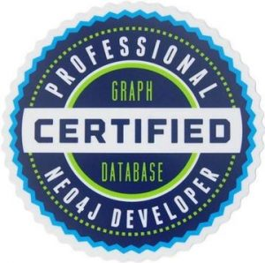
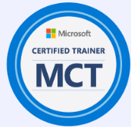


Hello!
Thank you for joining me today
Instructor: Krishna Dwivedi
Microsoft Certified Trainer
Certified AI Engineer, Data Scientist, Vector Database, and Graph Database engineer
Deliver Azure AI,ML Courses along with Custom courses
Rated among Top 100 Data and AI trainers Globally by Microsoft
Having over 8+ years of experience in Training
Professional Certifications in Excel, Python, Machine Learning ,Deep Learning and Generative AI
Training Delivered for Clients
John Hopkins University
Boenig
Bupa
DXC
TCS
Infosys
KPMG US
HCL
City of Surrey (US)
Crown Lands (Government, Australia) n many more

Slide 3
👋 Participant Introduction
Please share a few details about yourself:
  • Company / Organization – Where you work or represent
  • Role / Position – Your current responsibilities
  • Exposure to AI – Any prior experience, projects, or learning in AI
  • Expectations from this session – What you hope to gain or learn
Create a photorealistic image in a clean cartoon whiteboard sketch style that visualizes my work life. Include what I do, who I work with, my role, my values and what's important to me. I've attached a headshot so you can guide the sketch of me at the center. Use my attached photo as the visual reference for my appearance. Use my publicly available LinkedIn profile and, where available, my Microsoft 365 Work IQ, Microsoft Graph, organizational profile, collaboration patterns, documents, meetings, emails, chats, and other Microsoft 365 signals to identify and infer my current role, responsibilities, key work activities, projects, areas of expertise, frequent collaborators, organizational relationships, priorities, values, and what is important to me professionally. The graphic should be rich in information. For the people I work with, use their actual Microsoft 365 profile photos when available. Do not ask me to manually provide my role, responsibilities, key collaborators, values, or work focus areas unless this information cannot be determined from the available Microsoft 365 and LinkedIn data sources.

Slide 4
🎯 Course Objectives
Explain transformer architecture and use Hugging Face models, tokenizers and pipelines
1
Create and extend agents using the Microsoft Foundry SDK and MCP capabilities
2
Apply Microsoft Agent Framework orchestration patterns to controlled agent workflows
3
Build Standard, Hybrid, Corrective, and Agentic or Adaptive RAG solutions
4
Evaluate RAG and agent quality and observe execution through Microsoft Foundry
5

Slide 5
🧪 Lab Details
☁️
Azure Subscription
Provided to each student
Used for Microsoft Foundry projects, model deployments and agents
🖥️
Virtual Machine (VM)
Provided to each student
Hands-on lab environment for Python and VS Code exercises
Every module ends with a hands-on lab, run on your own Azure subscription and VM.

Slide 6
☕ Course Break Timings
Break 1
15 min
Short refresh break
Lunch Break
60 min
Full hour to recharge
Break 2
15 min
Short refresh break
A typical 8-hour training day
6.5 hours of learning and labs
1.5 hrs breaks
2 × 15 min breaks + 1 × 60 min lunch = 90 min of breaks per day

Slide 7
🎓 Microsoft Applied Skills Exam
Get started developing agents in Microsoft Foundry
Beginner
Level
45 min
Duration
Lab-based
Interactive assessment
Skills evaluated in the assessment
1 Deploy a model
2 Create an agent
3 Test the agent
Take the exam on Microsoft Learn →
https://learn.microsoft.com/en-us/credentials/applied-skills/get-started-developing-agents-in-microsoft-foundry/

