Slide 1
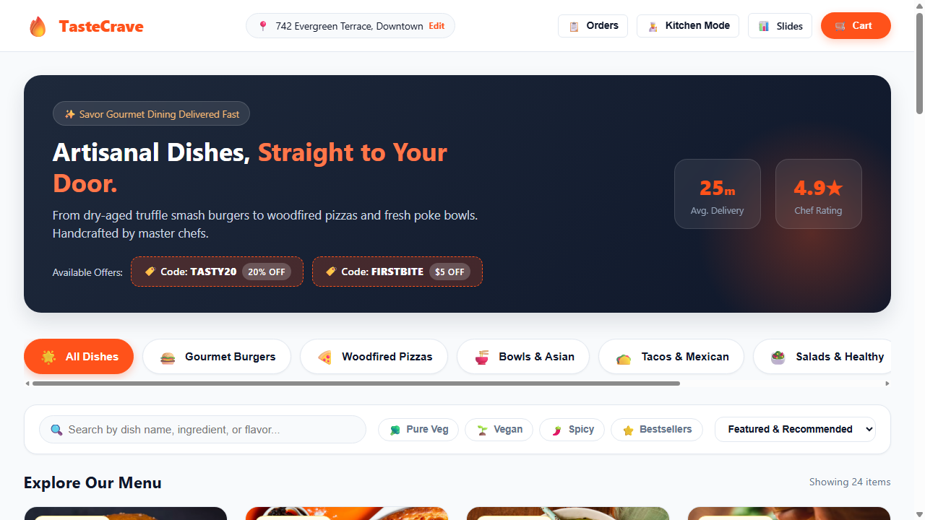
Slide 1: Online Food Ordering System - Home Page
Users can open the website to browse delicious food items.
Features top navigation, delivery address selector, and active promo offers (TASTY20, FIRSTBITE).

Slide 2
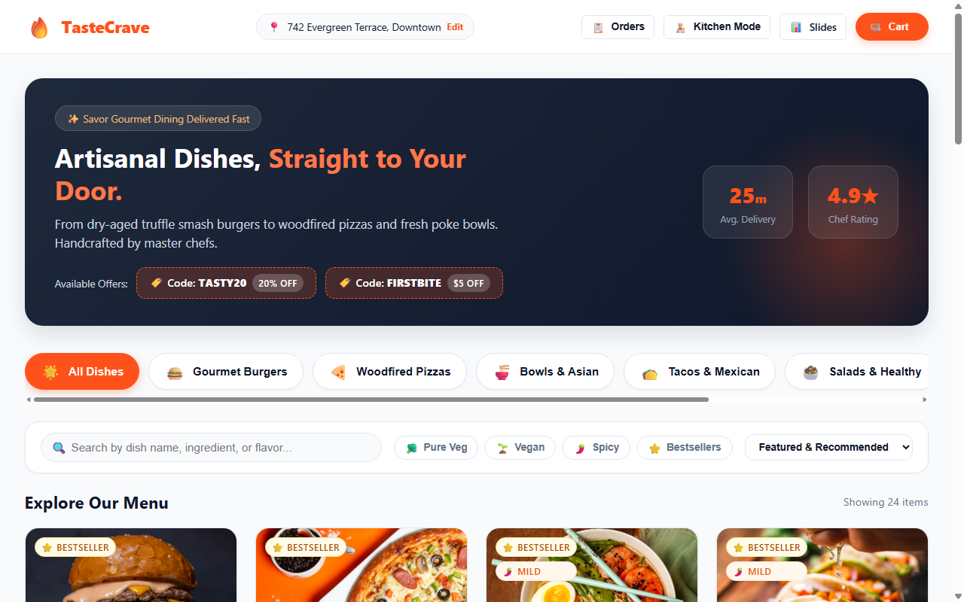
Slide 2: Viewing Food Items & Categories
7 categories: Burgers, Pizzas, Asian Bowls, Tacos, Salads, Desserts, and Drinks.
Each item displays high-definition photo, price, calories, prep time, and chef rating.

Slide 3
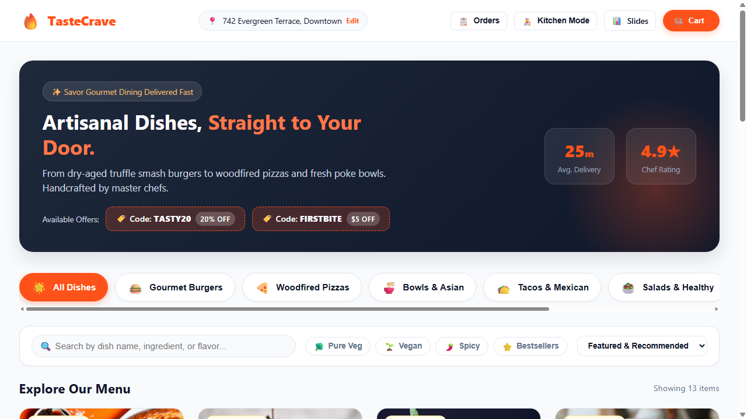
Slide 3: Search & Dietary Filters (Veg, Vegan, Spicy)
Search bar with live instant filtering as user types dish names.
One-click filter buttons for Pure Veg (🥦), Vegan (🌱), Spicy (🌶️), and Bestseller (⭐) dishes.

Slide 4
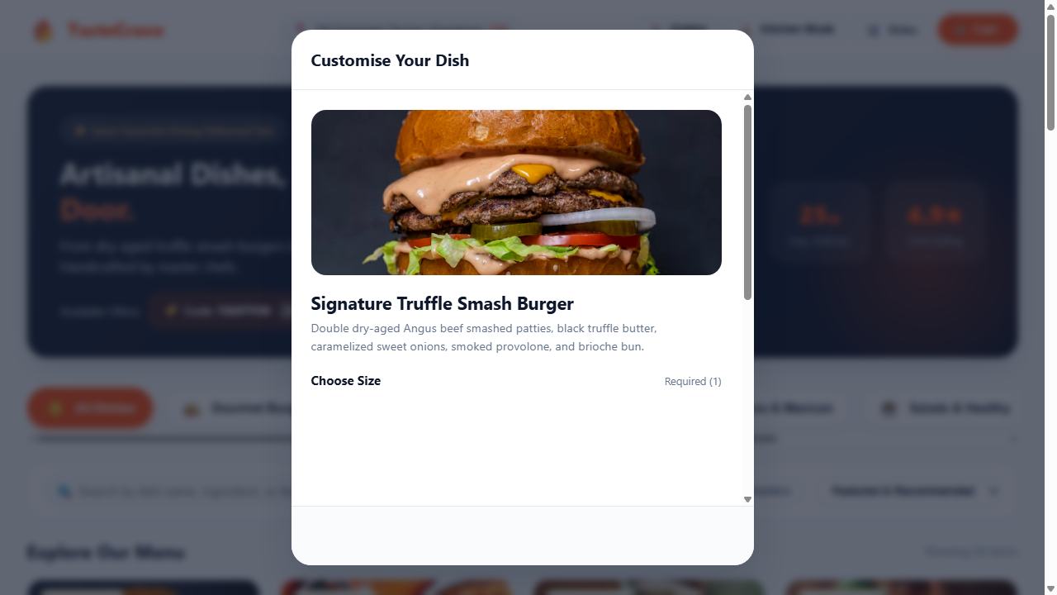
Slide 4: Customizing Dishes (Size & Crust Options)
Clicking 'Customise' opens this modal dialog for the selected dish.
Users choose size (Regular / Double Deluxe) and crust (Woodfired / Garlic Stuffed / Gluten-Free).

Slide 5
Slide 5: Adding Extra Toppings & Special Notes
Users can check extra toppings (Aged Cheddar, Smoked Bacon, Truffle Aioli).
Special cooking instructions textarea (e.g. 'Sauce on side, extra crispy fries'). Price updates live.

Slide 6
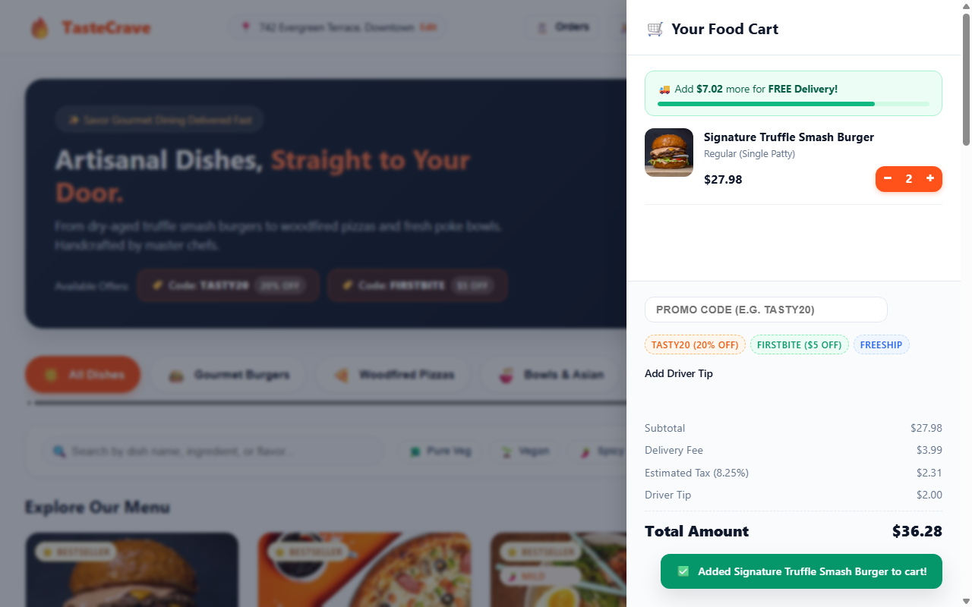
Slide 6: Shopping Cart Drawer & Free Delivery Meter
Slide-out cart drawer lets users increase/decrease quantity (- / +) or delete items.
Visual progress bar shows remaining amount needed to unlock Free Delivery ($35 threshold).

Slide 7
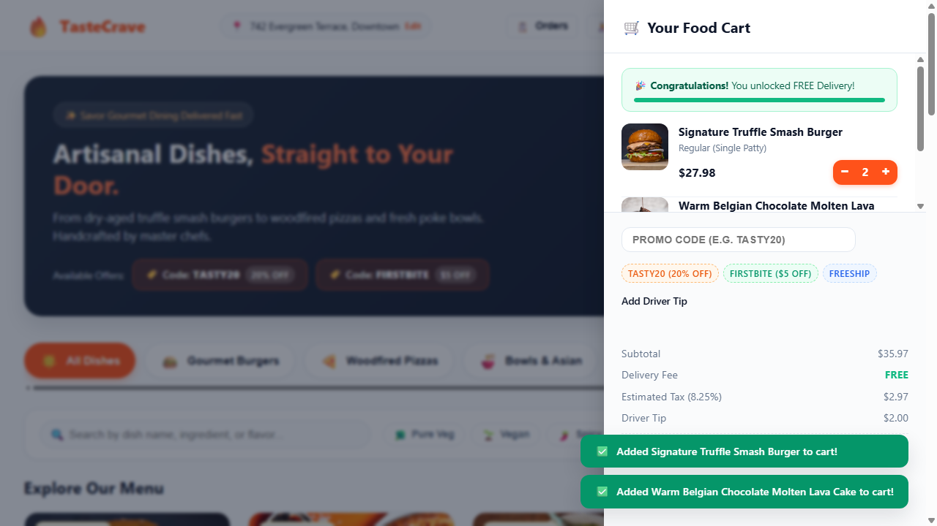
Slide 7: Applying Promo Coupons & Driver Tip
Users enter promo codes like 'TASTY20' to get an instant 20% discount on their order.
Driver tip selection pills ($0, $2, $3, $5) and transparent itemized bill breakdown.

Slide 8
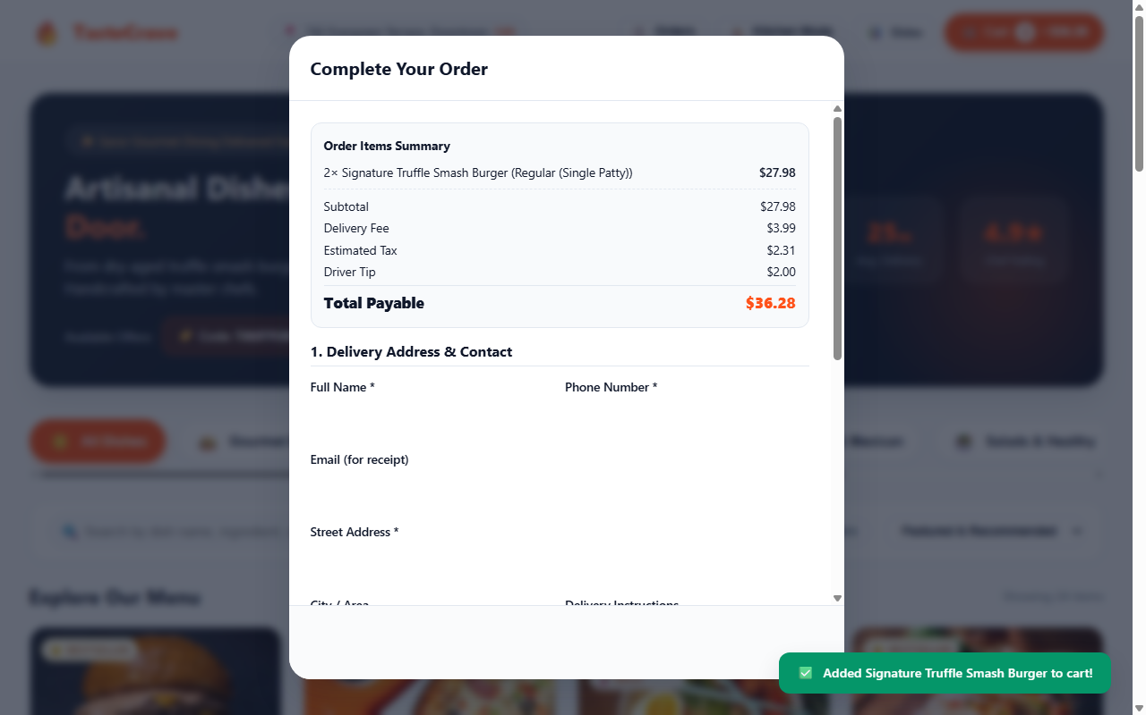
Slide 8: Checkout & Multiple Payment Methods
Customer enters delivery address, contact phone, and chooses standard or priority speed.
Supports 3 payment methods: Credit/Debit Card, Instant UPI QR Code, and Cash on Delivery (COD).

Slide 9
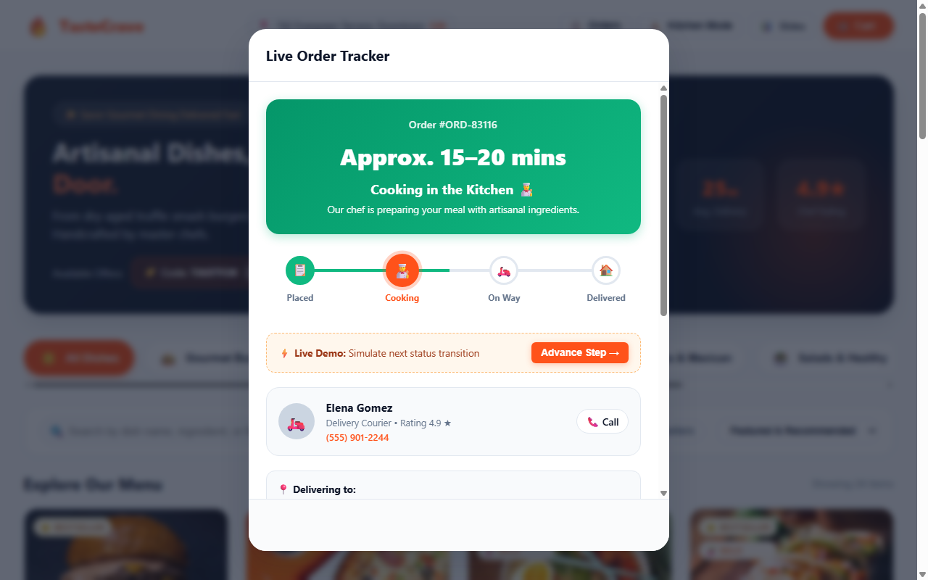
Slide 9: Live Order Tracking & Status Timeline
4-stage visual timeline: Order Placed -> Cooking in Kitchen -> Out for Delivery -> Delivered.
Shows assigned courier name, phone number, live ETA countdown, and itemized receipt.

Slide 10
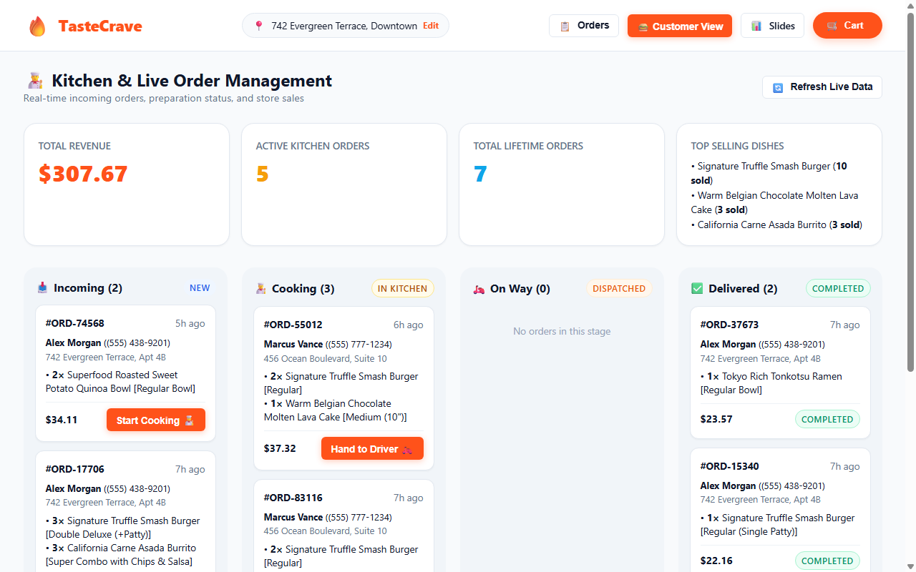
Slide 10: Kitchen Dashboard & Order Management
Restaurant staff can switch to Kitchen Mode to view live store revenue and active orders.
Kanban columns (Incoming, Cooking, On Way, Delivered) with buttons to advance order status.

