Slide 1

Social A2Z
Task - 2

Slide 2
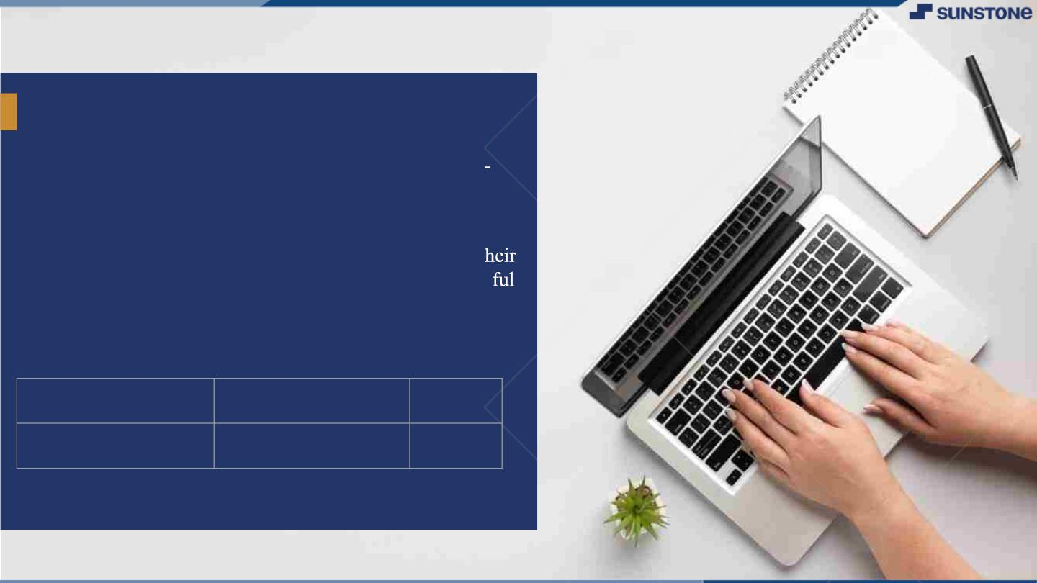
YourꢀProjectꢀName
▪
The primary objective of Social A2Z to create a user
friendly platform that facilitates communication,
community building, and content sharing.
▪
By using this platform, the users can easily manage t
regular day-to-day life by spending their time in a joy
manner.
LMS Username
2113a55319
Name
Batch
g.kavutham
A55

Slide 3

Step-WiseꢀDescription
1.The HTML file contains the basic structure of the web page, including a header, main content area with a
container for posts, and a form for creating new posts. It also includes a footer with the year and the name of the
website.
2.The JavaScript code begins by defining an empty array called posts, which will be used to store all of the posts
created by users.
3.It then selects the #post-form element and the #posts-container element from the HTML file using
document.querySelector(), and sets up an event listener to handle form submissions. When the user submits the
form, the event listener prevents the default behavior (submitting the form to a server) and instead creates a new
post object containing the user's input, adds it to the posts array, resets the form, and calls a function to re-render the
posts on the page.
4.The renderPosts() function is responsible for updating the HTML content of the #posts-container element to
display all of the posts in the posts array. It does this by iterating over the array using a for loop, creating an HTML
string for each post using template literals, and adding it to the #posts-container element's innerHTML property.
5.The renderComments() function is similar to renderPosts(), but is responsible for rendering the comments for a
single post. It takes a post object as an argument, iterates over its comments array using a for loop, and creates an
HTML string for each comment using template literals. It then adds the comments to a .comments-container
element inside the post's HTML.

Slide 4
Step-WiseꢀDescription
6.The handleLike() function is an event listener that is called when the user clicks the "like" button on a
post. It uses the dataset.id property of the button element to find the corresponding post object in the
posts array, increments the likes property of the post object, and calls renderPosts() to update the page.
7.The toggleComments() function is an event listener that is called when the user clicks the "comments"
button on a post. It uses the dataset.id property of the button element to find the corresponding post
object in the posts array, and toggles the visibility of the comments container for that post by adding or
removing the hidden class.
8.The handleComment() function is an event listener that is called when the user submits a comment on
a post. It uses the dataset.id property of the comment form element to find the corresponding post object
in the posts array, creates a new comment object using the user's input, adds it to the post's comments
array, resets the form, and calls renderPosts() to update the page.
9.The last few lines of the JavaScript code call renderPosts() to initially render the posts on the page,
and then attach event listeners to the "like" and "comments" buttons for each post, as well as the
comment submission forms.

Slide 5

Summary
▪ Created an array to store user posts and renders them on the page using JavaScript. It
also includes functions for rendering comments, handling likes, toggling comments,
and submitting new comments.
▪ The HTML file contains a basic structure for the web page, including a header, main
content area, and footer.
▪ The JavaScript code sets up event listeners to handle form submissions, button clicks,
and comment submissions. The last few lines of code call the renderPosts() function
to initially render the posts on the page and attach event listeners to relevant
elements.

Slide 6

AssessmentꢀParameter
SetupꢀProjectꢀforꢀSocialꢀMediaꢀ
project
SetupꢀbasicꢀstructureꢀofꢀSocialꢀ
Mediaꢀproject
Createꢀaꢀmainꢀcomponentꢀwithꢀtheꢀ
outerꢀstructureꢀofꢀSocialꢀMedia
Check-List
Createꢀmainꢀcomponentꢀwithꢀ
allꢀfeatureꢀbuttons
Createꢀaꢀbuttonꢀcomponentꢀ
withꢀonꢀclickꢀhandler
Createꢀaꢀjsonꢀobjectꢀtoꢀstoreꢀ
dataꢀforꢀSoclꢀMedia
Createꢀaꢀ`ꢀevaluateExpresion`ꢀ
functionꢀtoꢀevaluateꢀvalue
Pushꢀbothꢀcodeꢀtoꢀgithub

Slide 7

Submission Github
https://github.com/kavuthamgopi/Naan_Mudhalvan_task_2.git

Slide 8


