Slide 1
Enterprise-Ready RAG Retrieval-Augmented Generation for Secure & Scalable AI
Kavya Parige

Slide 2
Why RAG in Enterprise?
Problem
LLMs alone:
Don’t know private enterprise data
Hallucinate under uncertainty
Cannot enforce document-level security
Cannot handle real-time document updates
Enterprise Needs
Fresh documents ingestion
Secure retrieval
Measurable retrieval quality
Cost efficiency
Scalable inference

Slide 3


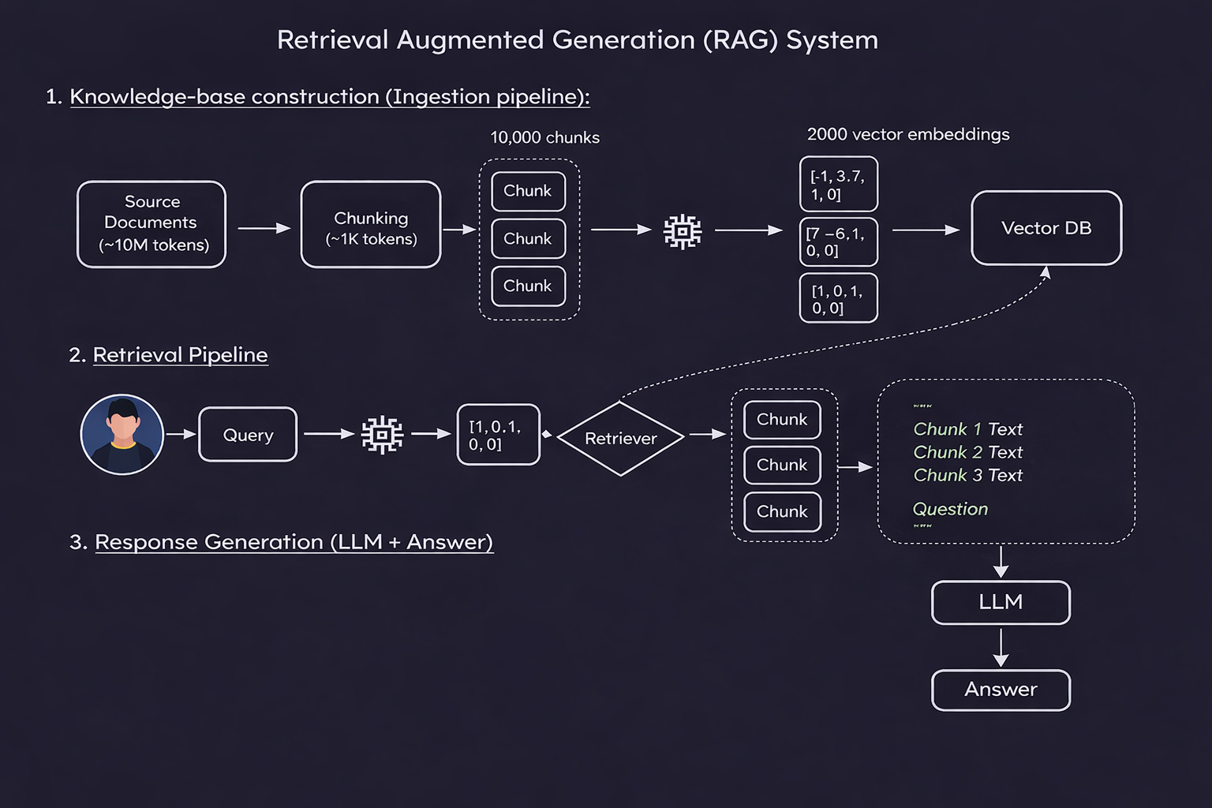



RAG Architecture

Slide 4
Design Decisions & Tradeoffs
Model Choice - Used local LLaMA via Ollama
Embedding Model - sentence-transformers
Reason: cost control + private deployment simulation
Tradeoff: smaller model vs embedding richness(lightweight, CPU-friendly)
Vector Store - Chroma
Reason: simple setup, fast local indexing
Retrieval Strategy - Top-K + similarity threshold
Tradeoff: precision vs recall

Slide 5
Enterprise Enhancements
STAGE | ENTERPRISE PROBLEM | SOLUTION
Data Ingestion | Frequent document updates Multi-source system Stale indexes Version conflits | Airflow/Kubeflow orchestration Incremental indexing Hash-based change detection Metadata + ACL tagging
Chunking & Indexing Quality | Poor chunk boundaries Token waste High re-index cost Irrelevant retrieval | Tuned chunk size + overlap Section-aware splitting Incremental upsets Namespace isolation
Retrieval Accuracy & Measurement | Low recall Domain ambiguity Irrelevant Top-K results No evaluation metrics | Top-K + threshold tuning Metadata filtering Hybrid search + reranking Recall@K, MRR, latency tracking

Slide 6
How I Ensure Reliability & Measurable Quality
Retrieval Metrics
Performance Metrics
Trust Controls
Recall@K
MRR
Context sufficiency rate
Token usage
GPU utilization
p50 / p95 latency
Refusal policy
Citation validation
Logging & traceability

Slide 7
Scaling Strategy for Enterprise Deployment
Data Scale | User Scale
Incremental indexing Sharded vector DB Namespace partitioning | Horizontal autoscaling Load balancing Caching
Model Scale | Cost Scale
Model routing GPU scheduling vLLM serving | Dynamic Top-K Token limits Embedding caching

Slide 8
How I Can Help Operationalize Enterprise RAG
Translate customer use cases into deployable RAG architectures
Tune ingestion, chunking, and retrieval for accuracy & latency
Diagnose scaling and GPU bottlenecks
Optimize cost per query through model routing & controls
Ensure measurable early value from AI deployments

Slide 9

Thank
You

