Slide 1
WEB NAVIGATOR AI AGENT
VINAKONDA KAVYA – [22491A0580]
[ROLE – TEAM LEARDER-DOCUMENTATION]
SHAIK KAREEMA - [22491A05C0]
[ROLE – TEAM NUMBER1-FRONTEND]
RACHIPUDI ALEKHYA – [22491A05B4]
[ROLE – TEAM NUMBER2 – FRONTEND]
VINUKONDA HEMANTH – [22491A05J4]
[ROLE – TEAM NUMBER3 – BACKEND]
EDUPULAPATI VENKATA JYOTHI SWAROOP [22491A0581]
[ROLE – TEAM NUMBER4 – BACKEND]

Slide 2
Problem Statement:
Build an AI Agent that can take natural language instructions and autonomously drive the web on a local computer. The system should combine a locally running LLM (for understanding and planning) with a browser automation setup such as Chrome Headless or a browser inside a local VM. Users should be able to give simple commands (e.g., ''search for laptops under 50k and list top 5'') and the agent should execute them by controlling the browser, extracting results, and returning structured outputs.

Slide 3
SOLUTION:
A person can just type what they want in plain words, like asking for news, products, or recipes. The AI agent understands the request and opens a browser on its own. It searches online, looks at all the results, and picks only the useful information. Then it organizes everything clearly, showing names, short descriptions, prices if needed, and links. Finally, it gives the complete answer in one place, so the person does not have to search or check websites themselves.
The Web Navigator AI Agent is like a smart helper on your computer. You just type what you want in simple words, such as news, products, or recipes. The agent understands your request and then goes online by itself. It searches, checks the results, and picks only the useful information. After that, it organizes everything neatly, showing names, short details, prices if needed, and links. Finally, it gives you the complete answer in one place, so you don’t have to search manually or open many websites.

Slide 4
Previous System: AI Chatbot Navigator
Earlier chatbots could understand what people typed in natural language. For example, if you asked “What is Python?” the chatbot would reply with a text answer like “Python is a high-level programming language.”
But they had many limits:
They only gave text answers.
They could not open websites or search the internet.
They could not prepare results in tables or lists.
The user still had to do all the browsing work manually.

Slide 5
SYSTEM ARCHITECTURE:
User Input Layer
The user gives commands in plain language (text or voice).
Language Understanding (LLM)
A locally running AI model understands the user’s request and plans the steps.
Browser Control Layer
The system uses tools like Chrome Headless or a virtual browser to perform actions on websites.
Example: opening Google, searching for laptops, clicking links.
Data Extraction Layer
Collects useful details (like names, prices, or lists) from the web pages.
Removes ads and unnecessary content.
Processing & Organization Layer
Organizes the collected data into a clean format.
Example: showing “Top 5 laptops under 50k with prices”.
Response Layer
Presents the final result back to the user in a simple and structured way.

Slide 6
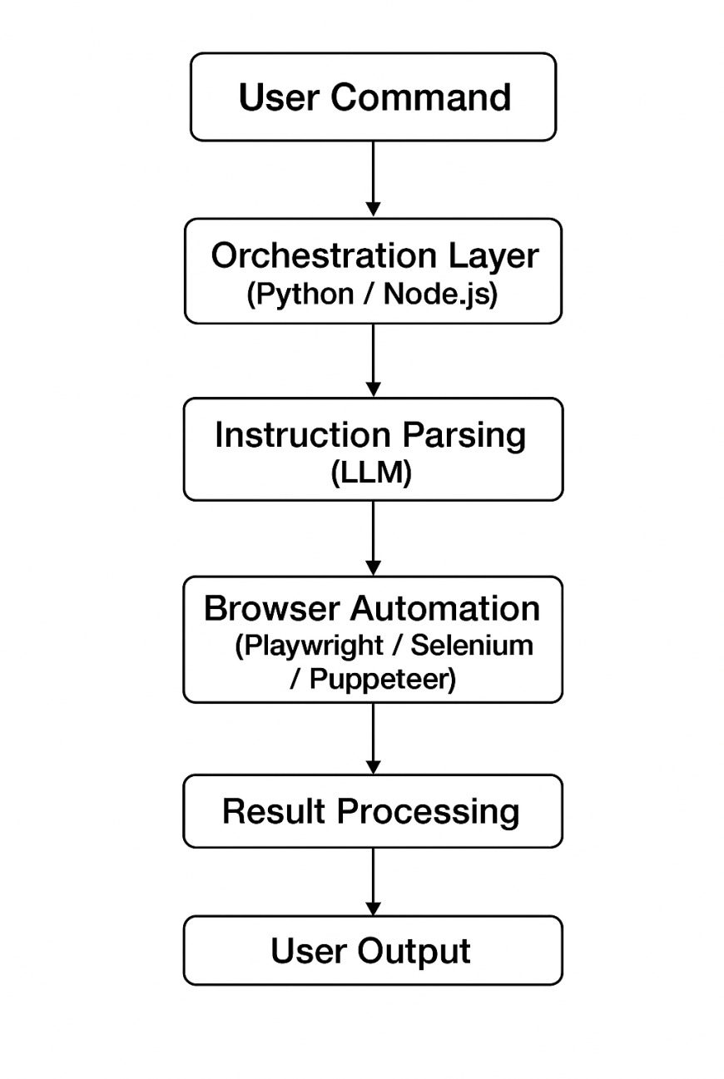

Slide 7
KEY FEATURES:
Natural Language Commands:
Users can give instructions in plain English, like “search for laptops under 50k and list top 5.” The agent understands and carries out the request.
Automated Web Navigation:
The system can open websites, click links, fill forms, and browse automatically—just like a human user would.
Result Extraction & Formatting:
The agent collects the required information (such as product names, prices, or details) and neatly presents it. Results can be shown in a table, Excel sheet, or PDF for easy use.
Easy-to-Use Interface: A simple, friendly interface allows anyone to use the system without technical knowledge.

Slide 8
TECHNOLOGY STACK:
Backend: Built using Python to handle all the main logic and processes of the AI agent.
AI: Uses a local Large Language Model (LLM), optionally with LangChain, to understand user commands and plan tasks.
Browser Automation: Tools like Playwright, Selenium, or Puppeteer help the agent automatically navigate websites, click links, and fill forms.
Frontend : A simple interface using React or any basic UI framework to let users type commands and view results easily.

Slide 9
DEMO WORKFLOW:
Step-by-Step Flow:
User Command → The user types or speaks a natural language instruction.
System Execution → The AI agent understands the command, plans the steps, and uses browser automation to perform tasks.
Result Output → The agent collects the required information, organizes it, and displays it in a clean format (table, Excel, or PDF).
Example:
User: “Find top 5 laptops under 50k”
Agent:
Opens Google or shopping sites
Searches for laptops under 50k
Extracts relevant data (names, prices, ratings)
Shows results in a table for easy reading

Slide 10
ADVANTAGES: Saves Time: Automatically navigates websites and collects information, reducing manual work.
Works on Any Website: Can perform searches, extract data, and interact with most websites reliably.
User-Friendly: Simple interface allows anyone, even non-technical users, to use it easily.
Accurate Results: Collects and organizes data correctly, reducing errors compared to manual browsing.
Customizable Output: Results can be displayed in tables, Excel sheets, or PDFs based on user needs.
Reduces Human Effort: Eliminates repetitive tasks like searching, clicking, and copying data manually.
Consistent Performance: Can run 24/7 without fatigue, providing reliable results every time.

Slide 11
FUTURE SCOPE:
Voice-Based Navigation: Users can give commands using voice, making interaction faster and hands-free.
Multi-Browser Support: Extend compatibility to multiple browsers like Firefox, Edge, or Safari for wider usage.
API Integrations: Connect with other applications, services, or databases to automate more complex tasks.
Advanced Analytics: Provide insights or trends from collected data for smarter decision-making.
Cloud & Remote Execution: Run the agent remotely or in the cloud to support multiple users simultaneously.

Slide 12
CONCLUSION:
The Web Navigator AI Agent is an innovative solution that understands natural language commands and autonomously navigates the web to gather, extract, and organize information efficiently. By presenting results in structured formats like tables, Excel sheets, or PDFs, it saves significant time and effort for users. Its user-friendly design ensures that even non-technical individuals can perform complex web tasks effortlessly. Combining AI-driven understanding with browser automation, this system is both versatile and reliable, making it a smart and impactful tool with the potential to expand into voice-based navigation, multi-browser support, and API integrations in the future.

Slide 13
Thank You

