Slide 1



Water Quality prediction using ML
Kavya Malik
AICTE Student ID: STU2024190886F2C008 AICTE Internship ID: INTERNSHIP_17513641056863b20937d78

Slide 2

Learning Objectives
1.Understand key water quality parameters.
2. Apply machine learning models to predict water potability.
3. Perform data preprocessing and feature engineering.
4. Evaluate models using accuracy and other metrics.
5. Develop a reliable system for water safety prediction.
GOAL
To build a machine learning model that predicts whether water is safe or unsafe for human consumption based on chemical and physical attributes.
GOAL
Source :
www.freepik.com/

Slide 3
Tools and Technology used
Programming Language: Python
Libraries:
Data Handling → Pandas, NumPy
Visualization → Matplotlib, Seaborn
Machine Learning → Scikit-learn (RandomForestClassifier, train_test_split, StandardScaler, SimpleImputer)
Evaluation → Accuracy Score, Classification Report, Confusion Matrix, Mean Squared Error
Environment: Google Colab
Dataset Source: Kaggle

Slide 4
Methodology
Data Collection – Obtain water quality dataset containing physicochemical features (pH, Hardness, Solids, Chloramines, Sulfate, Conductivity, Organic Carbon, etc.).
Data Preprocessing – Handle missing values (SimpleImputer), normalize features (StandardScaler), and prepare dataset for training.
Exploratory Data Analysis (EDA) – Visualize distributions and correlations using Matplotlib & Seaborn.
Model Training – Apply machine learning models (Random Forest, Logistic Regression, etc.) using Scikit-learn.
Model Evaluation – Measure performance with accuracy, confusion matrix, classification report, and mean squared error.
Prediction – Classify water samples as Potable (Safe) or Not Potable (Unsafe).

Slide 5
Problem Statement:
Access to safe drinking water is a major global challenge. Traditional laboratory-based water testing methods are time-consuming, costly, and not scalable for continuous monitoring. There is a need for an automated, reliable, and cost-effective machine learning solution that can predict whether water is safe or unsafe for human consumption based on its physicochemical properties.

Slide 6
Solution:
The project provides a machine learning-based predictive system that uses physicochemical properties of water (such as pH, hardness, solids, sulfate, chloramines, conductivity, organic carbon, etc.) to classify whether water is potable (safe) or not potable (unsafe).
Preprocessed data ensures clean and reliable input.
Random Forest and other ML algorithms are applied to achieve high accuracy.
The system enables faster and cost-effective monitoring compared to manual lab testing.
GITHUB LINK : https://github.com/kavya-malik/Water-Quality-Prediction-using-Machine-Learning

Slide 7
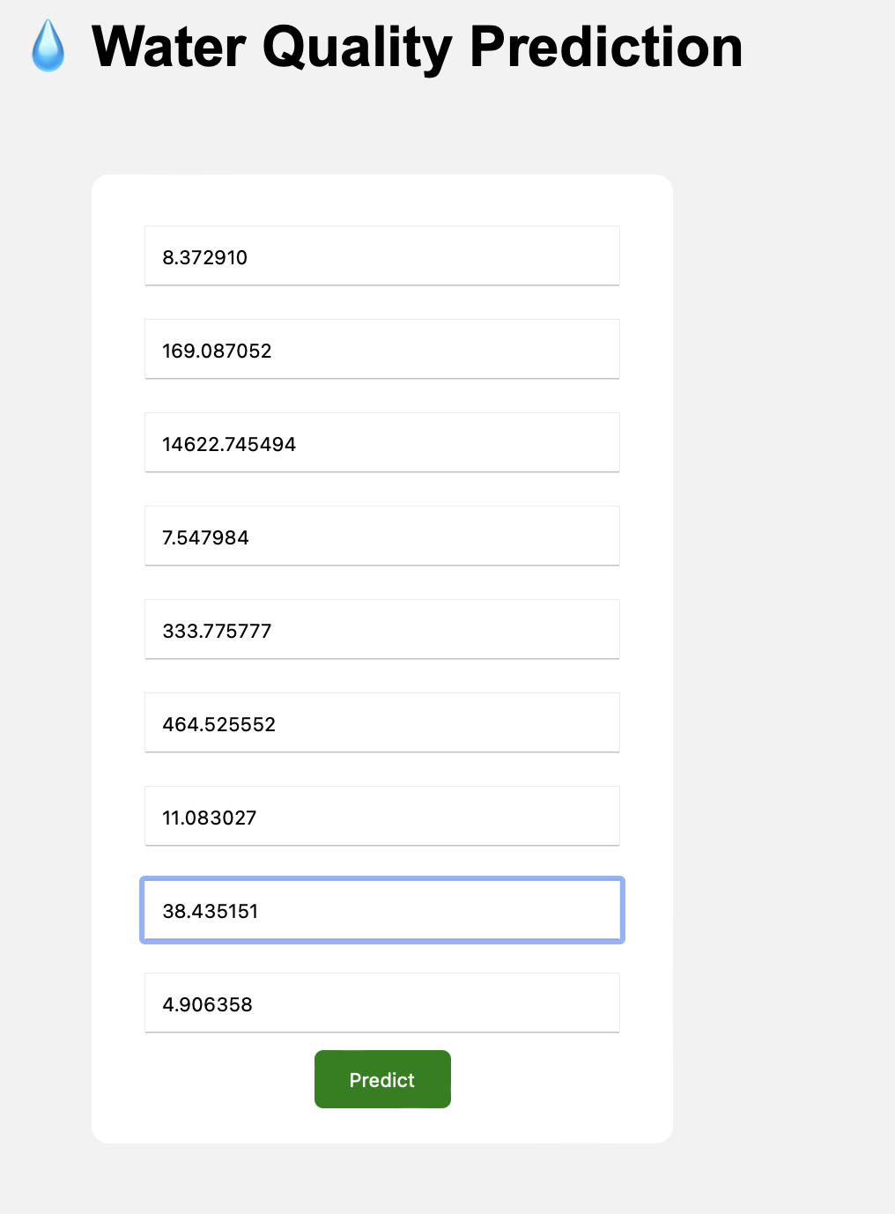
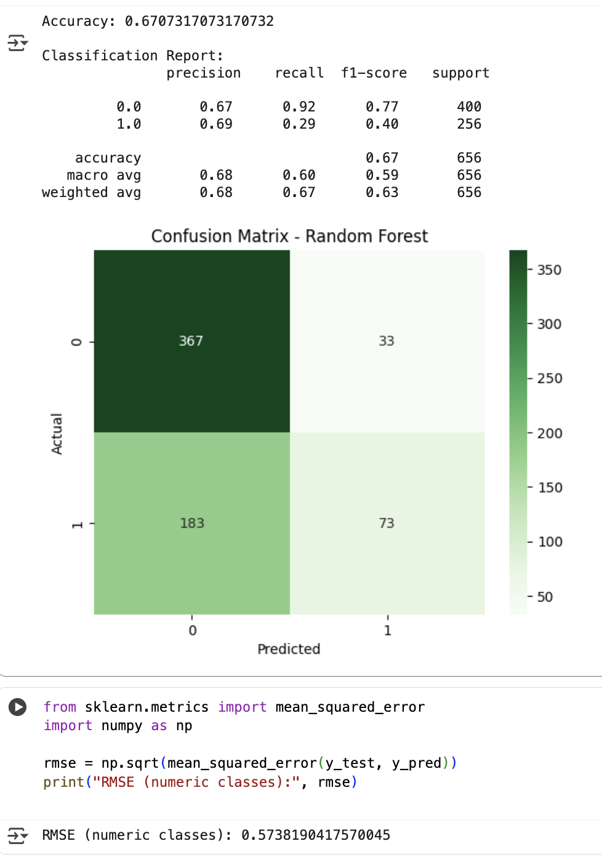
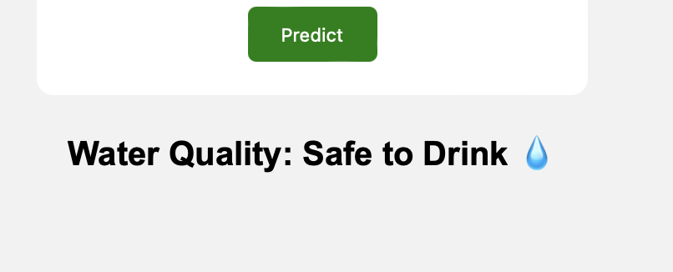
Screenshot of Output:

Slide 8
Conclusion:
The developed machine learning models can accurately predict water quality using chemical and physical parameters.
This system demonstrates that AI can complement traditional water testing, making it faster, cheaper, and scalable.
The project highlights the importance of data preprocessing and feature engineering in improving prediction accuracy.
With deployment, such a model can support governments, industries, and communities in ensuring safe drinking water.

