Slide 1
Forks and Knives (Hack The Box Challenge)
Kavya Sree Chandhi VENKATA SRI SAI GAMAN YERRAMNENI Tejaswi Reddyvallapu

Slide 2
Challenge Overview
Goal: Gain a remote shell and retrieve the flag.
Vulnerabilities: Buffer Overflow, Stack Canary, Format String.
Techniques: Canary brute-forcing, libc leak, ROP chain building.

Slide 3
Tools Used
Pwntools
Netcat
Python 3
Local libc.so.6

Slide 4
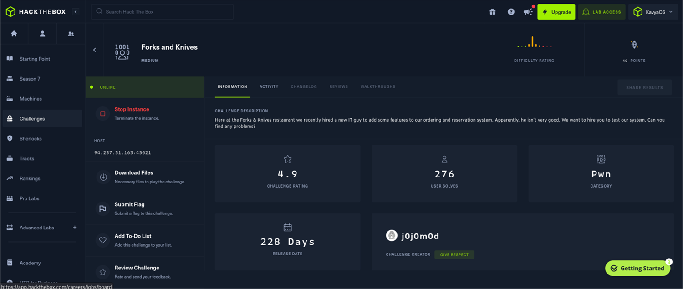
Connecting to Hack The Box VPN

Slide 5
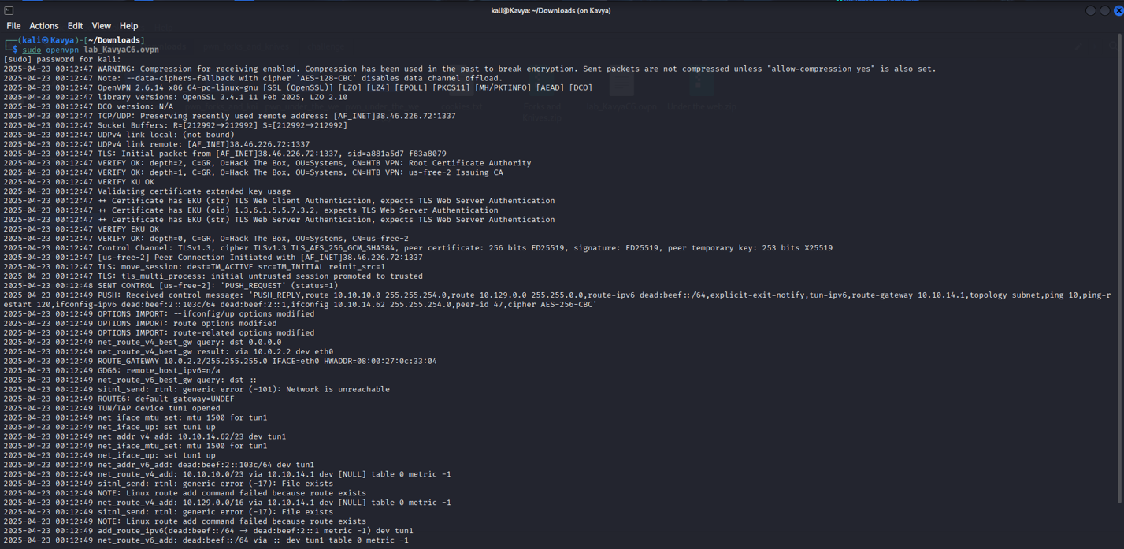

Slide 6
Setup - Docker Environment
Built with Ubuntu 22.04 in Docker.
Created 'ctf' user and copied challenge files.
Built image: pwn_forks_and_knives.

Slide 7
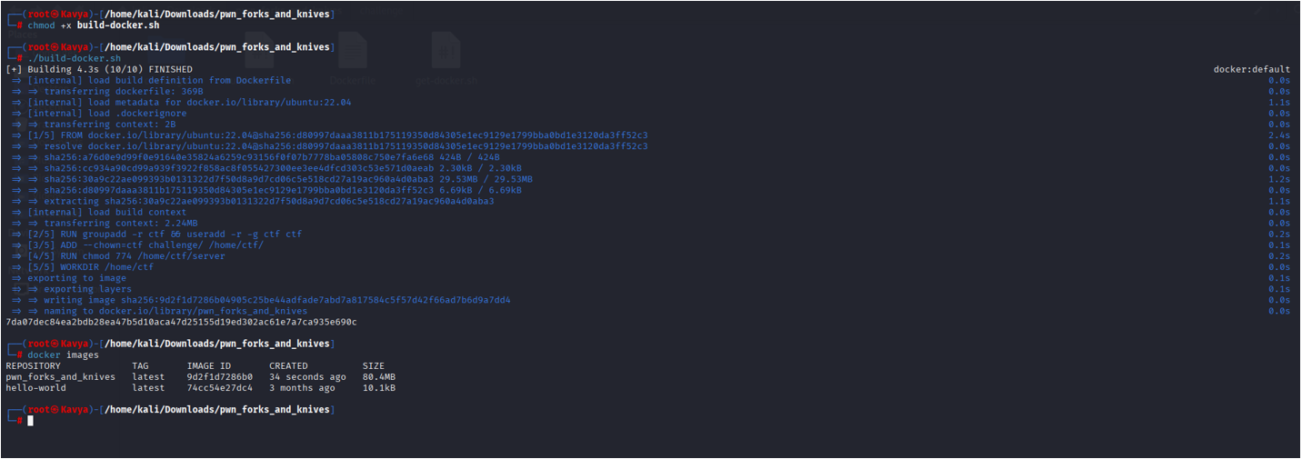

Slide 8
Vulnerability Discovery
Manual buffer overflow test.
Sent 255 A's, additional A's caused crash.
Confirmed buffer overflow vulnerability.

Slide 9
Canary Brute Forcing
Stack canary bypassed by brute-forcing byte-by-byte.
Full canary recovered successfully.

Slide 10
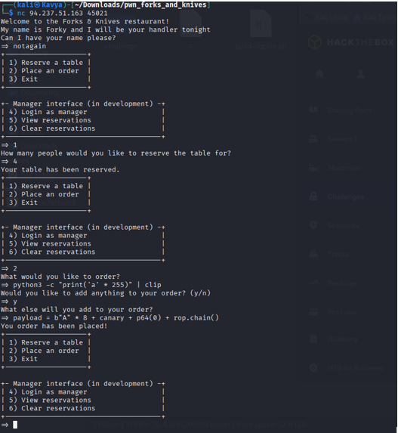

Slide 11
Format String Exploit
Used %2$p input to leak libc address.
Subtracted offset of lseek64+11 to calculate libc base address

Slide 12
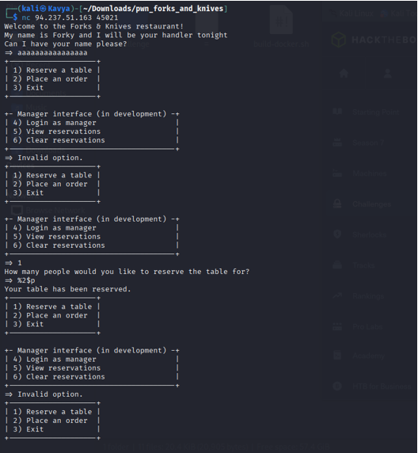

Slide 13
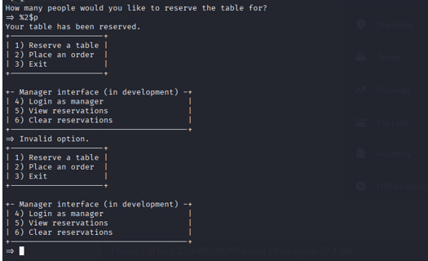

Slide 14
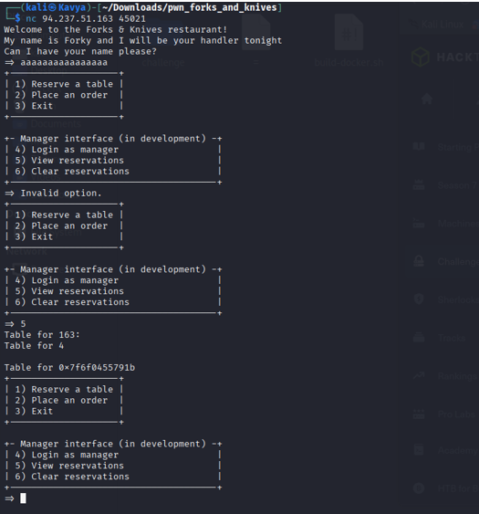

Slide 15
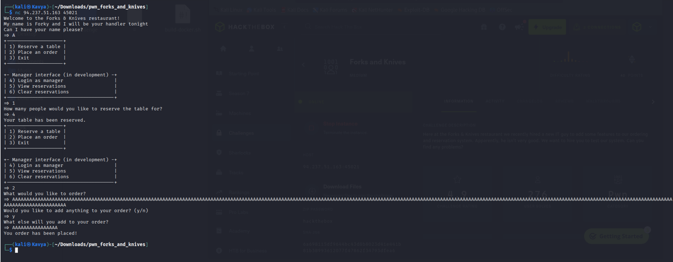

Slide 16
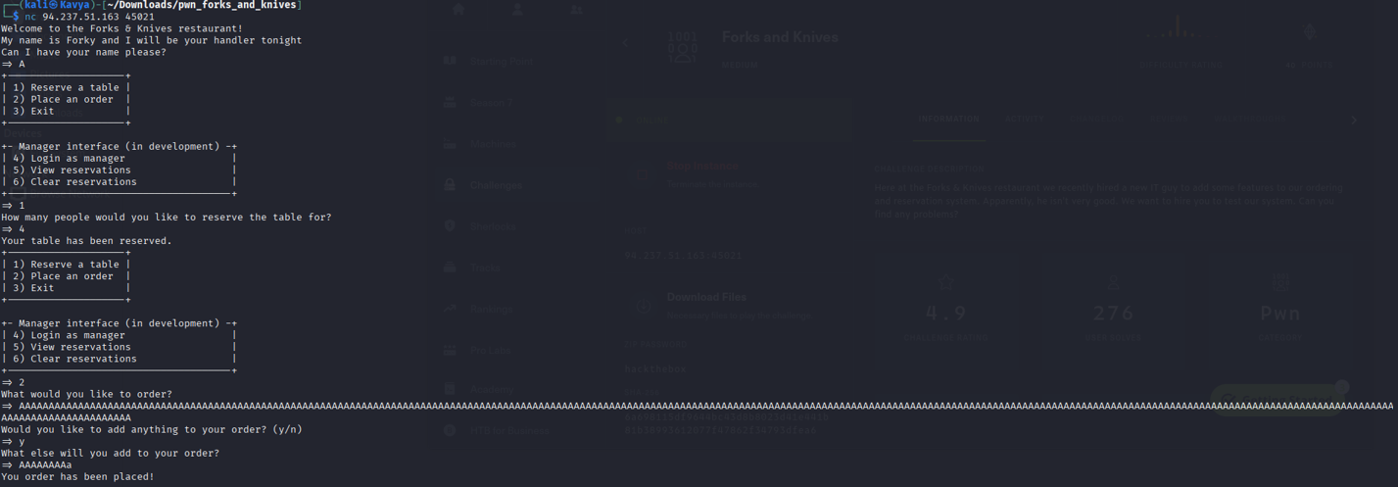

Slide 17
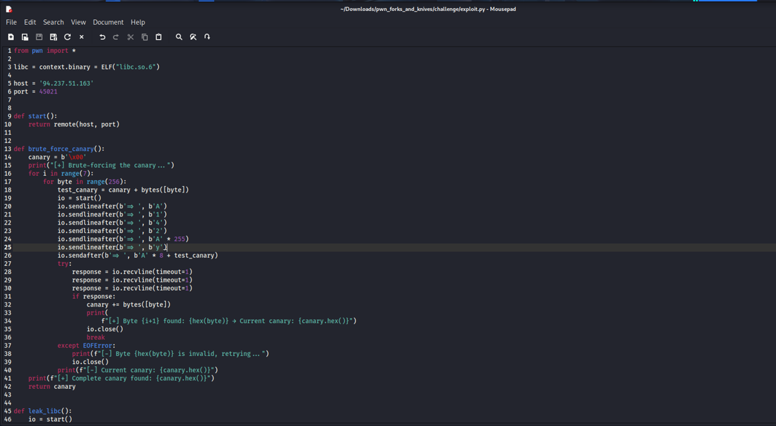
exploit.py :

Slide 18
Final Exploitation - Getting Shell
Payload sent after canary bypass.
Final payload: padding + canary + fake RBP + ROP chain
ROP chain called dup2() and system("/bin/sh")
Gained remote shell access with io.interactive()

Slide 19
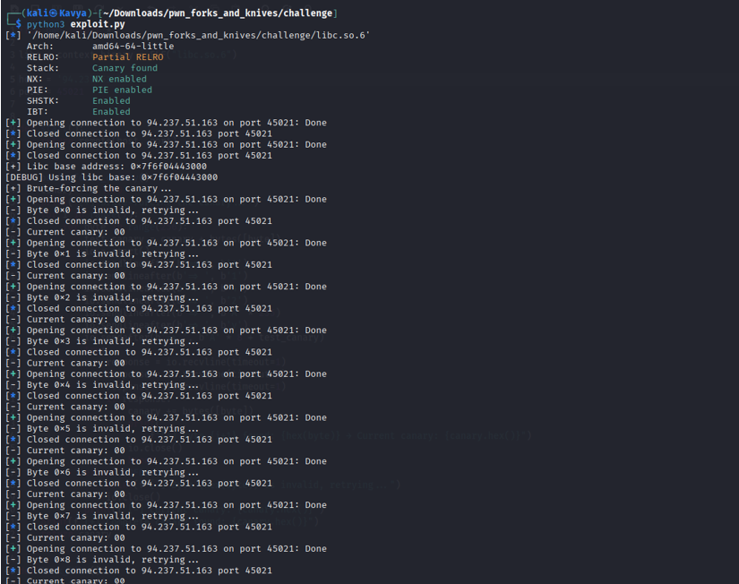

Slide 20
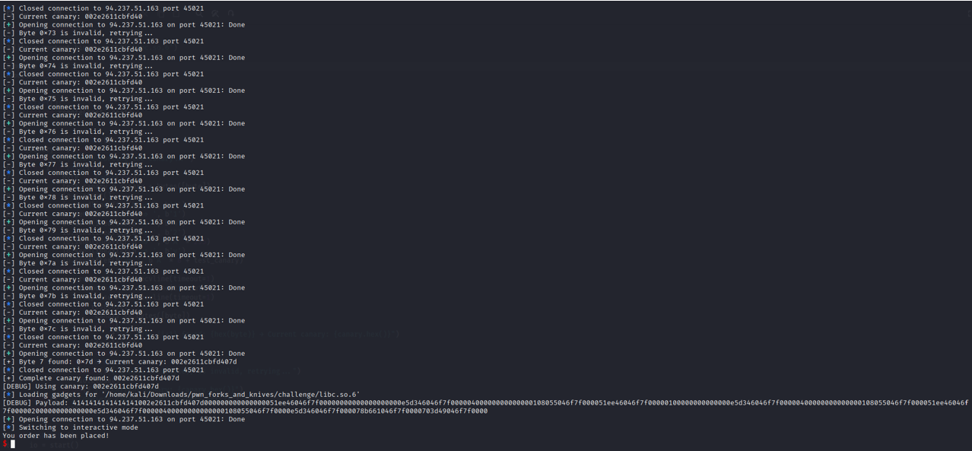

Slide 21
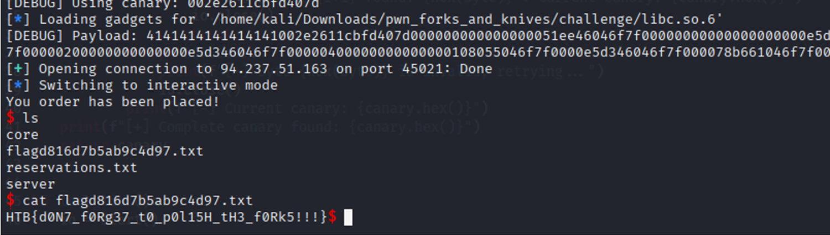
Flag Capture
Captured flag: HTB{d0n7_f0Rg37_t0_p0L15H_th3_f0Rk5!!!}

Slide 22
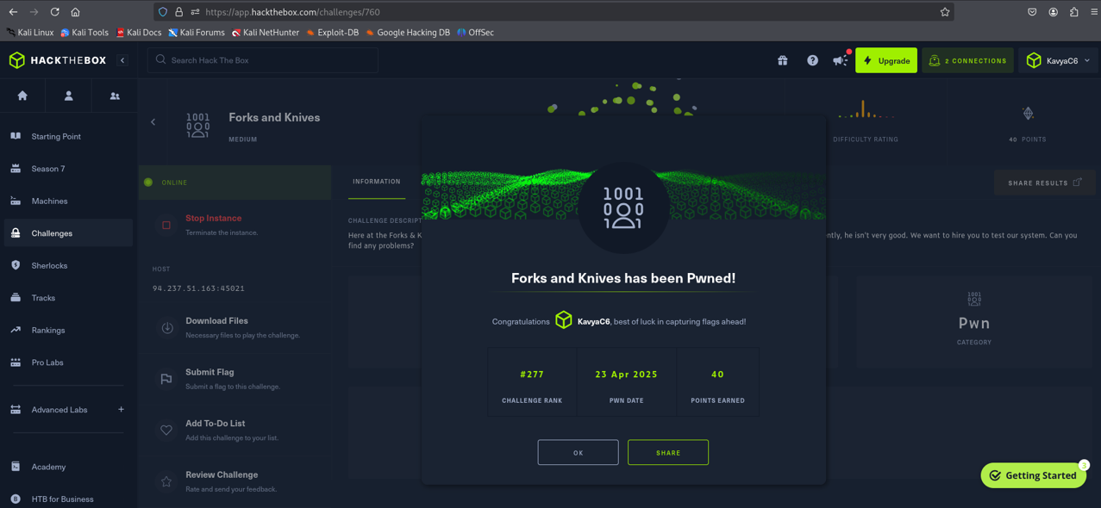

Slide 23
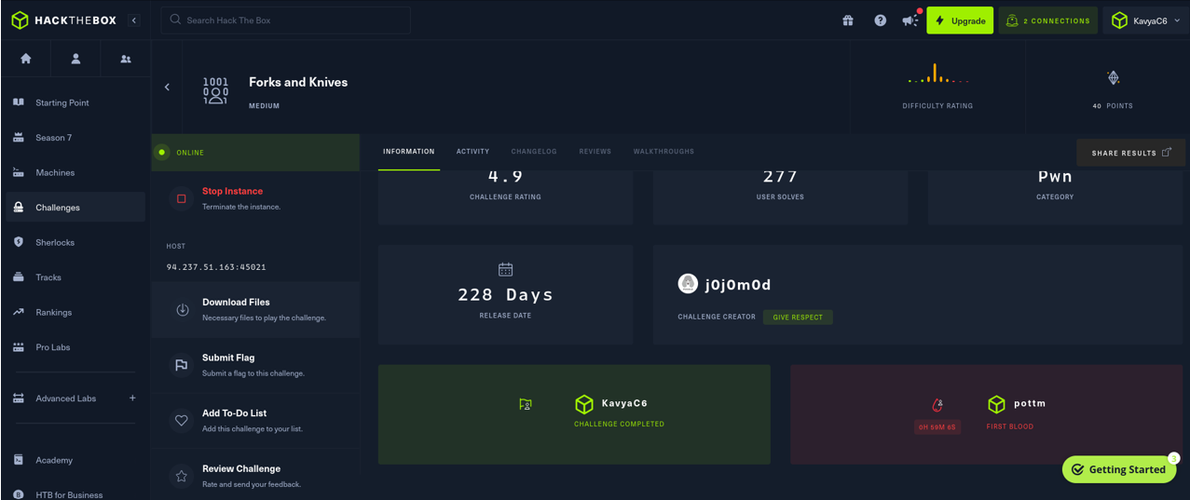

Slide 24
Summary of Attack Steps
Connected to VPN & launched Docker
Discovered buffer overflow
Verified stack canary protection
Leaked libc address using format string
Calculated libc base address
Brute-forced 8-byte canary
Built ROP chain using pwntools
Sent payload to get shell
Captured flag ✅

Slide 25
Thank You!

