Slide 1

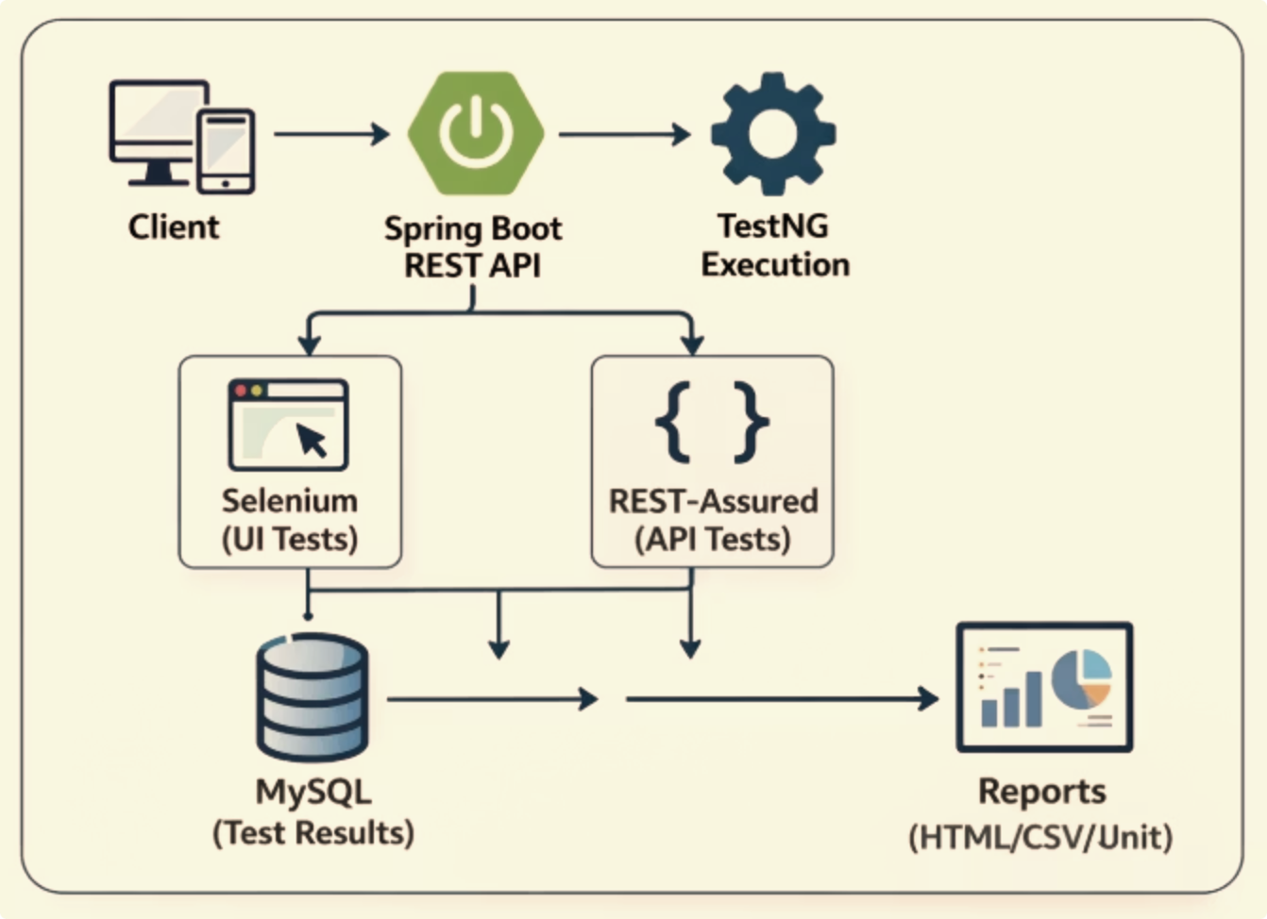
Automated Regression Test Framework
A scalable, Java-based framework designed to automate regression testing, reduce manual effort, and provide reliable results across UI and API layers.

Slide 2
Introduction
Problem Statement
Solution Overview
Manual regression testing is time-consuming and prone to human error
Repetitive test execution across multiple builds reduces efficiency
Difficult to scale testing as application complexity increases
Develop an automated regression testing framework
Use Selenium for UI testing and REST-Assured for API testing
Enable parallel test execution using TestNG
Provide RESTful APIs using Spring Boot to trigger and monitor test execution

Slide 3

OBJECTIVES
What This Framework Sets Out to Solve
Automate Regression
Parallel Execution
Replace repetitive manual test runs with fully automated regression suites triggered on demand or on schedule.
Execute test cases in parallel using TestNG to reduce overall execution time.
Improve Reliability
Test Management APIs
Minimize human error in test runs to improve consistency and reliability of results.
Provide RESTful endpoints to trigger, monitor, and retrieve test results programmatically.

Slide 4
TECH STACK
Core Requirements
Java + Spring Boot
Selenium + REST-Assured
Spring Boot serves as the application backbone, providing REST API endpoints, dependency injection, and lifecycle management for the framework.
Selenium drives browser-based UI tests; REST-Assured handles HTTP-layer API validation with expressive, chainable assertions.
Maven / Gradle
MySQL + TestNG
Standard build tooling for dependency management, test execution lifecycle, and CI integration via plugins.
MySQL persists test results and metadata; TestNG orchestrates test execution with parallel support, grouping, and rich XML-based configuration.

Slide 5
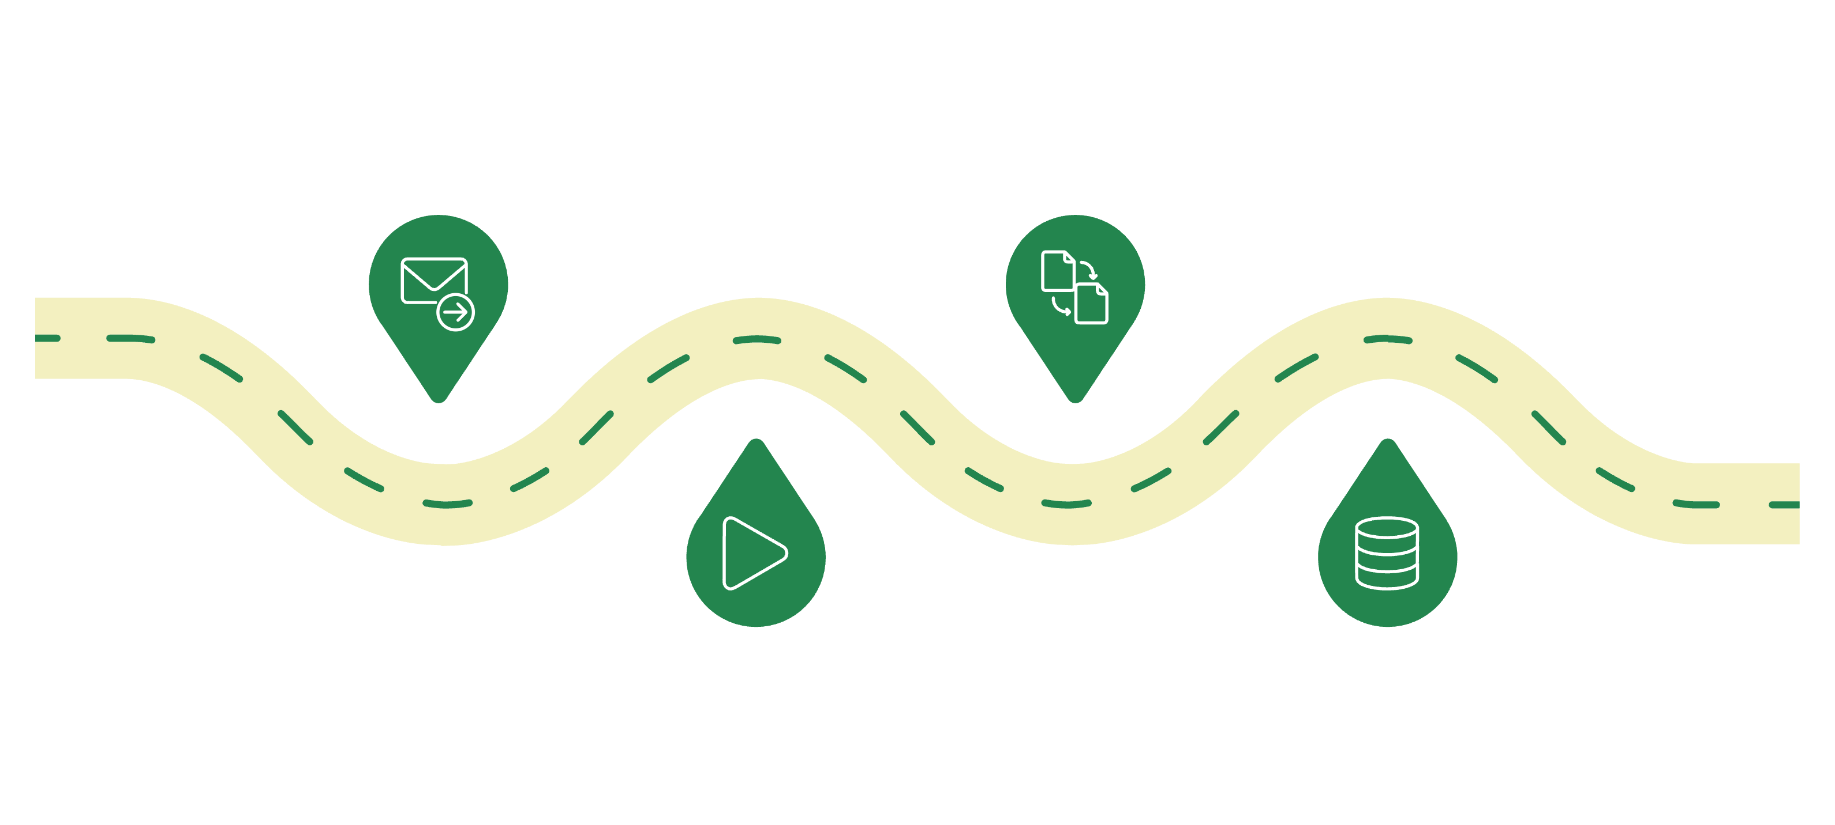
ARCHITECTURE
System Architecture Overview
API Request
Parallel Tests
Client sends REST API call
UI and API tests run concurrently
Execution Engine
Persistence
API layer triggers test run
Results saved to MySQL database
The framework uses REST APIs as the entry point. Requests are handled by the execution engine, which runs UI and API tests in parallel. Test results are stored in MySQL and displayed through reports and logs

Slide 6
MODULES
Core Framework Modules
Test Integration Engine
Scheduling & Execution
Manages test execution by integrating Selenium (UI) and REST-Assured (API) based on test type.
Supports on-demand and scheduled test execution with parallel runs using TestNG.
Reporting & Logs
Result Analytics
Generates HTML reports and logs with test results, including pass/fail status and screenshots.
Stores test results in MySQL and helps track execution status and trends over time

Slide 7
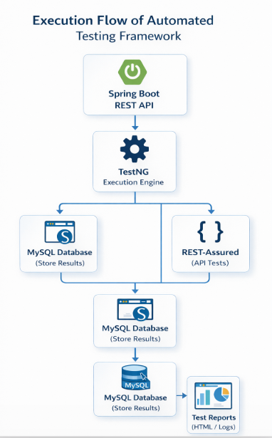
EXECUTION FLOW
Execution Process
1
Trigger
Test run is triggered via REST API or scheduler
2
Execute
TestNG executes test cases for UI and API testing
3
Parallelize
Tests run in parallel using multiple threads
4
Persist
Test results are stored in MySQL
5
Report
Reports and logs are generated for analysis

Slide 8
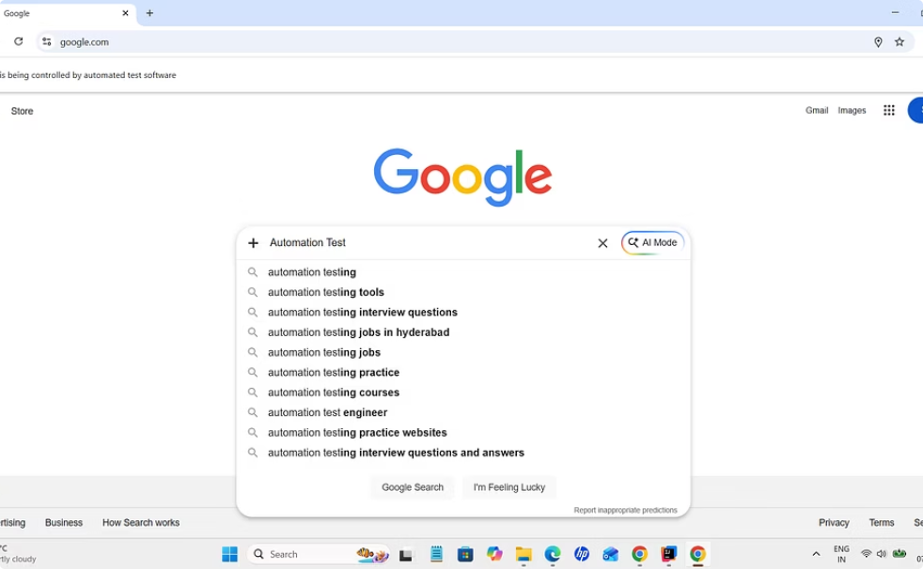
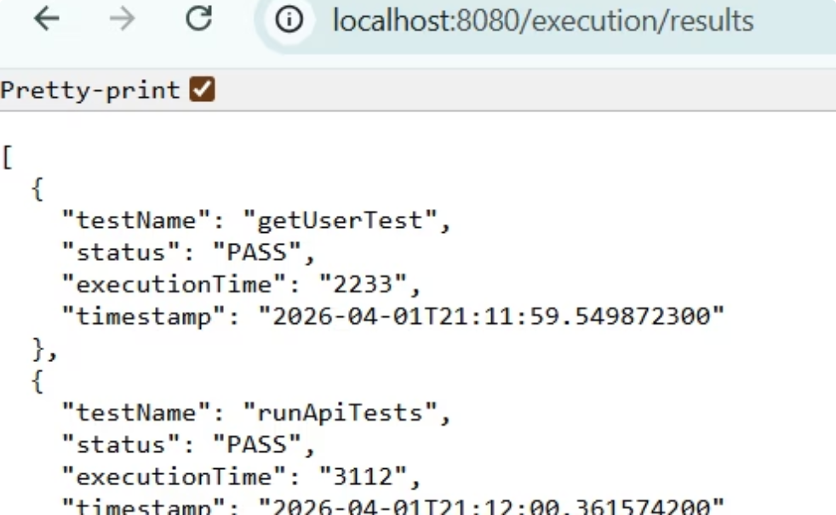
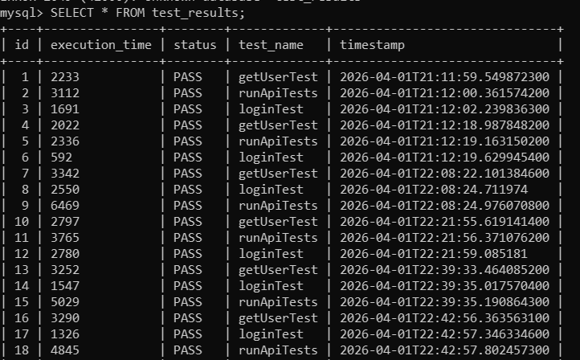
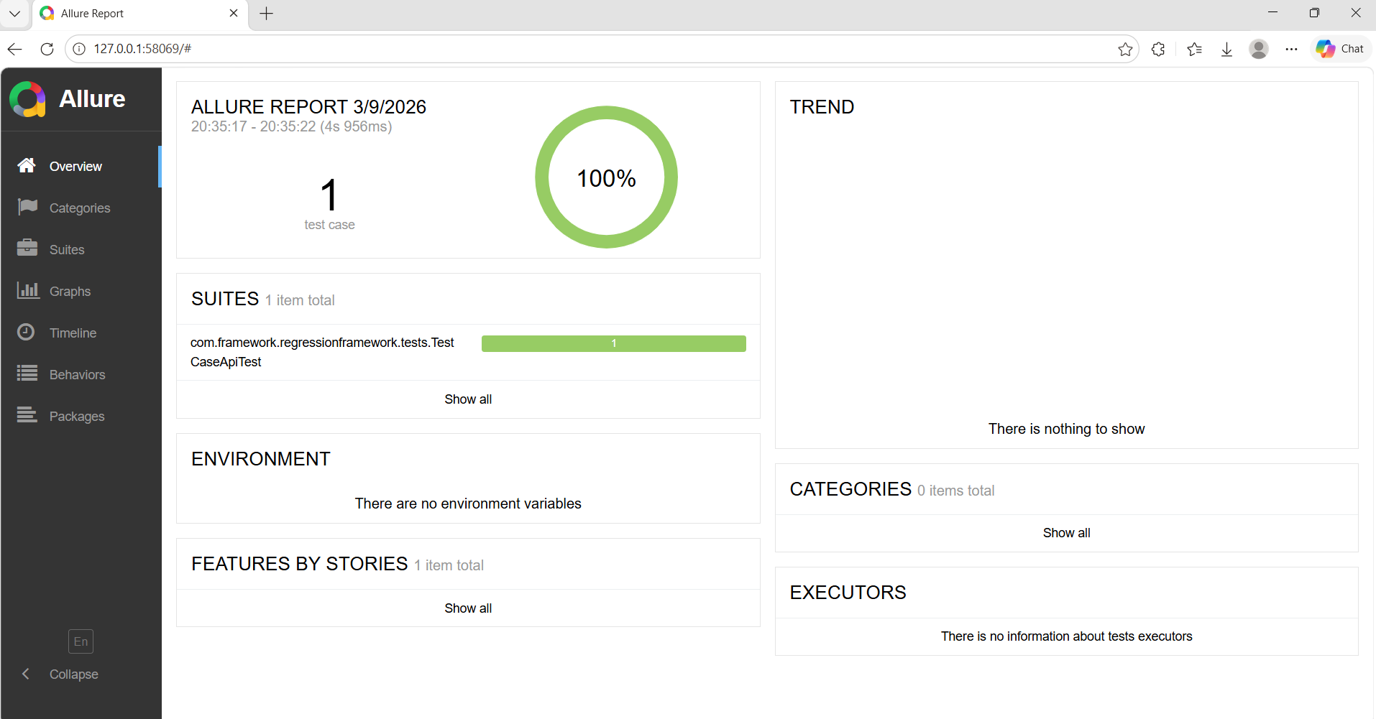
SCREENSHOTS
Framework in Action
UI Test Execution
API Test Validation
Selenium drives browser interactions end-to-end, capturing screenshots on failure for immediate visual debugging.
REST-Assured validates response bodies, status codes, and headers with expressive, readable assertion chains.
Database Persistence
Report Output
Every test result is written to structured MySQL tables, enabling long-term trend analysis and audit trails.
Rich HTML reports summarize suite results at a glance with drill-down detail per test case and step.

Slide 9




CONCLUSION
Conclusion
Automation Achieved
Speed & Reliability
Supports regression testing across UI and API layers with on-demand and scheduled execution.
Parallel execution reduces test runtime and improves consistency of results.
Scalable by Design
Modular architecture and RESTful APIs allow easy extension across different test environments

Slide 10

Thank You
Mentor: Joyce Nivetha

