Slide 1


Slide 2
INTRODUCTION
PRICE COMPARISION WEBSITE
Blink Buy is a website where buying and selling of goods and services over the Internet.
It is conducted over computers, tablets, smartphones, and other smart devices.
Almost anything can be purchased through ecommerce today; for this reason, ecommerce is often highly competitive.
Ecommerce operates in several market segments including business-to-business,
business-to-consumer, consumer-to-consumer, and consumer-to-business.
Top Examples of Ecommerce. There are some pretty major examples of ecommerce businesses that have made it big, including Amazon, Flipkart, eBay, and Myntra.

Slide 3





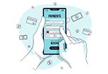
Save Money
24/7 Support
Online Order
Happy Sell
Free Shipping
Promotions

Slide 4
USER FLOW
1
STORE
2
SIGN UP
3
LOGIN
E-COMMERCE
WEBSITE
4
CART
5
ORDERS
6
LOGOUT

Slide 5
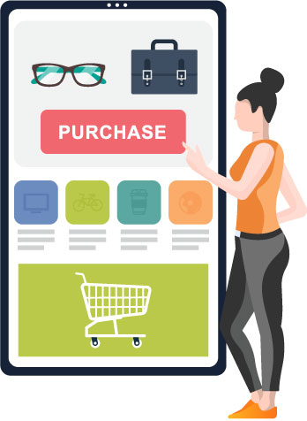

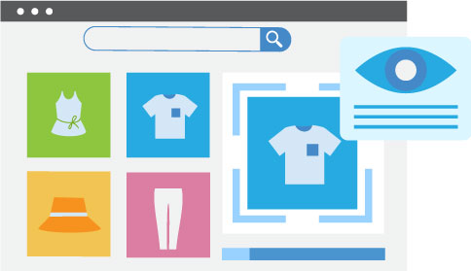
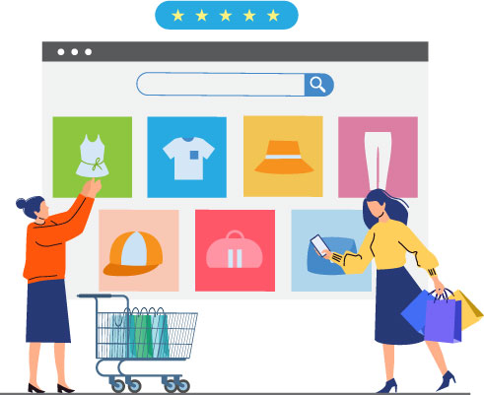
FUTURE SCOPE
Alternative
Transactions
Customer experience
Image recognition turned product recognition
Real Time Price Tracking

Slide 6
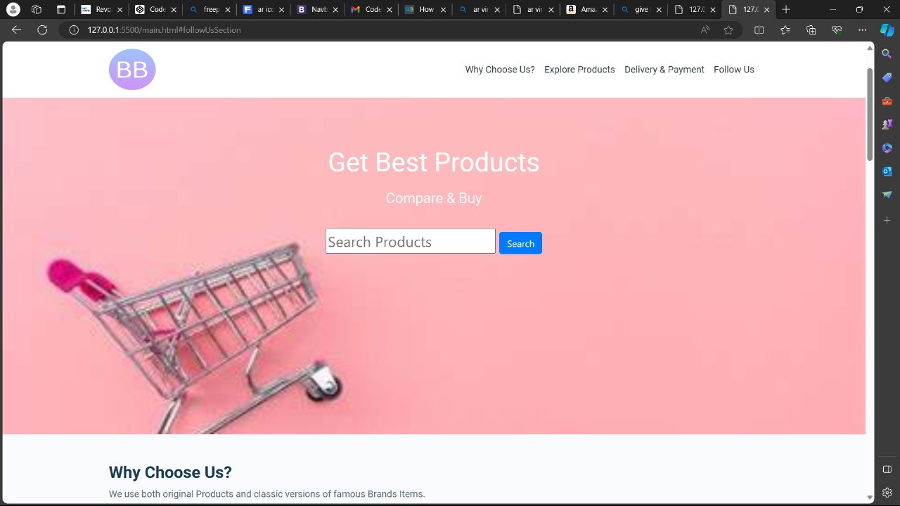
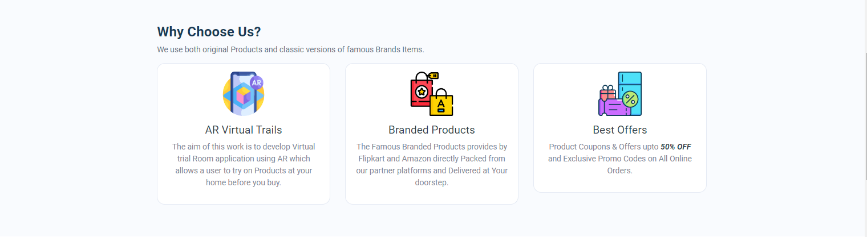
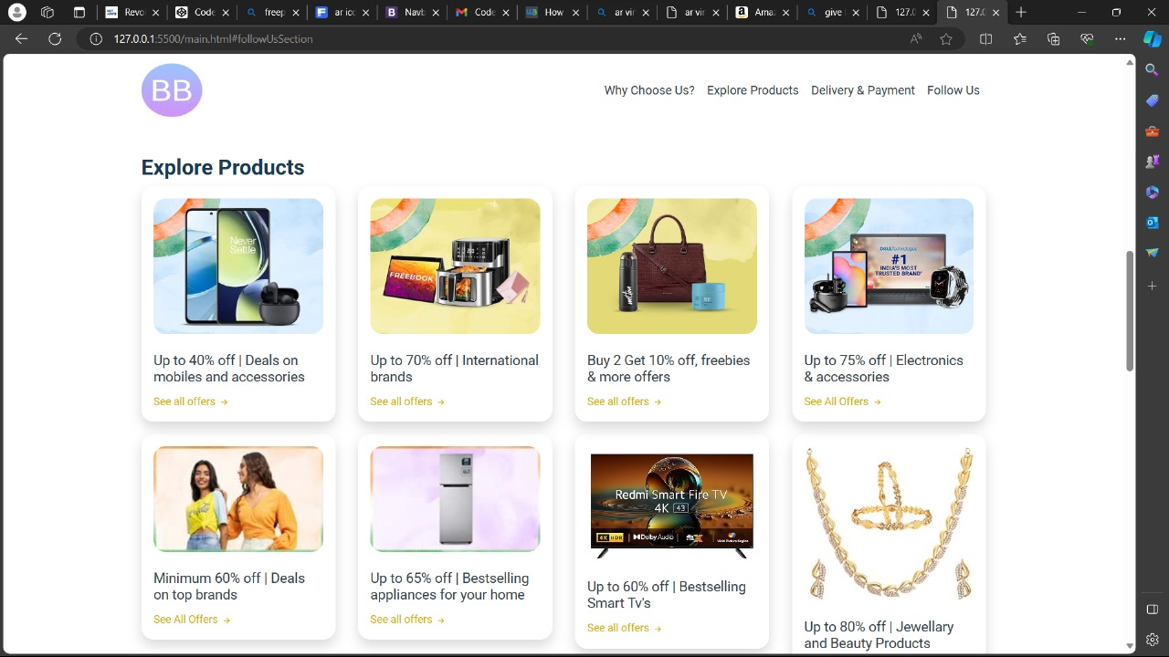
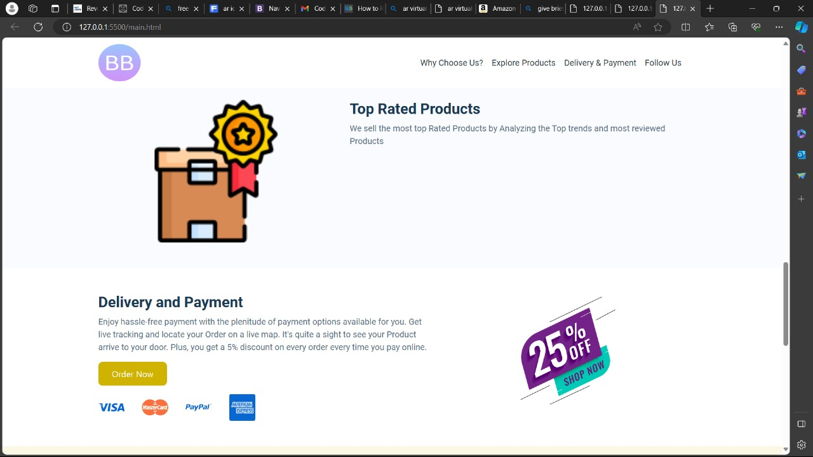
SCREENSHOT OF BLINKBUY WEBSITE

Slide 7
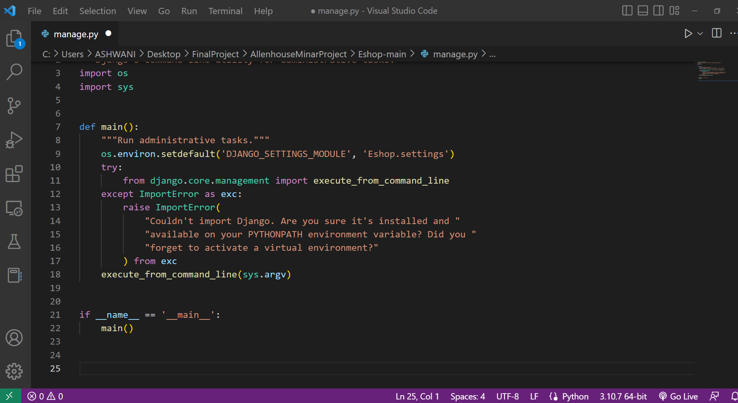
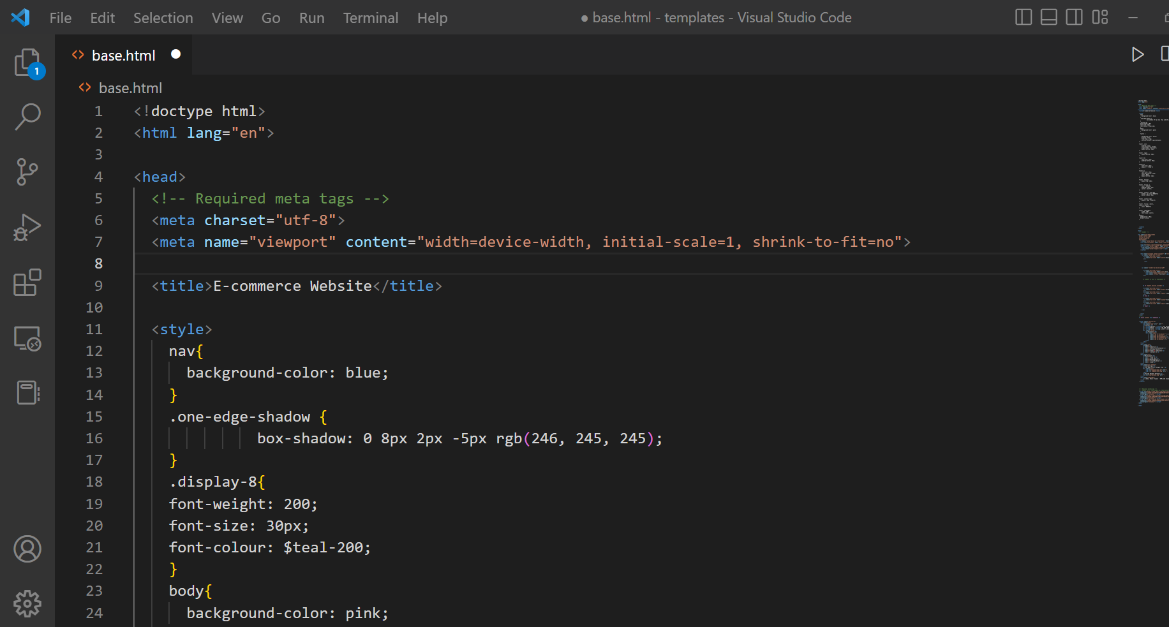
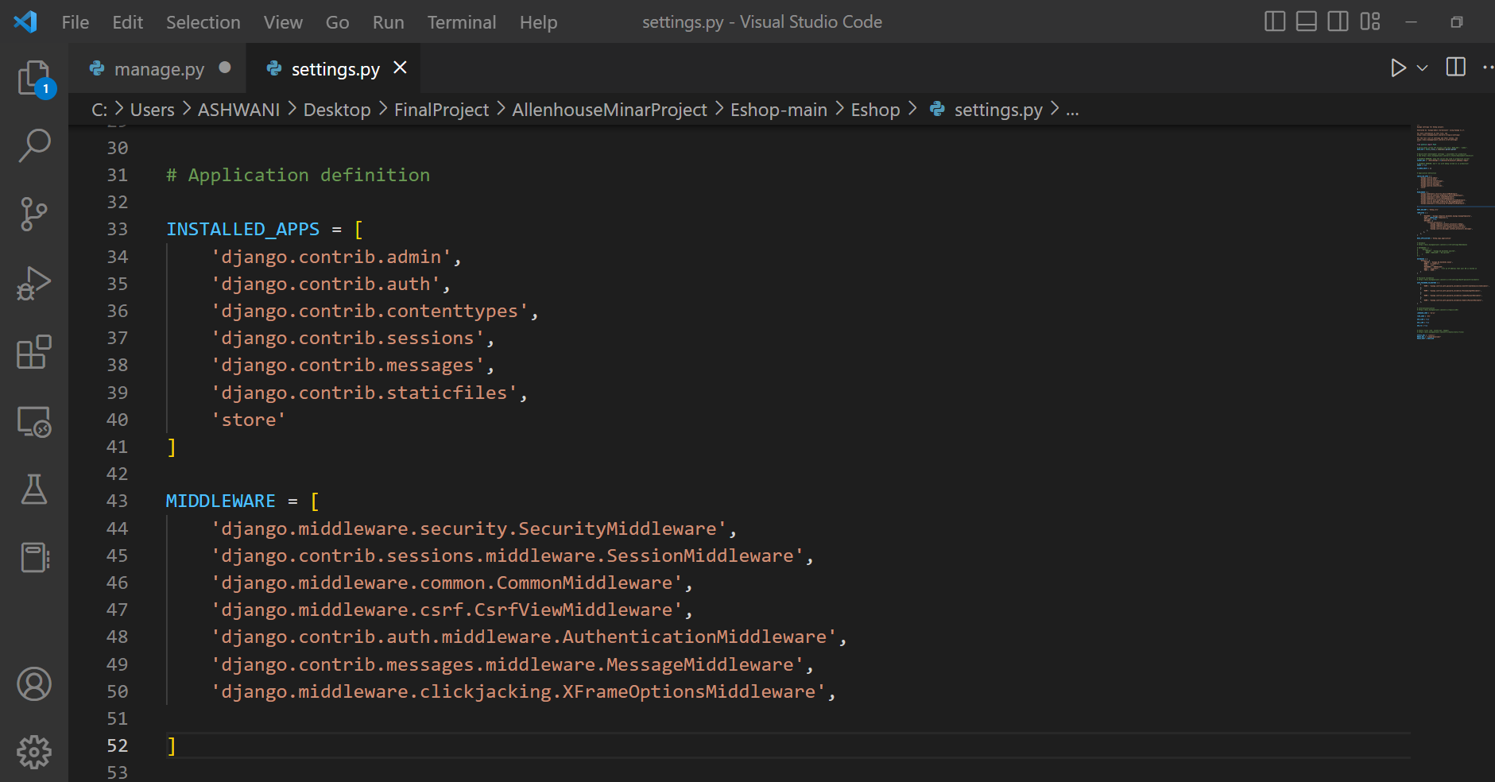
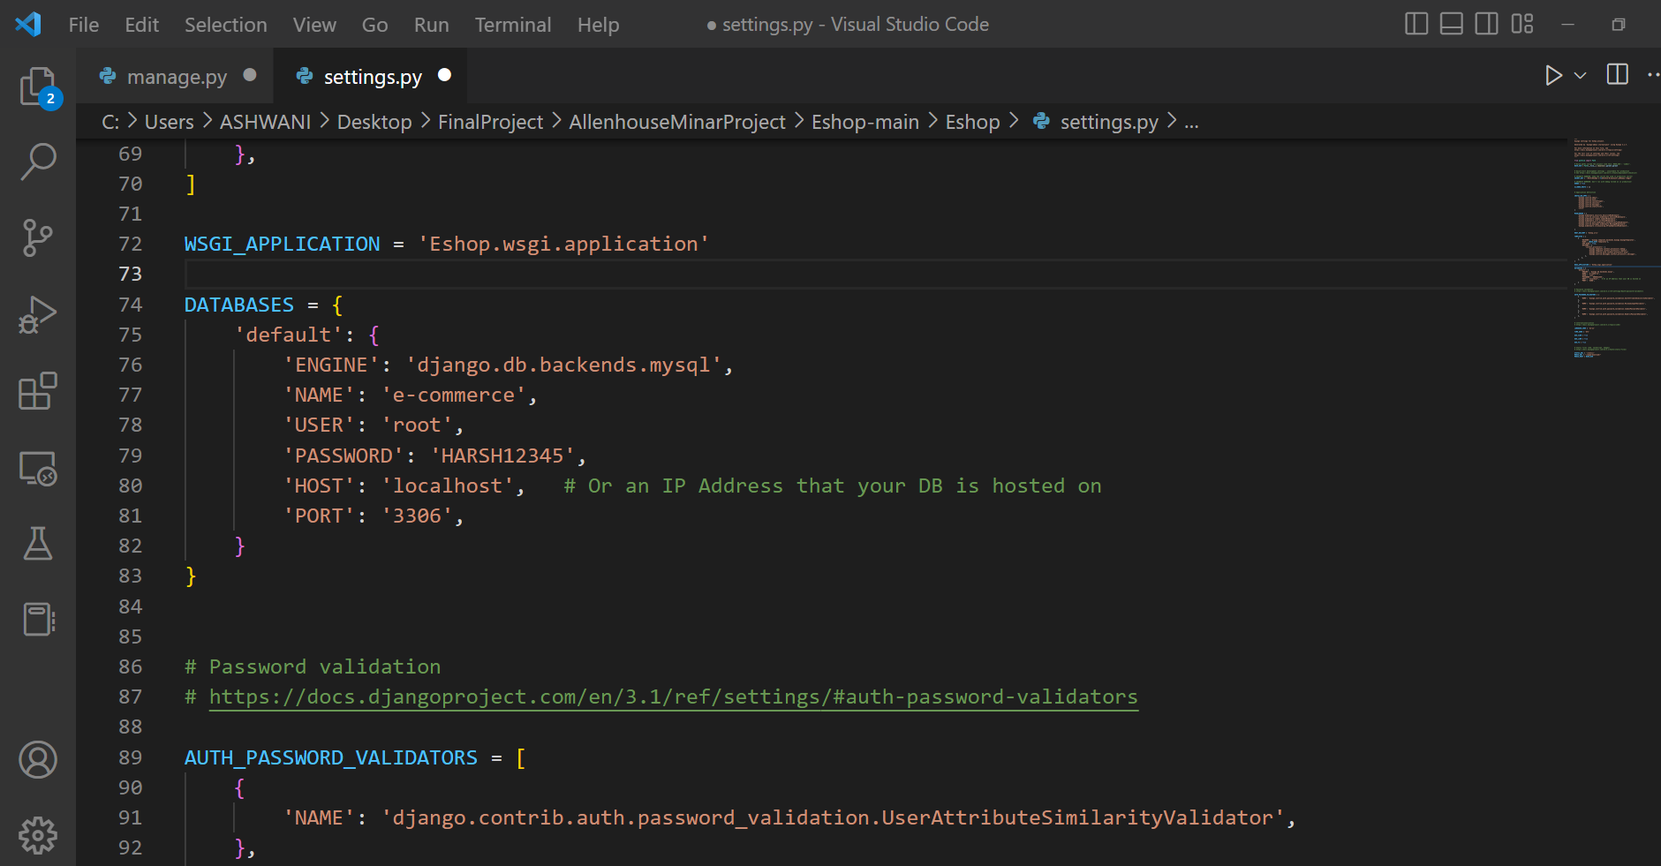
CODING

Slide 8
CONCLUSION
E-commerce still represents one of the business methods that take advantage if done the right way, even if the stock market and commodities fell, but E-Commerce still able to survive and receive high transaction. In addition, it is also to introducing new techniques and styles in a transaction , along with which we are providing AR Virtual Trails which allow a user to try on products at your home before you buy.
THANKYOU

