Slide 1
SEQUENCE MODELS
RNN, LSTM & GRU
Explained with a simple time-series dataset and working code
RNN
LSTM
GRU

Slide 2
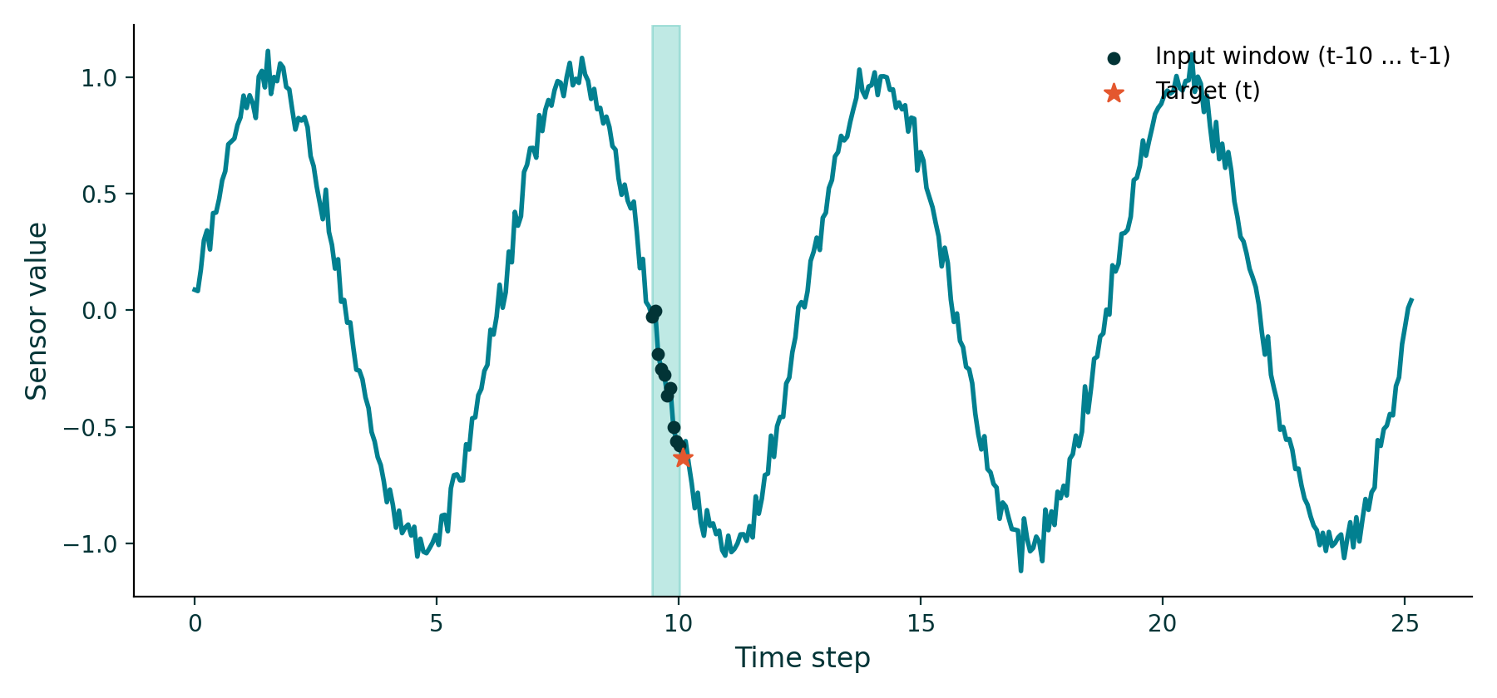
THE DATASET
A simple numeric time series
Task: given the last 10 readings from a sensor, predict the next one. The signal is a noisy sine wave — one number per time step, so the model only has to learn temporal order, not complex features.
1
input feature
10
timesteps / window
1
value predicted
2

Slide 3
MOTIVATION
Why not a regular neural network?
Feed-forward network
Recurrent network
x1
x2
x3
x1
x2
x3
Every input is treated independently — no sense of what came before.
A hidden state carries information forward, step by step — the network remembers.
3

Slide 4
BUILDING BLOCK 1
Recurrent Neural Network (RNN)
At each step, the hidden state h(t) combines the new input with the previous hidden state.
hidden state passed forward →
Limitation
h0
h1
h2
Over long sequences, gradients shrink (or blow up) while training — the network struggles to remember anything far in the past.
x1
x2
x3
4

Slide 5
BUILDING BLOCK 2
Long Short-Term Memory (LSTM)
LSTM adds a separate cell state and three gates that decide what to forget, add, and output.
Forget gate
Input gate
Output gate
Decides what old information to drop from the cell state.
Decides what new information to add to the cell state.
Decides what part of the cell state becomes the hidden output.
5

Slide 6
BUILDING BLOCK 3
Gated Recurrent Unit (GRU)
GRU simplifies LSTM: no separate cell state, just two gates — fewer parameters, faster to train.
Update gate
Reset gate
Decides how much of the past hidden state to keep vs. replace with new content.
Decides how much past information to ignore when computing the new candidate state.
6

Slide 7
COMPARISON
RNN vs. LSTM vs. GRU
RNN
LSTM
GRU
Internal memory
Hidden state only
Hidden + cell state
Hidden state only
Gates
None
Forget, input, output
Update, reset
Long-range memory
Weak
Strong
Strong
Parameters
Fewest
Most
Fewer than LSTM
Training speed
Fastest
Slowest
Faster than LSTM
7

Slide 8
SIMPLE CODE
Same architecture, one layer swapped
Keras treats RNN, LSTM and GRU as interchangeable layers — swap the class name and the rest of the pipeline stays identical.
from tensorflow.keras.models import Sequential
from tensorflow.keras.layers import LSTM, Dense
# X_train shape: (samples, 10 timesteps, 1 feature)
model = Sequential([
LSTM(32, input_shape=(10, 1)), # <- swap for SimpleRNN or GRU
Dense(1) # predicts the next value
])
model.compile(optimizer='adam', loss='mse')
model.fit(X_train, y_train, epochs=20, batch_size=16)
8

Slide 9
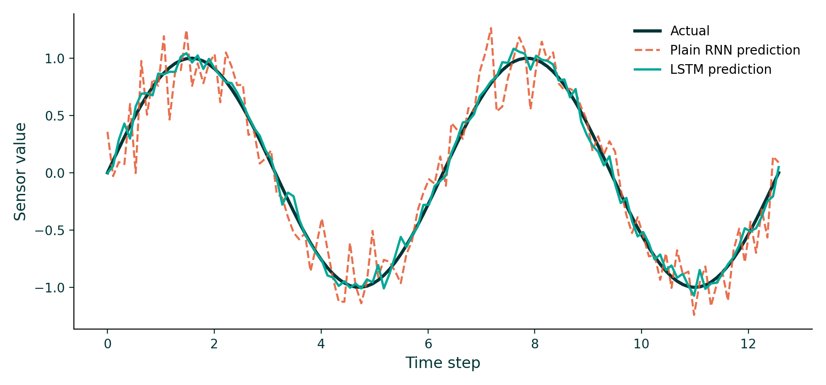
RESULTS
LSTM tracks the signal far more closely
Both models were trained on the same windows. The plain RNN prediction is noticeably noisier — a sign of the vanishing-gradient problem in action.
9

Slide 10
KEY TAKEAWAYS
Pick the right memory for your sequence
RNN
Simple and fast — fine for short sequences, struggles with long-range dependencies.
LSTM
Most powerful memory (3 gates + cell state) — best when long-range patterns matter most.
GRU
A lighter LSTM (2 gates, no cell state) — nearly as strong, quicker to train.
10

