Slide 1
HOW CNNs WORK
A Hands-On Walkthrough of Convolutional Neural Networks
Real code, a real dataset, and real input/output at every step
Dataset: scikit-learn “digits” (8×8 grayscale handwritten digits)

Slide 2
ROADMAP
What we'll cover
1
The dataset
2
Convolution
8×8 grayscale digit images from scikit-learn
Sliding filters/kernels extract features
3
ReLU activation
4
Max pooling
Introducing non-linearity
Shrinking feature maps, keeping key signals
5
Flatten + Dense
6
Softmax output
Turning maps into a decision
Turning scores into probabilities
2

Slide 3
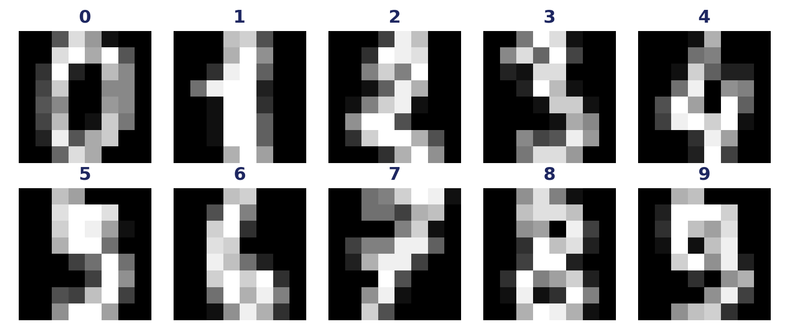
01 · DATASET
A simple, real dataset: digits
1,797 grayscale images of handwritten digits (0–9)
Each image is only 8×8 pixels — small enough to inspect by hand
Pixel values range 0–16 (light → dark ink intensity)
10 classes — one per digit — a classic starter dataset
Sample images — one per digit class
from sklearn.datasets import load_digits
digits = load_digits()
X = digits.images # shape (1797, 8, 8)
y = digits.target # labels 0-9
3

Slide 4
OVERVIEW
The CNN pipeline, end to end
Input
Image
→
Convolution
+ Filters
→
ReLU
Activation
→
Max
Pooling
→
Flatten
→
Dense
Layer
→
Softmax
Output
Each stage transforms the image into a more compact, more meaningful representation — raw pixels become edges, edges become shapes, shapes become a class prediction.
Local features
Shared weights
Hierarchy
Filters look at small neighborhoods, not the whole image at once
The same filter slides across the whole image — fewer parameters
Later layers combine earlier features into higher-level concepts
4

Slide 5
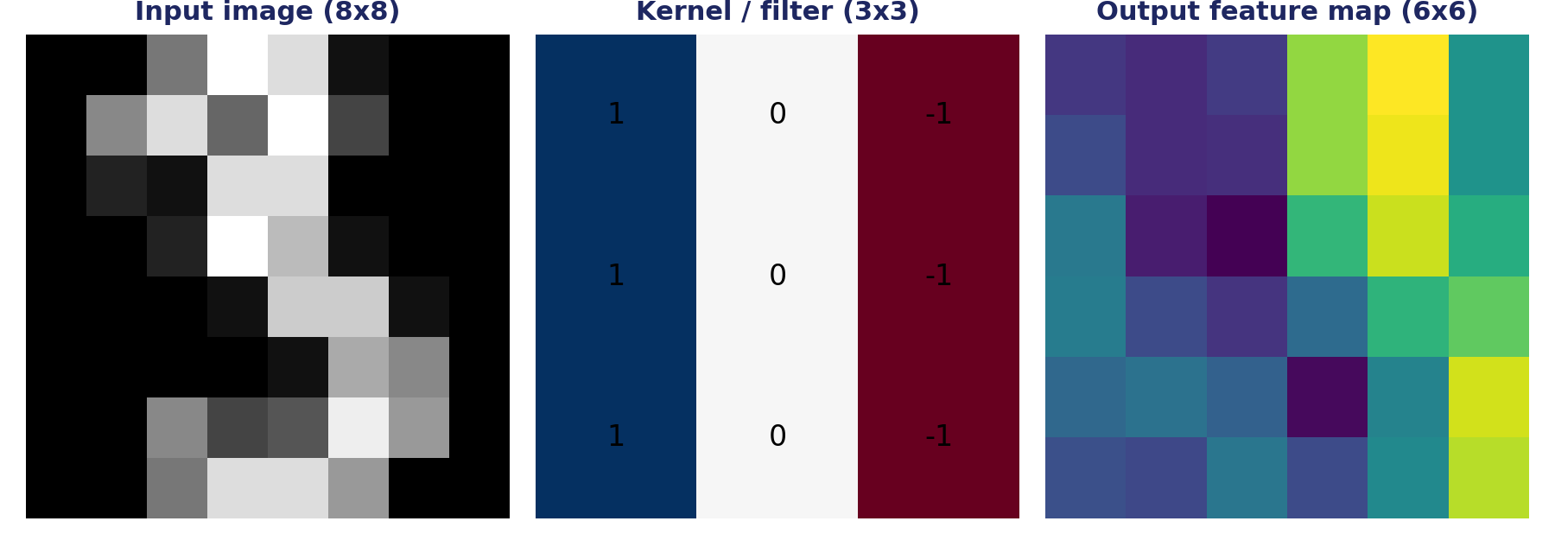
02 · CONVOLUTION
Sliding a filter across the image
A kernel (small grid of numbers) slides over the image. At each position it multiplies overlapping values and sums them — producing one pixel of the output feature map.
kh, kw = kernel.shape
oh, ow = (image.shape[0]-kh)+1, (image.shape[1]-kw)+1
for i in range(oh):
for j in range(ow):
out[i, j] = np.sum(image[i:i+kh, j:j+kw] * kernel) # multiply + sum
5

Slide 6
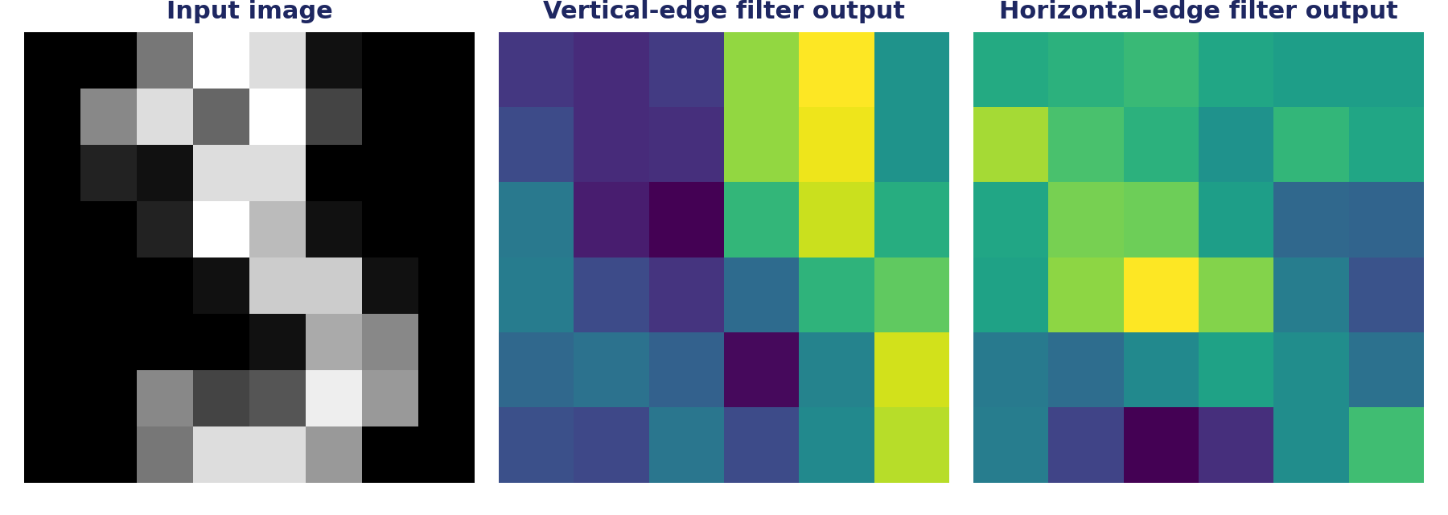
02 · CONVOLUTION
Different filters find different features
Vertical-edge filter
Horizontal-edge filter
[1,0,-1] rows — lights up where intensity changes left-to-right
[1,1,1 / -1,-1,-1] — lights up where intensity changes top-to-bottom
In a real CNN, a conv layer applies dozens of such filters at once — and learns their values during training, instead of hand-designing them.
6

Slide 7
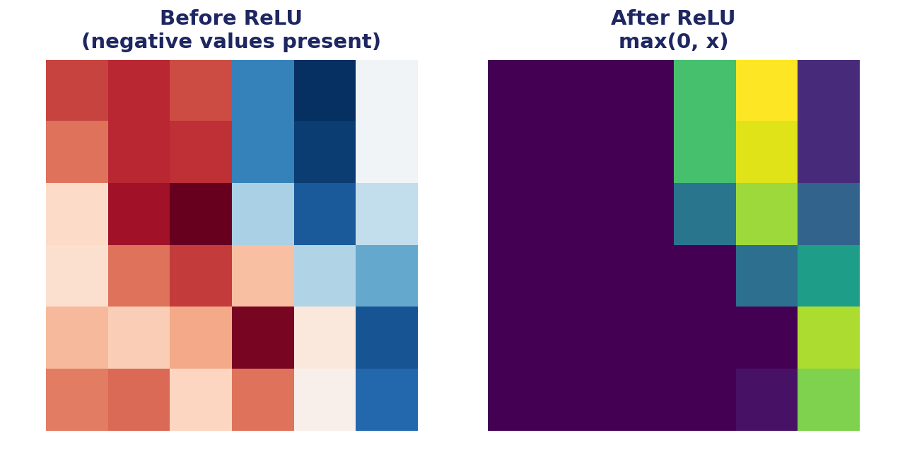
03 · ACTIVATION
ReLU: adding non-linearity
ReLU (Rectified Linear Unit) simply replaces every negative value with zero, keeping positive values unchanged: f(x) = max(0, x). This lets the network model complex, non-linear patterns.
relu_out = np.maximum(feature_map, 0)
Without it, stacking conv layers would collapse into one linear operation
Cheap to compute — just a threshold at zero
Negative responses (“not this pattern”) are dropped; positive ones (“this pattern is present”) pass through
7

Slide 8
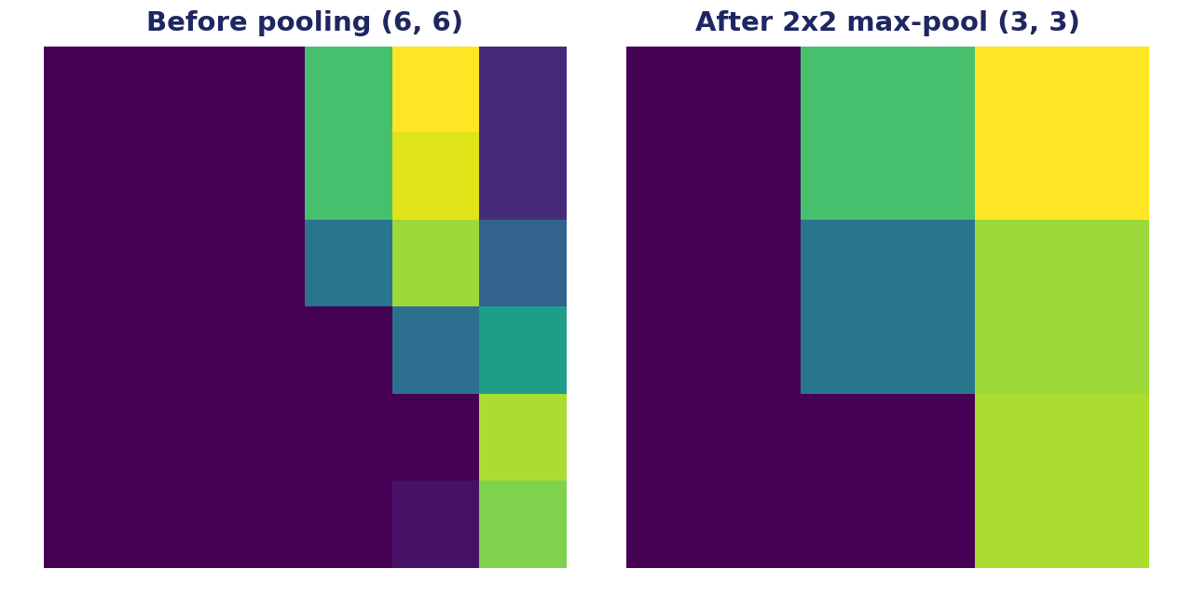
04 · POOLING
Max pooling: shrinking, not losing signal
A 2×2 max-pool slides over the feature map and keeps only the largest value in each window — halving both dimensions while preserving the strongest activations.
oh, ow = feat.shape[0]//2, feat.shape[1]//2
for i in range(oh):
for j in range(ow):
out[i, j] = np.max(feat[i*2:i*2+2, j*2:j*2+2]) # largest value in each 2x2 window wins
8

Slide 9
05 · FLATTEN + DENSE
From a grid of numbers to a decision
Flatten reshapes the pooled 2D feature map into a single 1D vector. A Dense (fully connected) layer then combines every value in that vector, weighted, into a raw score for each of the 10 digit classes.
3×3 pooled
feature map
10 output
scores
(logits)
[v1 v2 ... v9]
vector (len 9)
→ flatten() →
→ Dense →
one score per digit class 0–9
flat = pooled.flatten() # shape (9,)
logits = W @ flat + b # shape (10,)
9

Slide 10
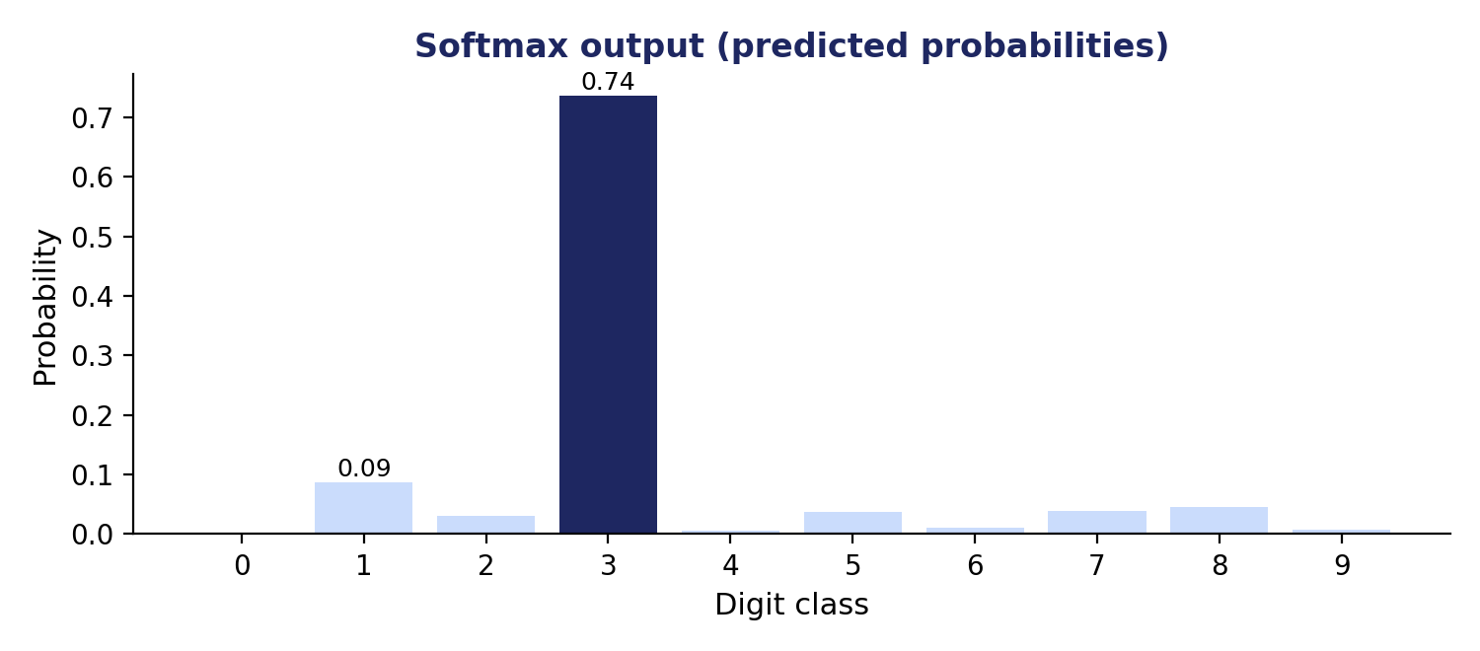
06 · OUTPUT
Softmax: scores become probabilities
Softmax exponentiates each score and normalizes so all 10 values sum to 1 — giving a clean probability distribution over the digit classes.
exp = np.exp(logits - logits.max())
probs = exp / exp.sum()
prediction = np.argmax(probs)
Predicted digit: 3
True label: 3 — correct prediction on this sample
(Weights above are illustrative, not trained — a real CNN learns W and b from thousands of examples.)
10

Slide 11
PUTTING IT TOGETHER
The full forward pass, in code
image = X[idx] / 16.0 # normalize pixel values
feature_map = conv2d(image, kernel) # 1. Convolution
activated = np.maximum(feature_map, 0) # 2. ReLU
pooled = max_pool2d(activated) # 3. Max pooling
flat = pooled.flatten() # 4. Flatten
logits = W @ flat + b # 5. Dense layer
probs = softmax(logits) # 6. Softmax
prediction = np.argmax(probs) # -> predicted digit
This is exactly what a framework like Keras or PyTorch does under the hood — just with many more filters, several stacked conv/pool blocks, and weights learned via backpropagation instead of random numbers.
11

Slide 12
KEY TAKEAWAYS
What makes a CNN work
Convolution
Small filters slide across the image to detect local patterns like edges
ReLU
Adds non-linearity so the network can learn complex patterns, not just straight lines
Pooling
Shrinks feature maps while keeping the strongest signals, reducing computation
Flatten + Dense + Softmax
Turns spatial features into class probabilities for a final prediction
Same idea, bigger scale: real CNNs (ResNet, VGG, etc.) repeat this conv → ReLU → pool pattern many times over larger, color images.

