Slide 1

DEPARTMENT OF COMPUTER SCIENCE AND ENGINEERING
MACHINE LEARNING FRAMEWORKS FOR AUTISM
SPECTRUM DISORDERS​
PRESENTED BY:
N.SAI SRI HARSHITHA 21RG1A05A4
P.KAVYA 21RG1A05B4
Y.SINDHU 21RG1A05D0
K.SANGEETHA 21RG1A0590
UNDER THE GUIDENCE OF:
Ms SHILPA
B.Tech, M.Tech

Slide 2
CONTENT
Abstract
Introduction
Existing System
Literature Survey
Proposed Method
Hardware & Software Requirements
Advantages
Applications
Result Analysis
Future Scope
Conclusion
References

Slide 3
ABSTRACT:
Especially in the case of neural disorders such as autism spectrum disorder (ASD), accurate detection was still a challenge.
Many machine learning techniques were proposed to improve the classification and detection accuracy of autism in MRI images. Our work focused mainly on developing the architecture of convolution neural networks (CNN) combining the genetic algorithm.
Such artificial intelligence (AI) techniques were very much needed for training as they gave better accuracy compared to traditional statistical methods.
The brainchild in any medical image processing lied in how accurately the diseases are diagnosed.

Slide 4
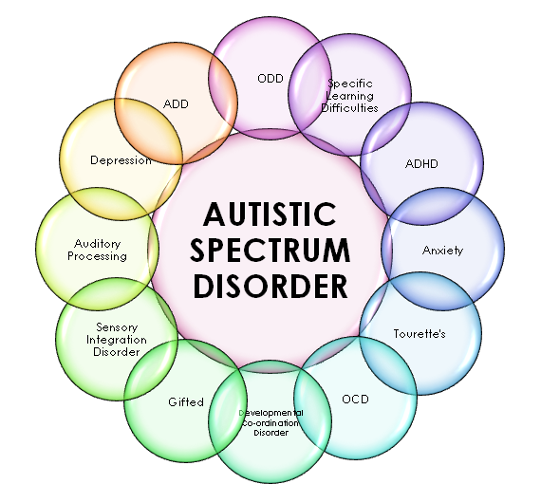
INTRODUCTION:
Autism spectrum disorder is a neurodevelopmental disorder that affects a person's interaction, communication and learning skills.
Although diagnosis of autism can be done at any age. Autism patients face different types of challenges such as difficulties with concentration. learning disabilities, mental health problems.
Diagnosis of autism requires significant amount of time and cost.
Earlier detection of autism can come to a great help by prescribing patients with proper medication at an early stage.
The objective of this work is to propose an autism prediction model using ML techniques and to develop a mobile application that could effectively predict autism traits of an individual of any age.

Slide 5
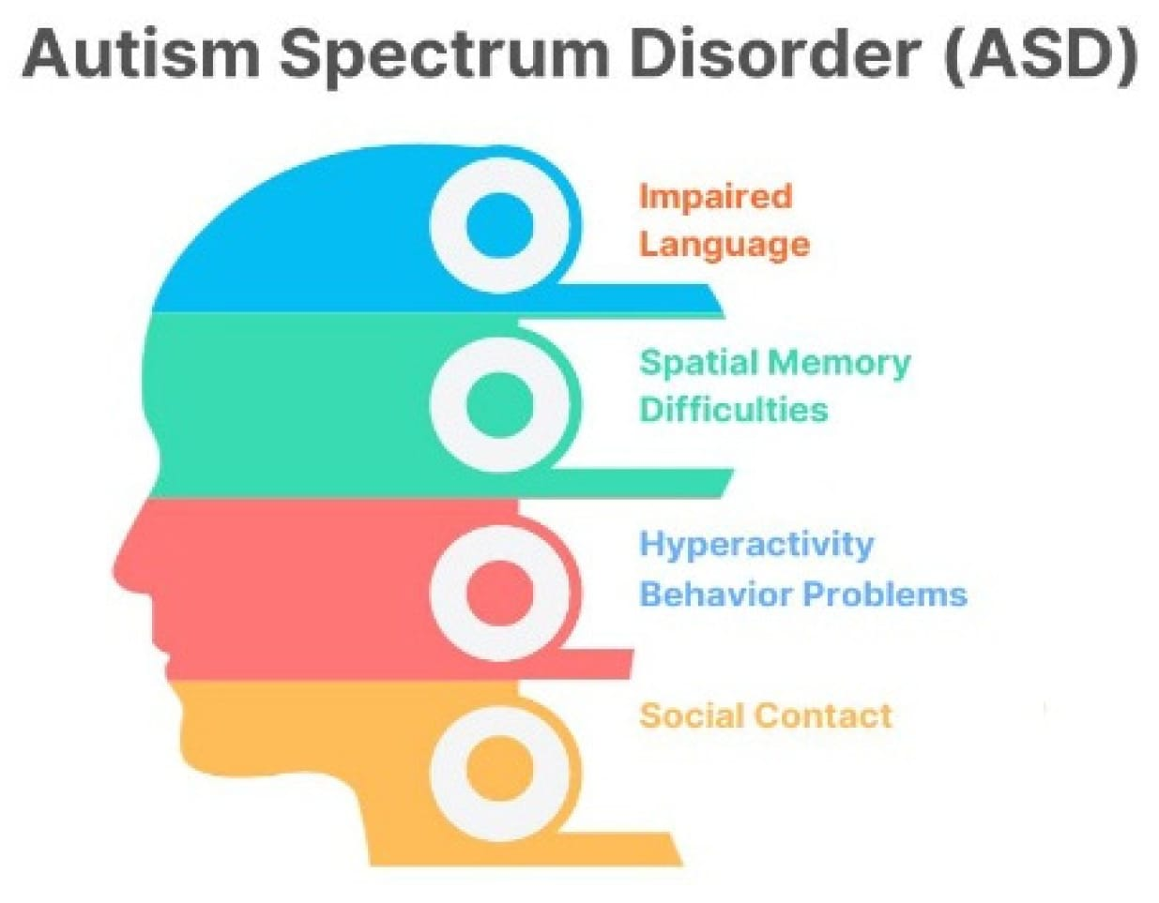
EXISTING SYSTEM:
The existing system for the detection of Autism Spectrum Disorder (ASD) was developed using the Ada Boost (AB) machine learning algorithm and achieved an impressive accuracy rate of 97.95%.
This system represented a significant milestone in the application of machine learning to ASD diagnosis.
In conclusion, the existing system that employed the Ada Boost (AB) algorithm for ASD detection and achieved an accuracy rate of 97.95% represented a significant advancement in the field of healthcare and machine learning.
DISADVANTAGES OF EXISTING SYSTEM
Data Dependency
Overfitting Risk
Limited Transparency
Computationally Intensive
Limited Feature Engineering
Lack Of Continous Learning

Slide 6
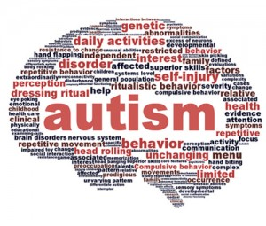
PROPOSED SYSTEM:
➤ Our proposed strategy focuses on a novel machine learning procedures for Autism spectrum disorder (ASD) classification and prediction, thus overcoming the existing problem.
➤ By utilizing Random Forest (RF), Support Vector Machine(SVM), AdaBooster algorithms we will make our model in order to increase the performance and accuracy
ADVANTAGES OF PROPOSED SYSTEMS:
High Accuracy
Robust Generalization
Rich Feature Set
Early Daignosis
Flexible Apllication
Continous Learning Application

Slide 7
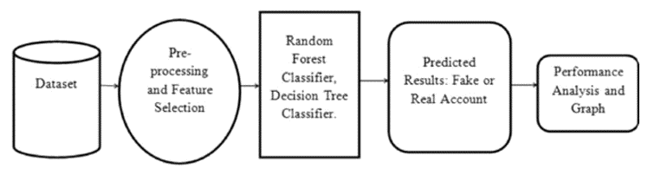
SYSTEM ARCHITECTURE:

Slide 8
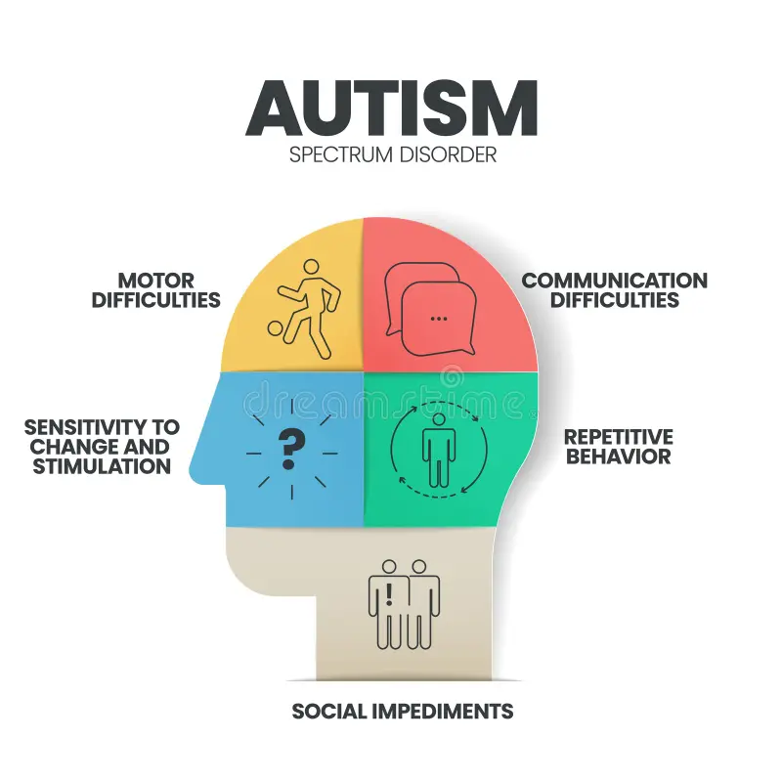
REQUIREMENTS
HARDWARE REQUIREMENTS:
Processor:i5 and above
Ram:4gb and above
Hard Disk:50gb
Operating System: Windows Only
SOFTWARE REQUIREMENTS:
Visual Studio Community Version
NodeJS (Version 12.3.1)
Python IDLE (Python 3.7)
Database:SQLite

Slide 9
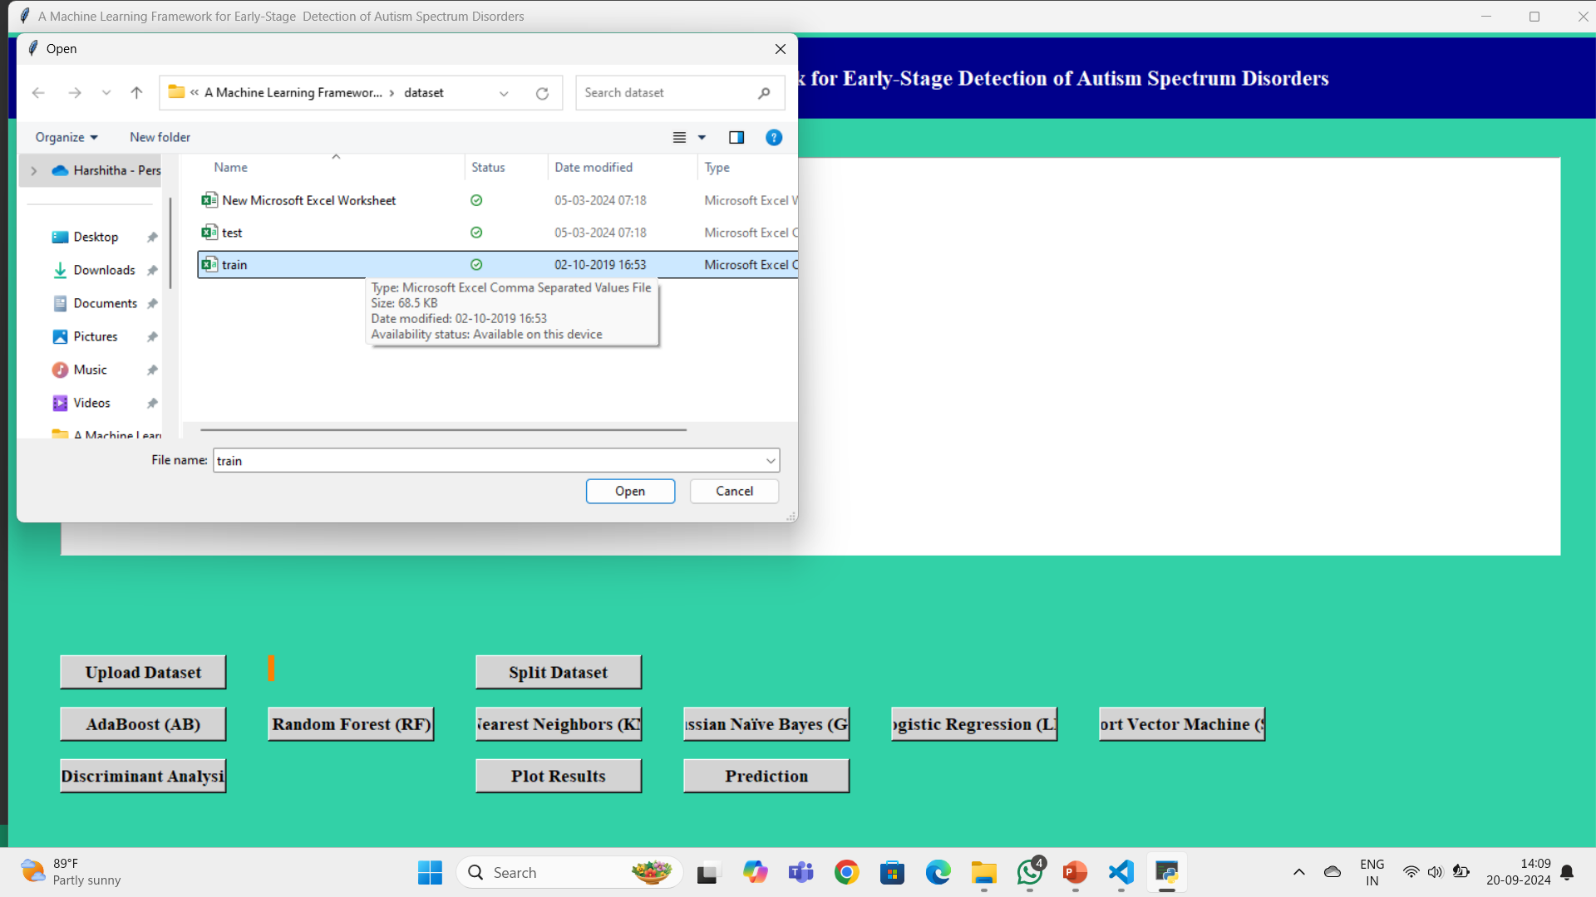
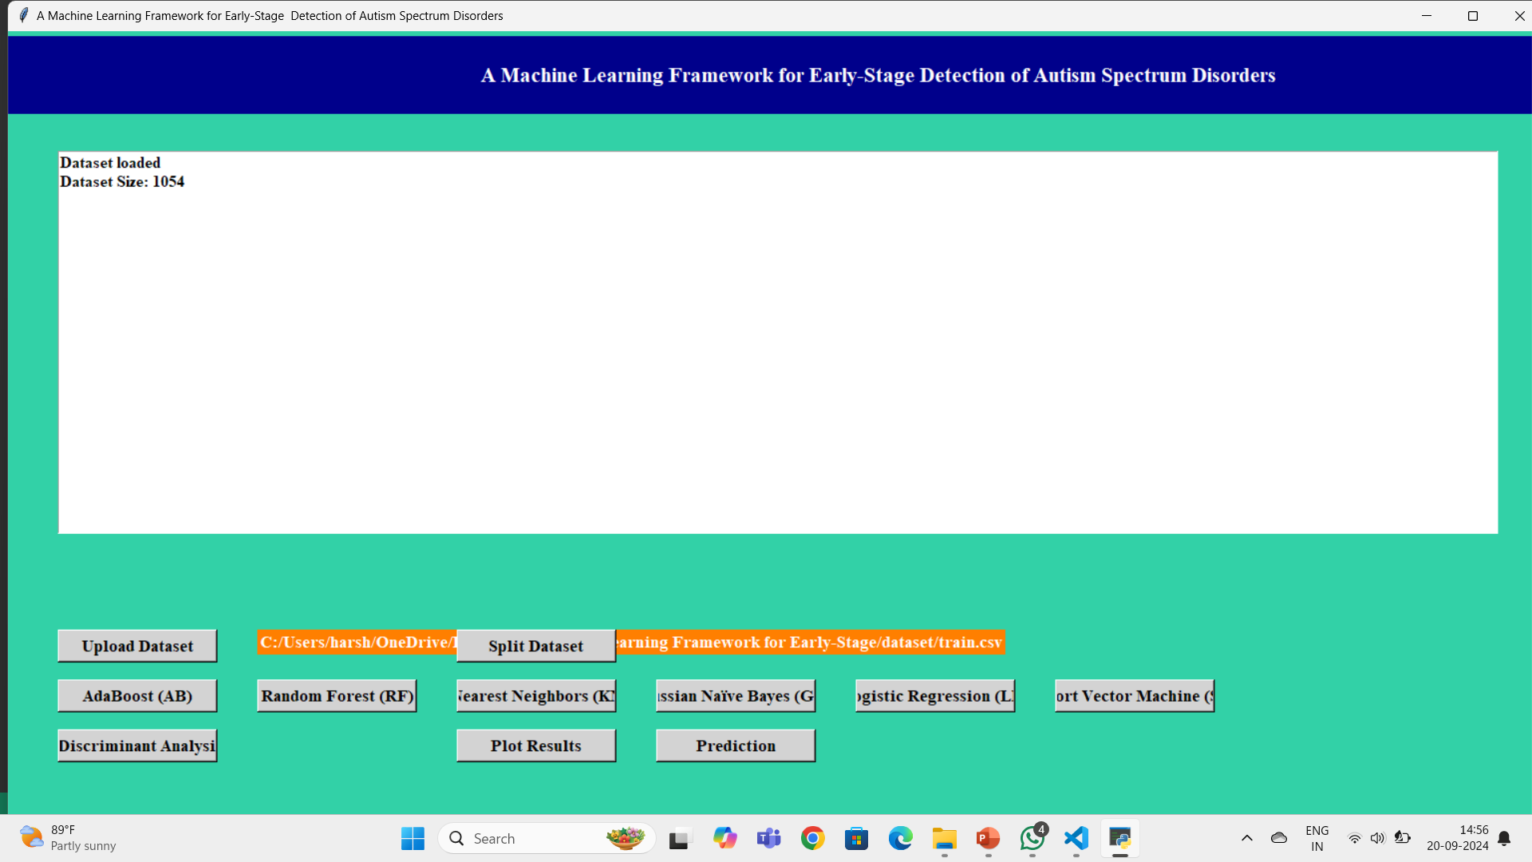
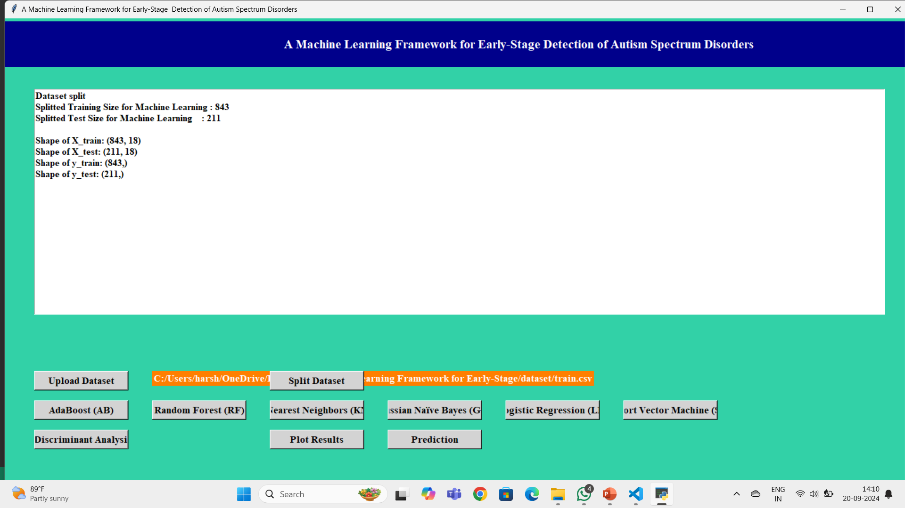
RESULT ANALYSIS
After setting path double click on RUN bar file to run the project and to get below screen
Click on Upload dataset and train file
Data set is uploaded and it displays the size of dataset
Click on the Split dataset
Apply the following algorithms to get better result

Slide 10
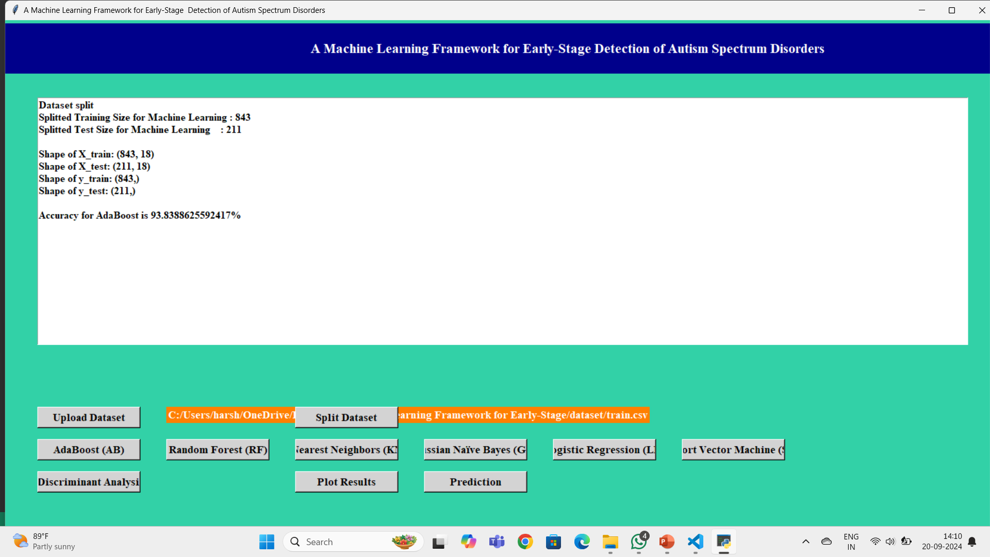

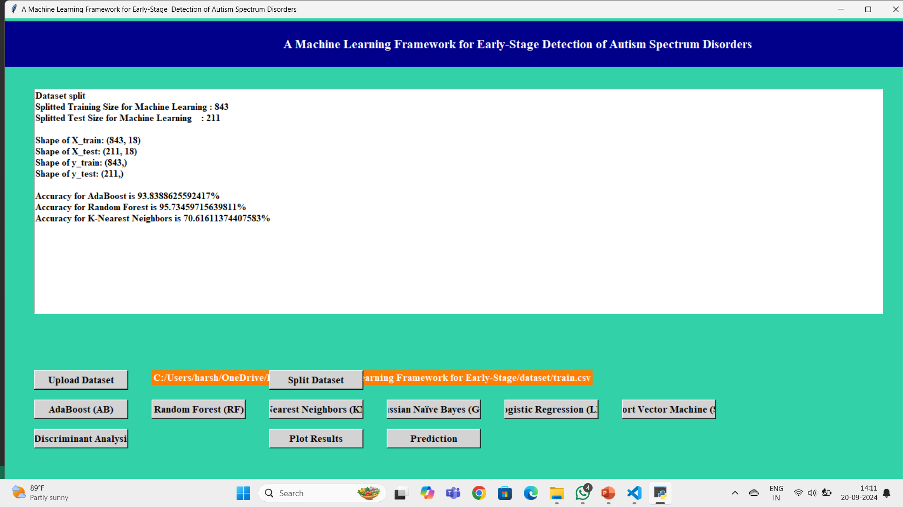
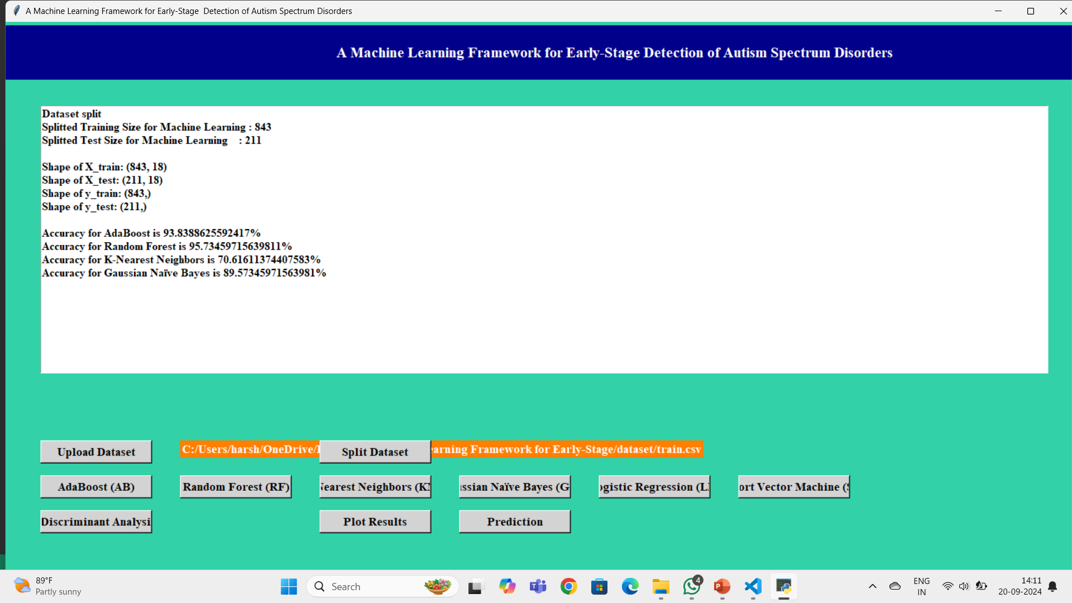

Slide 11
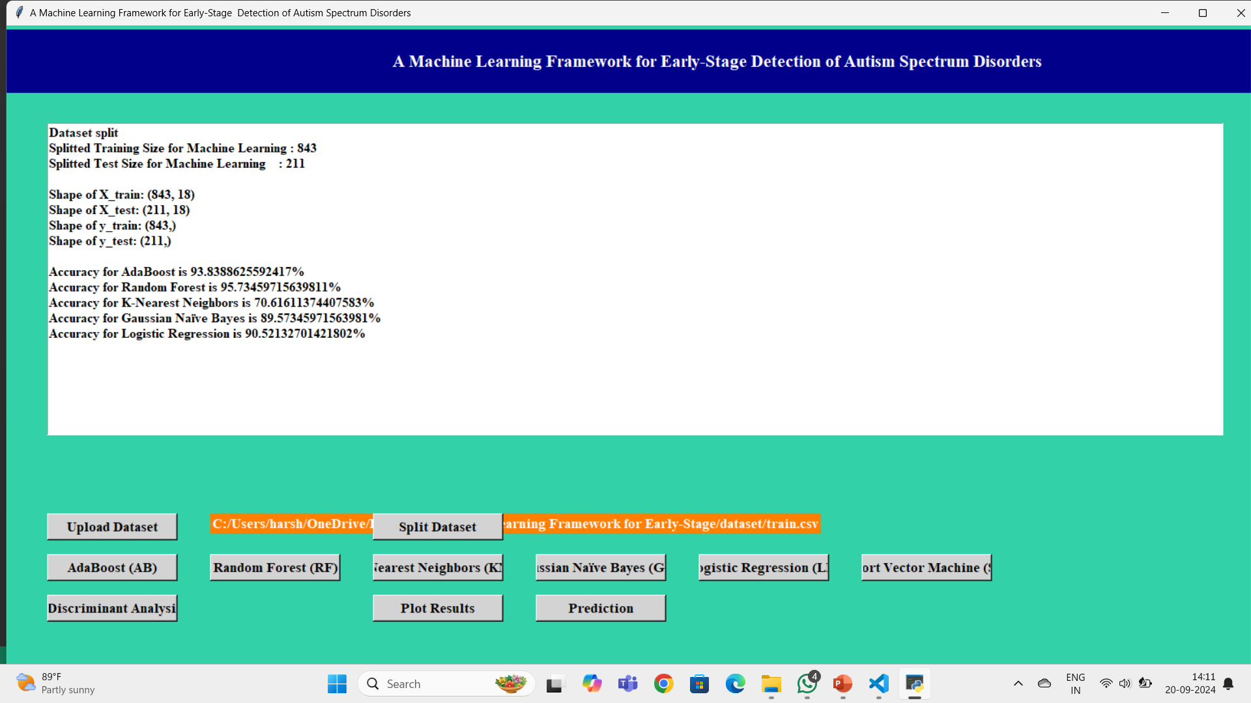


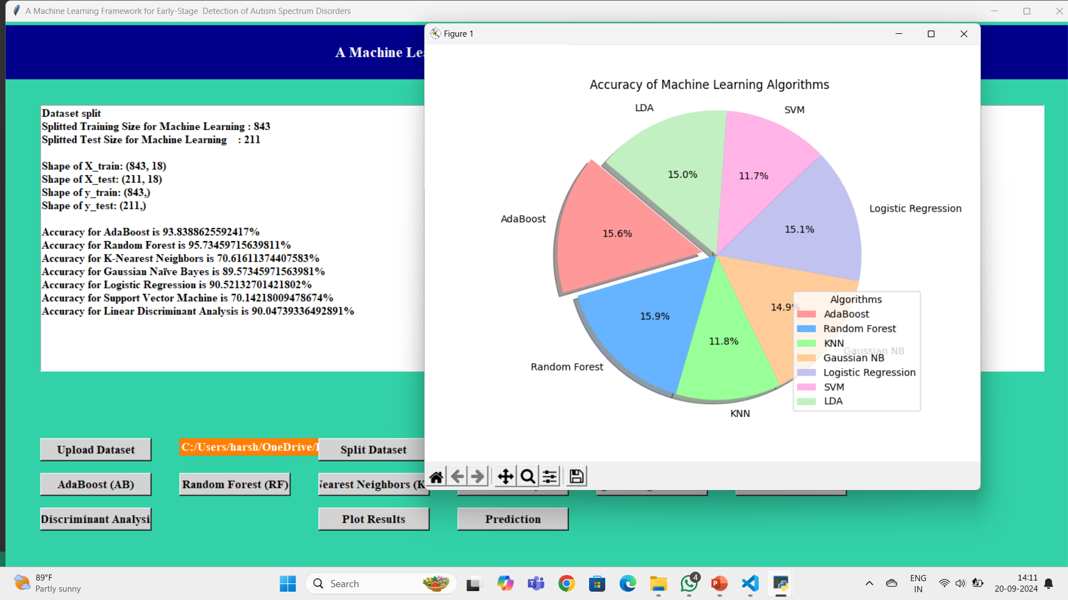

Slide 12
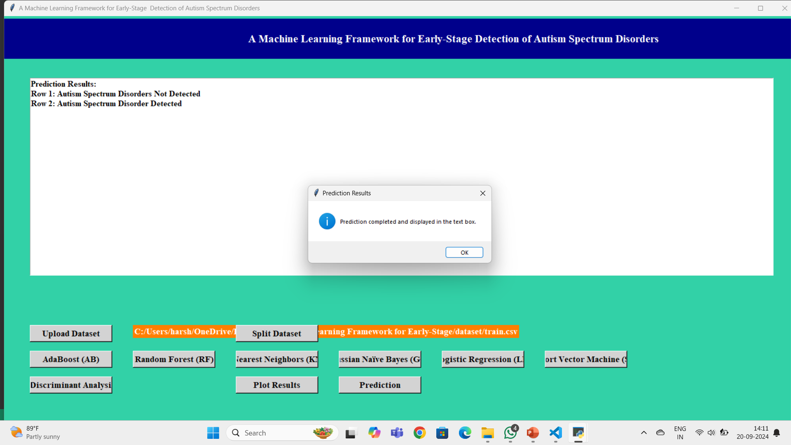
Click on the Predict button to check the patient’s autism disorder is detected or not

Slide 13
ADVANTAGES
1. *Early Detection*: ML models can identify patterns in large datasets, potentially detecting early markers of ASD that may be subtle or overlooked by human observers. Early intervention is critical for improving outcomes
.2. *Improved Accuracy*: By analyzing multiple features such as genetic data, neuroimaging, and behavioral patterns, machine learning algorithms can improve diagnostic accuracy, reducing misdiagnosis and ensuring appropriate interventions.
3. *Scalability*: ML frameworks can process large amounts of data from multiple sources, including speech, video, and clinical records. This makes it easier to scale ASD detection to broader populations, reducing bottlenecks in specialized diagnostic services.
4. *Automation*: Automating the ASD detection process through ML reduces the need for extensive manual assessments, saving time for clinicians and allowing them to focus on treatment and intervention strategies.
5. *Personalized Diagnosis*: ML models can analyze an individual’s unique combination of behavioral and biological markers, enabling more personalized and precise diagnoses compared to one-size-fits-all approaches.
6. *Cost-Effectiveness*: Early, accurate detection via ML can reduce the costs associated with delayed diagnosis, long-term therapy, and misdiagnosis, leading to more efficient use of healthcare resources
7. *Continuous Learning & Improvement*: ML models can continuously improve over time as more data is collected, refining their ability to detect ASD with better precision.

Slide 14
APPLICATIONS
1.*Behavioral Analysis* - *Video and Gesture Analysis*
2. *Neuroimaging Data Analysis* - *Brain Imaging (fMRI/EEG)
3. *Genetic and Genomic Analysis* - *Genomic Data Processing*
4.*Early Screening Tools* - *Questionnaires,Clinical Screening Automation*
5.*Real-Time Monitoring and Assessment* - *Wearable Devices and Sensors*
6.*Predictive Modeling* - *Risk Stratification Models*
7.*Social Interaction and Communication Analysis* - *Virtual Reality (VR),AI-driven Interactions*
8.*Personalized Intervention Strategies* - *Customized Therapies

Slide 15
CONCLUSION:
In this work, we proposed a machine-learning framework for ASD detection in people of different ages (Toddlers, Children, Adolescents, and Adults).
We show predictive models based on ML techniques are useful tools for this task.
The ASD datasets were scaled using four different types of feature scaling (QT, PT, normalizer, MAS) techniques, classified using eight different ML classifiers (AB, RF, DT, KNN, GNB, LR, SVM, LDA).
Consequently, our proposed prediction models based on ML techniques can be utilized as an alternative accurately identify ASD cases for people of different ages.
The limitation of our research work is that the amount of data was not sufficient enough to build a generalized model for people of all stages.
In the future, we intend to collect more data related to ASD and construct a more generalized prediction model for people of any age to improve ASD detection and other neuro-development disorders

Slide 16
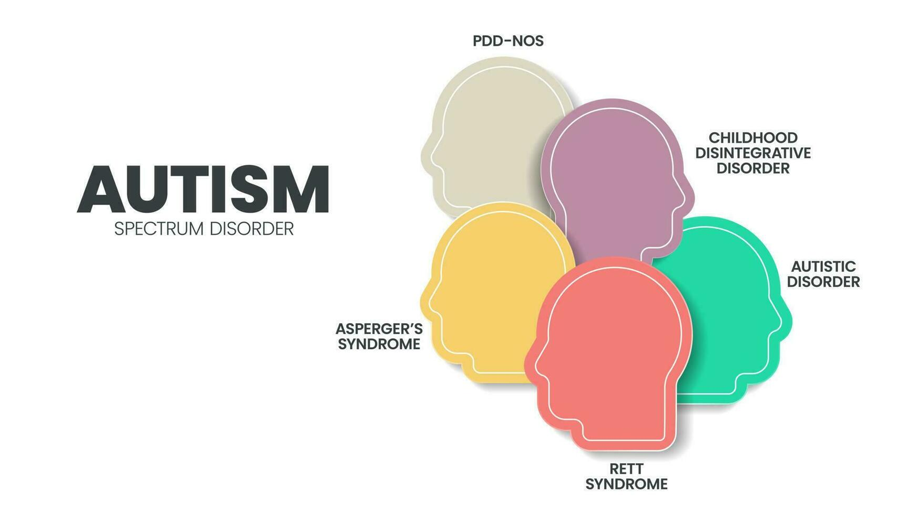
FUTURE SCOPE
1*Early Detection and Diagnosis*
2. *Personalized Treatment Recommendations*
3. *Data-Driven Behavioral Assessment*
4. *Genetic and Environmental Research*
5. *Cross-Cultural and Socioeconomic Generalization*
6. *Integration with Digital Health Platforms*
7. *Collaboration with Neurological and Behavioral Sciences*.

Slide 17
REFERENCE
[1] M. Bala, M. H. Ali, M. S. Satu, K. F. Hasan, and M. A. Moni, ‘‘Efficient machine learning models for early stage detection of autism spectrum disorder,’’ Algorithms, vol. 15, no. 5, p. 166, May 2022.
[2] D. Pietrucci, A. Teofani, M. Milanesi, B. Fosso, L. Putignani, F. Messina, G. Pesole, A. Desideri, and G. Chillemi, ‘‘Machine learning data analysis highlights the role of parasutterella and alloprevotella in autism spectrum disorders,’’ Biomedicines, vol. 10, no. 8, p. 2028, Aug. 2022.
[3] R. Sreedasyam, A. Rao, N. Sachidanandan, N. Sampath, and S. K. Vasudevan, ‘‘Aarya—A kinesthetic companion for children with autism spectrum disorder,’’ J. Intell. Fuzzy Syst., vol. 32, no. 4, pp. 2971–2976, Mar. 2017.
[4] J. Amudha and H. Nandakumar, ‘‘A fuzzy based eye gaze point estimation approach to study the task behavior in autism spectrum disorder,’’ J. Intell. Fuzzy Syst., vol. 35, no. 2, pp. 1459–1469, Aug. 2018. \
[5] H. Chahkandi Nejad, O. Khayat, and J. Razjouyan, ‘‘Software development of an intelligent spirography test system for neurological disorder detection and quantification,’’ J. Intell. Fuzzy Syst., vol. 28, no. 5, pp. 2149–2157, Jun. 2015.
[6] F. Z. Subah, K. Deb, P. K. Dhar, and T. Koshiba, ‘‘A deep learning approach to predict autism spectrum disorder using multisite resting-state fMRI,’’ Appl. Sci., vol. 11, no. 8, p. 3636, Apr. 2021

Slide 18


