Slide 1



SRI RAMAKRISHNA ENGINEERING COLLEGE
[Educational Service : SNR Sons Charitable Trust]
[Autonomous Institution, Accredited by NAAC with ‘A’ Grade]
[Approved by AICTE and Permanently Affiliated to Anna University, Chennai]
[ISO 9001: 2015 Certified and all eligible programme Accredited by NBA]
VATTAMALAIPALAYAM, N.G.G.O. COLONY POST, COIMBATORE – 641 022.
CAREERMATE
GUIDED BY: TEAM MEMBERS:
Mrs. C. Padmavathy , Kavya. A (1601107)
AP(Sl.Gr) /CSE Muthumeena. K (1601126)
Ponmadathi. V (1601137)
Praharshita. T (1601142)

Slide 2
AGENDA
Introduction
Problem Definition
Hardware and Software Requirements
Modules
Future Scope
References

Slide 3
INTRODUCTION
CAREERMATE is to provide student information on the basis on Training and placement department of the collage to the companies. It provides the details of students in a database for the companies to their process of recruitment provided with a proper login. This system can stores all the personal information of the students ,like their personal details and academic details. This system is maintaining student’s information, the system helps to have selections to be made easy for a company in its test for the recruitment process. The students can update their own information only.

Slide 4
PROBLEM DEFINITION
There is a need to store and maintain all the papers of Student personal details and academic details, causing large amount of space. It is manually done, chances of missing, difficult to handle the details of students information required for the training and placement department of the college.

Slide 5
HARDWARE AND SOFTWARE REQUIREMENTS
Operating System : Windows
RAM : 8GB
Software : XAMPP, Notepad++
Languages : PHP, HTML, JS, CSS

Slide 6
MODULES
There are two modules in this project CARERRMATE.
Admin Module
Student Module
Report generation Module

Slide 7
MODULE DESCRIPTION
Module 1 : Admin Module
Admin module stores all the details entered by students such us personal details and their academic details. The main work of an admin is to enter the company details.
Maintain records of all valuable information about every student.
Company details can be filtered according to the student’s CGPA and their department wise.
The company details can be updated.

Slide 8
Module 2 : Student Module
Student module made available to enter all the personal details and academic details required for the training and placement department.
Students can signup and login.
Logging into the system can access only those are authenticated to enter their details.

Slide 9
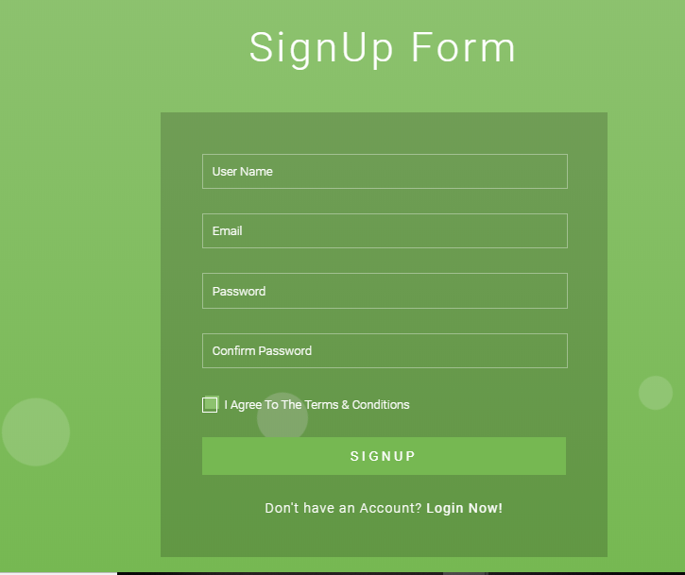

Slide 10
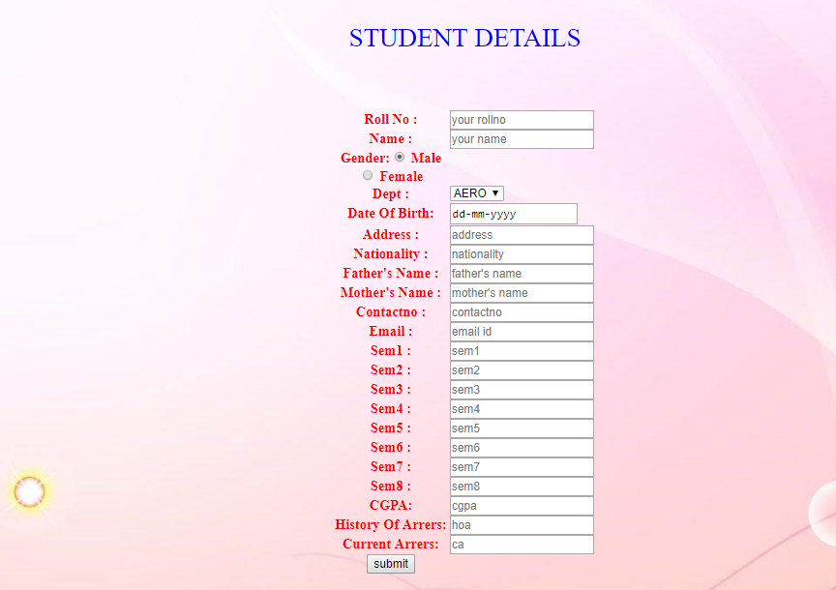

Slide 11
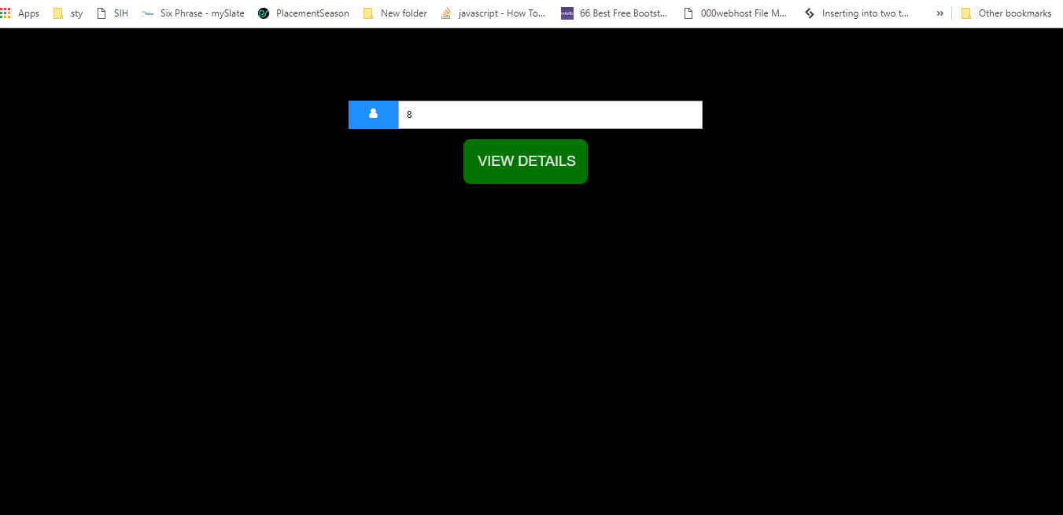
Module 3 : Report generation Module
Retrieve records of the students on the basis of CGPA. List of eligible students will be made available through this module.

Slide 12
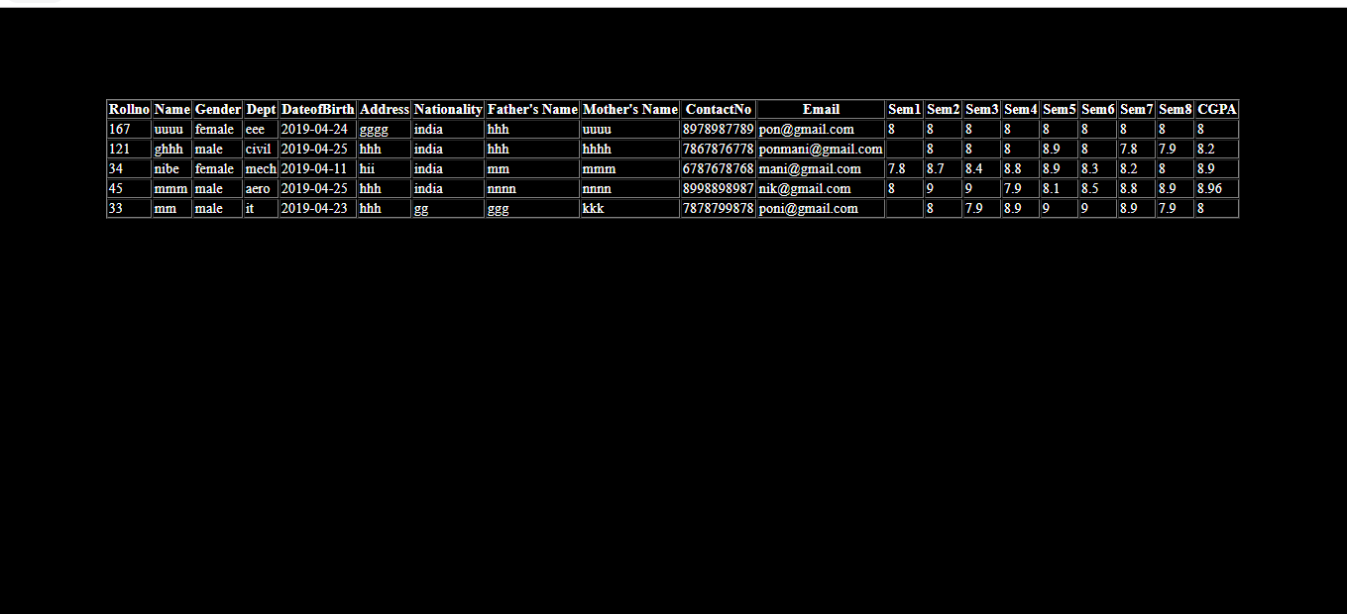

Slide 13
FUTURE SCOPE
The Future scope is to predict the student’s eligibility for the company by the records of student’s past Training and placement department’s assessment tests. Examining each student’s way of handling their problems and answering their questions are stored. Predictions are made by reviewing the previously collected data to the current performances, able to predict whether the student is eligible for the company or not.

Slide 14
CONCLUSION
CAREERMATE create an environment which remove the pen and paper work and reduce the time consuming work. It also have particular module for particular areas like student and academic details in student module and company details are uploaded in admin module. For security purpose also have password changing options. It is very important system for those students who are graduate and searching for the jobs in different areas.

Slide 15
REFERENCES
Rupali Komatwar, Swapnil Kamble, Mihir Khedekar, Kishor Walzade, “Placement support system” Internatioanl journel of advanced research in computer and communication Engineering, Vol. 5, Issue 1,January 2016 Vol. 5,Issue 1, January 2016.
Sanket R. Brahmankar, Rahul S. Ghule, Shubham k.Chavan, Landge D. Ashish, Pavan D. Borse, “A survey on Android App for Training and placement cell”, IJARIIE-ISSN(O)-2395-4396, Vol-1 Issue-4 2015.
Rohit, A.Dhole, Department of Electronics, Ram Meghe Web Based Autoimation of Training and placement cell, Instiutute of Technology and Research, Amravati.

Slide 16
Thank You…!

