Slide 1


Digital Portfolio
STUDENT NAME: KAVYA R
REGISTER NO AND NMID: DBAA422086A2AF59E994446E01A6C146 DEPARTMENT:B.SC COMPUTER SCIENCE COLLEGE: SRM ARTS AND SCIENCE COLLEGE UNIVERSITY:MADRAS UNIVERSITY
1

Slide 2


PROJECT TITLE
Digital portfolio
2

Slide 3




AGENDA
1.Problem Statement 2.Project Overview 3.End Users 4.Tools and Technologies 5.Portfolio design and Layout 6.Features and Functionality 7.Results and Screenshots 8. Conclusion 9.Github Link
3
3/21/2024 Annual Review

Slide 4

PROBLEM STATEMENT
In today’s competitive world, having only a resume is not enough to showcase skills and achievements. Many students and professionals struggle to present their projects in an attractive way. Traditional resumes fail to highlight creativity and technical abilities effectively. A well-structured portfolio can act as a digital identity for individuals. The problem is the lack of a simple and professional solution for this need. This project focuses on solving that by creating a portfolio website. It helps individuals stand out and create a better impression.
4

Slide 5

PROJECT OVERVIEW
The project aims to design and develop a personal portfolio website using web technologies. The portfolio highlights a user’s personal details, skills, education, and projects in an organized format. It focuses on creating a clean layout that is both attractive and easy to navigate. HTML, CSS, and JavaScript are used to structure, style, and add interactivity. The final product provides an effective platform to present information onl ine. This project is about designing and developing a personal portfolio website. It acts as a one-stop platform to display skills, education, and achievements. The website is user-friendly and can be accessed anytime, anywhere. It is designed with a professional layout to catch the attention of recruiters. Different sections are included for About Me, Skills, and Projects. The aim is to give users a digital space to highlight their work. It combines design, functionality, and accessibility in one platform.
5

Slide 6

WHO ARE THE END USERS?
The primary users are students who want to showcase their work to recruiters. Job seekers can use it to highlight their experience and skills effectively. Freelancers can use the portfolio to attract clients by showing past work. Recruiters and employers can access portfolios to evaluate candidates easily. Teachers and institutions may also encourage students to use such platforms. Overall, it connects talent with opportunities in a professional manner. It benefits both the candidate and the evaluator equally
6

Slide 7

TOOLS AND TECHNIQUES
This project uses fundamental web development tools and technologies. HTML provides the structure of the website, while CSS is applied for design and styling. JavaScript is included to add interactive elements and improve functionality. Coding is carried out using a text editor such as Visual Studio Code. GitHub is used for hosting and sharing the project online. Browser developer tools assist in testing and debugging the final design.
7

Slide 8

POTFOLIO DESIGN AND LAYOUT
The portfolio is designed with a clean, modern, and minimal layout. It has sections such as Home, About, Skills, Projects, and Contact. Navigation is smooth with menus and quick links for easy access. The color scheme and fonts are chosen to look professional. The design is fully responsive, working well on both mobiles and laptops. Images, icons, and project cards make the design more attractive. The layout focuseson clarity, simplicity, and
readability.
8

Slide 9
FEATURES AND FUNCTIONALITY
Linksto GitHub, LinkedIn,orother platforms areintegrated.Userscan
view live project demos through provided links. Overall, the site balances design with real functionality. The website highlights personal info rmation, skills, and project showcases. It supports responsive design,
so it looks perfect on any device. A contact form is included to connect
with visitors or recruiters. It has smooth navigation for an easy user
experience. Links to GitHub, LinkedIn, or other platforms are integrated.
Users can view live project demos through provided links. Overall, the
site balance s design with real functionality.
9

Slide 10


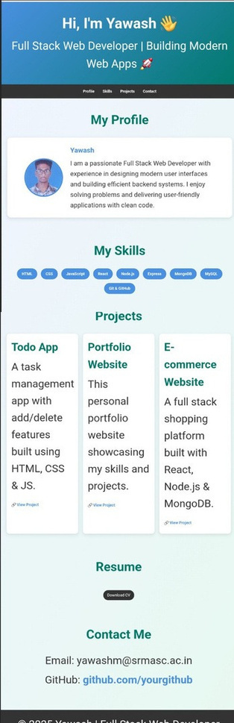
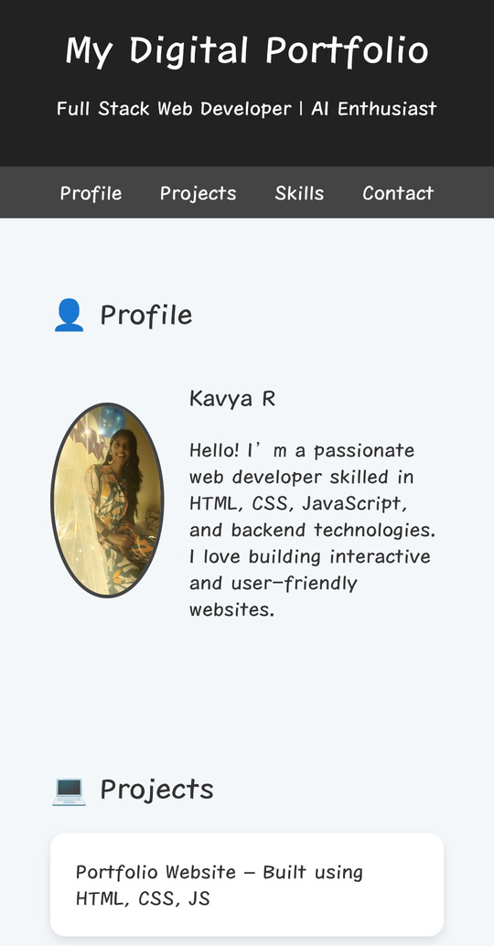
RESULTS AND SCREENSHOTS
The final portfolio website is fully functional and responsive. Screenshots show different sections like Home, About, and Projects.
10

Slide 11
CONCLUSION
The project successfully solves the problem of professional presentation. It creates a strong online presence for students and professionals. The portfolio is easy to use, well-designed, and highly responsive. It helps in personal branding and career growth opportunities. The design and tools used make it simple yet powerful. Future improvements can include adding animations or blogs. It shows the importance of a digital portfolio in today’s world. 1
11

Slide 12
GitHub link
https://kavya18-08.github.io/kavya/
1 2

Slide 13
Thanking you
1 3

