Slide 1
Traffic Signal Recognition
for Visually Impaired
Kavya Rajiv
(Pes university)

Slide 2
Discussion Points
Problem Statement
Data
Flowchart
Classification
Object Detection
Prediction
Results
Conclusion
Future Scope
Bibliography

Slide 3
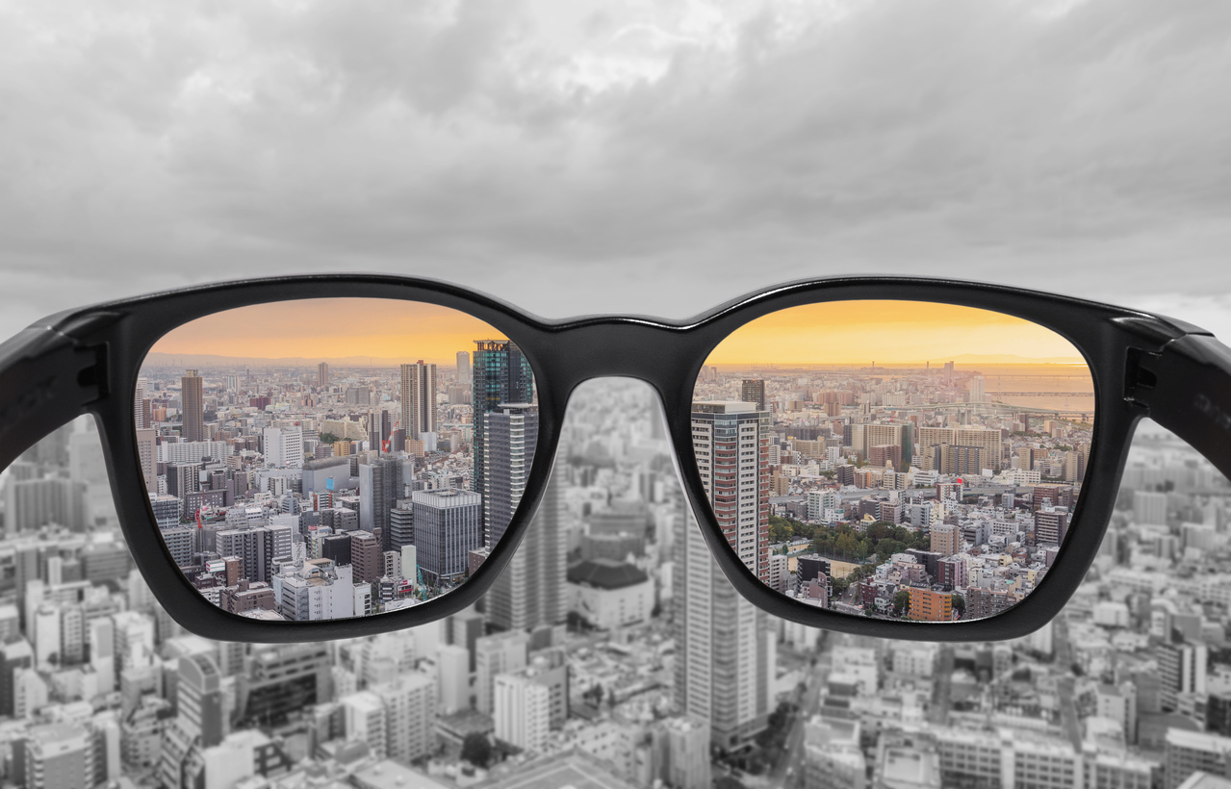
Problem Statement
To develop an application that recognizes traffic lights and classifies them as red, yellow, or green and converts the corresponding action expected to audio.

Slide 4
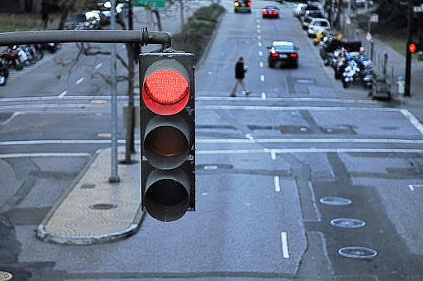
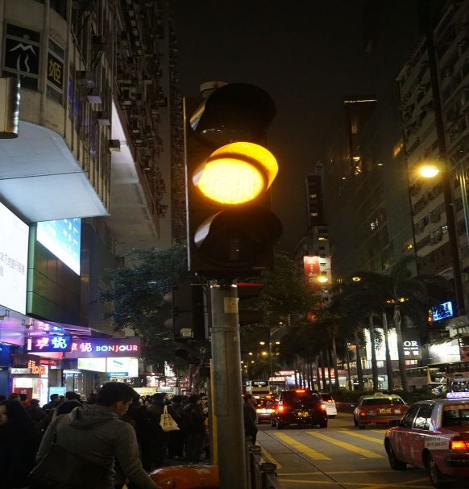
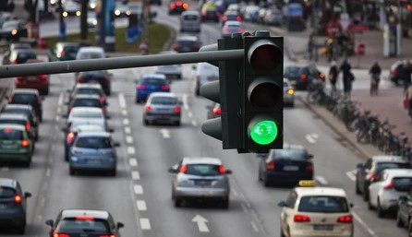
Data
1987
The dataset consists of 2485 images of traffic lights consisting of 3 classes (red, yellow, green) .The dataset is further split into Train (1987 images ) and Validation (498 images).

Slide 5
Flowchart
Object Detection
Classification
Prediction
Detecting traffic lights from an image and cropping it.
Saving the cropped image
Classifying the cropped image into red or green as per the classes in the dataset
With respect to the predicted class, an audio message will be conveyed.

Slide 6
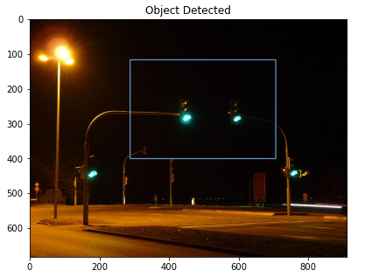
Object Detection
1. Initializing Object Detection Model.(Yolo v3)
3.Forward Propagating the blobs detected through the network
4.Output from network used to obtain the class index, box coordinated and confidence level of just traffic lights.
2. Detecting the objects as blobs
YOLO v3 pre-trained network used.
COCO dataset with 80 classes used for labelling.

Slide 7
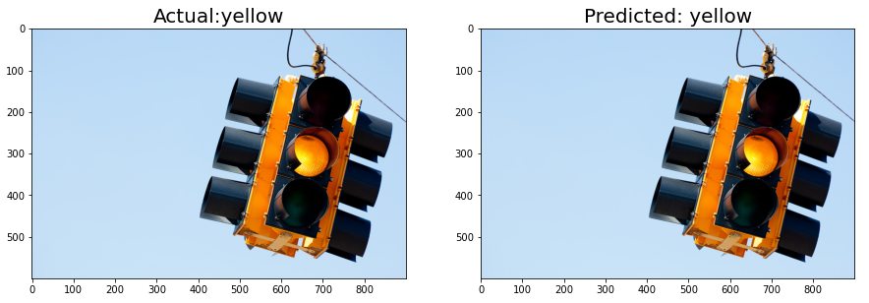
Classification
1.
Data Augmentation
Generating train and validation data.
2.
Building the VGG16 network
Initialize VGG16 .
3.
Training the Model
Compile the model
Setting suitable target size for images.
Define new Dense layers to train.
Fit the model on train data for 25 epochs .
Building a CNN classification model using pre-trained VGG16 network.
Image-net Dataset used.

Slide 8
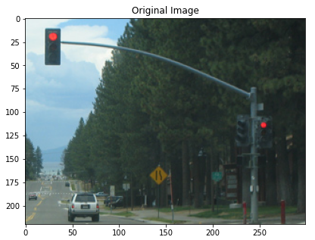
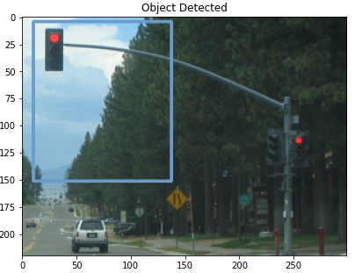
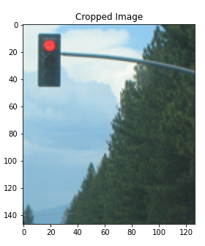

Prediction
Original Image passes through Object Detector
Detected object is cropped out
Classifier
If Red then “STOP”
If Yellow then “Get Ready”
If Green then “Go”
Cropped image passes
Through Classification model
Output

Slide 9
Results & Conclusion
Results:
The classification model gave an accuracy of 78.9% on Train data and 76.8% on Validation data.
A categorical cross-entropy loss of 0.46 on Train data and 0.48 on Validation data was obtained.
The model gave accurate predictions for each of the signals.
Conclusion:
People suffering from color blindness and other forms of visual impairment find it difficult to drive vehicles since they can’t recognize traffic signals clearly. This model would come in handy to predict the color of the traffic light by giving a form of audio output of the action expected such as Stop, Get Ready & Go for the Traffic Lights Red, Yellow, Green respectively.

Slide 10
Future Scope
With more data, the performance of the model can improve further
On using GPU, more iterations can be considered to fit the model which will run much faster.
Can consider street signs further for further advancement of the application.

Slide 11
Bibliography
Dataset: https://www.dropbox.com/s/87xark39qyer8df/TLdataset02.zip?dl=0
Yolov3 cfg: https://github.com/pjreddie/darknet/blob/master/cfg/yolov3.cfg
Yolov3 weights: https://github.com/ultralytics/yolov3/tree/master/weights
Coco names: https://github.com/pjreddie/darknet/blob/master/data/coco.names

Slide 12
Thank You

