Slide 1
Genesis Workshop
Bolt.new
Windsurf
Supabase
Building Full-Stack Apps with AI Tools
Amrita School of Engineering, Bengaluru

Slide 2
About This Session
What You Will Build
How This Session Works
A complete blood bank management system (frontend + backend)
3 topics, each with a live demo
A real REST API endpoint
Follow along on your own laptop
A live PostgreSQL database on Supabase
Ask questions at any time
User authentication with RLS policies
Errors are normal — AI handles them
Real-time updates across two browser tabs
All built using AI — no memorising code

Slide 3
Session Timeline
11:00 – 11:05
Intro & Big Picture
11:05 – 11:25
Topic 1 — Rapid Prototyping with Bolt.new
11:25 – 11:50
Topic 2 — Backend Development with Windsurf
11:50 – 11:55
Break
11:55 – 12:30
Topic 3 — Database & BaaS with Supabase
12:30 – 12:40
Recap & Q&A

Slide 4
TOPIC 1
Rapid Prototyping
with Bolt.new
11:05 – 11:25 | 20 minutes

Slide 5
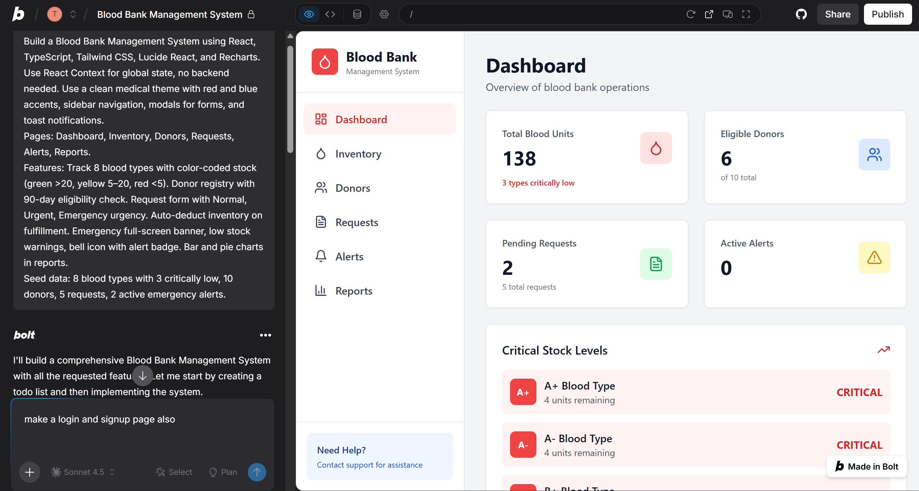
What is Bolt.new?
The Concept
Live — bolt.new
AI that generates an entire application — frontend, backend, and database — from a single text description. No manual setup. No boilerplate.
Best used for
MVPs and hackathon projects
Quick prototypes when time is short
Vibe coding — describe and ship
Key rule: specificity = better output

Slide 6
Live Demo — Type This Prompt
Build a Blood Bank Management System using React, TypeScript, Tailwind CSS, Lucide React, and Recharts. Use React Context for global state, no backend needed. Clean medical theme with red and blue accents, sidebar navigation, modals for forms, and toast notifications.
Auth: Login and Signup pages with email, password, name and role selector (Admin or Staff). After login redirect to Dashboard. Admin can add, edit, delete. Staff can only view and submit requests. Add logout in sidebar.
Pages: Dashboard, Inventory, Donors, Requests, Alerts, Reports.
Features: Track 8 blood types with color-coded stock (green >20, yellow 5–20, red <5). Donor registry with 90-day eligibility check. Request form with Normal, Urgent, Emergency urgency. Auto-deduct inventory on fulfillment. Emergency full-screen banner, low stock warnings, bell icon with alert badge. Bar and pie charts in reports.
Seed data: 8 blood types with 3 critically low, 10 donors, 5 requests, 2 active emergency alerts.
What Bolt generates
Then iterate with a follow-up prompt
"When blood stock hits zero, automatically reject incoming requests for that type"
OR
"When a request is fulfilled, automatically deduct the units from inventory"
OR
"Add a print button to the reports page"
React frontend with components and routing
Express.js backend with API endpoints
Database schema and authentication

Slide 7
TOPIC 2
Backend Development
with Windsurf IDE
11:25 – 11:50 | 25 minutes

Slide 8
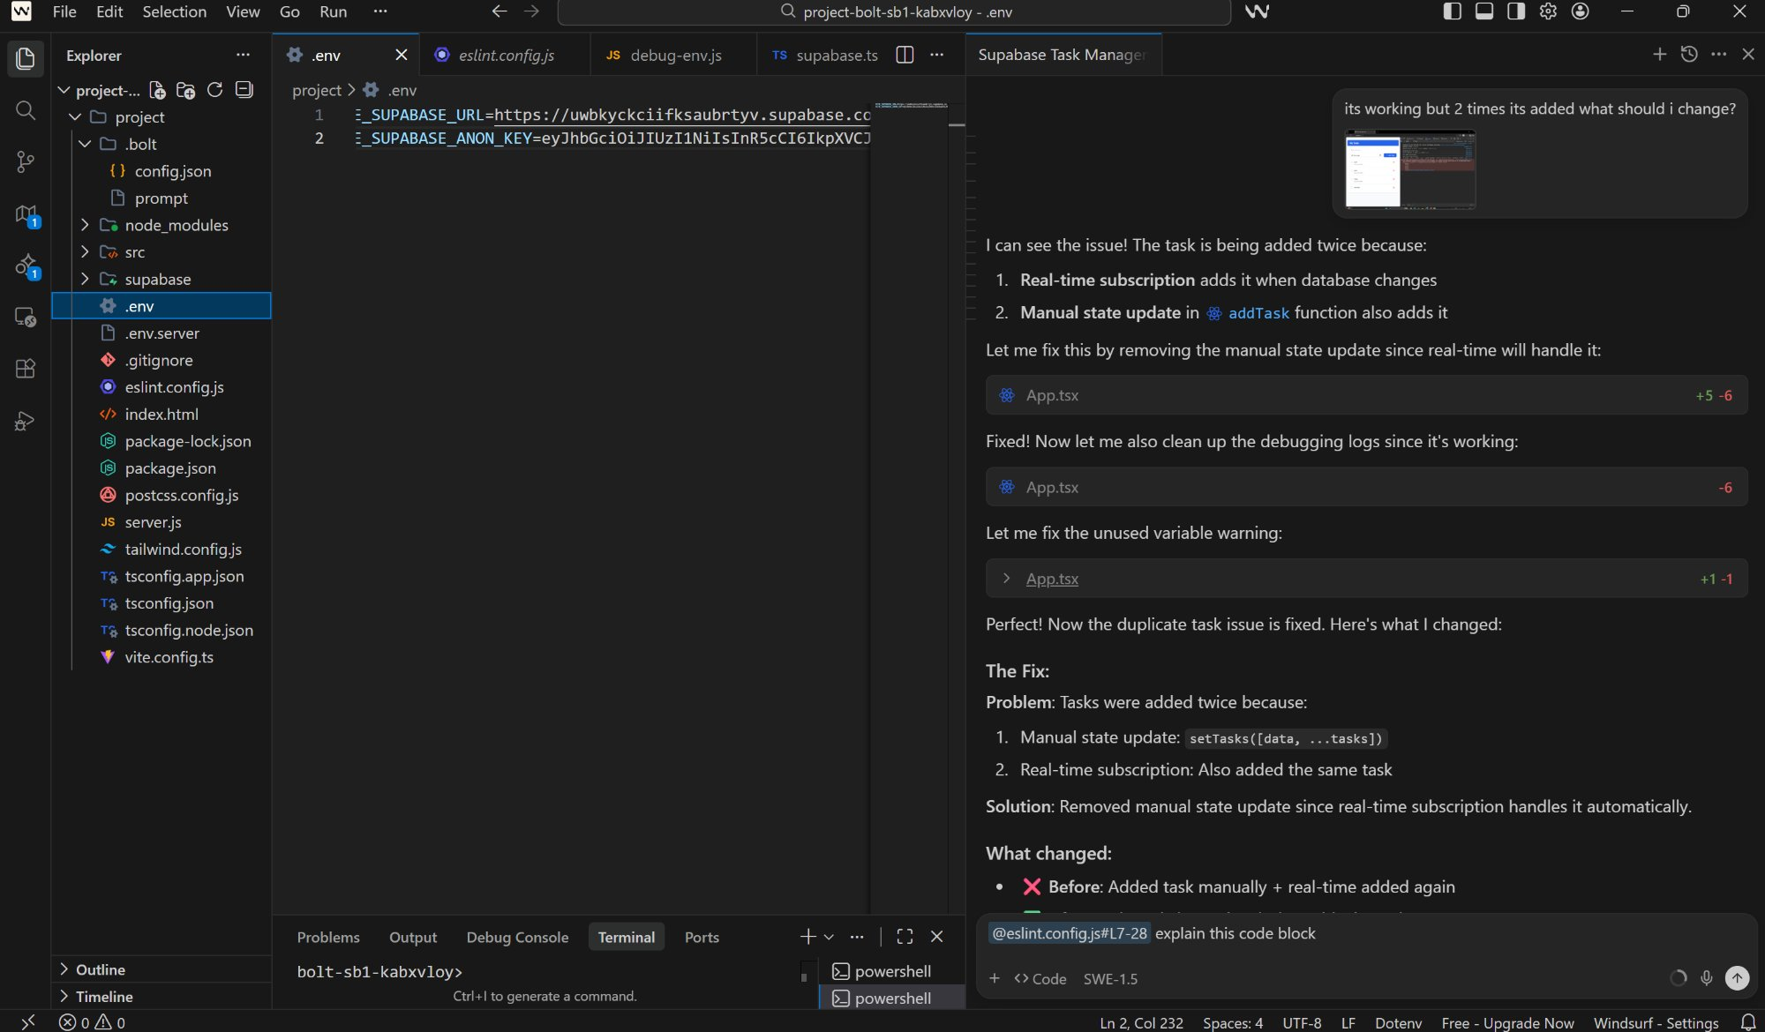
Windsurf — AI-Powered IDE
Cascade — AI Chat Panel
Windsurf in action — adding the supabase connection
Describe what you want in plain English. Windsurf reads your entire codebase first, then writes the code.
TIP🎯 : Always start with "Look at the existing project structure..."
Multi-File Awareness
Unlike ChatGPT, Windsurf understands how all your files connect. It updates routes, models, and schemas together — not just one file.
Explain and Refactor
Select any code block, open chat (Ctrl+L), and ask it to explain line by line or refactor for readability. This is how beginners learn.

Slide 9
Windsurf — Live Demo Prompts
3 Defined prompts
Explain the code​
STEP 1
3 STANDARD PROMPTS
Supabase Setup: "Look at the existing project structure and install the Supabase JavaScript client. Create a src/supabase.ts file that initializes Supabase using environment variables VITE_SUPABASE_URL and VITE_SUPABASE_ANON_KEY. Create a .env file with placeholder values for those two keys. Create a .env file with placeholder values for those two keys and create a schema.sql file with tables for blood_inventory, donors, requests, and alerts.""
Connect Data: "Look at the existing project structure and replace all dummy seed data in React Context with real Supabase queries. Fetch blood_inventory, donors, requests, and alerts from Supabase on page load. Make all form actions insert, update, and delete from Supabase instead of local state."
Auth and Realtime: "Look at the existing project structure and replace the dummy login and signup with Supabase Auth using signInWithPassword and signUp. Protect all routes so only logged in users can access them. Add Supabase realtime subscriptions on alerts and blood_inventory so the UI updates automatically without page refresh."
STEP 2
Explain the code
"Explain the code in server.js lines 28–33 line by line, like I am a complete beginner. What is each line doing and why?"
STEP 3
Refactor for readability
"Refactor this code to be more readable. Add a comment above each section explaining what it does."
Key lesson: use AI to understand the code, not just generate it.

Slide 10
Windsurf —Prompts​
STANDARD WINDSURF CASCADE PROMPTS 🤟:
Prompt 1 — Supabase Setup: "Look at the existing project structure and install the Supabase JavaScript client. Create a src/supabase.ts file that initializes Supabase using environment variables VITE_SUPABASE_URL and VITE_SUPABASE_ANON_KEY. Create a .env file with placeholder values for those two keys. Create a schema.sql file in the root of the project with all necessary tables for [table names] with all required columns."
Prompt 2 — Connect Data: "Look at the existing project structure and replace all dummy seed data in React Context with real Supabase queries. Fetch [table names] from Supabase on page load. Make all form actions insert, update, and delete from Supabase instead of local state."
Prompt 3 — Auth and Realtime: "Look at the existing project structure and replace the dummy login and signup with Supabase Auth using signInWithPassword and signUp. Protect all routes so only logged in users can access them. Add Supabase realtime subscriptions on [table names] so the UI updates automatically without page refresh."
Prompt 4 – Explain Code : "Explain the code in server.js lines 28–33 line by line, like I am a complete beginner. What is each line doing and why?"
Prompt 5 – Refactor : "Refactor this code to be more readable. Add a comment above each section explaining what it does."
Note (prompt for admin and regular user) : "Look at the existing project structure. Show the [action buttons] only if the logged in user has the [Admin/Staff] role. If the user has the [Patient/User] role, hide those buttons and only show the [status/view]. Store the user role in Supabase auth user metadata during signup. For this project, the action buttons are Fulfill Request and Reject, the privileged role is Admin or Staff, the regular role is Patient, and the regular user should only see the request status."

Slide 11
TOPIC 3
Database & BaaS
with Supabase
11:55 – 12:30 | 35 minutes

Slide 12
Traditional Backend vs Supabase
Traditional Setup
Supabase
Cost: Expensive • Time: Weeks • Complexity: High
Cost: Free • Time: Minutes • Complexity: Low
Rent a server (AWS, GCP, etc.)
Create project (done in 2 minutes)
Configure PostgreSQL manually
PostgreSQL — auto-configured
Build an auth system from scratch
Auth — email, Google, GitHub built in
Write all API endpoints by hand
REST APIs — auto-generated per table
Set up file storage separately
Real-time subscriptions out of the box
Configure monitoring and logging
Storage and monitoring included

Slide 13
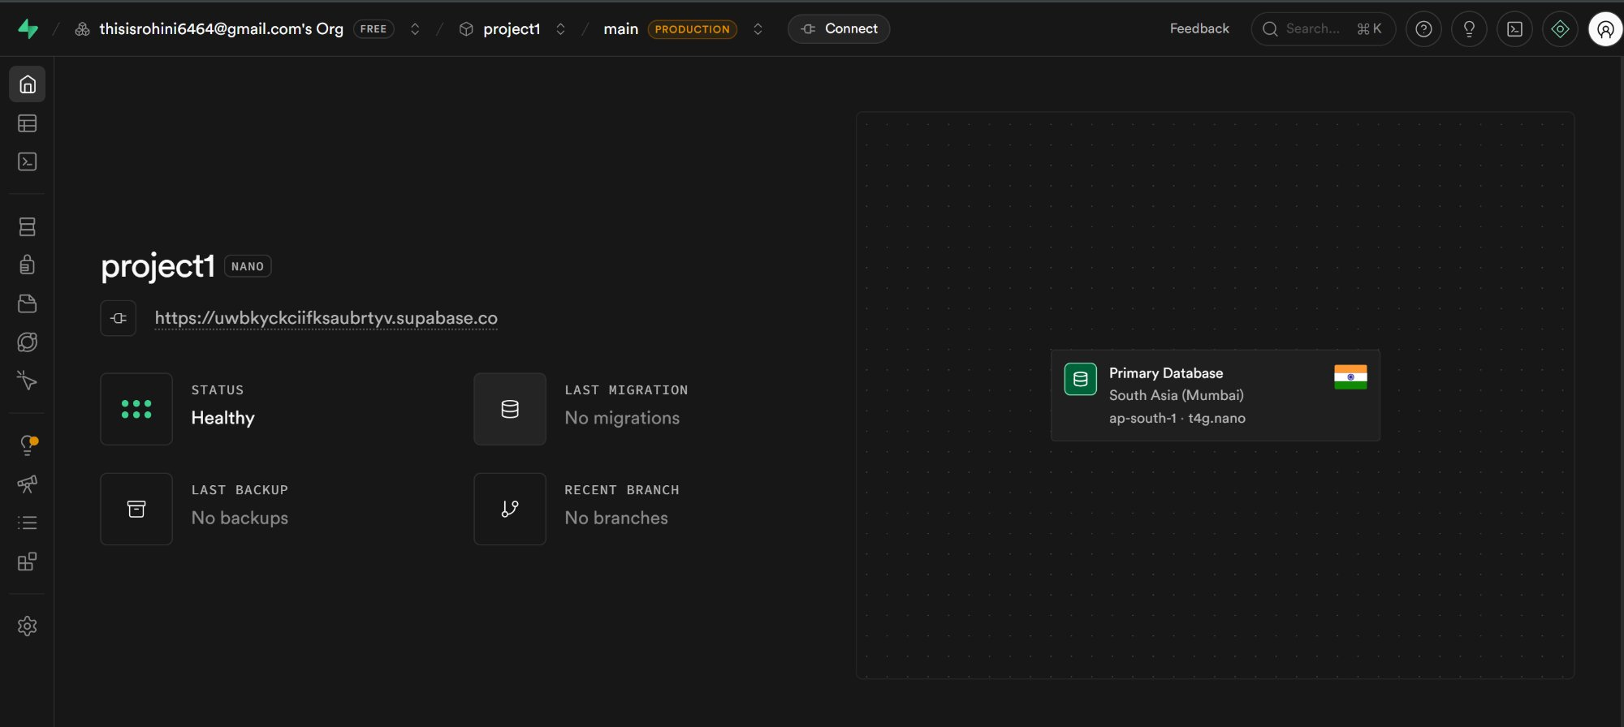
Supabase — Project Dashboard
Your Supabase project — status: Healthy, region: South Asia (Mumbai)
What you see here
Project URL
Your database endpoint
Status: Healthy
All services running
Region: Mumbai
Closest to India
Primary Database
PostgreSQL on t4g.nano

Slide 14
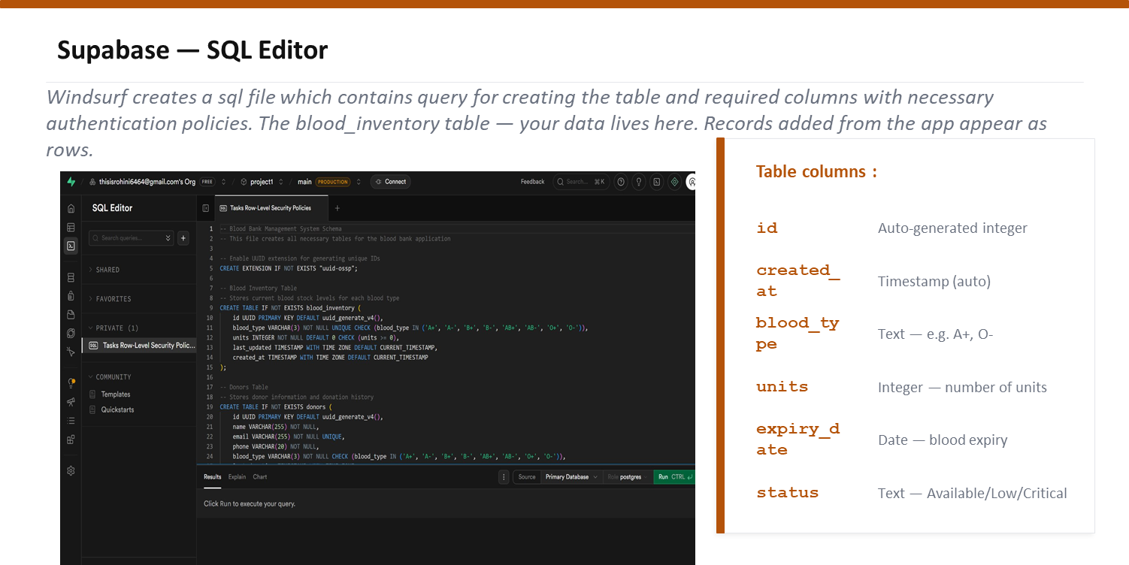

Slide 15
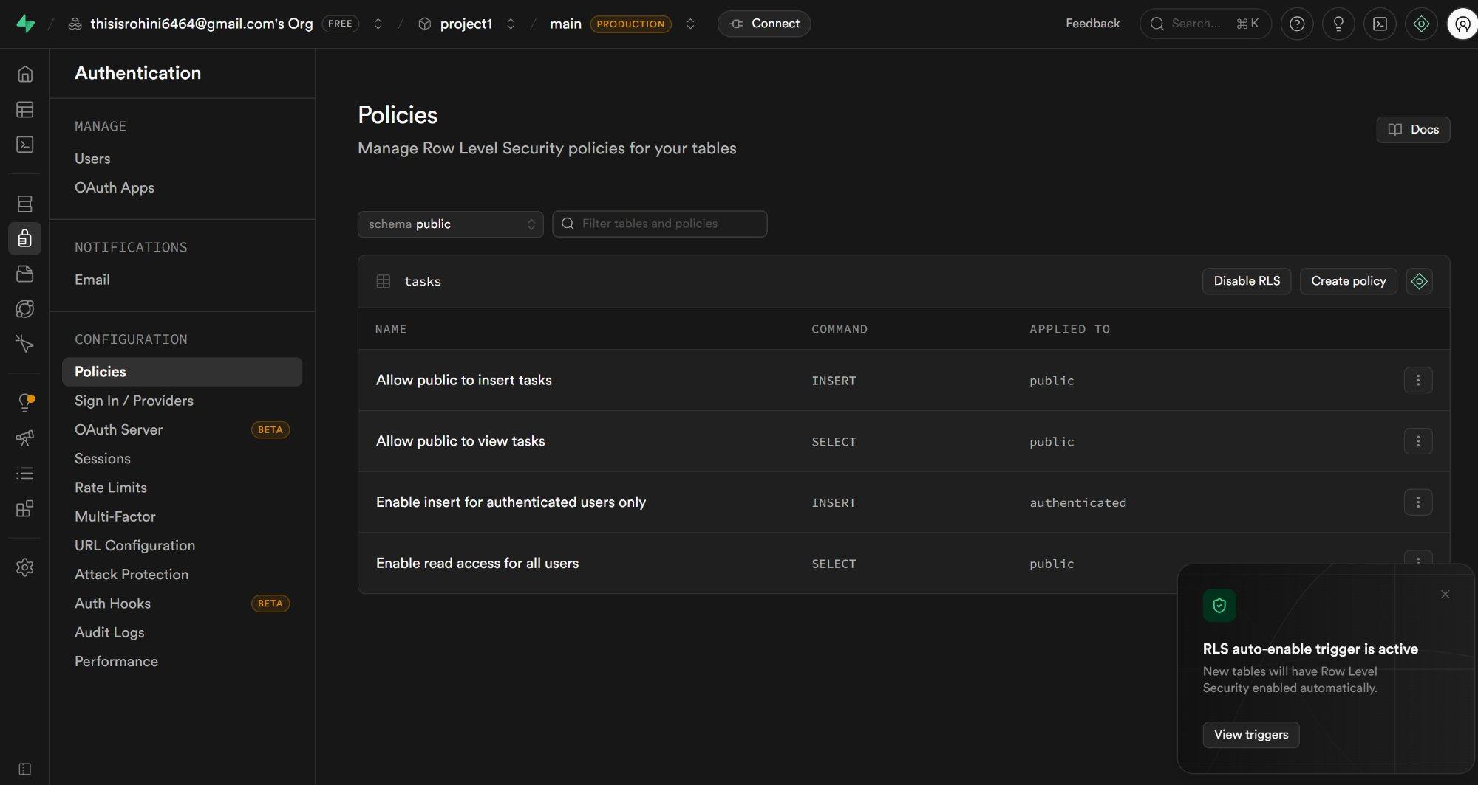
Row Level Security — RLS
Your RLS policies for the tasks table — controlling who can read, insert, or delete.
What is RLS?
Without RLS: any user can read, write, or delete every row in the database.
With RLS: you define policies that restrict what each user can access.
Some of the policies are :
Allow public to view (SELECT)
Allow public to insert (INSERT)
Enable read access for all users

Slide 16
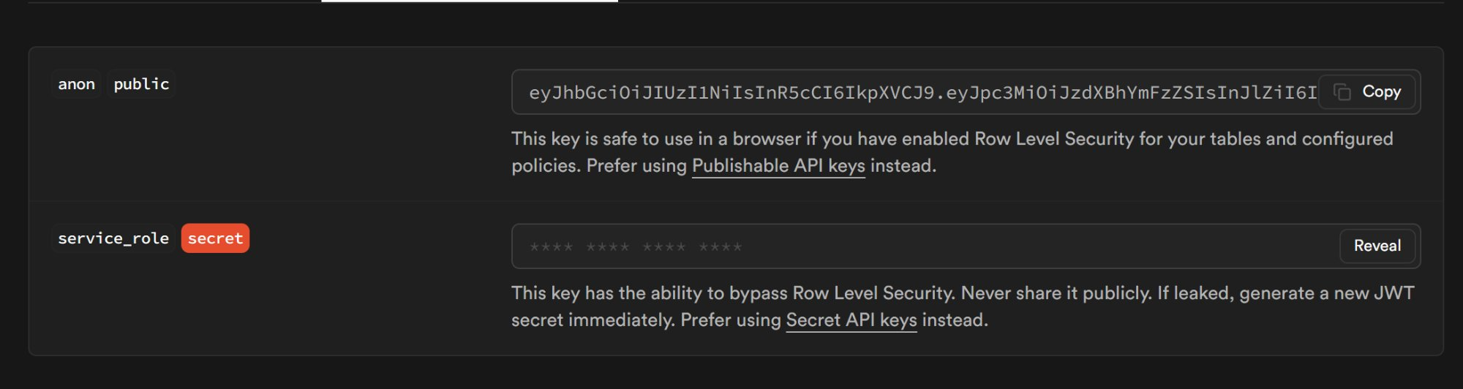
Connecting Supabase to Your App
Step 1 — Get your API keys from Settings > API Keys
Important ✍️
• For anon keys use key that starts with eyJ...
• For URL, copy the project ID and write in windsurf as :
https://--your project url--.supabase.co
Step 2 — Paste into your .env. file in Windsurf
VITE_SUPABASE_URL=https://uwbkyckciifksaubrtyv.supabase.co
VITE_SUPABASE_ANON_KEY=eyJhbGciOiJIUzI1NiIsInR5cCI6IkpXVCJ9…
Step 3 — Submit a blood request . Check the Supabase Table Editor. It appears as a real row.

Slide 17
Real-Time Subscriptions
Tab 1
Tab 2
Submitted blood request
Click fulfilled
The request is fulfilled automatically
No refresh required.
instant
+ Add Task
localhost:5173
localhost:5173
This is how WhatsApp messages, Swiggy order tracking, and Google Docs live editing all work.

Slide 18
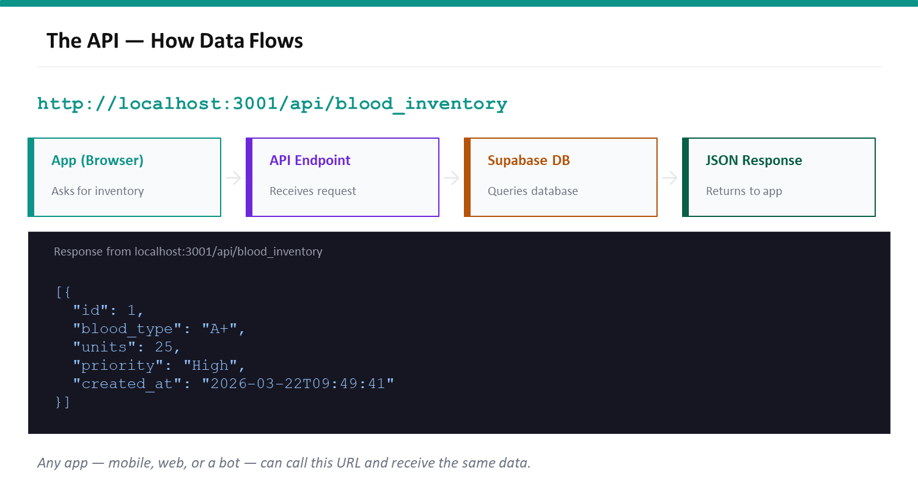

Slide 19
Key Takeaways
01
Prompt quality is everything. Describe what you want like you are briefing a junior developer — include the UI, the behavior, and the data.
02
Give AI full context. In Windsurf, always reference existing files before asking it to write new code. The more context, the better the output.
03
Supabase removes the biggest barrier. No server setup, no DevOps, no auth from scratch. Your entire backend is a dashboard.
Bolt.new — quick prototypes | Windsurf — intelligent editing | Supabase — backend infrastructure

Slide 20
You built a full-stack app.
Bolt.new app
REST API
PostgreSQL DB
Auth & RLS
Real-time
Q&A — Ask anything
Start building your ideas today. The barrier to entry has never been lower.
Genesis Workshop | Amrita School of Engineering, Bengaluru

