Slide 1


MACHINE LEARNING

Slide 2
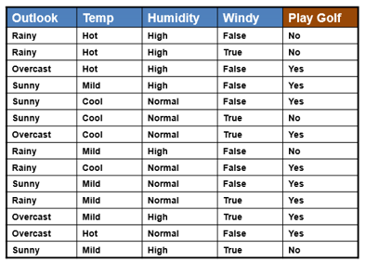

Slide 3
Outlook | Yes | No | P(X|Yes) | P(X|No)
Sunny | 3 | 2 | 3/9 | 2/5
Overcast | 4 | 0 | 4/9 | 0/5
Rainy | 2 | 3 | 2/9 | 3/5
Outlook : P(Outlook|Yes)=9/14
P(Outlook|No)=5/14

Slide 4
Outlook | Yes | No | P(X|Yes) | P(X|No)
Sunny | 3 | 2 | 3/9 | 2/5
Overcast | 4 | 0 | 4/9 | 0/5
Rainy | 2 | 3 | 2/9 | 3/5

Slide 5
Temp | Yes | No | P(X|Yes) | P(X|No)
Hot | 2 | 2 | 2/9 | 2/5
Mild | 4 | 2 | 4/9 | 2/5
cold | 3 | 1 | 3/9 | 1/5
Humidity | Yes | No | P(X|Yes) | P(X|No)
High | 3 | 4 | 3/9 | 4/5
Normal | 6 | 1 | 6/9 | 1/5
Windy | Yes | No | P(X|Yes) | P(X|No)
True | 3 | 3 | 3/9 | 3/5
False | 6 | 2 | 6/9 | 2/5

Slide 6
P(Yes|X)=P(Rainy|Yes)xP(Cool|yes)xP(High|yes)xP(True|yes)x P(Yes)
=2/9 x 3/9 x 3/9 x 3/9 x 9/14
=0.005291
P(No|X)=P(Rainy|No)xP(Cool|No)xP(High|No)xP(True|No)
=3/5 x 1/5 x 4/5 x 3/5 x 5/14
=0.02057
P(Yes|X)=0.00521/(0.005291+ 0.02057)
P(yes|X)=0.2045
=20%
P(No|X)= 0.02057/(0.005291+ 0.02057)
=0.7954
=80%

