Slide 1
Department of Computer Science & Engineering
UE17CS355 – Web Tech II Laboratory
Project Evaluation
Project Title : E-commerce Website
Project Team : PES1201700847 Daksha Singhal
PES1201700788 Adithya Vardhan
PES1201701136 Kavya Khatter

Slide 2
Project Description
This is a E-commerce web application built using JQuery and Flask as the frontend and backend frameworks respectively and SQLite as the database .
E-commerce application is an online shopping system that ensures a registered user to buy products in a user friendly way.
It allows user to maintain their profile via allowing them to update their details.
Our team has incorporated machine learning recommendation systems for our application which enables the user to view related products for a particular item.
The website is periodically refreshed to view the latest deals.

Slide 3
Technologies Used
jQuery
The framework acts as an intermediary between the frontend and the backend parts.
It facilitates AJAX calls to the server in a much simpler way.
HTML/DOM manipulation, CSS manipulation and controlling HTML event methods can be implemented easily.
jQuery code is more robust as compared to the native JavaScript.
Flask
It is a micro web framework written in python used as the server end.
It helps to define routes for the website and the related functionalities that must be carried out based on the request made.

Slide 4
Techniques Implemented
Ajax pattern : Periodic Refresh
AJAX allows web pages to be updated asynchronously by exchanging data with a web server behind the scenes . It makes it possible to update parts of a web page, without reloading the whole page.
It is employed to periodically refresh the passbook of the user. It reloads transaction data every 120 seconds.
Ajax pattern Multistage Downloading
AJAX allows web pages like the product by category page to be loaded into a page initially and then downloading other components like the image of the products and description of the product

Slide 5
Intelligent Functionality
Recommendation system using clustering
Data is fed into the K means algorithm to cluster the products.
The clustering was based on features such as gender , price and category of the item .
Once the clusters are formed, these clusters were assigned to each product and there after the user who viewed an item which also can view the related products.

Slide 6
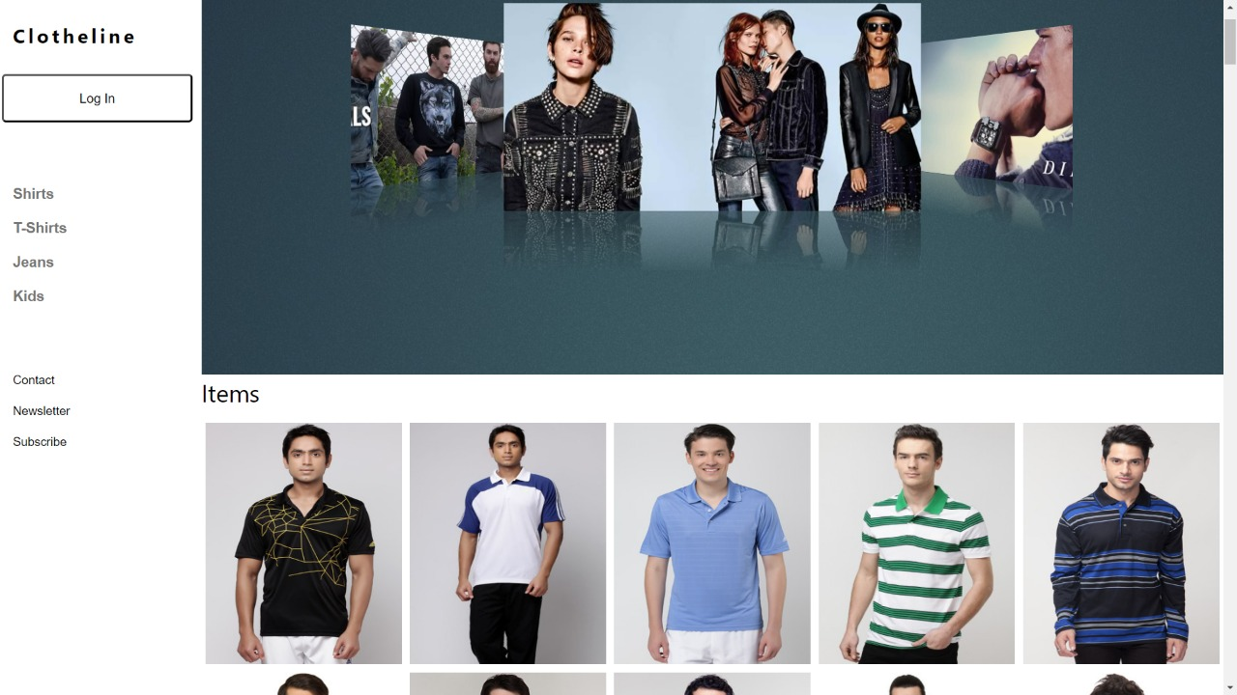
Screenshots
Homepage

Slide 7
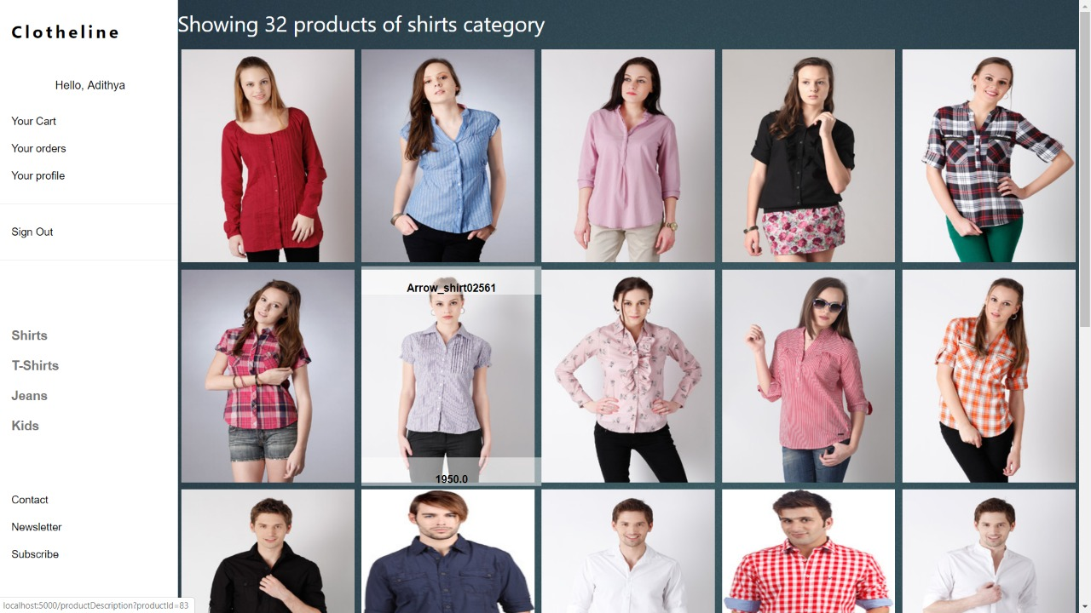
Screenshots
Product By Category

Slide 8
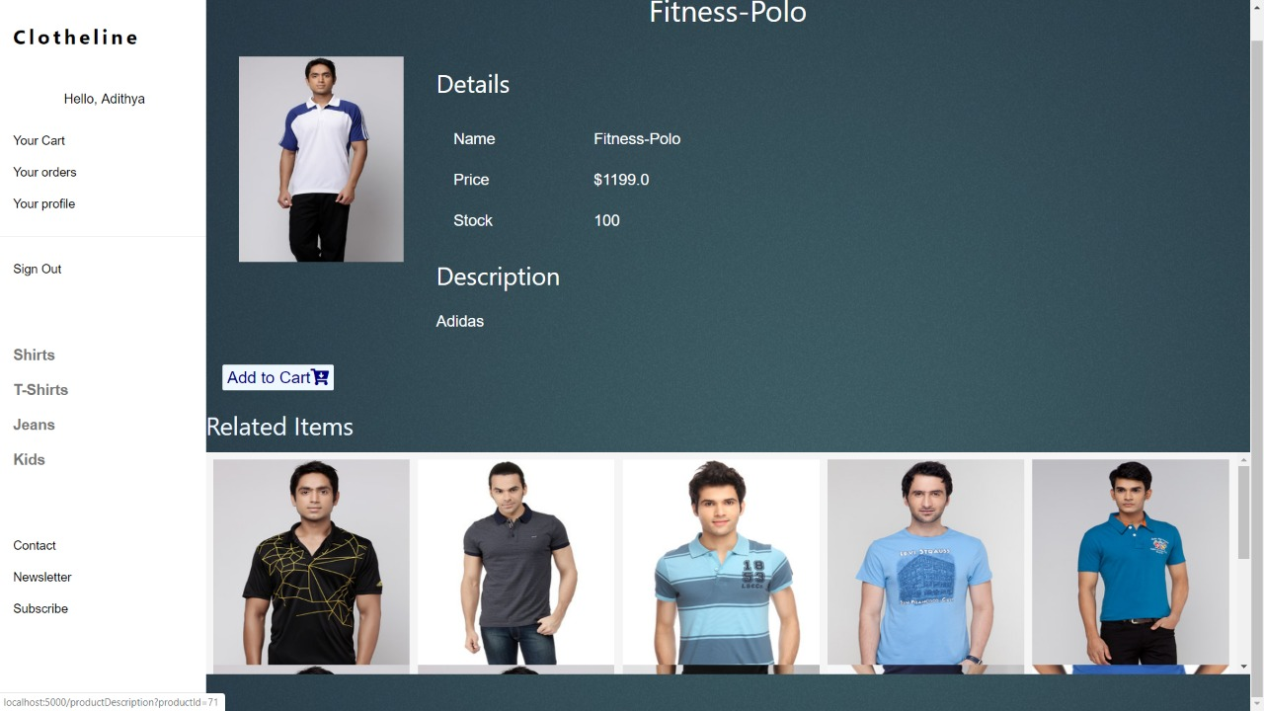
Screenshots
Product Description

Slide 9
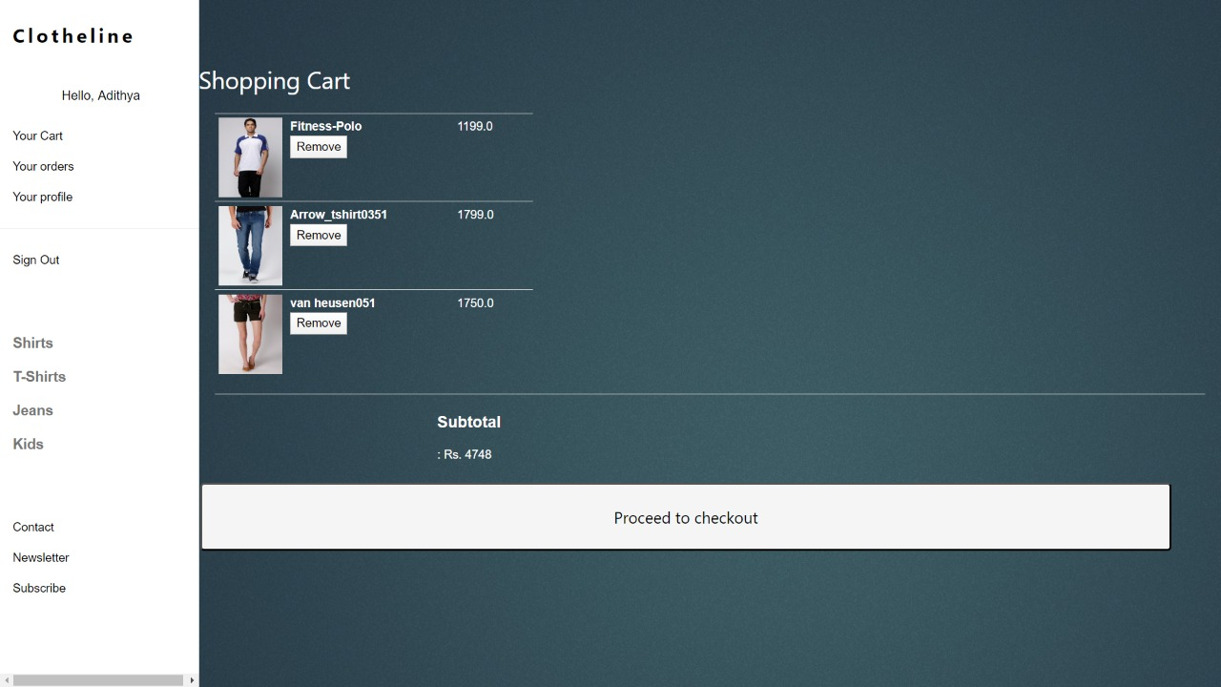
Screenshots
Cart

Slide 10
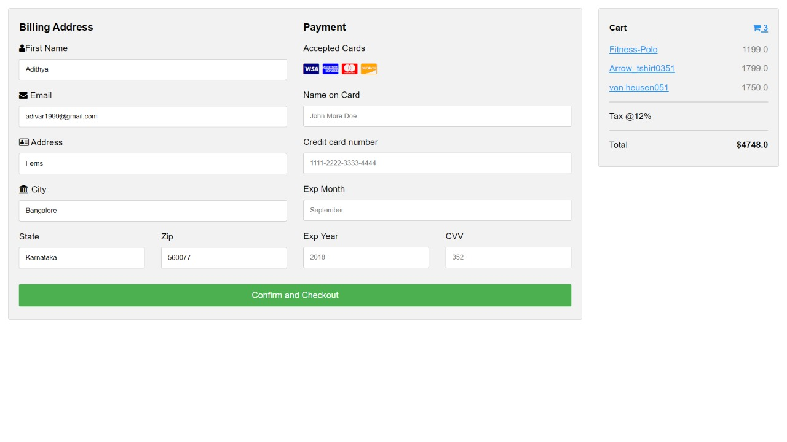
Screenshots
Checkout

Slide 11
Thank You

