Slide 1
Digital Portfolio
STUDENT NAME: S.KAVYA
REGISTER NO AND NMID: astvu20920924u09086
DEPARTMENT: BCA
COLLEGE: COLLEGE/ UNIVERSITY:SHANMUGA INDUSTRIES ARTS
AND SCIENCE COLLEGE/
THIRUVALLUR UNIVERSITY .

Slide 2
PROJECT TITLE
Digital portfolio for computer teachers using html,css and
javascript.

Slide 3


AGENDA
Problem Statement
Project Overview
End Users
Tools and Technologies
Portfolio design and Layout
Features and Functionality
Results and Screenshots
Conclusion
Github Link
3/21/2024 Annual Review

Slide 4

PROBLEM STATEMENT
Many students struggle to understand computer concepts without practical exposure.
Traditional teaching methods often fail to keep learners engaged.
There is a need for digital and interactive approaches to make computer education more effective.

Slide 5

PROJECT OVERVIEW
This project is a digital portfolio for computer teaching, built with HTML, CSS, and JavaScript.
It highlights teaching skills, projects, and achievements with an interactive and stylish design.
The portfolio serves as a professional platform to share expertise and connect with students.

Slide 6

WHO ARE THE END USERS?
The portfolio is designed for students seeking guidance in computer education.
It also serves schools, colleges, and training centers evaluating teaching expertise.
Recruiters and employers can use it to assess skills and professional background.

Slide 7

TOOLS AND TECHNIQUES
Developed using HTML, CSS, and JavaScript for structure, styling, and interactivity.
Applied modern web design practices like responsive layout, animations, and custom themes.
Utilized VS Code and browser debugging tools for coding, testing, and deployment.

Slide 8
POTFOLIO DESIGN AND LAYOUT
Built with a modern, black-themed layout for a professional and elegant look.
Organized into sections: About, Skills, Projects, and Contact for easy navigation.
Enhanced with interactive elements and visuals to engage visitors effectively.
8

Slide 9
FEATURES AND FUNCTIONALITY
Showcases teaching skills, projects, and achievements in a structured format.
Includes interactive skill bars, contact form, and WhatsApp integration for communication.
Provides a responsive design that works smoothly across devices.

Slide 10
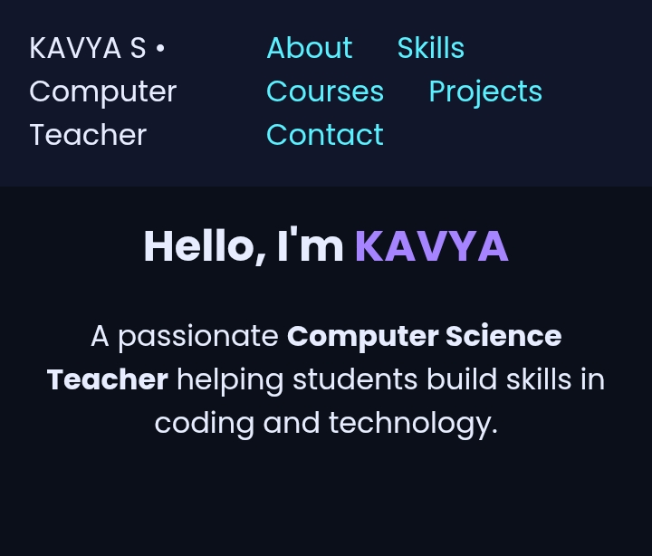

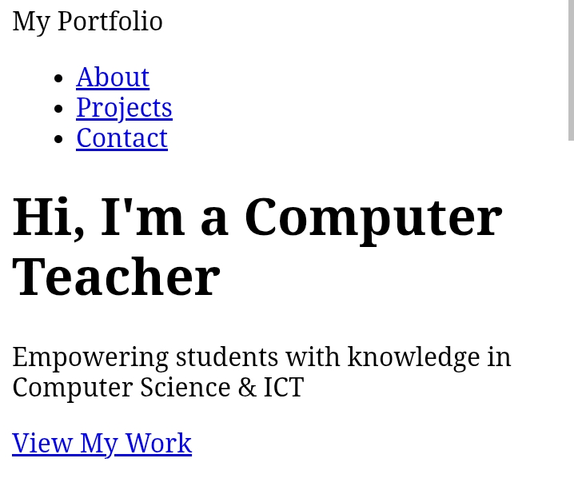
RESULTS AND SCREENSHOTS
Screenshots of each section
Before Vs after (HTML->with CSS and JAVASCRIPT)
3/21/2024 Annual Review
10

Slide 11
CONCLUSION
The Digital Portfolio Program helps users showcase their skills and projects easily.
It improves career opportunities by providing a professional digital profile
11

