Slide 1
Book2
File created on: 07-07-2022 03:19:00 PM

Slide 2
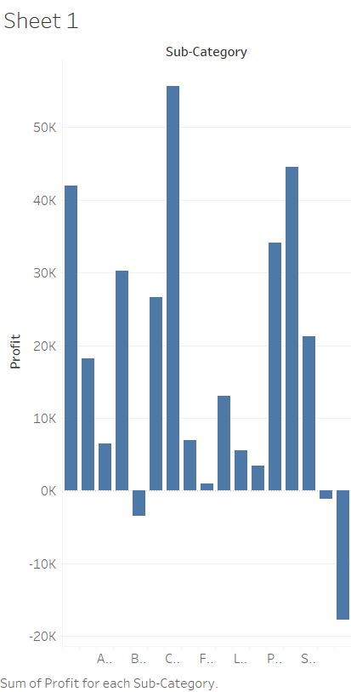

Slide 3
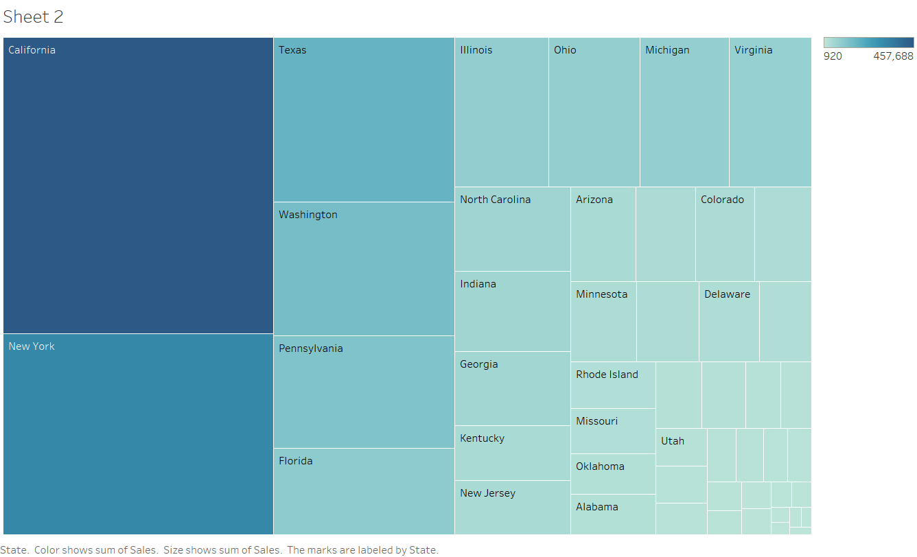

Slide 4
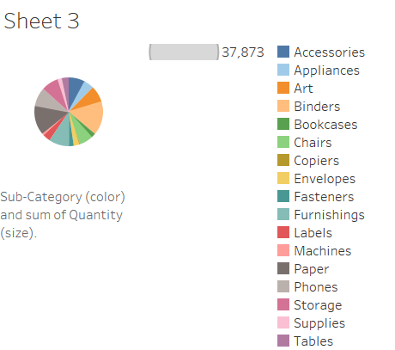

Slide 5


Slide 6
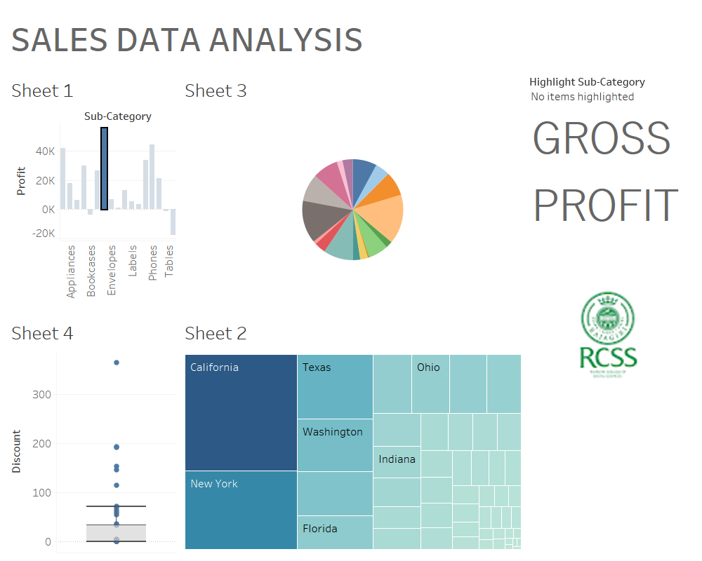

Slide 7
