Slide 1
Multi-Class Loan Risk-Category Prediction Using Multinomial Logistic Regression
BY:
Ch. Kavya Sree - 2520030413
G. Neha Reddy - 2520030409
Team: 20 | Guide: Shaik Asif | KLH, CSE | ML

Slide 2
Abstract
Banks need to know the risk level of a loan applicant before approving a loan; manual scoring and simple rule-based checks miss relationships between applicant details.
This project uses Multinomial Logistic Regression to predict a Low, Medium or High risk category instead of a simple Yes/No decision.
Inputs are applicant details: age, income, home ownership, employment length, loan intent, loan amount, interest rate, loan-to-income ratio, prior default flag and credit history length.
The workflow covers data cleaning, encoding, scaling, a stratified train/test split, class-balanced training and L2 regularization.
The model is evaluated with accuracy, precision, recall, F1-score and a confusion matrix, and its coefficients explain what drives risk.
Result: 88.6% test accuracy and macro F1 of 0.77 on a strongly imbalanced target.

Slide 3
Problem Statement
Lenders need more than approve/reject: a borderline applicant and a very risky applicant call for different decisions.
Existing systems rely on manual scoring or binary models that give little explanation and no risk levels.
The data mixes numeric and categorical features and has skewed values, outliers and missing entries.
The risk classes are imbalanced: only 3.9% of applicants are High risk, so a plain model would ignore them.
Objective
Classify each applicant as Low, Medium or High risk.
Output a probability for every class.
Handle the class imbalance.
Explain which features raise or lower risk.

Slide 4
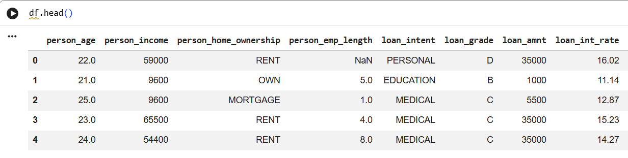
Dataset Overview
Source: credit_risk_dataset.csv (Kaggle loan applicant data)
Size: 32,581 rows x 12 columns; 32,416 rows after removing 165 duplicates
Missing: person_emp_length: 895; loan_int_rate: 3,116
Types: 7 numeric and 3 categorical features, plus loan_grade and loan_status
Outliers: Age up to 144, employment length up to 123 years, income up to 6,000,000
Column | Type
person_age | Numeric
person_income | Numeric
person_emp_length | Numeric
loan_amnt | Numeric
loan_int_rate | Numeric
loan_percent_income | Numeric
cb_person_cred_hist_length | Numeric
person_home_ownership | Categorical
loan_intent | Categorical
cb_person_default_on_file | Categorical
loan_grade | Categorical (target source)
loan_status | Binary (dropped)

Slide 5
Data Cleaning and Target Creation
Duplicates: 165 removed, leaving 32,416 rows
Impossible values: 5 ages over 100 and 2 employment lengths over 60 set to missing, not dropped
Imputation: Missing values filled with the median inside the pipeline, so no test-set leakage
Leakage control: loan_grade and loan_status dropped before training: the target is derived from the grade
Risk Category Mapping
Loan grade | Risk category | Share
A, B | Low | 65.1%
C, D | Medium | 31.0%
E, F, G | High | 3.9%
The target is strongly imbalanced, so class-balanced weights are used in training.

Slide 6
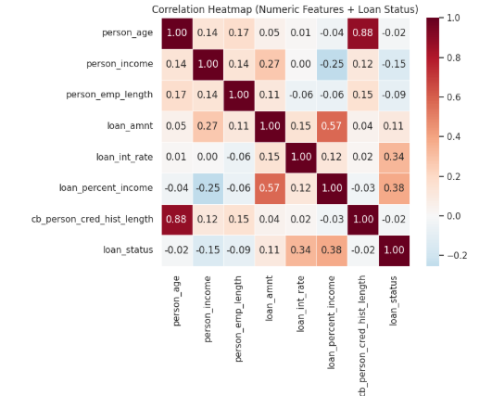
EDA Results and Process
Risk classes: Low 65.1%, Medium 31.0%, High 3.9%
Distributions: Income and loan amount are right-skewed with a few extreme outliers
Correlation with default: Loan-to-income 0.38 and interest rate 0.34 are strongest; income is -0.15; credit history length is near zero (-0.02)
Key insight: Loan-to-income ratio and interest rate are the main applicant-side risk drivers
Process: Histograms, boxplots, categorical bars and a correlation heatmap on the cleaned data

Slide 7
Graphs Generated: EDA
Risk Category Distribution: bar chart of applicants per Low/Medium/High class
Numeric Histograms: distribution and skew of the 7 numeric features
Loan Grade Counts: number of applicants per grade A to G
Default Rate by Grade: percent of defaults for each loan grade
Categorical Bars: counts for home ownership, loan intent and prior default
Risk Mix by Category: 100% stacked bars of risk class within each category
Boxplots: outlier screening for numeric features; key features split by risk class
Correlation Heatmap: pairwise correlation of numeric features with loan status

Slide 8
Graphs Generated: Model Results
Confusion Matrix: counts and row-normalised (recall) view of actual vs predicted risk
Per-Class Metrics: precision, recall and F1-score for Low, Medium, High
Coefficients Heatmap: multinomial coefficient of every feature for each class
High vs Low Coefficients: bar charts of feature effect on High-risk and Low-risk log-odds
Random Forest Importance: top 10 features, used for the future-scope comparison

Slide 9
Data Preprocessing
One-Hot Encoding
Median Imputation
Standard Scaling
3 text features become 9 binary columns: home ownership (3), loan intent (5), prior default (1). The first category of each is dropped to avoid redundant columns.
Fills 895 missing employment lengths and 3,116 missing interest rates, fitted on training data only.
7 numeric features scaled to mean 0 and unit variance so coefficients are comparable.
loan_intent (before) | is_EDUCATION | is_MEDICAL | is_PERSONAL
EDUCATION | 1 | 0 | 0
MEDICAL | 0 | 1 | 0
PERSONAL | 0 | 0 | 1
Result: 7 numeric + 9 encoded = 16 model inputs.

Slide 10
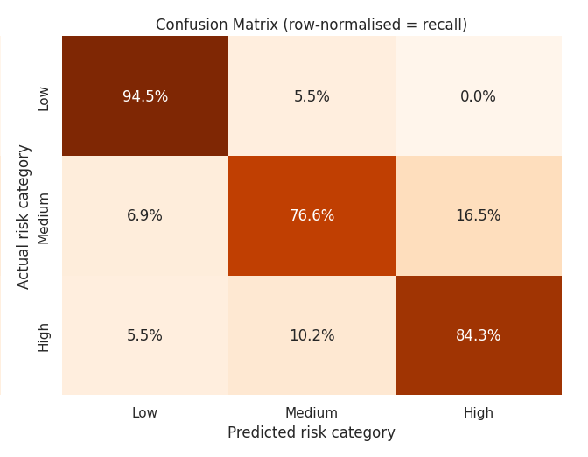
Confusion Matrix and Classification Report
Confusion matrix: rows are actual classes, columns are predicted; the diagonal shows correct predictions
Precision: of applicants predicted as a class, the share that truly belong to it
Recall: of applicants truly in a class, the share the model found
F1-score: balance of precision and recall; macro F1 averages the three classes
Class | Precision | Recall | F1
Low | 0.963 | 0.945 | 0.954
Medium | 0.858 | 0.766 | 0.809
High | 0.392 | 0.843 | 0.535
Accuracy 88.6% | Macro F1 0.77

Slide 11
Output
88.6%
0.77
84%
Test accuracy
Macro F1-score
High-risk recall
Every applicant gets a probability for Low, Medium and High risk; the highest is the predicted class.
The model finds 84% of truly High-risk applicants, but only 39% of its High flags are correct: the cost of class balancing on a 3.9% class.

Slide 12
Model Interpretation
Interest rate: strongest driver of High risk (odds ratio about 18 per standard deviation)
Prior default on file: raises High-risk odds about 11 times
Weaker effects: home ownership "Other" and loan amount push risk up slightly; owning a home, personal and medical intents push it down
Note: loan-to-income ratio correlates most with default, but interest rate dominates because risk is derived from loan grade

Slide 13
Future Scope and Conclusion
Future Scope
Conclusion
Random Forest already reaches about 95% accuracy and macro F1 0.85 vs 88.6% and 0.77; try XGBoost too.
Improve High-risk precision with resampling or threshold tuning.
Use feature importance to identify critical attributes.
Deploy as a web app for real-time risk prediction.
Multinomial Logistic Regression classifies applicants into Low, Medium and High risk with 88.6% accuracy.
Class probabilities and coefficients make it interpretable for lending decisions.
Interest rate and prior default are the strongest risk signals.

Slide 14
Thank You

