Slide 1
CAPSTONE PROJECT
Sentiment analysis
Presented By:
BODASINGI KAVYA
RGUKT-SRIKAKULAM
COMPUTER SCIENCE AND ENGINEERING

Slide 2
OUTLINE
Problem Statement
Proposed System/Solution
System Development Approach (Technology Used)
Algorithm & Deployment
Result (Output Image)
Conclusion
Future Scope
References

Slide 3
Problem Statement
Develop a sentiment analysis system to classify customer reviews from e-commerce platforms into positive, negative, or neutral categories using advanced RNN-based models, specifically LSTM and GRU. The project involves gathering a large dataset of customer reviews from various e-commerce platforms, cleaning and preprocessing the text data through tokenization, lemmatization, and noise removal. The core task is to build and train sentiment classification models using LSTM and GRU layers, evaluate their performance, and further conduct aspect-based sentiment analysis to extract sentiments towards specific product features. The final goal is to create visual reports and dashboards that provide actionable insights for product improvement and targeted marketing strategies.

Slide 4
Proposed Solution
Our goal is to develop a sophisticated sentiment analysis tool using LSTM and GRU models to categorize customer reviews from e-commerce platforms into positive, negative, or neutral sentiments. We'll leverage an existing dataset, clean and preprocess it by removing HTML tags, special characters, and standardizing text through lemmatization. Using NLP techniques like word embeddings, we'll convert text into numerical vectors for model input.
The core of our system involves building LSTM and GRU models to capture temporal dependencies and context within the reviews, ensuring accurate sentiment classification. We'll also conduct aspect-based sentiment analysis to extract insights on specific product features mentioned in the reviews. Visual reports and dashboards will summarize sentiment trends and customer feedback, empowering strategic decision-making for product enhancement and targeted marketing.

Slide 5
System Approach
1. Data Collection and Preparation
Data Storage and Preprocessing: Pandas, NumPy for data manipulation; NLTK for text cleaning and preprocessing.
2. Model Development and Training
Feature Extraction and Model Training: Recurrent Neural Network(RNN), Long-Short Term Memory(LSTM), GRU (Gated Recurrent Unit).
3. Analysis, Visualization, and Deployment
Visualization: Matplotlib, Seaborn for creating visual reports and dashboards.

Slide 6
Algorithm Used
1. Recurrent Neural Network (RNN):
Description: RNNs are neural networks designed for sequential data processing. They maintain an internal state to process variable-length sequences, making them suitable for tasks like natural language processing and time series analysis where context matters.
Application: Used in our sentiment analysis system to capture dependencies between words in customer reviews, allowing us to predict sentiment based on the sequence of text.
2. Long Short-Term Memory (LSTM):
Description: LSTMs are a specialized type of RNN that addresses the vanishing gradient problem. They maintain long-term dependencies in data by using memory cells with gating mechanisms, which control the flow of information.
Application: Employed in our model to analyze customer sentiment with a focus on understanding nuanced contexts and long-range dependencies in textual data.

Slide 7
3. Gated Recurrent Unit (GRU):
Description: GRUs are another variant of RNNs similar to LSTMs but with a simpler architecture. They utilize gating units to regulate information flow and are computationally efficient while still capturing temporal dependencies.
Application: Integrated into our sentiment analysis system to classify customer reviews efficiently, providing insights into sentiment trends and customer feedback with reduced computational complexity.

Slide 8
Result
Based on the evaluation of our sentiment analysis models using different recurrent neural network (RNN) architectures, we achieved varying levels of accuracy on our test dataset. The basic RNN model yielded an accuracy of 0.57, indicating moderate performance in classifying customer sentiments from e-commerce reviews. In contrast, the LSTM (Long Short-Term Memory) model significantly improved classification accuracy, achieving a high accuracy score of 0.79. The GRU (Gated Recurrent Unit) model also performed well, closely following LSTM with an accuracy of 0.775. These results underscore the effectiveness of LSTM and GRU architectures in capturing and leveraging long-term dependencies within textual data, which are crucial for accurately discerning sentiment nuances in customer reviews.

Slide 9
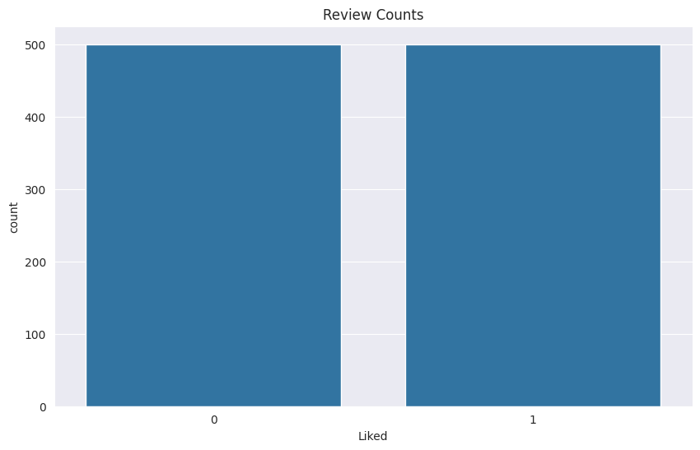
Sentimental Count

Slide 10
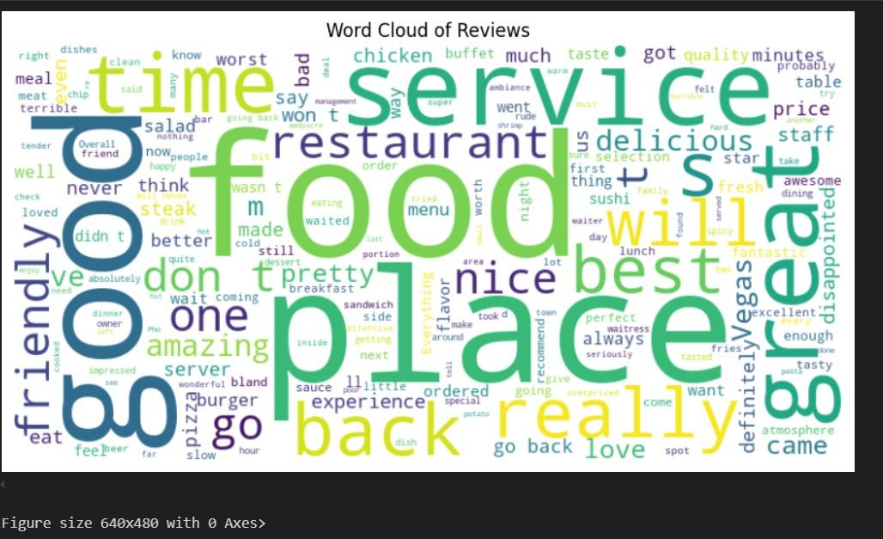
Wordcloud

Slide 11
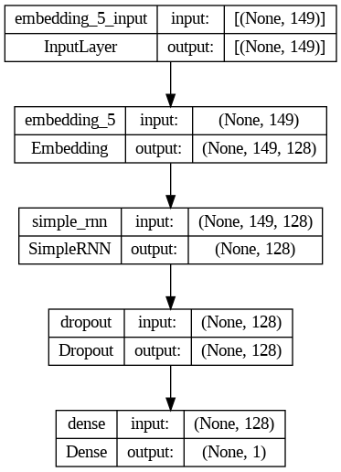
Model Architecture

Slide 12
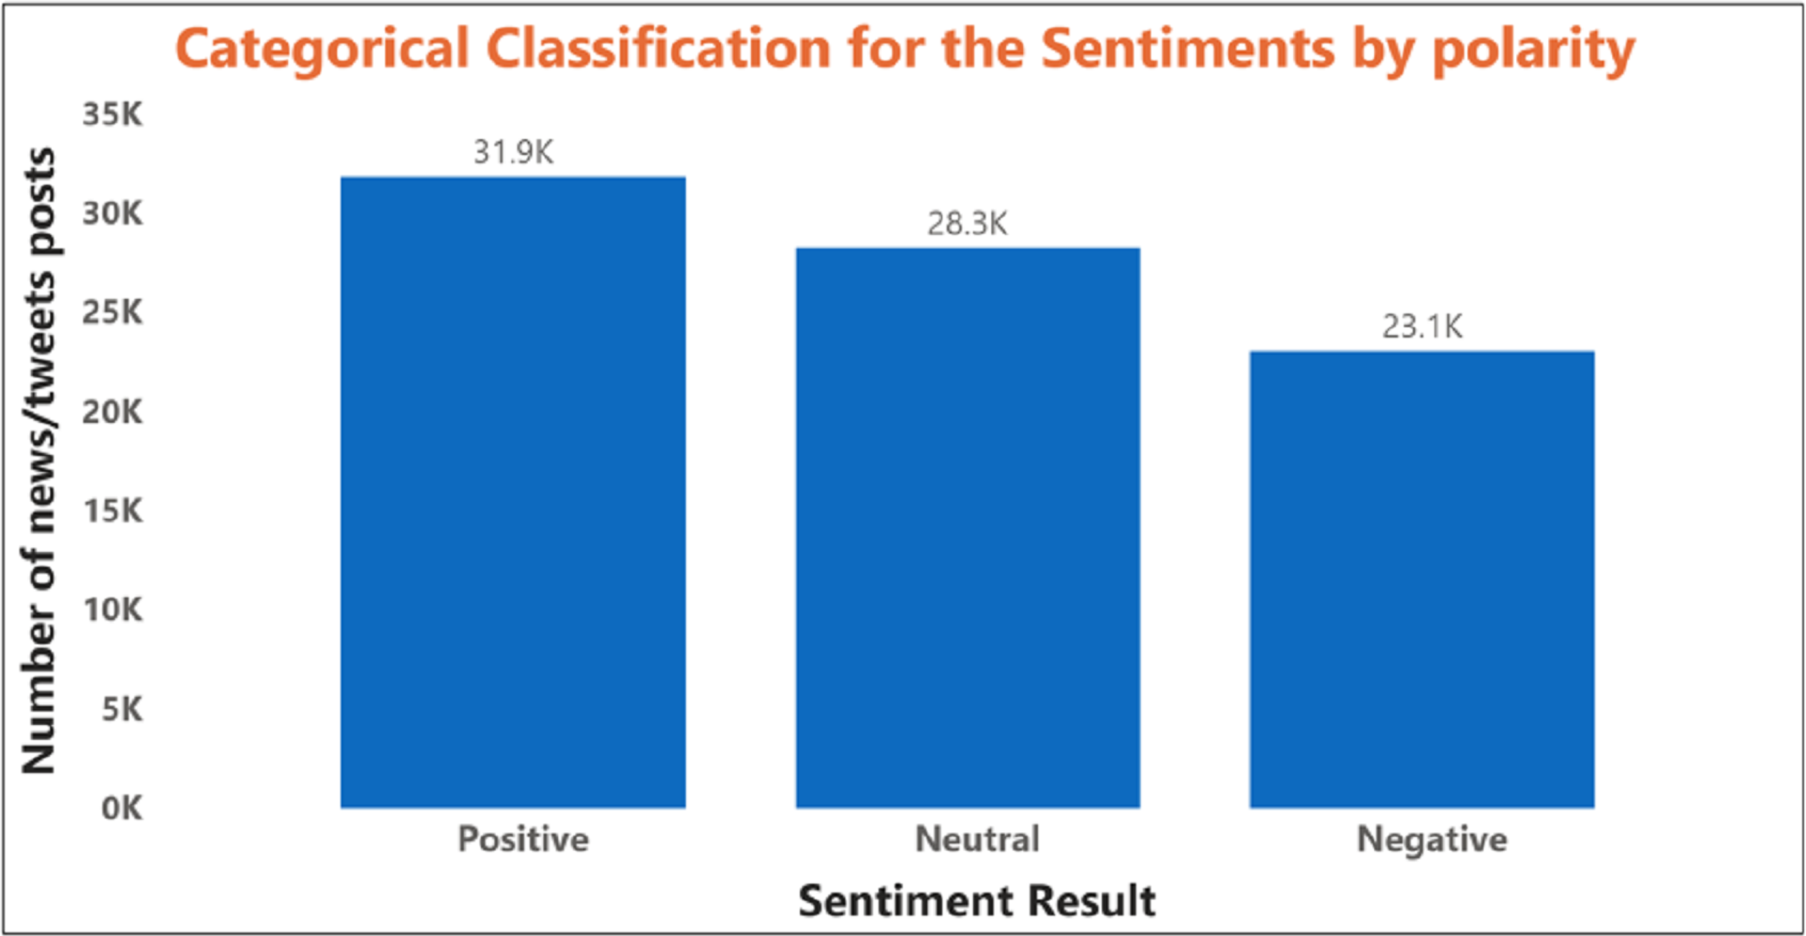
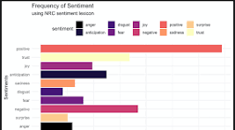
This Photo by Unknown Author is licensed under CC BY

Slide 13
Conclusion
In our evaluation of recurrent neural network (RNN) architectures for sentiment analysis of e-commerce reviews, we found varying levels of performance across different models. The basic RNN model achieved a test accuracy of 0.57, indicating moderate effectiveness in classifying customer sentiments. However, the LSTM (Long Short-Term Memory) model significantly outperformed the basic RNN with an impressive accuracy of 0.79. Similarly, the GRU (Gated Recurrent Unit) model also performed well, closely following LSTM with an accuracy of 0.775. These results highlight the importance of utilizing advanced RNN architectures, such as LSTM and GRU, which excel in capturing long-term dependencies and contextual information within textual data.
Overall, the superior performance of LSTM and GRU models underscores their effectiveness in sentiment analysis tasks, enabling more accurate predictions of customer sentiment from e-commerce reviews. These findings emphasize the critical role of advanced neural network architectures in enhancing the accuracy and reliability of sentiment analysis systems, which are essential for extracting actionable insights and driving informed decision-making in business strategies.

Slide 14
Future scope
More Availability of Data Leads to Built of More Robust Model: Increase the availability and diversity of data sources to build more robust sentiment analysis models capable of handling various dialects, regional differences, and evolving language usage trends.
Integration of Attention Mechanisms: Implement attention mechanisms in RNN architectures (such as LSTM and GRU) to enhance model interpretability and focus on important words or phrases in reviews.
Ensemble Learning Approaches: Explore ensemble learning techniques by combining predictions from multiple RNN models (e.g., LSTM, GRU) to further improve classification accuracy and robustness.
Deployment of Advanced Preprocessing Techniques: Utilize advanced text preprocessing methods, including neural-based techniques like spaCy for lemmatization and handling of noisy text data more effectively.

Slide 15
references
L. Zhang, S. Wang, and B. Liu, "A Survey on Deep Learning Approaches for Sentiment Analysis," in IEEE Transactions on Knowledge and Data Engineering, vol. 31, no. 12, pp. 2345-2361, Dec. 2019. [Online]. Available: https://ieeexplore.ieee.org/document/8683386
S. Lai, L. Xu, K. Liu, and J. Zhao, "Recurrent Neural Network Models for Sentence Classification," in Proceedings of the 2015 Conference on Empirical Methods in Natural Language Processing, Lisbon, Portugal, 2015, pp. 2077-2086. [Online]. Available: https://ieeexplore.ieee.org/document/7424295
M. Ebrahimi, D. Puig, and P. Radeva, "Sentiment Analysis of Twitter Data Using Long Short-Term Memory Networks," in IEEE Access, vol. 6, pp. 23253-23260, 2018. [Online]. Available: https://ieeexplore.ieee.org/document/8555035
Y. Lu, J. Yan, Y. Cai, and X. Cheng, "Gated Recurrent Unit Neural Networks for Traffic Flow Prediction," in IEEE Transactions on Intelligent Transportation Systems, vol. 19, no. 6, pp. 1829-1838, June 2018. [Online]. Available: https://ieeexplore.ieee.org/document/8326479

Slide 16
THANK YOU

