Slide 1

ESCORT 2 WOMEN
Members:
1) B. Venkata Kavya (14BQ1A0527)
2) Chandrika. K (14BQ1A0530)
3) A. Manogna (14BQ1A0510)
4) B. Sucharitha (14BQ1A0525)
Name of the Guide:
Dr. G. Sanjay Gandhi
Professor

Slide 2
Contents
Problem statement
Proposed solution
Architecture diagram
UML diagrams
Modules
Database tables
Development Environment

Slide 3
Problem Statement
The drawback of existing system is when emergency situation occurs the user cannot set the alert immediately.
The existing system contains panic button with in the app itself.
Whenever the victim is in danger, she should login to the app and press the panic button.

Slide 4
Proposed System
Unlike other apps, this app works only when the victim is in danger.
The proposed system contains panic button on the mobile panel.
If the victim initiates panic button for 3times the address of the victim is send to the registered contacts in the form of SMS.

Slide 5
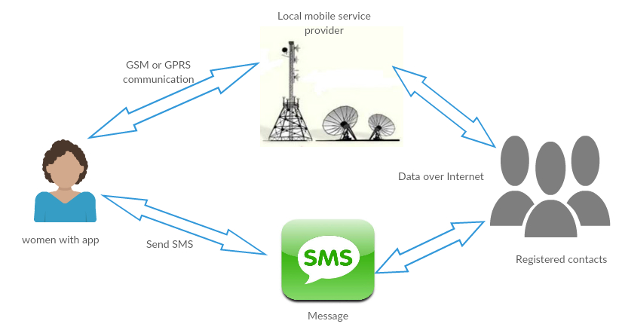
Architecture Diagram

Slide 6
Use case Diagram

Slide 7
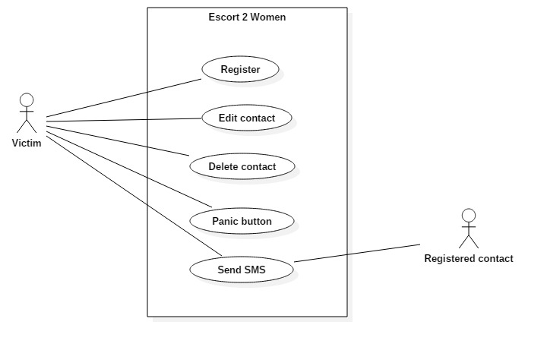

Slide 8
Class Diagram

Slide 9
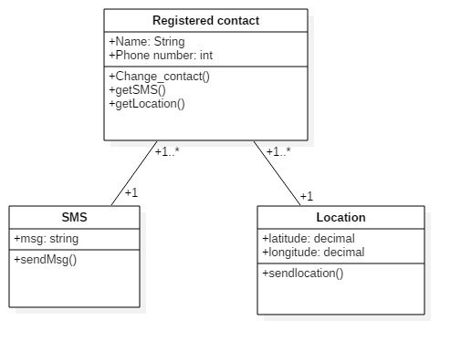

Slide 10
Sequence Diagram

Slide 11
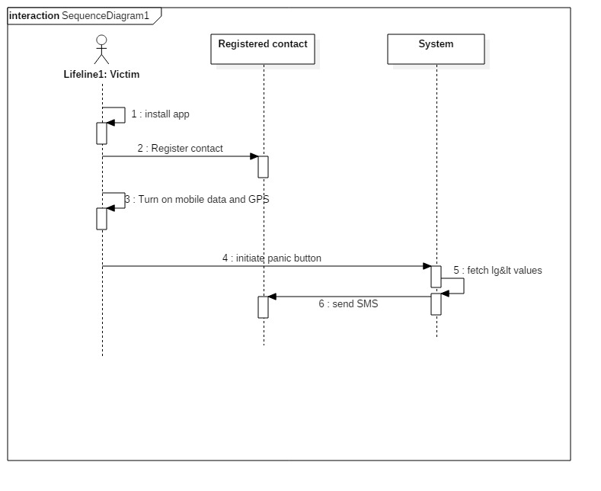

Slide 12
Activity Diagram

Slide 13
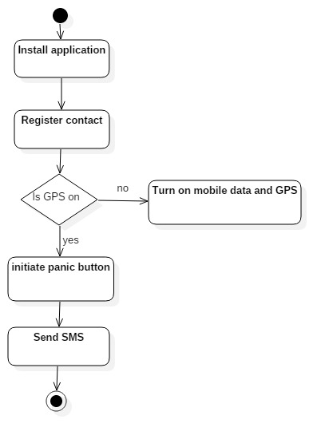

Slide 14
Deployment Diagram

Slide 15
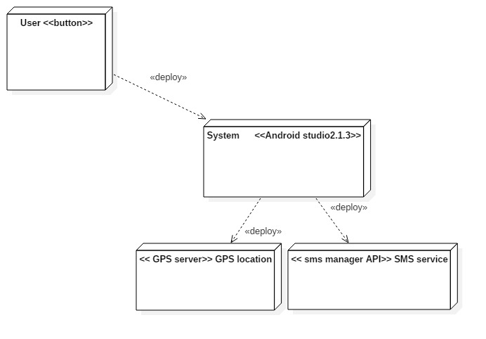

Slide 16
System Features
Register contact
Panic Button
Sending SMS

Slide 17


Slide 18
Register contact
Initially the victim has to register contacts of near and dear.
Location is send to the registered contacts in case of emergency.
Input :
Name
Phone number

Slide 19
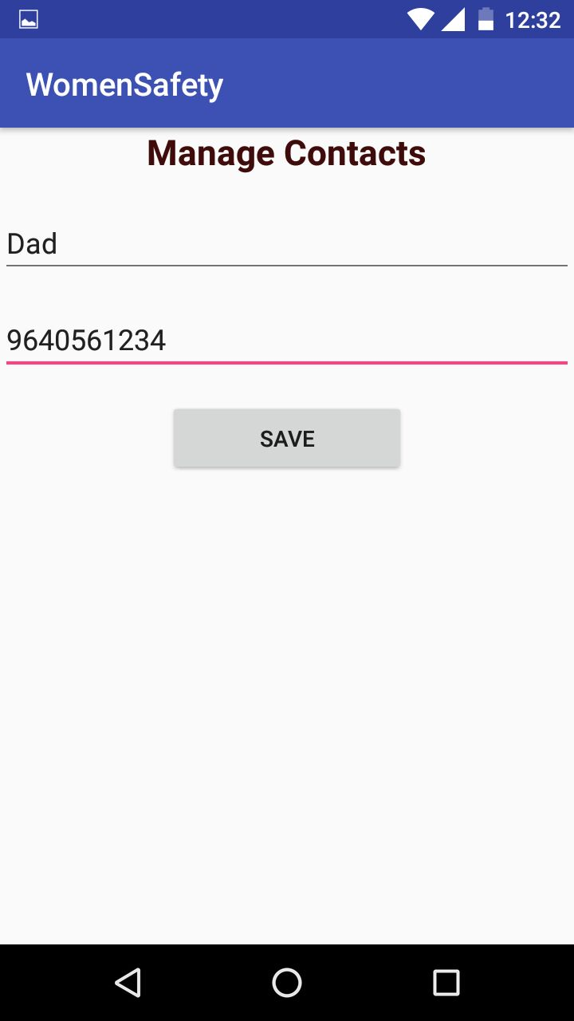
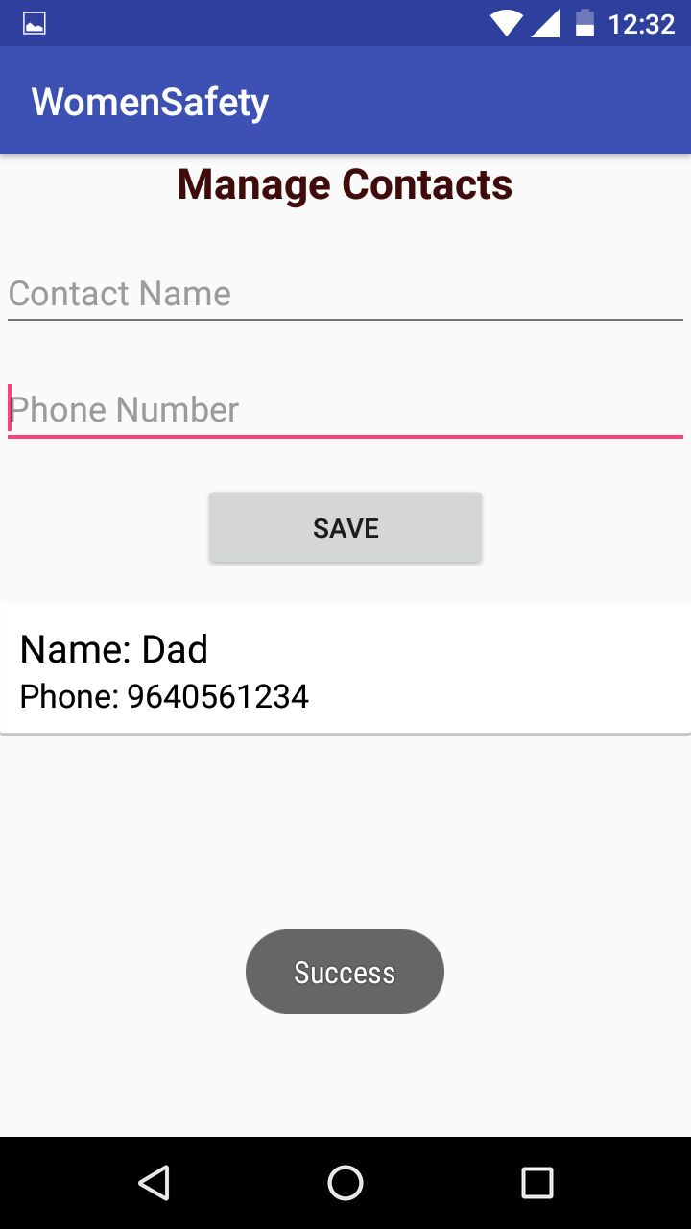

Slide 20
Panic Button
When the victim notices that she is in danger, then she should initiate panic button.
Input:
Clicking the panic button

Slide 21
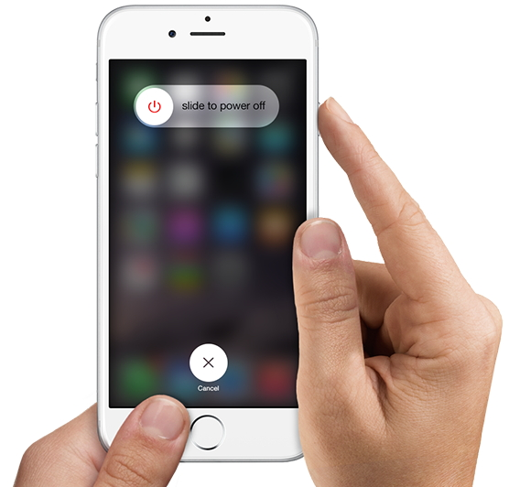

Slide 22
Sending SMS
When the victim initiates panic button, the location of the victim along with an alert message is sent to the registered contacts in the form of SMS.

Slide 23
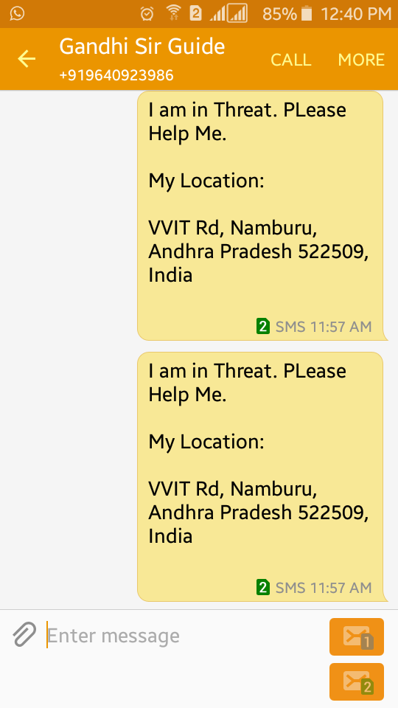

Slide 24
Database Tables
This application contains only one table.
Table name: MyEscort
Name
Contact number

Slide 25
Development Environment
Android studio 2.3
SDK version – 26
Minimum SDK version – 19
JDK version - jdk1.8.0_101

Slide 26
Thank You

