Slide 1
Unit 1: Algorithm Basics & Analysis - Space & time complexity
Name of the Faculty : Dr. Anurag Jain
Designation : Senior Associate Professor
Email id : anurag.jain@ddn.upes.ac.in

Slide 2
What is an Algorithm?
Algorithm is finite set of instructions which if executed will accomplish a specific task.
Essential characteristics which an algorithm must possess are:
Input
Output
Definiteness
Finiteness
Effectiveness

Slide 3
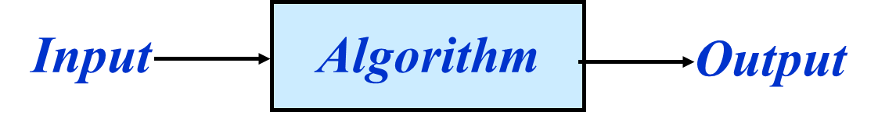
What is an Algorithm?
Example: sorting
input: A sequence of numbers.
output: An ordered permutation of the input.

Slide 4
Algorithm vs Pseudocode
An algorithm and pseudocode are both tools used in the field of computer science to describe and design processes or procedures for solving problems. However, they serve different purposes and have distinct characteristics.

Slide 5
Algorithm vs Pseudocode
Algorithm:
An algorithm is a step-by-step, well-defined set of instructions or rules that outlines how to solve a specific problem or perform a particular task.
It is a high-level description of the solution in a structured and systematic manner.
Algorithms are usually independent of any programming language or implementation details, focusing on the logic and methodology behind solving the problem.
They provide a clear and precise representation of the solution's logic.

Slide 6
Algorithm vs Pseudocode
Pseudocode:
Pseudocode, on the other hand, is an informal and human-readable representation of an algorithm.
It uses a mix of natural language and programming-like constructs to describe the logic of an algorithm without adhering to the strict syntax of a programming language.
Pseudocode is meant to bridge the gap between human understanding and actual code implementation.
It allows developers to sketch out the logic of an algorithm before writing the actual code.

Slide 7
Algorithm Analysis
Determining performance characteristics- means predicting the resource requirements
Time, memory, communication bandwidth etc.
Computation time (running time) is of primary concern.
Why analyze algorithms
Choose the most efficient of several possible algorithms for the same problem.
Is the algorithm optimal (best in some sense) – Is something better possible

Slide 8
Algorithm Analysis
Performance of an algorithm is analyzed by calculating the Running time complexity of the algorithm.
Running time complexity is denoted by number of steps required for the execution of the algorithm for a particular size of input

Slide 9
Worst, Average, and Best-case Complexity
Worst-case Complexity
Maximum steps the algorithm takes for any possible input.
Most tractable measure
Average-case Complexity
Average of the running times of all possible inputs.
Demands a definition of probability of each input, which is usually difficult to provide and to analyze.
Best-case Complexity
Minimum number of steps for any possible input.
Not a useful measure

Slide 10
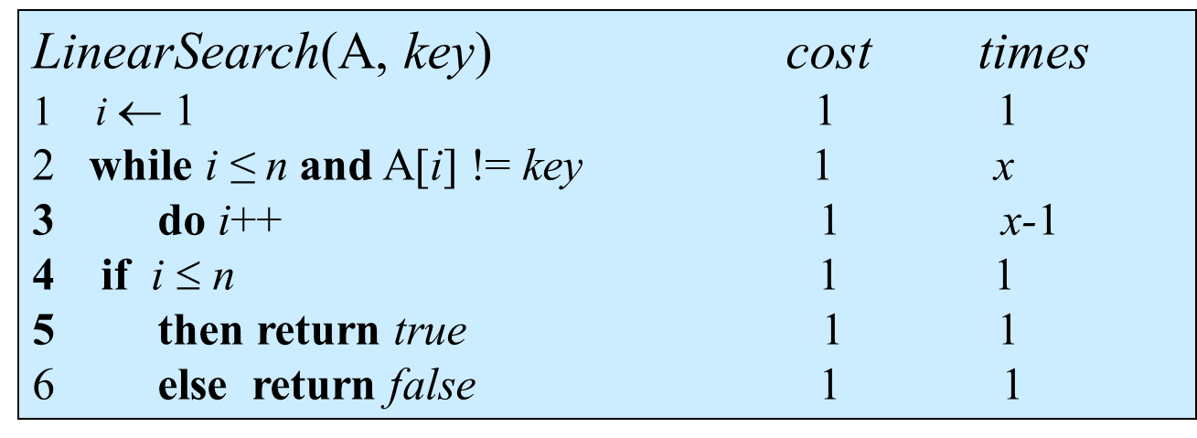
An example of Worst, Average, and Best-case Complexity
INPUT: a sequence of x numbers, key to search for.
OUTPUT: true if key occurs in the sequence, false otherwise.

Slide 11
An example of Worst, Average, and Best-case Complexity
Now, the running time ranges between
Best Case:1+ 1+ 1 + 1 = 4
Worst Case: 1+ (n+1)+ n + 1 + 1 = 2n+4
If we assume that we search for a random item in the list, on an average, Statements 2 and 3 will be executed n/2 times. Running times of other statements are independent of input.
Average Case: 1+ n/2+ n/2 + 1 + 1 = n+3

Slide 12
Order of Growth
Now, our main motive is to calculate the effect of input size on running time performance of the algorithm.
We use Asymptotic notations to express the growth of algorithm.
While expressing the order of growth corresponding to polynomial expression, we ignore the lower order terms and coefficient of higher order term.
e.g. for the expression 7n⁵+6n³+n+10, order of expression will be expressed through n⁵
If expression involve polynomial and exponential functions then order of expression will be expresses through exponential function
e.g. for the expression 2^{n}+ 7n⁵+6n³+n+10, order of expression will be expressed through 2^{n}

