Slide 1
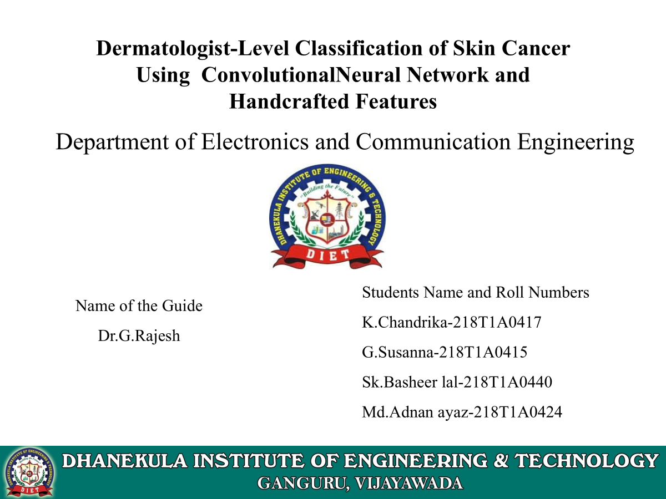
DEPARTMENT OF ELECTRONICS AND
COMMUNICATION ENGINEERING
Title: Real-Time Driver Drowsiness Detection Using Deep Learning and IoT for Enhanced Road Safety
Presented By:
218T1A0467-K.Kavya
218T1A0451-A.Hari Kishore
228T5A0427-SK.Haseena
218T1A0477-N.Mona Sai
Name of the Guide:
Dr.Surendra Loya
Acadamecian and Researcher

Slide 2
contents
Abstract
Introduction
Problem Statement
Objective
CNN Architecture
Block Diagram
Hardware Implementation
Advantages
Applications
Results
Conclusion

Slide 3
Abstract:
Driver drowsiness is a leading cause of road accidents worldwide, posing significant risks to life and property. This project proposes a real-time driver drowsiness detection system that leverages deep learning technology to enhance road safety. The system utilizes computer vision techniques powered by convolutional neural networks (CNNs) to monitor facial cues such as eye closure and yawning. These features are captured through a camera and processed in real time to determine the driver's alertness level. Once drowsiness is detected, the system immediately triggers an alert to awaken the driver, and optionally, communicates with connected IoT modules for further safety interventions such as slowing the vehicle or notifying emergency contacts. The integration of deep learning ensures high accuracy and adaptability across different individuals. This approach aims to significantly reduce drowsiness-related accidents and contribute to smarter and safer transportation systems.

Slide 4

Introduction:
Driver drowsiness is a leading cause of road accidents, making real-time detection crucial for enhancing road safety.
Leveraging CNN for feature extraction for temporal analysis to detect fatigue indicators like eye closure and yawning.
The system processes real-time video feeds, extracts facial landmarks using MediaPipe, and classifies the driver’s state. IoT integration enables instant alerts, ensuring timely intervention through alarms or emergency notifications.
This technology can significantly improve smart vehicles, fleet management, and driver assistance systems (ADAS), reducing fatigue-related accidents and enhancing transportation safety.

Slide 5
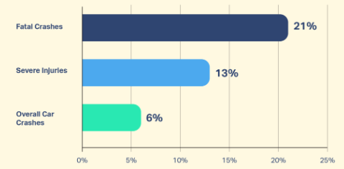
Problem Statement:
The increasing number of road accidents caused by driver drowsiness highlights a critical safety concern in transportation. Traditional methods of detecting driver fatigue, such as manual observation or basic sensor-based approaches, are often unreliable and lack real-time responsiveness. This project aims to address this gap by developing a Deep Learning and IoT-based system that can accurately detect drowsiness in drivers in real-time.
By utilizing Convolutional Neural Networks (CNNs) for facial analysis and IoT technology for immediate alert generation, the system will provide timely interventions, significantly enhance road safety, reduce accident rates, and support effective fleet management.

Slide 6
Objective
Develop a Real-Time Drowsiness Detection System using CNNs (ResNet50V2, InceptionV3) for facial analysis
Implement IoT-Based Alerts to trigger immediate intervention when drowsiness is detected
Enhance Road Safety by preventing accidents caused by driver fatigue
Optimize Fleet Management by monitoring driver fatigue in real-time.
Integrate with ADAS for seamless adoption in modern vehicles.
Enable Scalability for future use in smart vehicles and autonomous driving systems.

Slide 7
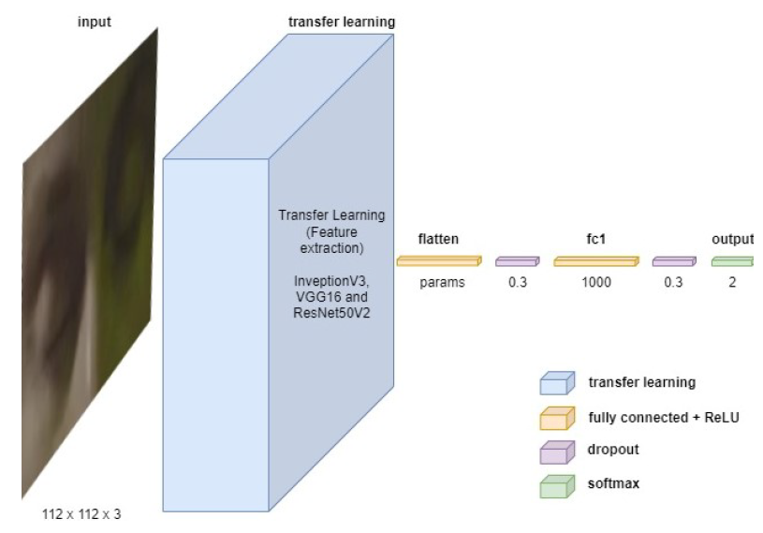
CNN Architecture:

Slide 8
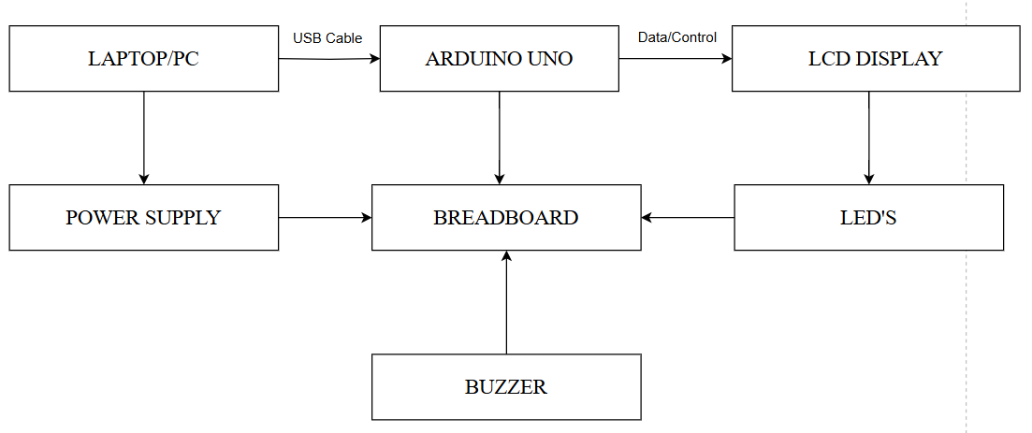




Block Diagram

Slide 9
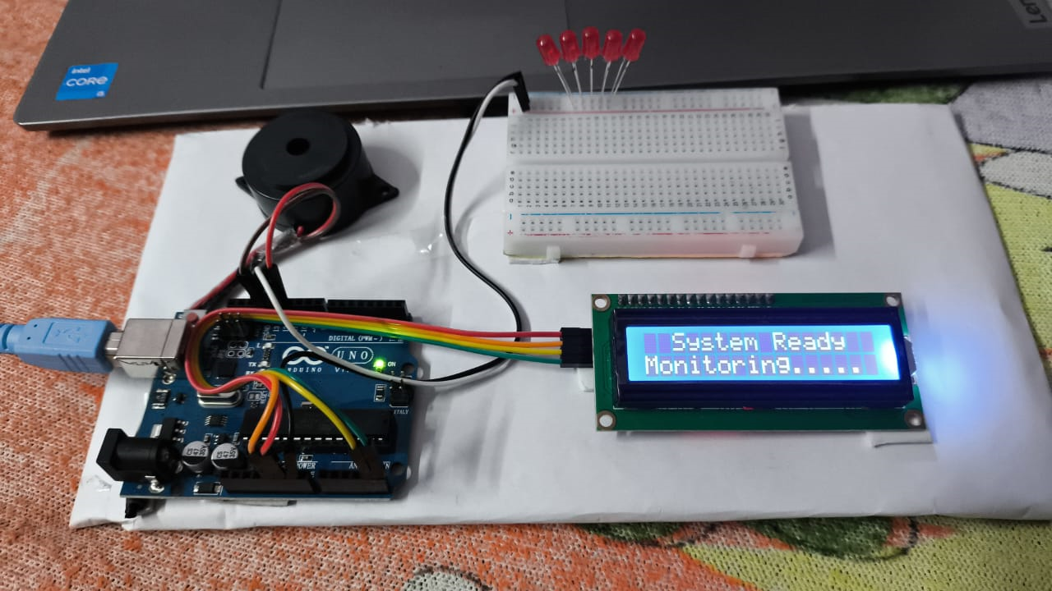
Hardware Implementation

Slide 10
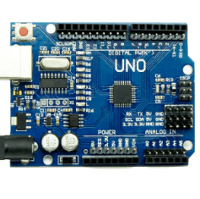
Components used
Arduino is an open-source platform with a microcontroller that controls sensors and electronics. In our project, it can use sensors like cameras or heart rate monitors to identify signs of fatigue, such as slow blinks, and trigger alerts to prevent accidents.

Slide 11
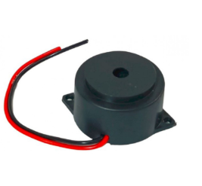
Buzzer
A buzzer is an electronic component that produces sound when activated. It is often used in systems to alert users with a sound signal. In drowsiness detection systems, a buzzer can be triggered by an Arduino to warn the user when signs of fatigue are detected.

Slide 12
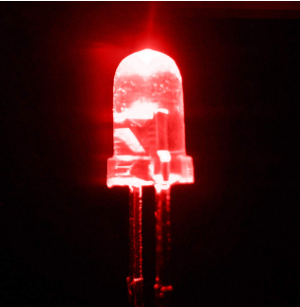
LED’s
LEDs (Light Emitting Diodes) are energy-efficient light sources that can be used for visual alerts. In drowsiness detection systems, LEDs can be used to indicate the status of alertness, such as glowing red when the user is drowsy or green when the user is alert, providing a clear visual signal.

Slide 13
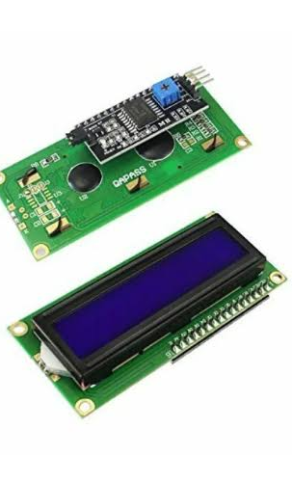
LCD Display
An LCD (Liquid Crystal Display) is a screen that can display text and graphics. In drowsiness detection systems, an LCD can be used to show real-time information such as the user's alertness status, warnings, or instructions, providing clear feedback to the user visually.

Slide 14
Advantages:
Real-Time Detection – Continuously monitors driver fatigue and provides instant alerts, preventing accidents.
High Accuracy – Uses CNNs (ResNet50V2, InceptionV3) and LSTMs for precise drowsiness detection.
Non-Intrusive Monitoring – Works through facial recognition without requiring wearable sensors.
IoT Integration – Enables remote monitoring, emergency alerts, and vehicle system integration.
Adaptability – Works in different lighting conditions and adapts to various facial structures.
Scalability – Can be integrated into ADAS, fleet management, and smart vehicle systems.
Improved Road Safety – Reduces fatigue-related accidents, ensuring safer transportation.

Slide 15
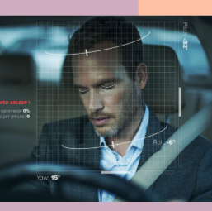
Applications:
Smart Vehicles & ADAS – Integration with Advanced Driver Assistance Systems (ADAS) for real-time fatigue monitoring.
Fleet Management – Enhances safety in commercial trucking and logistics by preventing driver fatigue-related accidents.
Public Transport Safety – Ensures alertness of bus, taxi, and train drivers, reducing accident risks.
Industrial & Heavy Machinery – Monitors operators of cranes, forklifts, and construction equipment to prevent workplace accidents.

Slide 16
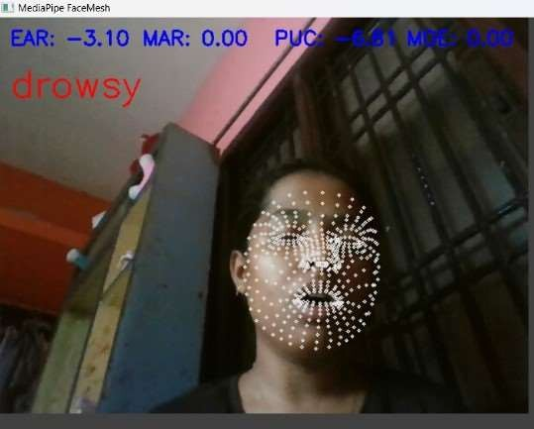
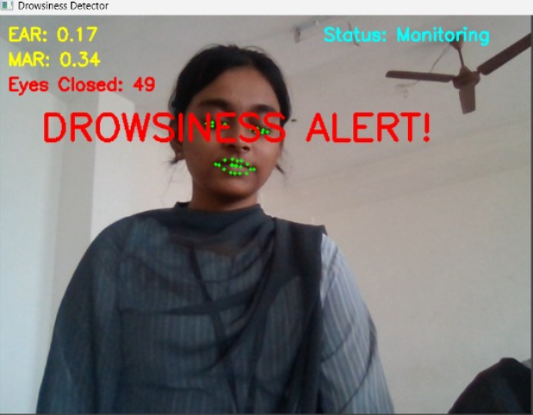
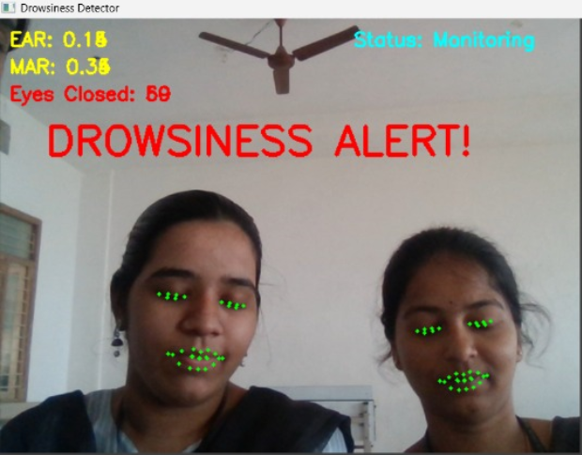
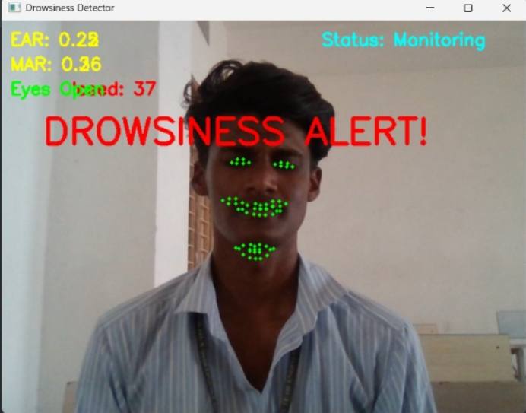
Results:

Slide 17
Conclusion:
This project presents a real-time driver drowsiness detection system using Deep Learning (CNNs, Open Cv, dlib, numpy,) and IoT to enhance road safety.
By analyzing facial features like eye closure and yawning, it provides accurate, real-time alerts to prevent accidents.The system ensures high accuracy and adaptability for ADAS, fleet management, and smart vehicles.

Slide 18
Thank you

