Slide 1

Problem Statement and Team Details
Problem Statement: Build a CFO Helper Agent that simulates budget scenarios and gives clear outcomes
Team Name: ACM KLH
Team Leader Name: KANNE KAVYA
Institute Name: KLH UNIVERSITY
Team Leader Email ID: kavyakanne22@gmail.com

Slide 2
Problem and Solution
Problem Statement
Managing money is difficult for startups, event organizers, and small businesses. People constantly ask “what-if” questions like:
If I hire more engineers, how long will my funds last?
If I spend more on marketing, what will be left for other needs?
If I increase prices, how will profits change?
Traditional tools like Excel are too basic and don’t give clear, real-time answers or easy scenario comparisons.
Our Solution
We are building a CFO Helper Agent that makes financial planning interactive and simple.
Users can adjust inputs (hiring, spending, pricing) using sliders.
The app shows instant forecasts in clear text and charts (budget, runway, profit).
Users can export short reports to share insights.
A usage counter with billing (Flexprice) ensures fair per-use payment.
With Pathway integration, the app can pull live financial data, keeping forecasts updated automatically.
This provides clarity, ease of use, and actionable insights for better decision-making.

Slide 3
Methodology & Implementation
Methodology
We identified the difficulty small businesses and startups face in financial planning and defined a solution that enables “what-if” analysis.
The system is designed with an interactive UI, a backend for financial calculations, Flexprice for billing, and Pathway for live data integration.
Implementation
Financial Engine: Calculates budget, profit, and runway dynamically.
UI (React): Sliders for hiring, spending, and pricing with real-time charts and summaries.
Backend (Node.js/Python): Handles logic, scenarios, and Flexprice billing.
Reports: Export short PDF summaries of scenarios.
Pathway Integration: Pulls mock/live financial data to update forecasts.

Slide 4
Technology Used
1. Frontend: The User Interface
This is what the user sees and interacts with.
HTML5: The structure of the web page, including all the buttons, sliders, and input fields.
CSS3: The styling and design of the app, giving it a clean, modern look. We used Tailwind CSS for a utility-first approach.
JavaScript (ES6+): This is the core logic that makes the app interactive. It handles reading the slider values, sending requests to the server, and updating the charts and metrics.
Chart.js: This is a powerful open-source library used to create the interactive financial line chart. It's a key part of the project's data visualization.
jsPDF: This is the library that allows the app to generate and download the PDF report on the client side.
2. Backend: The Server and Logic
This is the engine of your application that runs the simulations.
Node.js: The JavaScript runtime environment that powers your server. It's fast and perfect for building web applications.
Express.js: A popular Node.js framework that makes it easy to set up the server and define the API endpoints (/api/simulate, /api/recommend, etc.).
CORS (Cross-Origin Resource Sharing): A Node.js middleware that allows your frontend to securely talk to your backend server, even though they are running from different locations (your browser and your server).

Slide 5
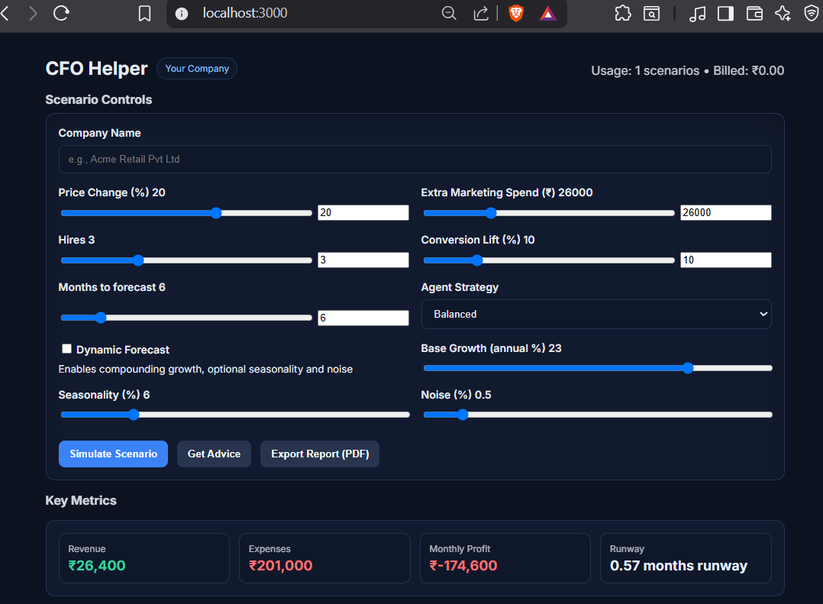
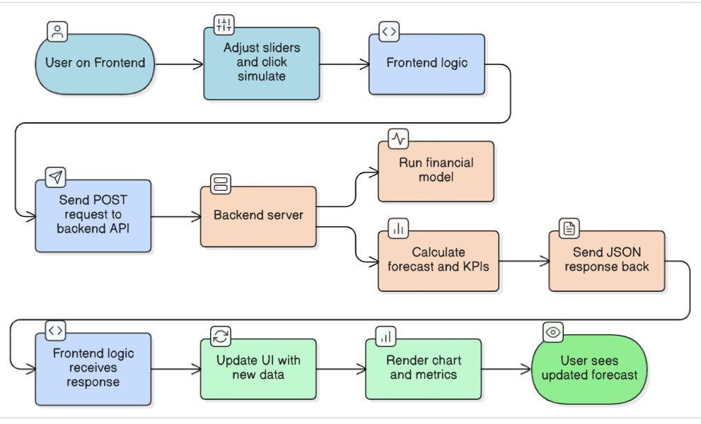
Flowchart & Supporting Images
Supporting Images
Flowchart

Slide 6
Feasibility and Market Use
Feasibility
This section proves that your project is not just an idea, but a working, scalable solution.
Technology Stack: Your project is built on a modern, robust, and open-source tech stack. The combination of Node.js for the backend and a lightweight frontend with JavaScript and Chart.js means the application is fast, cost-effective, and easy to maintain.
Rapid Development: The use of pre-built libraries like Express.js and jsPDF allowed for rapid prototyping and development.
Scalability: The architecture is designed to be scalable. The backend API is separate from the frontend, meaning it could be easily containerized and deployed to a cloud platform to handle a large number of users and simulations.
Market Use
This section explains who your app is for and why they need it. It shows that you've thought about the business problem, not just the technical solution.
Target Audience: The core market for this app is non-finance professionals who need to make financial decisions. This includes startup founders, small business owners, and project managers. They are often overwhelmed by complex spreadsheets and need a simple, intuitive tool.
The Problem: The current methods (manual spreadsheets) are prone to human error, time-consuming, and don't provide a clear, "what-if" visual of a scenario.
The Solution: Your app solves this problem directly by providing instant, visual feedback on financial decisions. The ability to export a clean report means they can easily share these insights with investors

Slide 7
Conclusion
The CFO Helper Agent is designed to make financial planning and decision-making simple, intuitive, and effective. Users can adjust key inputs such as spending, hiring, and pricing to simulate multiple scenarios, instantly seeing the impact on their budget, cash flow, and business runway. Visual forecasts in charts or text provide clarity, while easy-to-share reports help communicate insights to stakeholders. Integration with Flexprice ensures accurate billing per scenario or exported report, and Pathway integration allows the system to reflect fresh financial data, keeping forecasts up-to-date. Overall, CFO Helper empowers startup founders, event organizers, and small business owners to make informed, data-driven decisions confidently, reduce financial risks, and plan for sustainable growth.

