Slide 1

Digital Library Management System
Intelligent Book Search · Issue-Return Automation · Fine Calculation
ACADEMIC PROJECT PRESENTATION
ROWTHU KAVYA KEERTHI
323129512048

Slide 2

The Problem with Traditional Libraries
As collections grow, manual processes become unsustainable bottlenecks.
Manual Records
Paper-based tracking leads to errors, lost data, and slow lookups.
Inefficient Search
No digital catalog — members spend hours locating books.
Delayed Updates
Issue/return records lag behind real transactions, causing conflicts.
Manual Fines
Hand-calculated overdue fines are error-prone and inconsistently applied.

Slide 3
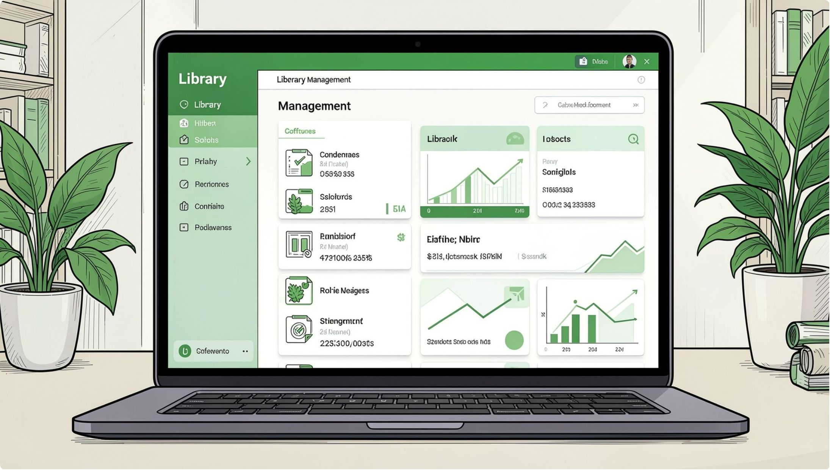
Our Solution: A Unified Digital Platform
The Digital Library Management System (DLMS) replaces manual operations with a centralized, web-based platform — automating search, transactions, fines, and reporting.
Intelligent Search
Automated Issue-Return
Smart Fine Calculation
Keyword-indexed catalog with multi-field queries.
Real-time transaction processing with instant record updates.
Policy-driven overdue fines computed automatically at return.

Slide 4
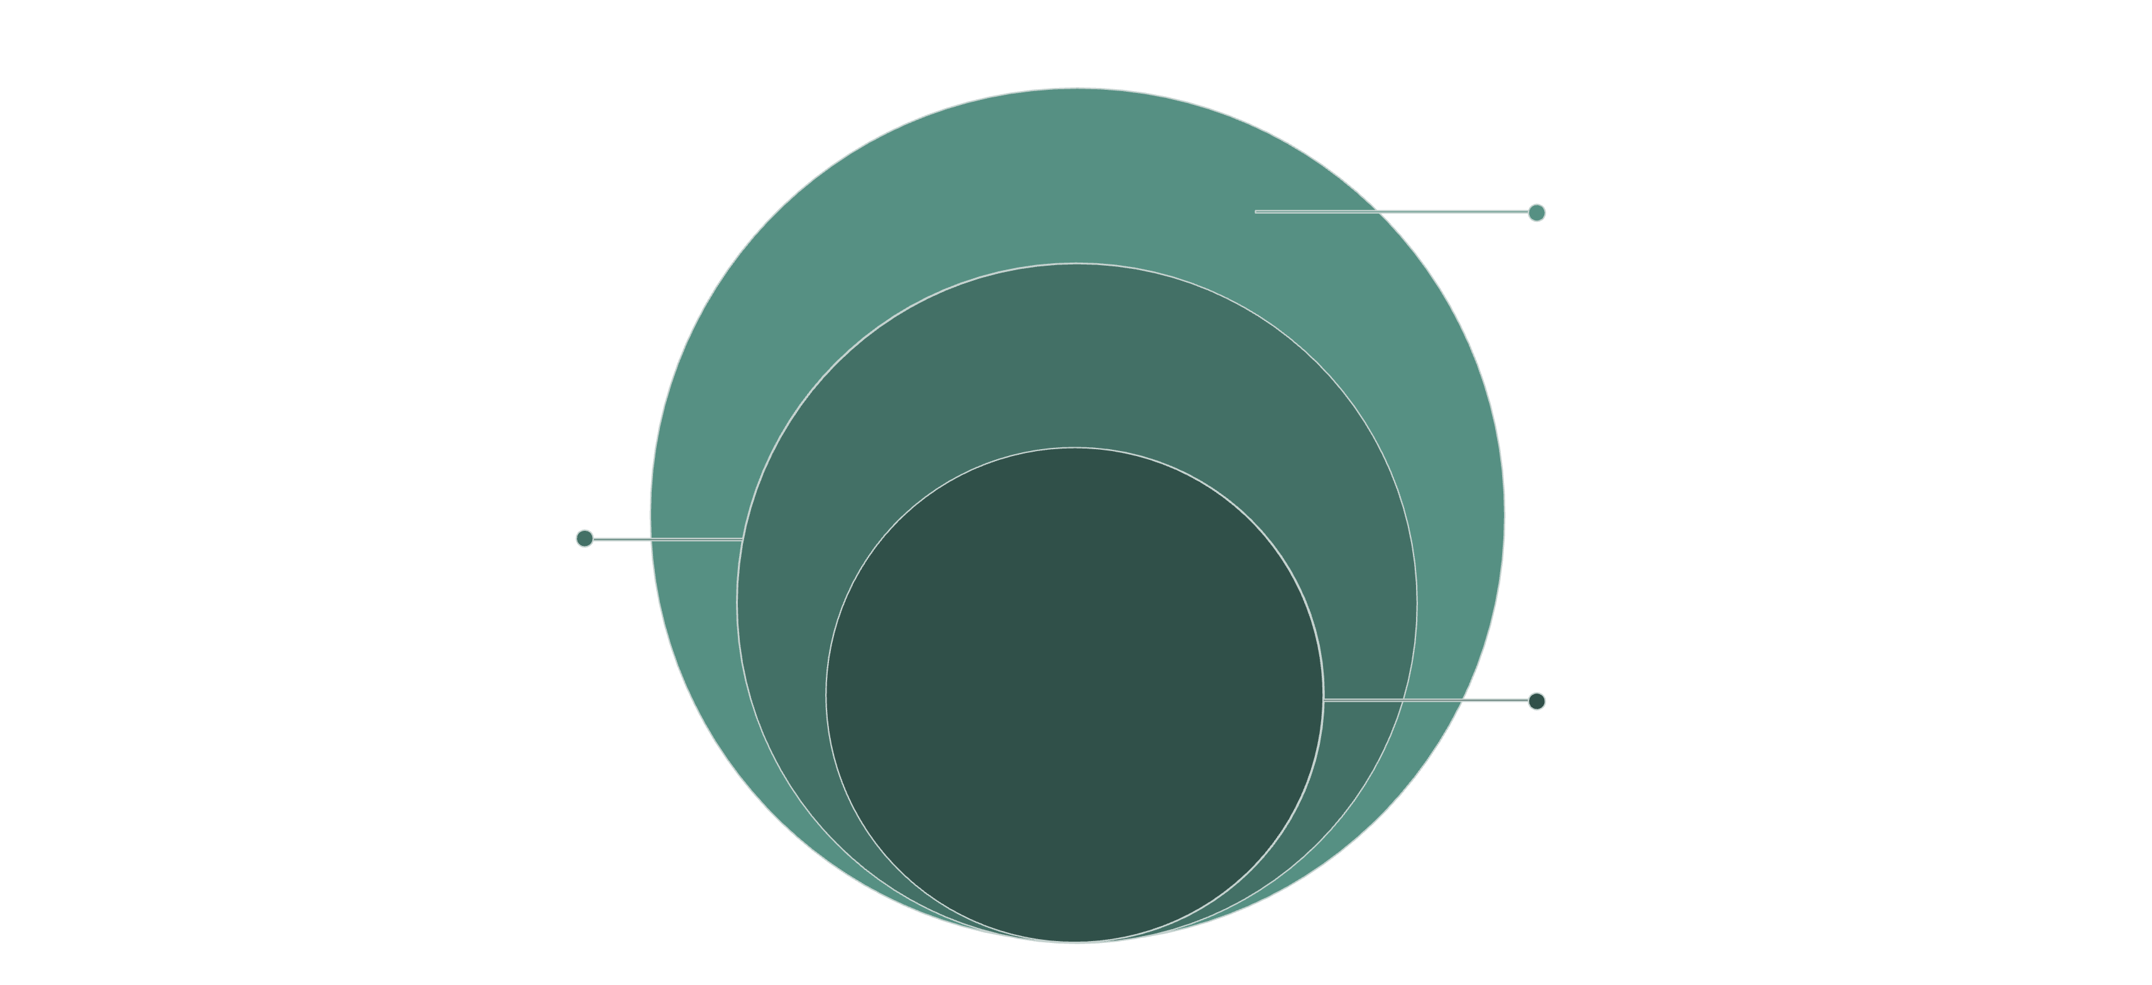
System Architecture & Core Modules
Edge & Presentation
Web UI, member portal, admin panel, infra
Data Layer
MySQL, keyword index, transaction logs
Core Services
Search, transactions, fines, notifications
The DLMS follows a layered architecture separating concerns across presentation, application, data, and infrastructure tiers — enabling modular development, secure access, and horizontal scalability.

Slide 5
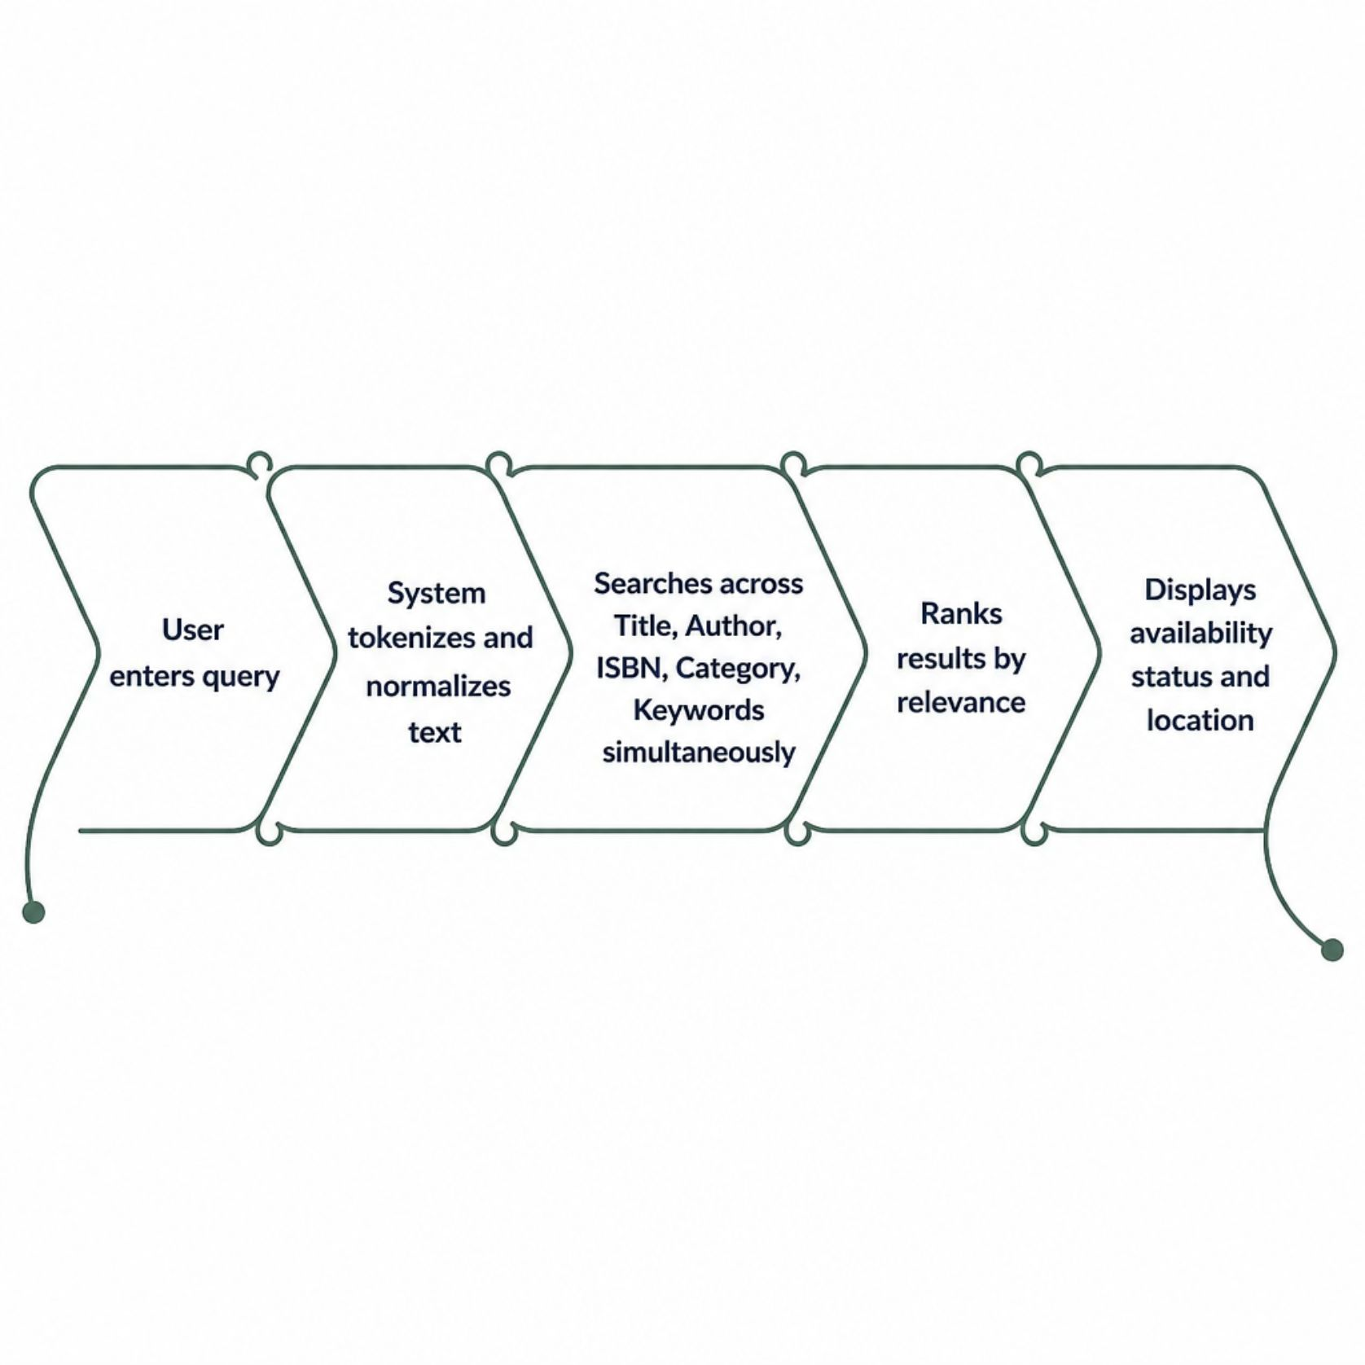
Intelligent Book Search
How It Works
Members search across title, author, category, ISBN, and keywords simultaneously. The system uses keyword indexing and inverted index structures to deliver sub-second results, even across tens of thousands of records.
Enter search query → system tokenizes input
Matches against indexed fields in parallel
Returns ranked results with availability status

Slide 6

Issue-Return Workflow Automation
Member Requests Book
Librarian Verifies & Issues
System Calculates Fines
Member Returns Book
Every transaction is processed in real time. The system instantly updates book availability, records borrowing history, sets due dates, and triggers notifications — eliminating manual record-keeping entirely.

Slide 7

Automated Fine Calculation
Policy-Driven & Accurate
Fine calculation is fully automated based on configurable library policies. When a book is returned, the system compares the return date against the due date and applies the correct rate.
Grace Period
Daily Rate
Capping
Optional grace days before fines accrue
Configurable per-day overdue charge
Maximum fine ceiling to prevent excessive charges

Slide 8



Features by User Role
Library Members
Librarians
Administrators
Search books by title, author, ISBN, or keyword
View real-time availability and borrow history
Receive due-date reminders and overdue alerts
Pay fines through integrated portal
Manage book inventory, new arrivals, and reservations
Process issue-return transactions instantly
Configure fine policies and membership rules
Generate overdue and circulation reports
Full system configuration and user management
Secure authentication and access control
Institution-wide reports and analytics
Backup, audit logs, and data integrity tools

Slide 9
Benefits & Key Metrics
~90%
0
Faster Search
Manual Fine Errors
Keyword-indexed queries return results in seconds vs. manual lookup.
Automated calculation eliminates human miscalculation entirely.
24/7
100%
System Availability
Real-Time Updates
Web-based portal accessible round-the-clock for members and staff.
Inventory and transaction records reflect live status instantly.
The DLMS reduces administrative workload, accelerates book discovery, and delivers a consistent, accurate experience for every stakeholder.

Slide 10
The Road Ahead: Future Enhancements
AI Recommendations
Barcode, QR & RFID
Cloud & Mobile
Personalized book suggestions powered by machine learning.
Automated check-in/out and real-time book tracking.
Cloud deployment with a native mobile app for on-the-go access.
Voice & E-Books
Predictive Analytics
Voice-enabled search and integrated digital e-book lending.
Usage forecasting and advanced dashboards for data-driven decisions.

