Slide 1
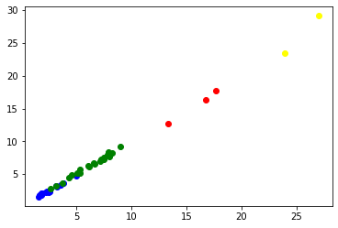
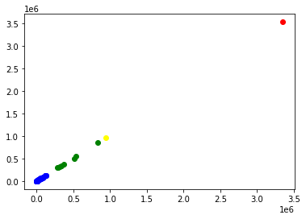
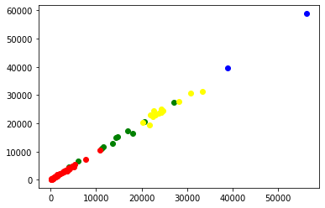
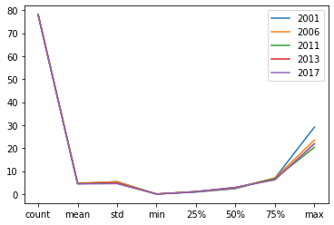
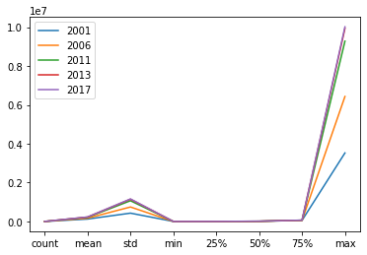
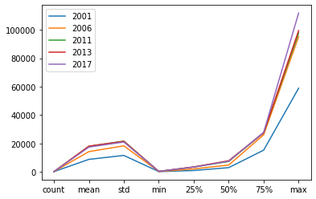
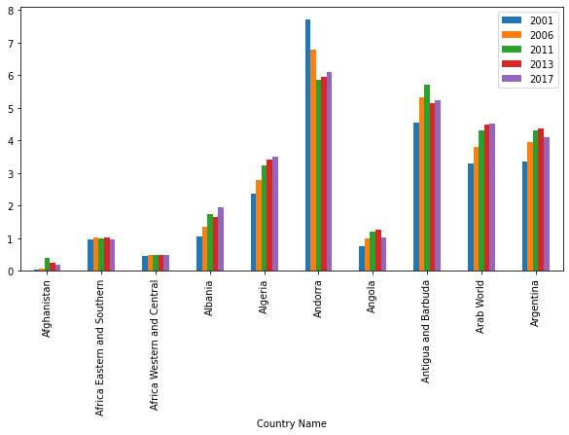
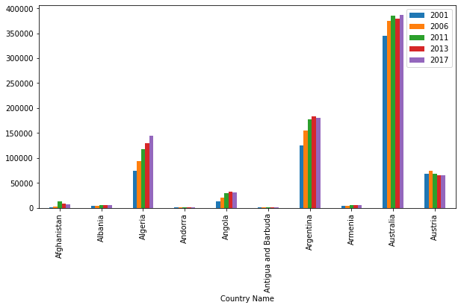
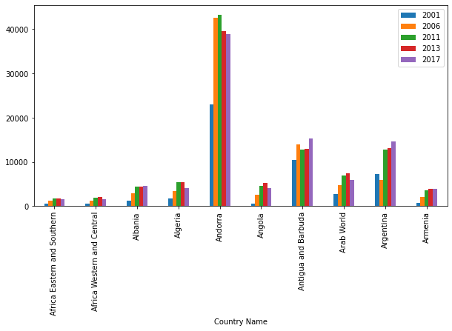
MAKING CLUSTERS OF DATASETS i.e., GDP per capita, Co2 in metric tons, Co2 in kilotons, USING K-MEANS ALGORITHM
Co2 emission in metric tons per capita
Co2 emission in kilotons
GDP per capita
These datasets includes data of Co2 emission in metric tons and Co2 emission in kilotons and GDP of various countries in the world.
Source:
https://data.worldbank.org/indicator

